Slide 1
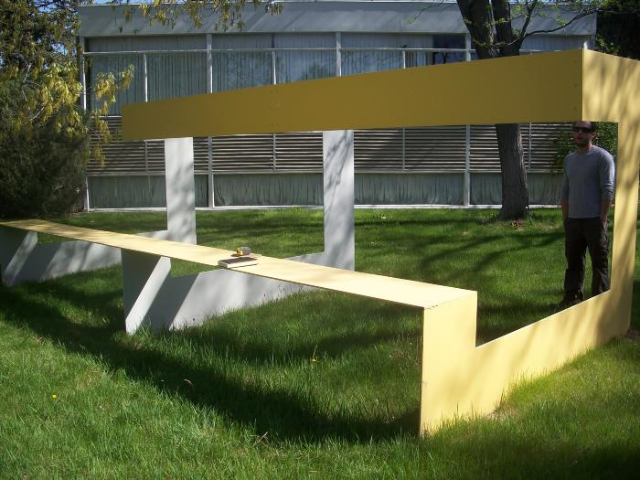
Untitled (yellow bench) (2009.8.1)

