Slide 1
Laughing Escalator (2004.4.1)
Visitors descending an escalator into the ballroom pre-function area encounter an unexpected serenade of laughter mysteriously rising from beneath their feet. Recorded laughs come up through the small cracks between steps, with a different voice heard every eight feet of the ride. Inside the escalator, a 4-channel sound system broadcasts a call and response volley of laughter between the speakers. The resulting open-air mix of sound creates a continually changing pattern of rhythms constructed from laughter.

Slide 2
I See What You Mean (2005.1.1)
Colloquially known as “The Big Blue Bear,” the artist has described "I See What You Mean" as a stylized representation of native fauna. As the bear peeks inside the enormous facility at the conventioneers, displacement and wonder pique curiosity and question a greater relationship of art, technology and whimsy.

Slide 3
Promenade (2006.4.1)

Slide 4
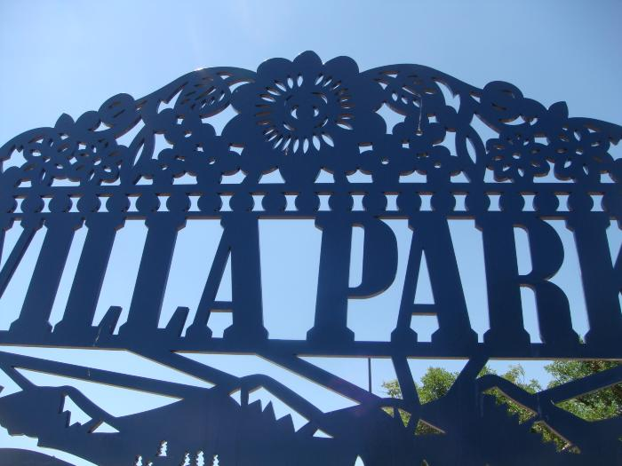
Villa Park Gateway (2008.1.1)

Slide 5
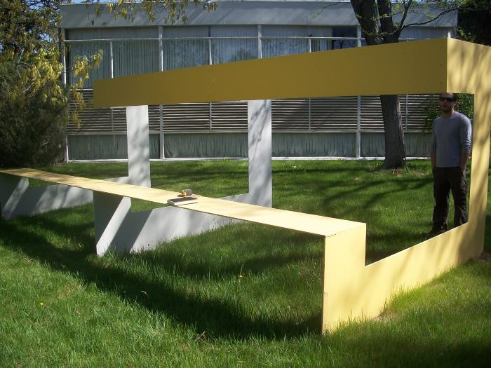
Untitled (yellow bench) (2009.8.1)

Slide 6
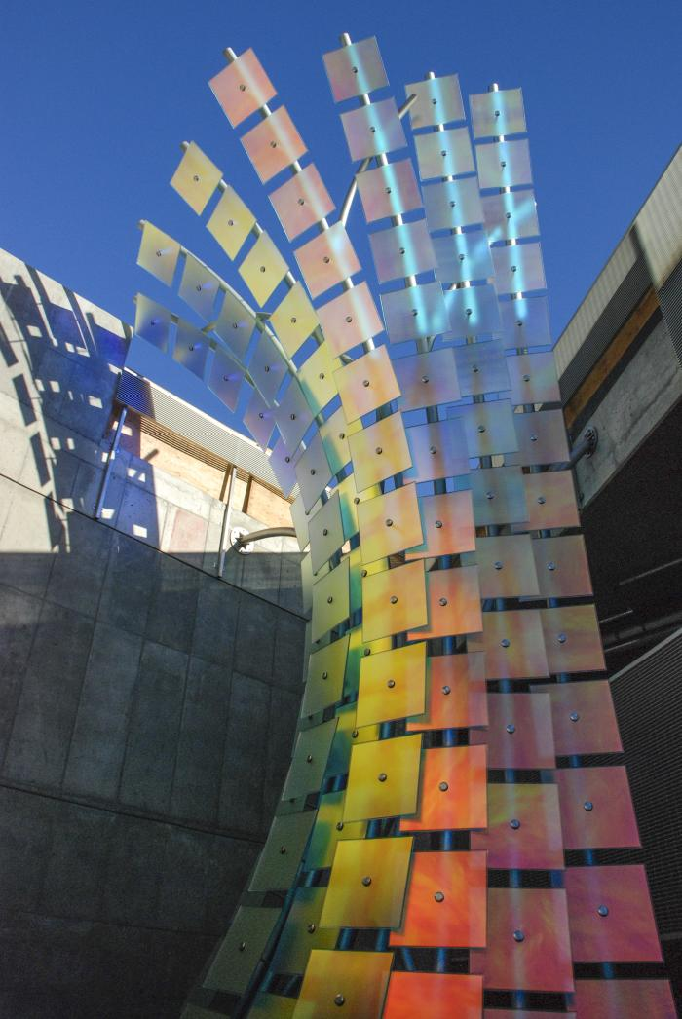
Albedo (2010.8.1)
Mr. Akan’s work often utilizes fiber optics and light in the natural environment allowing the elements (wind, natural light, etc) to enhance the piece. His pieces force the question of synthetic vs. natural environments. Albedo is an undulating sculptural wall that includes the fiber optic elements used in previous pieces for a night-time presence. The wall consists of multiple glass panels to resemble an abstract form of a greenhouse.

Slide 7
Thought Balloons (2011.1.1)
Thought Balloons is an interactive artwork that playfully inserts software generated text based dialog over seated people&#39;s heads. As people sit on the black bench, thought balloons, like those found in a comic book format, magically appear above their heads. At other times when two or more people sit on the bench a dialog starts up between them. The texts for each balloon or dialog bubble are kept fresh and lively with the help of the local community. Not only were Central Park residents of all ages invited to gather and playfully construct humorous conversations and informative repartee, community members are welcome to continually contribute to the dialog by submitting to www.thoughtballoons.org. In a new town like Central Park, Thought Balloons acts as a catalyst to bring people together. Not only by starting conversations in front of the piece but also by creating opportunities for members of the community to contribute language to the piece itself.

Slide 8
Sun Spot (2011.4.1)
Sun Spot is a multi-piece artwork for Denver’s new Municipal Animal Shelter at the South Platte Campus. The primary piece is a 25’-tall iconic dog sculpture located at the southeast corner of the site, adjacent to the South Platte Trail and visible from Interstate-25. The form of the dog is an amalgam of many different dogs, in effect becoming “every dog.” Its pet-like, “sitting dog” pose expresses a friendly, playful, and welcoming nature. The sculpture is made from a structural steel skeleton overlaid with stainless steel mesh that is then covered with more than 90,000 individual stainless steel pet tags. The accumulation of pet tags is a symbol of the thousands of pet adoptions that occur at the shelter every year. In addition to metaphoric meaning, the pet tags will have phenomenological effects. The tags hang from hooks and flutter in the breeze. The second piece of Sun Spot is a suspended sculpture located in the front lobby and adoption waiting room of the Animal Shelter. Its principal ele­ment is a 6’-diameter collar, sized to fit the exterior dog sculpture. Hanging from the collar is an oversized pet tag etched with the name “Sun Spot.” The collar is made from blackened steel and gold aluminum, with stainless steel buckle and spike details. Decorative patterns cut and etched into the collar are derived from the leaves and berries of the plants used around the dog sculpture. The stainless steel chain used to suspend the collar from the ceiling references dog leashes. Hanging from the lower side of the collar are approximately 100 individual strands of chain, ranging in length from 30” to 66”. Every time a pet is adopted from the shelter the new owner will be given an opportunity to have a pet tag engraved with the name of the pet and date of the adoption, and then attached to a link of the chain. While the tags used on the dog sculpture are all stainless steel circles, the tags for the collar will be a variety of shapes and colors. Over the years the sculpture will accumulate more and more tags, becoming a communal gesture of animal stewardship. The sculpture is designed to accommodate up to 7,000 tags. The final element of the artwork is another set of approximately 50 pet tags, subtly marking native plants along the South Platte Trail west of the South Platte Campus. These tags are engraved with botanical and common plant names. Using pet tags to “name” the plants links their value with the societal value placed on pets. The artists hope that the tree tags may eventually inspire an “adopt-a-tree” program, whereby non-native plants are replaced with native plants in an effort to regenerate the riparian plant zone similar to how the adjacent brownfield has been reclaimed by the municipal facility, and linking back to the pet adoptions that occur at the Animal Shelter. The three pieces of Sun Spot each work on an individual basis but are tied together by their common use of pet tags as an inspirational material that has a direct link to the function of the Animal Shelter.

Slide 9
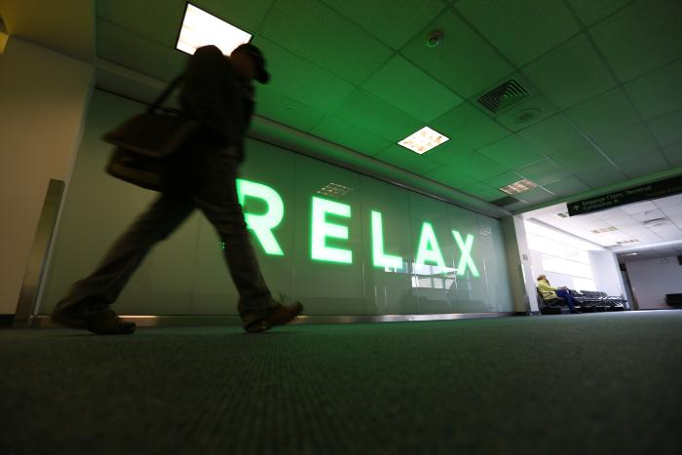
Relax (2013.5.1)
An environmental light installation contained within five bays. Each installation is "voiced" to reflect the different emotional experiences of travel: relax, caution, vacation and advertising, infinite inspection/reflection zones, and finally arrival and departure.

