Slide 1
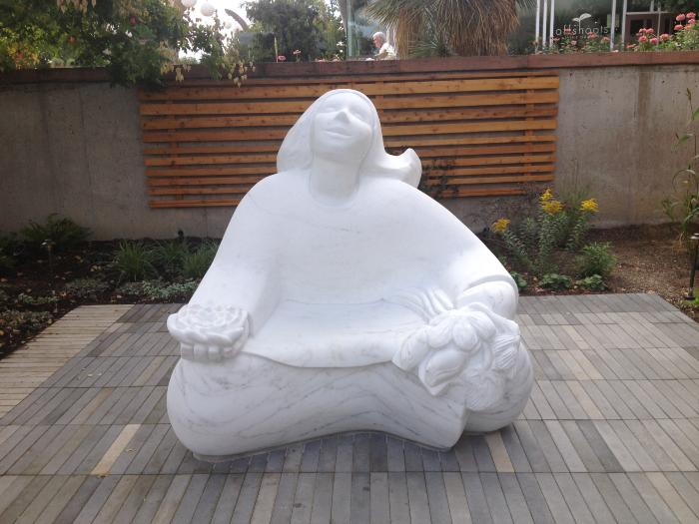
Flower Girl (2016.1.1)
Madeline Wiener created a carved marble sculpture of a girl holding a bouquet of flowers in her left hand and a lotus in her right hand. Her uplifted face is welcoming and her gesture is of joy in the experience of engaging with flowers. A joyful, interactive sculpture celebrating the natural world. Located at the Denver Botanic Gardens, visitors can find her inside the "Sensory Garden" and even sit on her lap. Carved from a solid block of Colorado Yule Marble she represents a garden visitor experiencing happiness through all her senses.

Slide 2
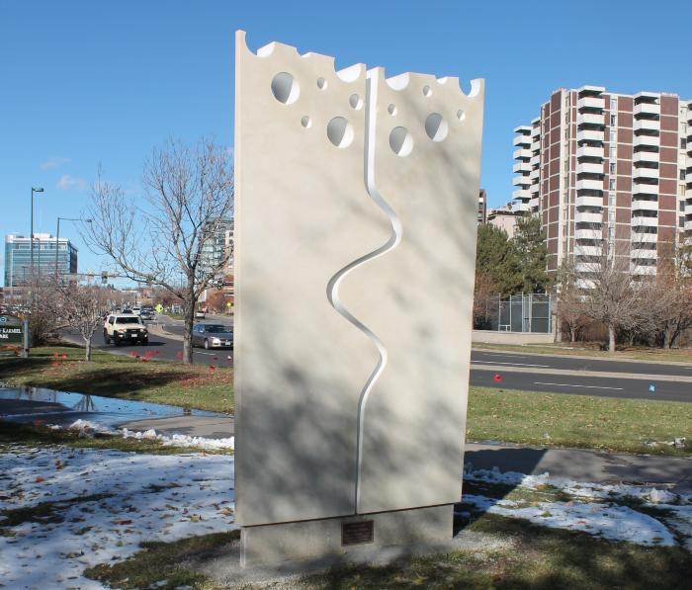
Allies in Life (2015.7.1)
Carved from a solid block of limestone, the work utilizes negative space to convey its message. The limestone block is divided into two pieces signifying the fact that Karmiel Park is part of Denver's Sister City program. The twin blocks represents "sisters" that, together, form a graphic of life.

Slide 3
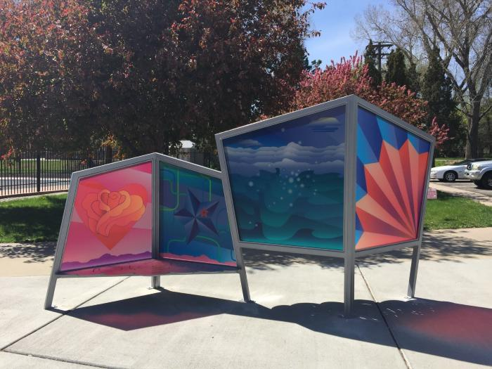
First Rose (2015.2.1)
A freestanding bench and windscreen with four images each representing qualities of Mamie Eisenhower (first lady) who grew up in Denver after the age of seven: a lady’s fan, a landscape with water activity, a five pointed star, and a heart of roses.

Slide 4
The Stream Rises Above the Fountain (2014.5.1)
The artwork is installed on the south wall of the Montbello Recreation Center. The work is 32 feet tall, 60 feet wide. The two dimensional aluminum and ceramic fountain symbolizes the positive and healing forces at work in the community. There are eight giant brightly glazed figures (seven animals and one human) tumbling around in the vertically plunging flow of aluminum. Through a series of free hands-on workshops at the Montbello Recreation Center, the community created additional tiles reflecting positive personal and collective expressions of Montbello. These tiles were incorporated into the final artwork.

Slide 5
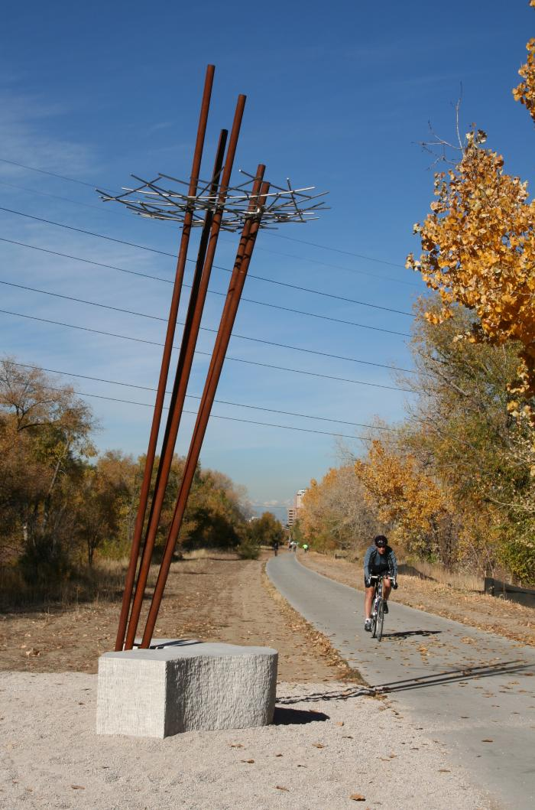
Current (2010.9.1)
Denver artist Michael Clapper created a sculpture and seating element inspired by the existing nature found along Cherry Creek Trail. The sculpture was created from stainless steel and forms abstract tree trunks topped by rusted steel "nests." The seating element mimics the bend in the nearby creek. "Current" sits atop a crest of the trail looking out on the creek.

Slide 6
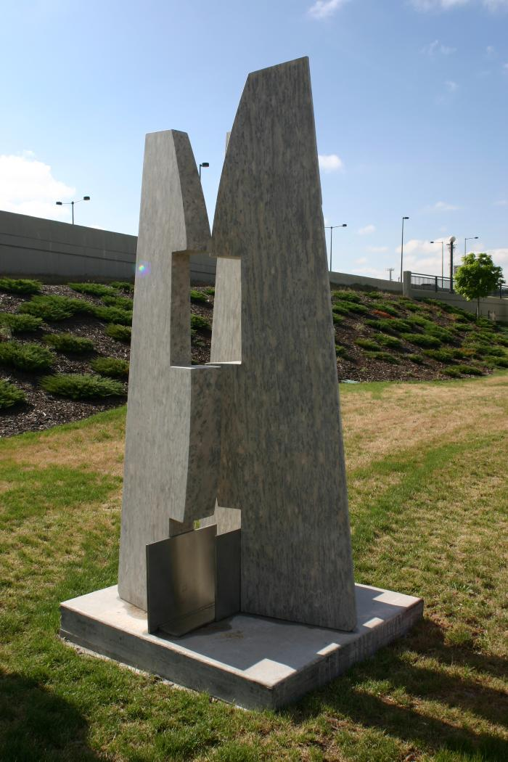
Camino (2005.5.1)

Slide 7
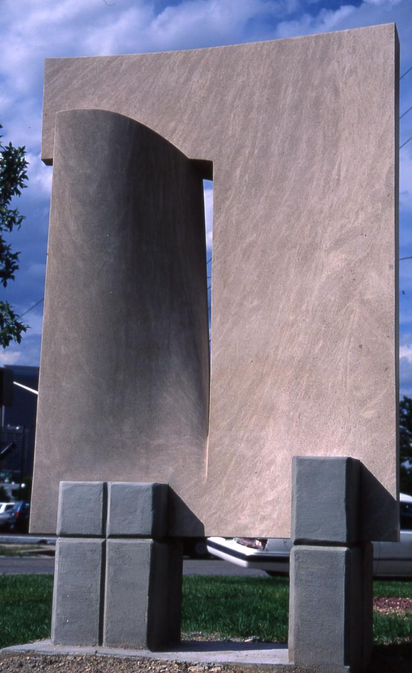
Empathy (1998.4.1)

