Slide 1
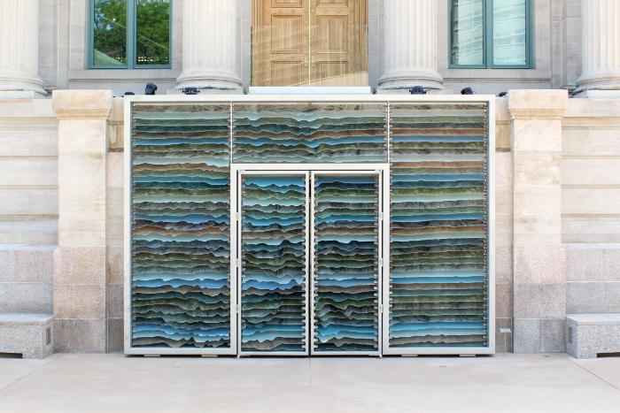
Mine Craft (2017.2.1)
Mine Craft is the result of studying of the iconic imagery associated with Colorado. Inspiration was drawn from the geography, industry and global presence of the state, and explored a variety of methods to represent these abstracted elements through the application of the current advancements in fabrication technology. The geography and landscape of Colorado is unique and exceptionally beautiful. Mine Craft uses the topography of the state, cut from a variety of materials embedded with significance to the region and stacked in order to create an abstracted scale map of Colorado. Decades ago, like many of the states that were on the frontier, Colorado was wild and beautiful and free for the taking. This artwork delves into the increasingly relevant subject of our responsibility to the environment. Conscientious extraction and use of the earth’s resources has implications not only for the residents of the region, but also on a much larger, global scale. The striations seen in the piece are intended to represent materials that are locally sourced. The overall design is tactile and nuanced - distinctly modern, both in its formal representation and materiality - and sits in subtle contrast to the neo-classical architecture of the McNichols Building. Mine Craft acts as an invitation to entice visitors into the building to explore its contemporary art exhibitions.

Slide 2
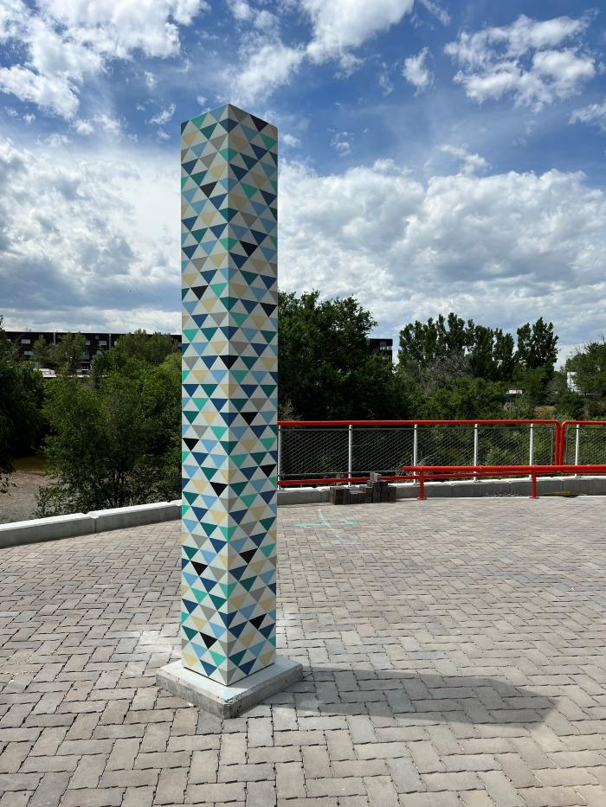
Course (2022.6.1)
The artwork consists of six vertical column sculptures. The sculptures are fabricated out of 3/16th plate aluminum, hand-painted with a pigment and then fired. A final UV protective coating is applied to each column. The columns lead the viewers along the promenade in a visual narrative that represents the source and demand of water along the South Platte River Watershed. The descriptions below are arranged as a viewer would encounter the work starting at the southernmost end (South Entry Column #1) of the promenade and ending at the northernmost end (North Entry Clolumn #6) of the promenade. 1. Mountain design indicates the source of the South Platte River Watershed. Blues represent water source and accumulation for downstream usage. 2. Tree design indicates the transition from high mountain region to forest region of South Platte River Watershed. Decreasing use of blue represents water demand from downstream usage. 3. House design indicates transition from forest region to human inhabitant region of South Platte River Watershed. Decreasing use of blue represents water demand from downstream usage. 4. City building design indicates human inhabitant city region of South Platte River Watershed. Decreasing use of blue represents water demand from downstream usage. 5. Suburb/rural design indicates transition from human inhabitant city region of South Platte River Watershed to rural region of South Platte Watershed. Decreasing use of blue represents water demand from downstream usage. 6. Rural/prairie design indicates transition from human inhabitant city region of South Platte River Watershed to rural prairie region of South Platte Watershed. Decreasing use of blue represents water demand from downstream usage. This design is comprised mostly of warm colors to indicate lack of water due to downstream demand.

