Slide 1
Thought Balloons (2011.1.1)
Thought Balloons is an interactive artwork that playfully inserts software generated text based dialog over seated people&#39;s heads. As people sit on the black bench, thought balloons, like those found in a comic book format, magically appear above their heads. At other times when two or more people sit on the bench a dialog starts up between them. The texts for each balloon or dialog bubble are kept fresh and lively with the help of the local community. Not only were Central Park residents of all ages invited to gather and playfully construct humorous conversations and informative repartee, community members are welcome to continually contribute to the dialog by submitting to www.thoughtballoons.org. In a new town like Central Park, Thought Balloons acts as a catalyst to bring people together. Not only by starting conversations in front of the piece but also by creating opportunities for members of the community to contribute language to the piece itself.

Slide 2
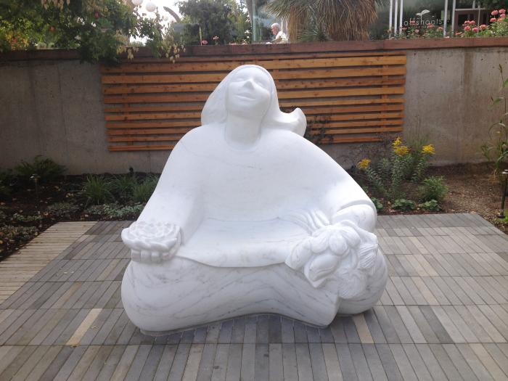
Flower Girl (2016.1.1)
Madeline Wiener created a carved marble sculpture of a girl holding a bouquet of flowers in her left hand and a lotus in her right hand. Her uplifted face is welcoming and her gesture is of joy in the experience of engaging with flowers. A joyful, interactive sculpture celebrating the natural world. Located at the Denver Botanic Gardens, visitors can find her inside the "Sensory Garden" and even sit on her lap. Carved from a solid block of Colorado Yule Marble she represents a garden visitor experiencing happiness through all her senses.

