Slide 1
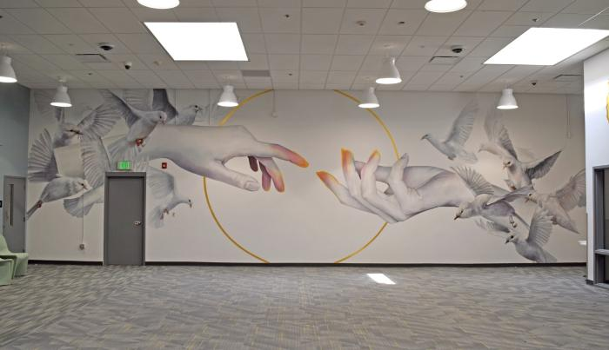
The Journey (2024.2.1)
THE JOURNEY is an installation of three murals within the Denver County Jail&#39;s Visitors&#39; Room. Intended to support the much-needed connection between people serving their short sentences and their loved ones, these murals symbolize our interconnection and unity, hope for the future, and growth.

Slide 2
Dynamic (2024.6.1.)
"Inspiration Point Park is steeped in Denver&#39;s history and has been dynamically used since before Colorado achieved statehood and continues to serve the community today. The sculpture, titled &#39;Dynamic,&#39; celebrates the historical significance of the land and its people across generations and into the future."

Slide 3
Forest Woodlands (2024.9.1)
This sculpture features a selection of wildlife native to the alpine and forest woodland habitats of Colorado. Many of these species are currently threatened, and the artwork aims to raise awareness about them. As with all the sculptures, the ceramic work will feature relief elements that protrude up to half an inch from the background, adding an appealing tactile component to the art. The wildlife depicted on the south-facing side, from top to bottom, includes: Canada Lynx, Mountain Parnassian Butterfly, Subalpine Fir, Snowshoe Hare, Alpine Forget-me-not, Least Chipmunk, Heartleaf Arnica, Moose, and Northern Pocket Gopher. The wildlife depicted on the north-facing side, from top to bottom, includes: Golden Eagle, Alpine Lily, Pacific Marten, Avalanche Lily, Blue Grouse, Aspen leaves, White-tailed Ptarmigan, Purple Fringe, and Red Squirrel (Chickaree).

Slide 4
Pinyon/Juniper Woodlands (2024.9.4)
This sculpture features a selection of wildlife native to the pinyon and juniper woodland habitats of Colorado. Many of these species are currently threatened, and the artwork aims to raise awareness about them. As with all the sculptures, the ceramic work will feature relief elements that protrude up to half an inch from the background, adding an appealing tactile component to the art. The wildlife depicted on the west-facing side, from top to bottom, includes: Ringtail, Perky Sue, Blue-gray Gnatcatcher, Prickly Pear Cactus, Scaled Quail, Little Brown Bat, Pinyon Mouse The wildlife depicted on the east-facing side, from top to bottom, includes: Pinyon Jay, Juniper, Common Collared Lizard, Evening Grosbeak, Kinnikinnic, Pinyon Pine Seeds, Brown Tarantula

Slide 5
Nature's Songs (2024.10.1)
Nature’s Songs was designed with three key elements of ecology: magic, wonder, and the importance of environmental joy, education, and conservation. 1. **Pollinators** - These are essential for ensuring that plants develop fruit, seeds, and new plants. 2. **Seed Dispersal** - This refers to the movement, spread, or transport of seeds away from the parent plant. 3. **Eco & Bioacoustics** - This involves the audio documentation of nature, utilizing modern technology to aid in conservation and explore species interconnectedness. Nature serves as a rich metaphor for education and personal growth. The ELK Education Center acts as the foundational soil, nurturing and fostering growth. ELK’s programming functions as the pollination process, ensuring that the plants—representing ELK’s students—develop fully. These students are like seeds, growing, blooming, and eventually dispersing to perpetuate the cycle of growth for themselves, their communities, and the environment.

Slide 6
[BLANK] (IN PROGRESS_56TH AVENUE)

Slide 7
Pathway to Home (IN PROGRESS_BEHAVIORAL HEALTH )

Slide 8
Kissing Birds (IN PROGRESS_ELK EDUCATION CNT2)

Slide 9
[BLANK] (IN PROGRESS_FEDERAL&25TH)

Slide 10
[BLANK] (IN PROGRESS_FIRESTATION 40)

Slide 11
Silver Lining (IN PROGRESS_MOTHERSHIP Ext.)

Slide 12
[BLANK] (IN PROGRESS_MOTHERSHIP Int.)

Slide 13
[BLANK] (IN PROGRESS_ROCKY MTN LK PARK)

Slide 14
[BLANK] (IN PROGRESS_RUBY HILL PHASE 3)

Slide 15
[BLANK] (IN PROGRESS_SAND CREEK)

Slide 16
Mother Earth; Community (IN PROGRESS_SLOAN'S LAKE)

Slide 17
[BLANK] (IN PROGRESS_THEODORA HOTEL Ext)

Slide 18
[BLANK] [Duplicate] (IN PROGRESS_THEODORA HOTEL Int)

Slide 19
Talking Horseshoes (IN PROGRESS_URBAN FARM)

