Slide 1
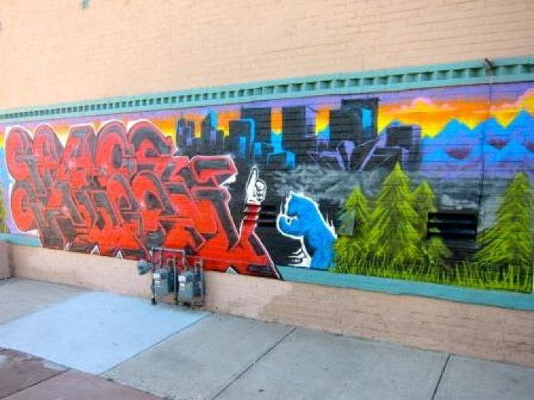
Outside the Walls (UAF.2009.1)

Slide 2
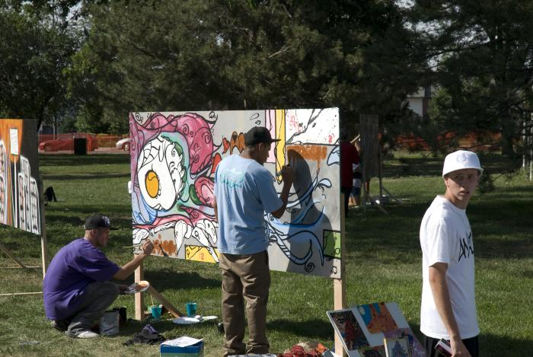
Off the Wall (UAF.2009.2)
Throughout the summer of 2009, Arts Street Youth Program conducted several youth workshops and created 18 murals panels displayed at La Alma/Lincoln Park.

Slide 3
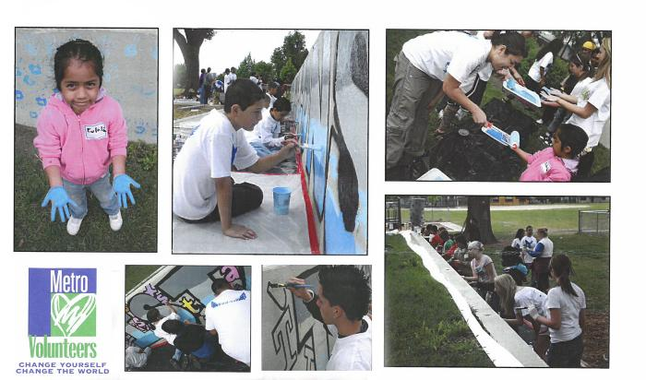
DPS Trevista at Horace Mann (UAF.2009.3)
Trevista at Horace Mann&#39;z student leader service group worked with a team of 20 students and local artist to design a school and community unity mural at Horace Mann Elementary School during Trevista&#39;s Service Project Day.

Slide 4
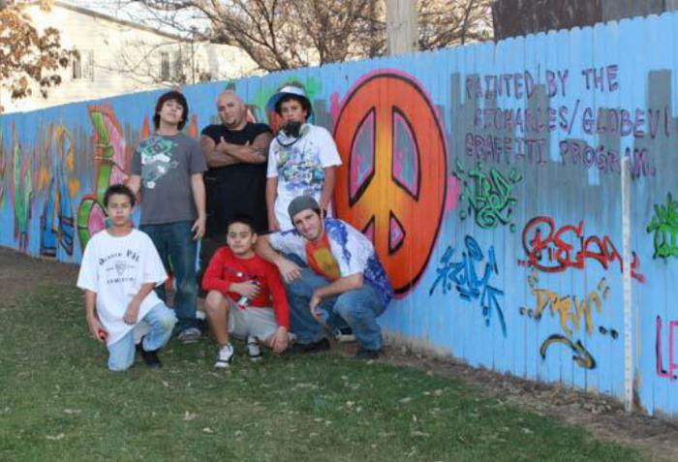
St. Charles Recreation Center (UAF.2009.4)
YNIG held summer sessions for youth leading to the creation of a mural along a fence line at St. Charles Recreation Center.

Slide 5
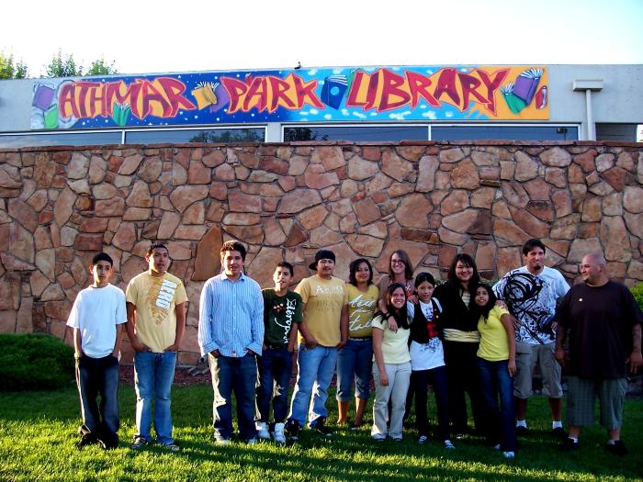
Summer of Reading: Be Creative/Express Yourself (UAF.2009.5)
This mural was created through student workshops at Denver Public Library's Summer Reading Program and Think 360 Arts.

Slide 6
Cleo Parker Robinson: Green Technology Summer Institute of Service Youth Program - 2009 (UAF.2009.6)
This mural was created through a summer program with Cleo Parker Robinson Dance. Their summer institute targeted the North East Park Hill Neighborhood, engaging youth in a range of activities and projects designed to build and enhance value for the neighborhoods and communities where the students reside, work and play.

Slide 7
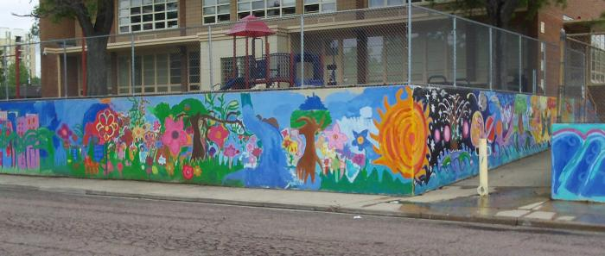
Brown Elementary School (abstract; sun, flowers, geometric designs) (UAF.2009.7)
Barth Quenzer, Denver Public School teacher, and local artist Jeremy Ulibarri (JOLT) created a mural program with students at Brown Elementary School.

Slide 8
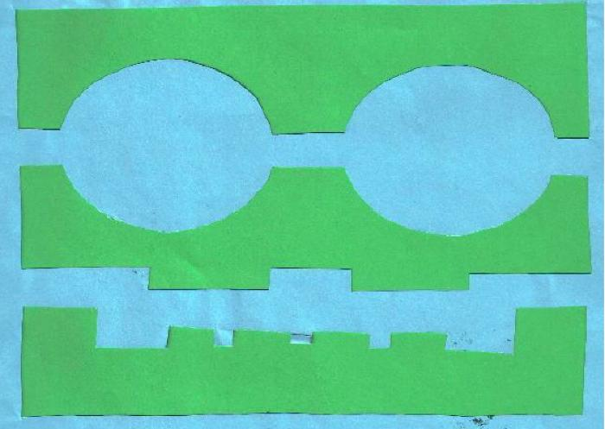
F.R.E.S.H. (Friends Respecting Everyone’s Success through Hip-Hop) (UAF.2009.8)
F.R.E.S.H. (Friends Respecting Everyone’s Success through Hip-Hop) created this mural in Rishel Middle School neighborhood, working with students from Rishel Middle School, Valverde Elementary and Kipp High School.
Through the graffiti/aerosol art element section of the curriculum, the F.R.E.S.H. program also provided participants, family members and community members opportunities to learn about an expressive art, how it affects the community, and how the larger world is affected by the interpretation of graffiti as an art and as a crime.
Beyond the invaluable lecturing and anecdotal conversations that occurred between staff and participants, the participants had many opportunities to create, improve and cultivate and exhibit their artistic abilities.

Slide 9
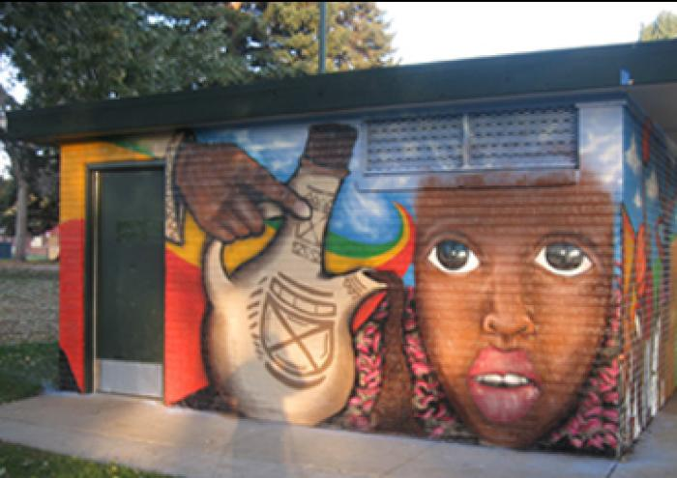
Axum Park (UAF.2009.9)
This mural at Axum Park was painted by Keith White (YNIG) and Joshua Rogers.

Slide 10
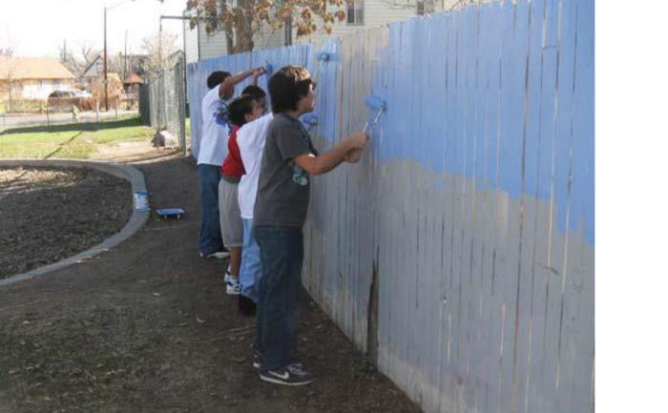
Globeville Recreation Center (UAF.2009.10)
YNIG worked with Globeville Youth students to create this mural.

Slide 11
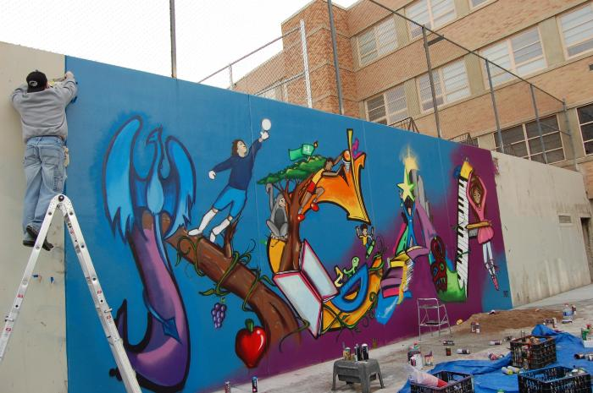
Kunnsmiller Art Academy (UAF.2009.11)
Barth Quenzer, Denver Public School teacher, and local artist Jeremy Ulibarri (JOLT) created a mural program with students at Kunnsmiller Art Academy.

Slide 12
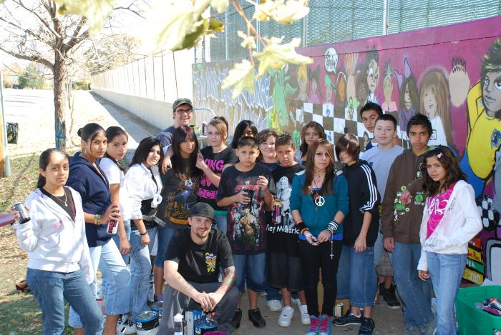
Lake Middle School (UAF.2009.12)
Barth Quenzer, Denver Public School teacher, and local artist Jeremy Ulibarri (JOLT) created a mural program with students at Lake Middle School.

Slide 13
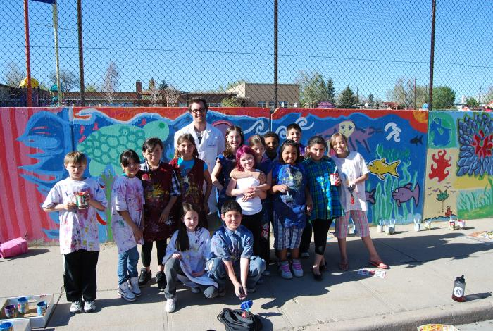
Brown Elementary School (flowers, blue design) (UAF.2010.1)
Barth Quenzer, Denver Public School teacher, and local artist Jeremy Ulibarri (JOLT) created a mural program with students at Brown Elementary School.

Slide 14
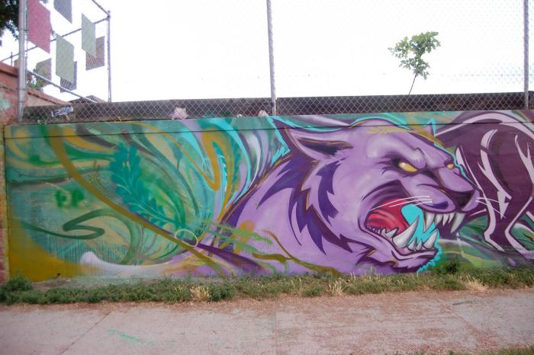
Valdez Elementary School (UAF.2010.2)
Local artist Jeremy Ulibarri (JOLT) worked with Valdez Elementary School students in the creation of this mural.

Slide 15
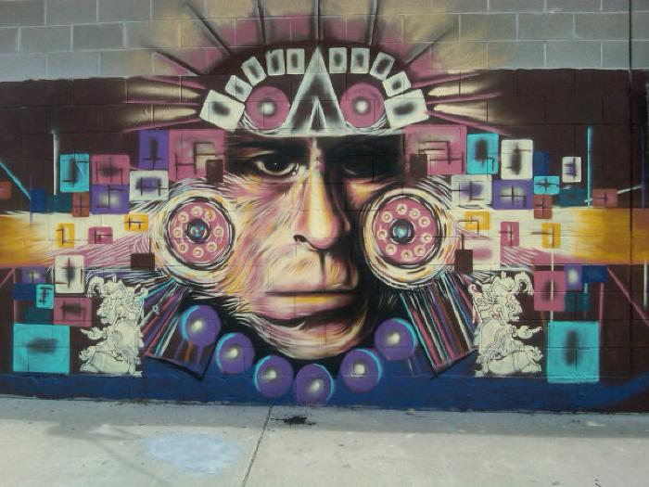
Untitled (Aztec figure) (UAF.2010.3)

Slide 16
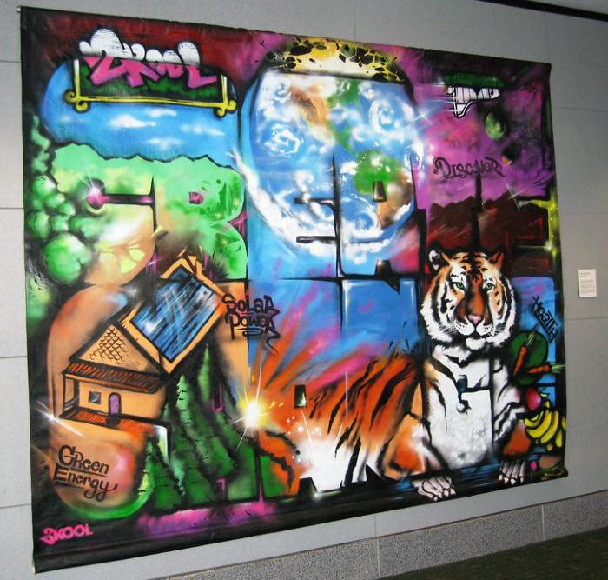
Create Change (UAF.2010.4)
As part of the Denver Urban Arts Fund program, YouthBiz/2Kool hosted and promoted the creation of a community-based “Create Change Mural” for subsequent display at various municipal and public locations, including a visit to Denver International Airport.
[vimeo src="https://player.vimeo.com/video/361949530"]

Slide 17
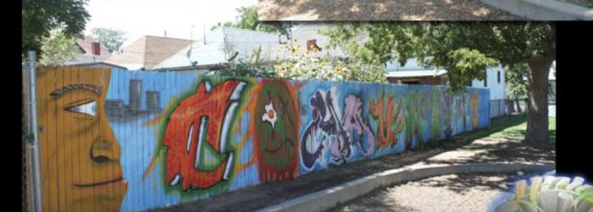
St. Charles Recreation Center (UAF.2010.5)
YNIG held summer sessions for youth ages 6-19, leading to the creation of this mural.

Slide 18
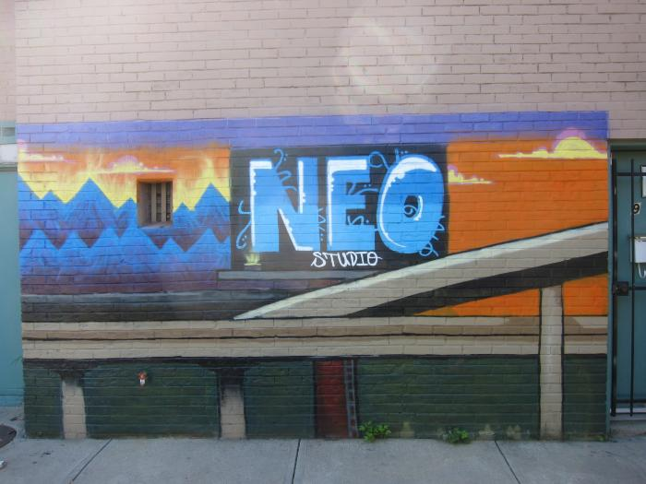
Access Gallery Fellowship Program (UAF.2010.6)
Access Gallery hosted and promoted a three-month fellowship program for 10 urban artists, and held 12 structured art classes where teens worked in a variety of art mediums.

Slide 19
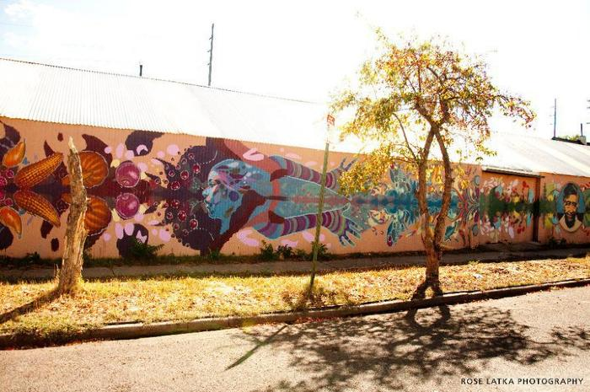
GetFRESH (UAF.2010.7)
YouthBiz youth-entrepreneurs studied eco-cultivation over the 2010 summer, and Denver Urban Gardens youth-growers worked directly with master artists, historians and organic gardeners through an inter-generational curriculum including dialogue research and food preparation to bring a unique perspective and voice to this mural project.

Slide 20
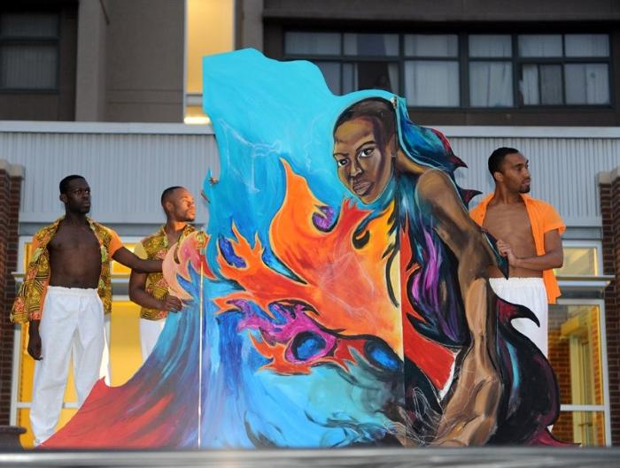
Cleo Parker Robinson: Green Technology Summer Institute of Service Youth Program - 2010 (UAF.2010.8)
This mural was created through a summer program with Cleo Parker Robinson Dance. Their summer institute targeted the North East Park Hill Neighborhood, engaging youth in a range of activities and projects designed to build and enhance value for the neighborhoods and communities where the students reside, work and play.
Youth completed construction of a three-piece traveling mural that highlighted the four elements. Green Technology staff members Charles White and Leticia Tanguma worked with the youth to build the mural and produce a performance around the eight foot mural that creatively addressed taking care of Mother Earth and her inhabitants. Elements of the production were presented for patrons and passersby of Wystones World Teas as well as hundreds of students at the Bruce Randolph School.

Slide 21
GRASP (UAF.2010.9)
GRASP (Gang Rescue and Support Project) is a peer-run, intervention program that works with youth who are at-risk of gang involvement or are presently active in gangs, helps families of gang victims, and serves as a youth advocate. GRASP engaged 10-15 neighborhood youth for a 1400 sq. ft. wall mural in the intersection of 13th Ave. & Osage St.

Slide 22
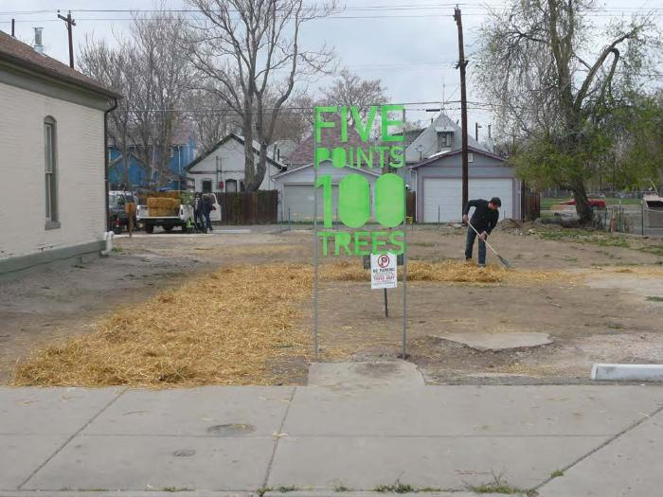
Five Points 100 Trees (UAF.2010.10)
Center For Transitional Landscapes used apple trees in the Five Points Neighborhood to promote sustainable graffiti prevention.

Slide 23
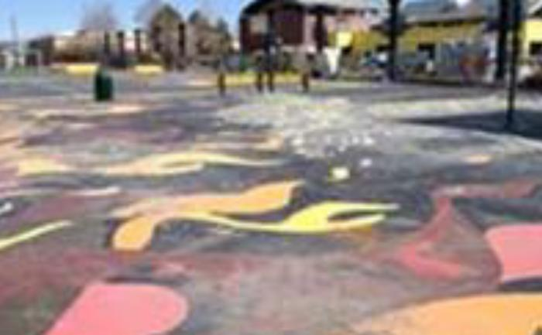
Prodigal Son Initiative original (UAF.2010.11)
This project converted 22,000 sq. feet of damaged concrete into a community gathering spot including six murals created and painted by local artists and community youth, three basketball courts and 12 steel pillars transformed into peace columns.

Slide 24
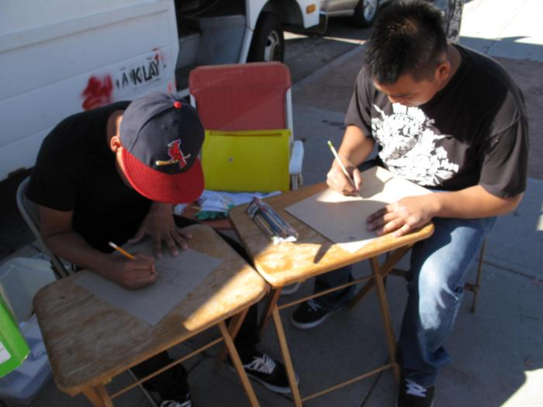
bARTer Collective Youth Educational Workshops (UAF.2010.12)
The bARTer collective worked with youth to design t-shirt stencils.

Slide 25
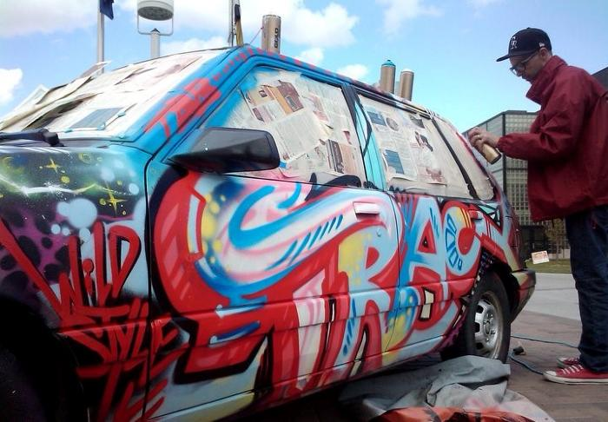
Tracy 168 at Auraria Campus (UAF.2010.13)
Tracy 168 created temporary mural boards on Auraria campus. This project also included a classroom lecture about his work and live car painting outside of Tivoli Student Union.

Slide 26
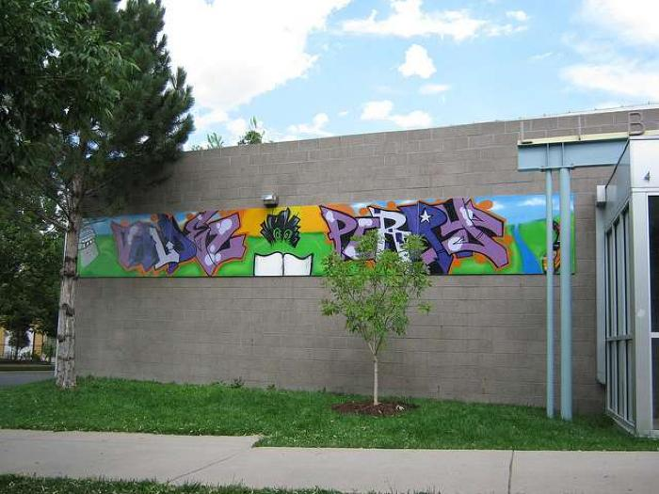
Denver Public Library Summer of Reading and Graffiti Prevention Program (UAF.2010.14)
YNIG hosted workshops with students in the Denver Public Library Summer of Reading Program.

Slide 27
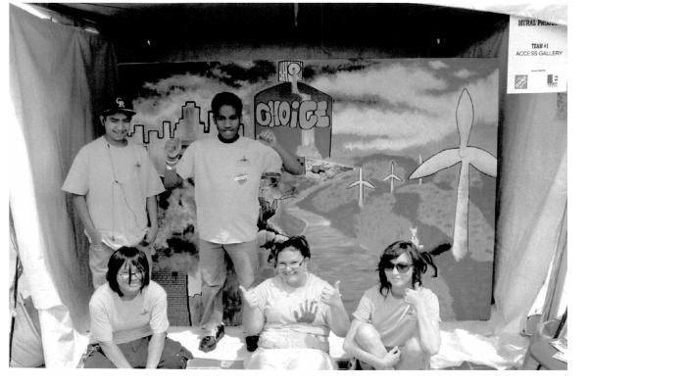
Access Gallery and Capitol Hill People's Fair (UAF.2011.1)
Access Gallery teamed up with Capitol Hill People&#39;s Fair for these murals.

Slide 28
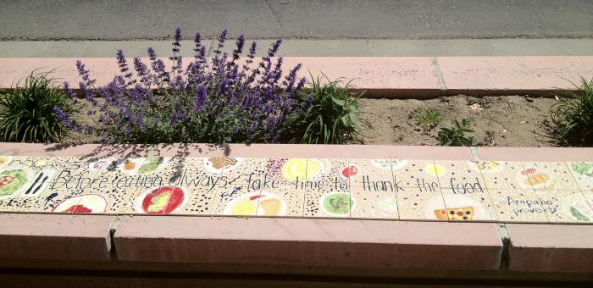
Morrison Road Mosaic Benches (UAF.2011.2)
Kempner Middle School art teacher, Pam Rojas worked with BuCu West Development Association and local school students to develop artistic tiles placed on the top of 10 landscape planters.

Slide 29
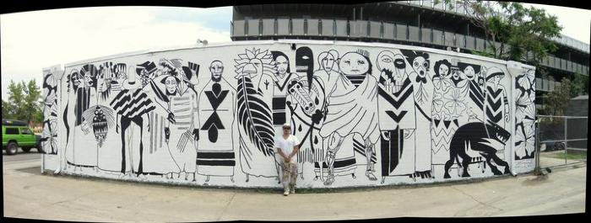
Untitled (black and white figures) (UAF.2011.3)
Artist Diego Rodriguez partnered with Guerilla Garden and a few youth volunteers from Lookout Mountain Youth Corrections. By including east and west walls, visible to passers-by at different times, this black and white project demonstrates the ability to articulate two perspectives in dialogue with each other. Additional photos of this project are available on the Guerilla Garden website.
Artist Statement:
The mural takes the form of an allegorical mirror, both celebrating what so many love about the street (its place as a pedestrian convergence for all walks of life) and posing an important question: How does one sustain the rich social environs while simultaneously improving the economics of an area?
The figures who inhabit the mural were designed over a five-week period with the input of a group of local youth who have been exploring art and different methods of expression through a city-funded grant. The images run the gamut, both real and fantasy, serious and comical, in an attempt to touch for a single moment the universality of Colfax as we experience it.
It was a joy watching these taciturn, "cool kids" unfold, coming to class excitedly showing their new drawings, encouraging the younger kids, and generally showing a marvelous sense of pride in what they were doing. They volunteered with the firm intent of being a part of every step of the process. Watching them develop in leaps and bounds, it was hard for me not to recognize that with students like this, the teacher’s job is made positively easy. Their enthusiasm made even the mundane (but necessary!) steps in the mural process effortless and fun. Not only do I feel more confident working with youth in the future, I wish to seek this sort of work out. There is no doubt in my mind that this workshop has touched the youth who were a part of it, and I would not be surprised if several of them end up running similar workshops in the future.

Slide 30
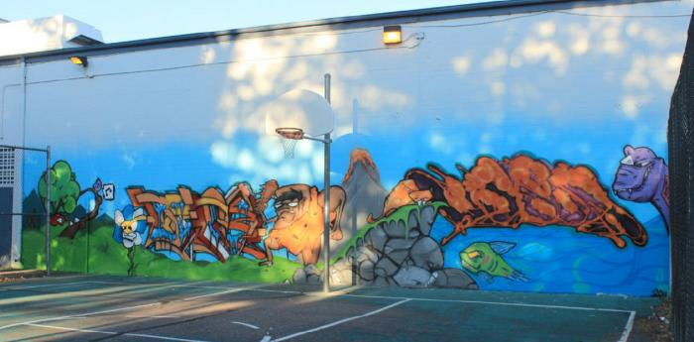
YNIG Art Education Mural Program (UAF.2011.4)
In addition to the artwork, this project included celebrations and youth-community interaction.

Slide 31
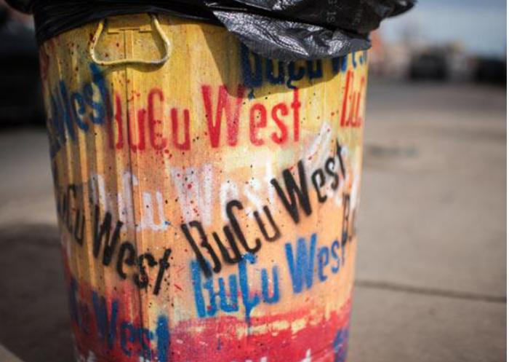
BuCu West Benches and Trash Cans (UAF.2011.5)
Various trash cans and benches along the Morrison corridor were painted with colorful murals.

Slide 32
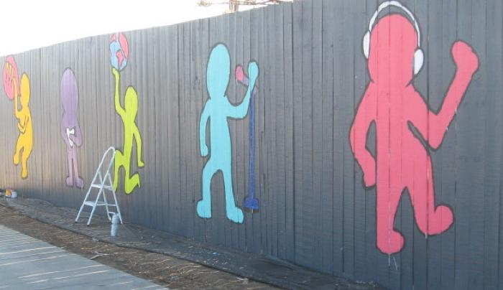
Girls Inc. (UAF.2011.6)
Girls Inc. of Metro Denver and Arts Street implemented class time for this project, which stretches along 91 feet of fencing on Colfax Ave.

Slide 33
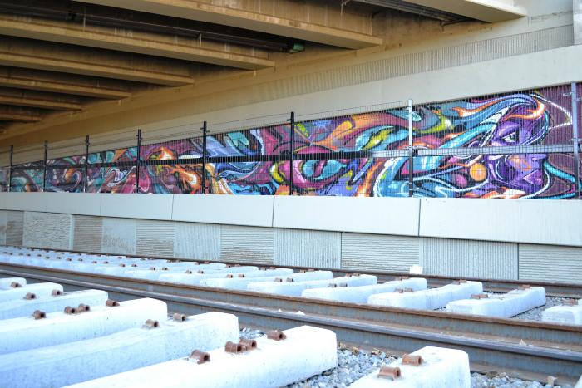
RTD Station (UAF.2011.7)
This Federal Blvd. bridge mural created by JOLT and Guerrilla Garden is visible to RTD Light Rail commuters.

Slide 34
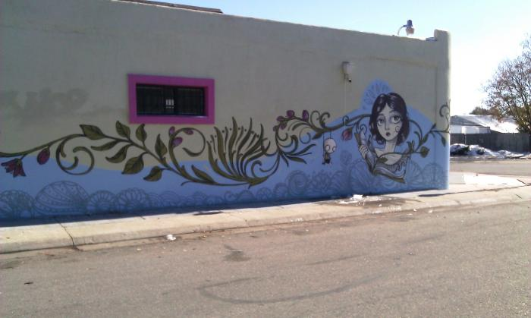
Sandi Calistro (UAF.2011.8)

Slide 35
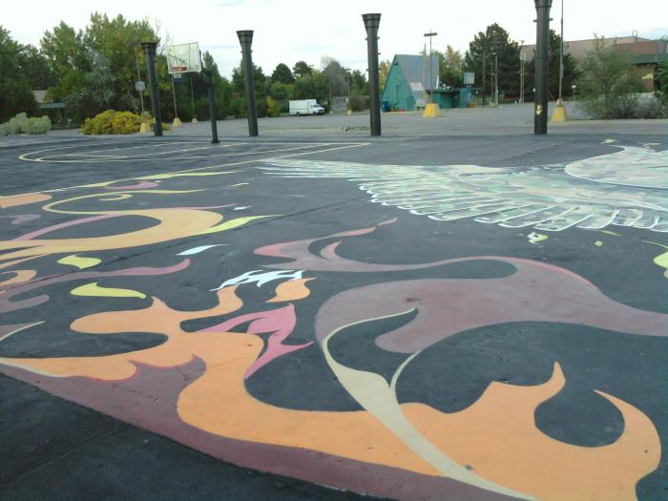
Peace Murals (UAF.2011.9)
This project converted 22,000 sq. feet of damaged concrete into a community gathering spot including six murals created and painted by local artists and community youth, three basketball courts and 12 steel pillars transformed into peace columns.

Slide 36
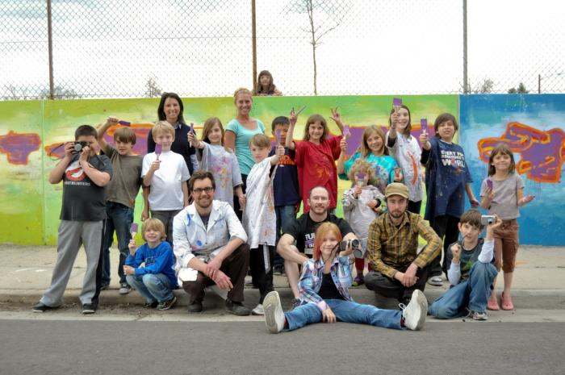
Brown Elementary School (abstract; purple, green, blue) (UAF.2011.10)
Barth Quenzer, Denver Public School teacher, and local artist Jeremy Ulibarri (JOLT) partnered with Think 360 Arts and local students for this Brown Elementary School mural.

Slide 37
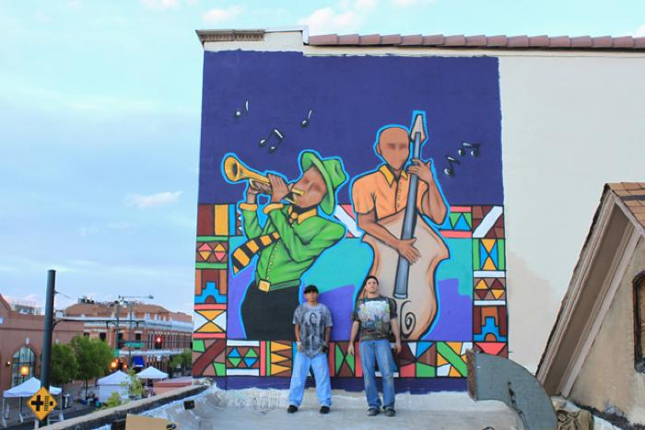
YNIG Murals at Five Points (UAF.2011.11)
This pair of murals in the Five Points Neighborhood were created by Keith White (YNIG) and Joshua Rogers.

Slide 38
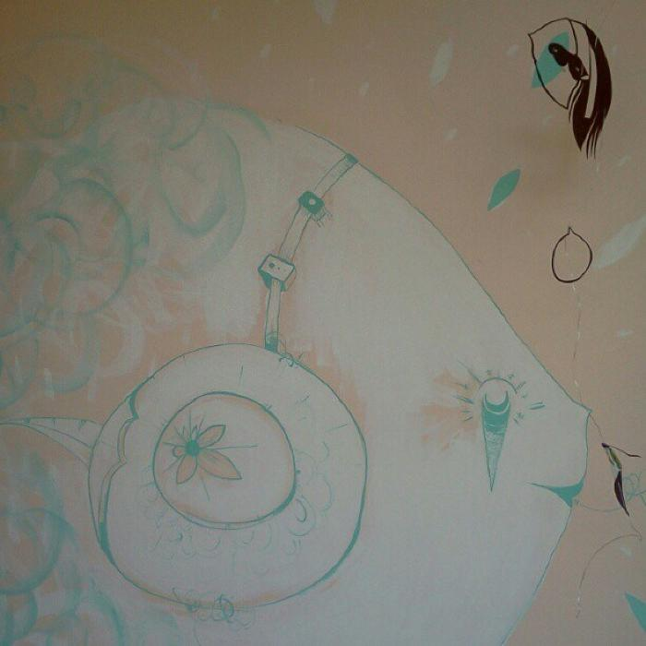
Colorado Creative Giving (no longer on exhibit) (UAF.2012.1)
Five artists had their works installed at six storefronts along Welton Street during the ninth annual Five Points Jazz Festival (May 19, 2012).

Slide 39
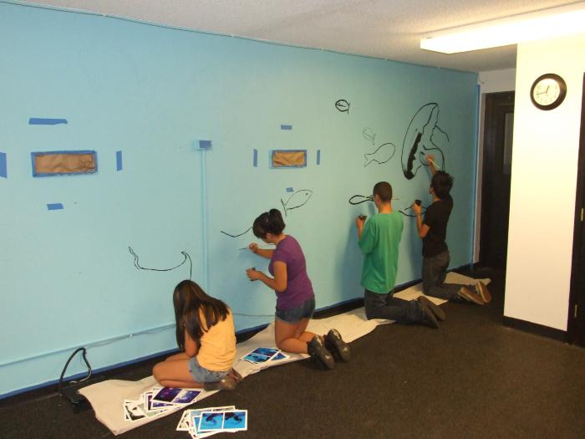
Street Kidz Center (UAF.2012.2)

Slide 40
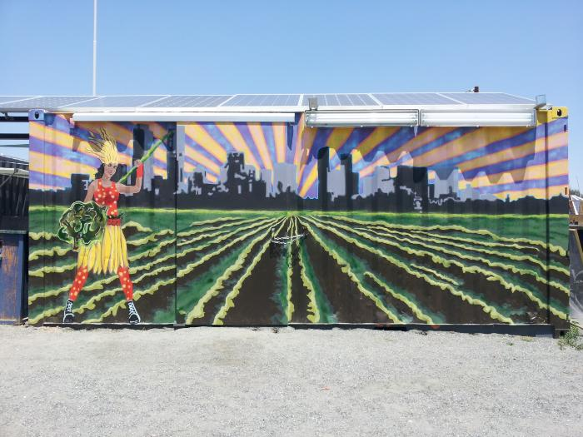
Three Trailer Pod (UAF.2012.3)

Slide 41
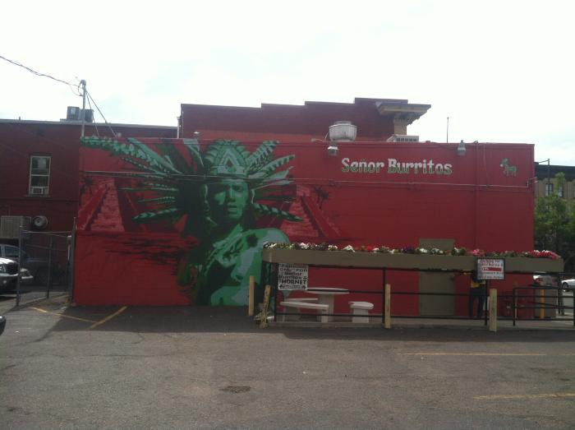
Indio Chichen Itza (UAF.2012.4)
Artist Bimmer Torres worked with five youth from the Juvenile Diversion Program to design and create this mural in only three days. The figure represents a wise Mayan warrior in front of a large pre-Columbian city built by the Maya civilization.
The Juvenile Diversion Program targets youth as a prevention program for illegal graffiti tagging. One participant said of the project, "this program shows you how graffiti can be done legally and how it can inspire others."

Slide 42
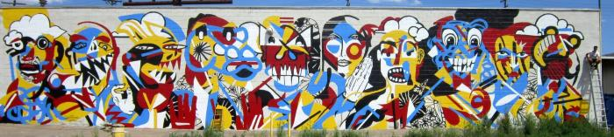
Rite of Passage (UAF.2012.5)
This red, yellow and blue mural was created by Diego Rodriguez and several youth.

Slide 43
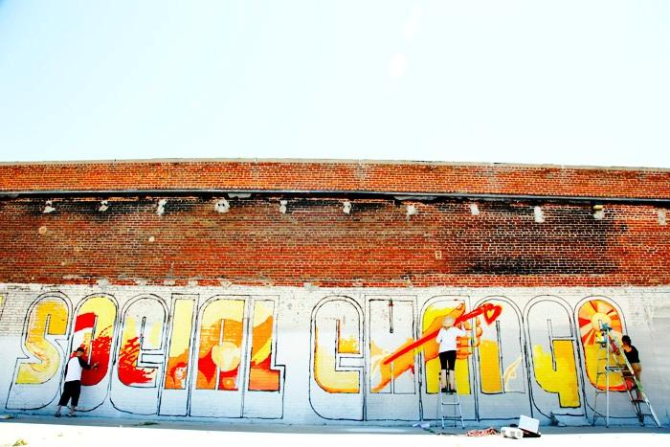
We Are But Seeds of Social Change (UAF.2012.6)
Barth Quenzer and local artist Jeremy Ulibarri (JOLT) worked with Denver Public School teachers on this mural.

Slide 44
VSA Summer Program (UAF.2012.7)
VSA Colorado/Access Gallery Summer Program application for one-time funding in the amount of $3,000 USD, for Summer Program. VSA Colorado will implement this program as part of our ongoing summer job training program ARTWORKS. We have operated a summer job training program for youth for the last 5 years. This project will be incorporated into our program as we have always included leadership and self esteem work in our projects. Several of our projects are led by Grafitti artist whose message is that creativity is good, vandalism is bad, we work hard to channel the creativity and talent these kids have into positive outlets that earn them money

Slide 45
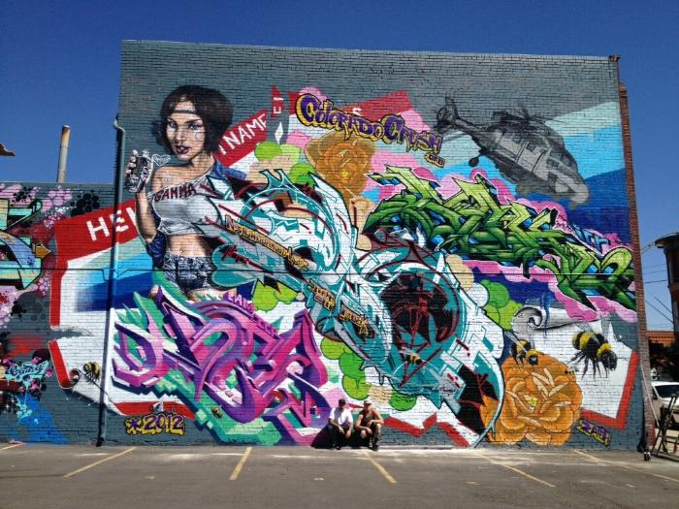
Crush (UAF.2012.8)
Beginning of Crush Murals

Slide 46
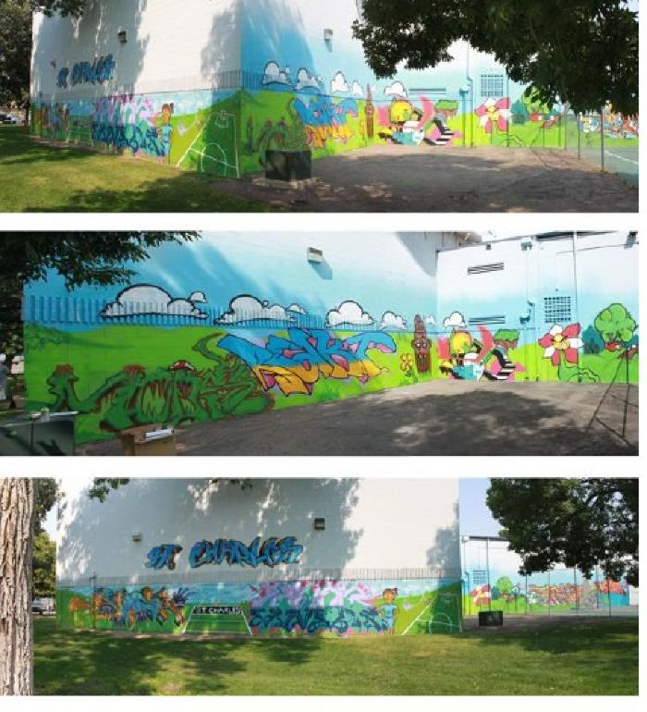
St. Charles Summer Program (UAF.2012.9)
St. Charles Recreation Center summer mural program with YNIG

Slide 47
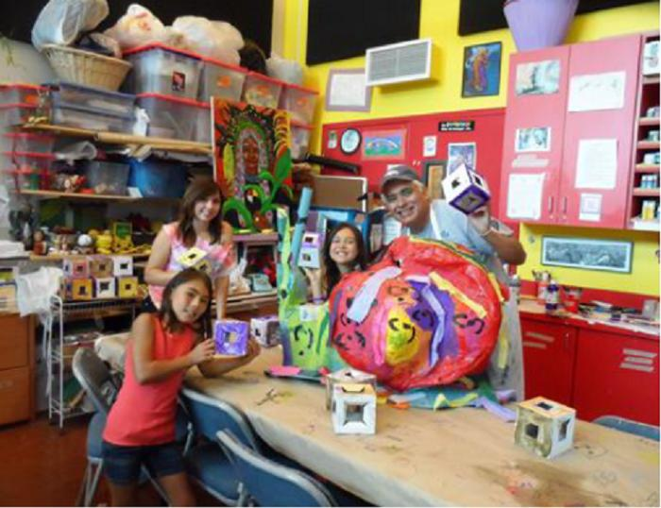
La Alma Rec Center Youth Summer Program (UAF.2012.10)

Slide 48
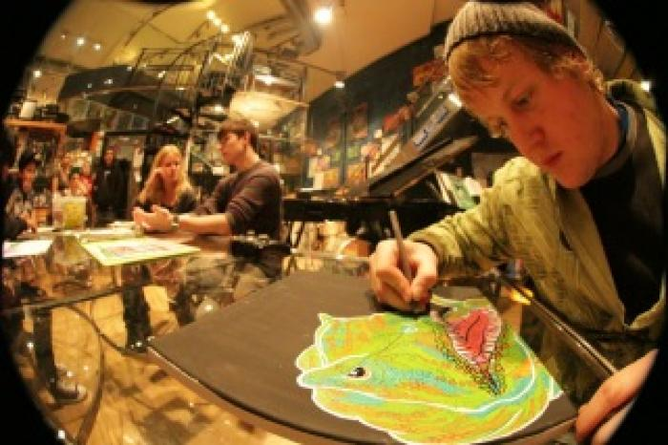
Absolute Family After School Graffiti Session (UAF.2012.11)
Afterschool Graffiti Sessions with youth

Slide 49
Art Lab Summer Intensive Program (UAF.2012.12)
Platte Forum Summer Intensive Program with artist Andrea Moore

Slide 50
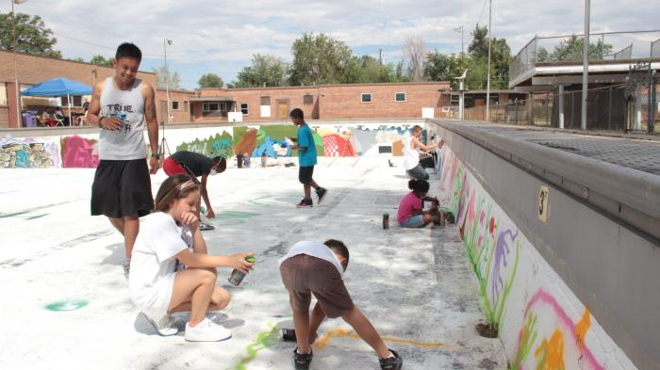
Arts of Mind (UAF.2012.13)
Ratha Sok lead artist along with Gerald Hamel created a Youth Empowerment Program

Slide 51
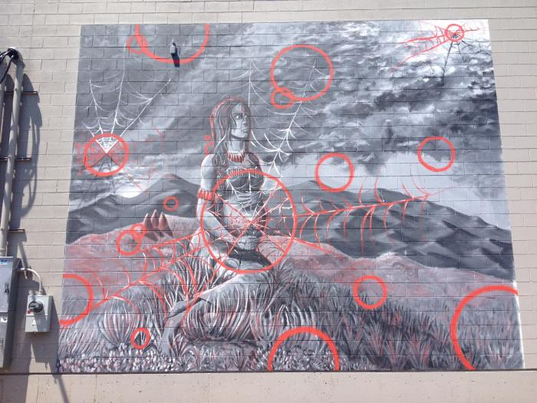
Untitled (pregnant woman seated on hill in black, white and red) (UAF.2012.14)

Slide 52
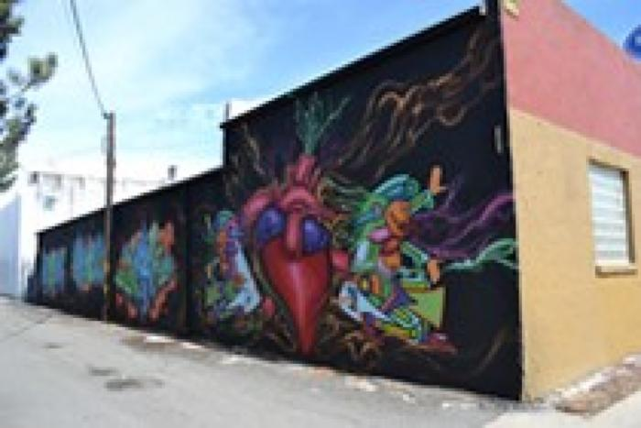
Untitled (abstract heart on black field) (UAF.2012.15)
Mural on 6th Avenue and Santa Fe Drive by Keith White (a.k.a. YNIG) and Joshua Rogers

Slide 53
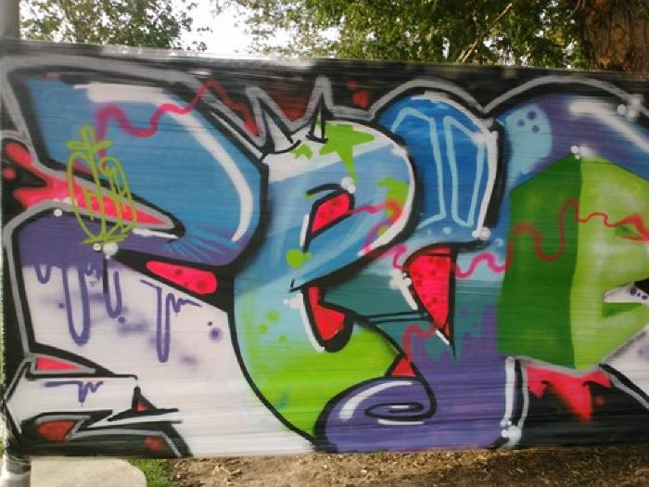
Globeville Street Kids (UAF.2012.49)

Slide 54
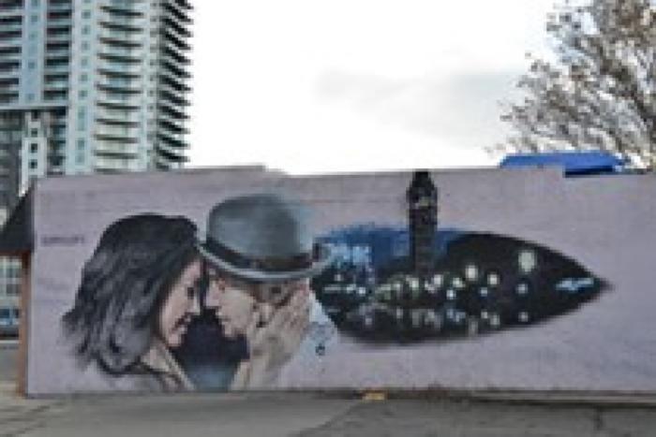
Bella Vista (UAF.2012.50)

Slide 55
Señor Burrito (UAF.2012.51)

Slide 56

Grandmother's Tea (UAF.2013.6)

Slide 57

The Awakening (UAF.2013.53)

Slide 58

Concrete Youth Collective @ Street-Kidz Center Art Program (UAF.2013.54)

Slide 59

La Alma Recreation Center Summer Program (UAF.2013.55)

Slide 60

Untitled (white tiger and wolf viewing each other) (UAF.2013.56)

Slide 61

Life (UAF.2013.57)
Bimmer Torres led youth at Denver Inner City Parish through creative workshops and created this mural at College View Community Center.

Slide 62

Future World Leaders (UAF.2013.58)

Slide 63

Arts of Mind (UAF.2013.59)
Students participated in a workshop at Columbine Elementary School and installed the final work at Barrett Elementary School.

Slide 64

Globeville: Change from Within (featuring farm workers and families) (UAF.2013.60)

Slide 65

Heal the Hood (colorful lion image) (UAF.2013.61)

Slide 66

Untitled (bird on a pier, part of 2013 CRUSH) (UAF.2013.62)
This mural was part of the 2013 CRUSH, an annual celebration of art, transforming the streets and alleyways of RiNo into permanent, open-air galleries.

Slide 67

Untitled (man painting "Brushstrokes," scene as if looking into a studio gallery) (UAF.2013.63)
* No Longer on View *

Slide 68

Untitled (neighborhood scenery, landscape highlighting Morrison Road) (UAF.2013.64)

Slide 69

Untitled (Native American faces silhouetted against Colorado mountains, setting sun resembles Colorado state flag) (UAF.2013.65)

Slide 70

Untitled (Aztec imagery in orange and green) (UAF.2013.67)

Slide 71

Untitled (woman with arms reaching out) (UAF.2013.68)

Slide 72

Untitled (geometric colored shapes on fence and walls) (UAF.2013.69)
This mural was part of the 2013 CRUSH, an annual celebration of art, transforming the streets and alleyways of RiNo into permanent, open-air galleries.

Slide 73

Queen City of the Plains (UAF.2013.70)

Slide 74

Untitled (Aztec face with arms reaching out) (UAF.2013.71)

Slide 75

Untitled (scroll with written values, along with ink and candles) (UAF.2013.72)

Slide 76

Untitled (two sculptural female figures with abstract figure in middle) (UAF.2013.73)

Slide 77

This River is Alive
(UAF.2014.1)
While in Denver for an exhibition at the David B. Smith Gallery, Brazilian artist Bruno Novelli created a mural in the city’s Confluence Park. "This River Is Alive" is an intricate geometric design.

Slide 78

Sleeping Giant (UAF.2014.7)

Slide 79

Untitled (two faces on suspended barbed wire) (UAF.2014.74)

Slide 80

Untitled (woman suspended over bed) (UAF.2014.75)

Slide 81

Wonderland (UAF.2014.77)

Slide 82

Untitled (bright colors, circular shapes) (UAF.2014.78)

Slide 83

Untitled (circles with interior geometric patterns) (UAF.2014.79)

Slide 84

Untitled (Zeus holding bird to chest) (UAF.2014.80)

Slide 85

Untitled (Latina woman blowing foliage and Cesar Chavez watering plants) (UAF.2014.81)

Slide 86

Eagle Feather (UAF.2014.82)

Slide 87

Untitled (colorful female with abstract hair flowing) (UAF.2014.83)

Slide 88

Untitled (treasure chest with playing cards) (UAF.2014.84)

Slide 89

Untitiled (black and white, man's face with mountains) (UAF.2014.85)

Slide 90

Que Sera (UAF.2014.86)

Slide 91

Dark Fist (UAF.2014.87)

Slide 92

Mountain scenery on building (UAF.2014.88)

Slide 93

Como Sabor (UAF.2014.90)

Slide 94

5th Street Hub Sustainability Mural (UAF.2014.91)

Slide 95

Untitled (map) (UAF.2014.92)

Slide 96
Untitled (broken bedroom furniture) (UAF.2014.93)
* No Longer on View *
About the artists:
Claudio Ethos (ETHOS)
Ethos was born in São Paulo in 1982 and currently lives and works there. He began putting in work around the age of 15 with spray paint as well as ballpoint pen, which, to this day, serve as his primary tools. Highly influenced by many of the usual suspects from the Brazilian scene, Os Gemeos, Vitche, Onesto, and Herbert Baglione, Ethos’ style has taken its own highly unique state and individual genesis. Many in São Paolo today still prefer the stencil technique, or are part of large pixação crews with their own signatures, but Ethos has carved out his own niche amongst the muralists. His large-scale outdoor murals are less impulsive in origin than many of his contemporaries&#39; works, but no less stunning. His flawless conversions of his ballpoint pen drawings, usually from 8.5” x 11” or smaller, make absolutely remarkable transitions from paper to concrete, almost as if an image has been transferred by projector. While using a thread technique, amongst others, the amount of detail in his outdoor portraiture has captured the attention of countless art enthusiasts, his peers, and gallerists around the world. His penchant for replicating, to scale, the fine details of his ink and pencil drawings onto large walls has become his lasting signature. The content of this work, both indoors and outdoors, is inevitably related to the struggle of day-to-day existence that Paulistas experience. Population density and the constant strain of urban anxiety have become the subjects of many of Ethos’ narratives. Ethos’ characters have undeniably become some of the most recognized all throughout Brazil, with his ephemeral work at times straddling the line between the figurative and abstract. His elongated, flexible, and strained figures have an almost liquid quality to them; one foot firmly in the school of the surrealists. He also displays a solid grasp of textiles in the use of patterns. Huge black balls serve as eyes for the exhausted and maligned residents of the concrete jungle. These characters are a mixture of dreams and fragments of everyday life within the city.
Alex Hornest (Onesto)
Onesto is a painter and sculptor who lives and works in Sao Paulo, a city that inspires you and makes you reflect on urban, playful and introspective themes. Based on that, his works focus on the relationship between cities and their inhabitants. Already, he often works with materials such as wood, bronze, porcelain and concrete shiro when he sculpts, and adds weird / random objects from our everyday life. In his ink oil, acrylic and duo works, he creates textures and contrasts with overlays that define light, shadow and depth, and blurs transparencies, so colors are not the key to the interpretation of objects or what they represent. In his works, imaginary and real characters reveal themselves, portraying a lyrical universe that balances chaos and turmoil.

Slide 97

Amigos (UAF.2015.9)

Slide 98

Thunderbird (UAF.2015.94)

Slide 99

Untitled (person wearing a hoodie, painting a rainbow) (UAF.2015.95)

Slide 100

City of the Sun (UAF.2015.96)
* No Longer on View *
This blue and gold mural along the Cherry Creek trail is a prayer mandala, with each of the painted lines representing a repeated prayer. Emphasizing the medium of time and intention, the mural includes an overwhelming number of interconnected white and gold lines. Reminiscent of a celestial night sky, the central gold geometric mandala radiates as a reflection of the Sun, surrounded by neighboring stars and the dark matter between. The central geometric mandala is based on Pythagorean mathematics, utilizing the ratio proportion of Phi, a proportion found everywhere in nature. According to the artist, Gemma Danielle, the mural could also be interpreted as the self being represented by the central gold mandala, with all the surrounding golden circles representing the people in our network of connections.
During the mural&#39;s creation, Gemma Danielle conducted a sound performance on the Full Moon Total Lunar Eclipse.
"City of the Sun" was recognized by Americans for the Arts Public Art Network (PAN) Year in Review in 2016. The Year in Review annually recognizes outstanding public art projects that represent the most compelling work for the year from across the country and beyond. Two or more public art professionals serve as jurors to review hundreds of project applications and select up to 50 projects to highlight the most compelling public artworks. The PAN Year in Review is the only national program that specifically recognizes public art projects. Read more.
[vimeo src=https://player.vimeo.com/video/178254948]
Read more about the mural in a Colorado Public Radio story.

Slide 101

Humming Birds (UAF.2015.97)

Slide 102

All Things Must Pass (UAF.2015.98)

Slide 103

Untitled (black and white flower design with blue columbine) (UAF.2015.99)
*Artwork No Longer on View*

Slide 104

Two mice on suspended wire (UAF.2015.100)

Slide 105

Fontana Tanager (UAF.2016.1)

Slide 106

Untitled (contemporary colorful shapes) (UAF.2016.2)
*Artwork No Longer on View*
This mural was designed to inspire the youth in Denver by encouraging them to follow their artistic passions and bring color into their everyday lives.
Oliver Vernon was born in New York in 1972. He received his BFA from Parsons School of Design in 1995, and currently lives and works in Northern California. He has exhibited his work in cities all across the United States, including New York, Los Angeles, Seattle, San Francisco, San Diego, Washington DC, Denver and Chicago, and has also shown in the UK, Italy, France, and Canada. His work is part of numerous collections, including the Microsoft Corporation and the Metropolitan Museum of Art.
Visually, Oliver Vernon’s paintings draw upon an incredibly varied pool of influences, from abstract expressionism, to post-pop surrealism and the polished finish of figurative realism.

Slide 107

Denver rules everything around me (UAF.2016.3)

Slide 108

Paramount (UAF.2016.4)
* No Longer on View *
The "Paramount" murals on Cherry Creek revisit the history of humanity in America and its relationship with nature. For the two murals framing both sides of the Broadway bridge, Alexander Orion, an internationally recognized artist from Brazil, used a forced perspective technique that distorts paintwork to create an optical illusion when viewed diagonally from the bicycle trail.
A child surrounded by Native American patterns is shown on either side of the bridge, relating the artwork directly to the river and its banks, in order to revisit humanity’s relationship with nature. Orion chose these walls for his murals because they stake out a natural boundary between the creek and a city produced by a civilizing process. "The river environment was a great source of inspiration," he says. "The history of this place comes from this river where native peoples came together or traveled. Settlers arrived here; battles were fought here; people lived and died here. It is the origin of everything. The city arose from this place and now the river is an oasis hemmed in by asphalt and high walls securing the city."
Having worked on walls around the world for more than 22 years, Orion was struck by the peace and quiet of Cherry Creek, hence his decision to highlight the paradox between walls and river, and between nature itself and the landscape controlled by civilizing forces. Feeling that “we are losing touch with Earth, our origin,” he decided to revisit aspects he sees as paramount. “Painting children harkens back to the earliest periods of humanity’s existence. Native Americans were the first inhabitants of this land. We are all part of this civilization and we all contribute to what we call evolution, but to find a truly evolutionary path, I believe we must revisit our history to redeem ourselves from the barbaric crimes that were committed against Nature and human beings. We must recognize ourselves in our relationship with Nature.”

Slide 109

Dark Dark Dark (UAF.2016.5)
“Dark Dark Dark” is a constructed, three-dimensional mural inset into a vertical garden that is meant to help create a social economy through the sharing and harvesting of food at The Temple building as well as Curtis Park and Five Points. The mural depicts what is meant to be a trickster spirit emerging from the ether and acting as guardian to the garden. The arms of a larger deity are poised to drag him out of this existence and back from where he came.
“Dark Dark Dark” (Temple Living Wall) utilizes experimental modular hexagonal planter boxes to create a garden. The boxes are arranged so as to be accessible from the sidewalk. Each of the planter boxes is inset with painted and layered wood. The pieces were constructed, painted and then assembled.
Artist&#39;s Statement:
Imagine a living wall full of light and life, dozens of plant varieties from Colorado’s indigenous ecology, sustainable material elements engraved with geometric forms that reflect the religious history of The Temple, edible landscapes and painted iconography, where a sidewalk becomes a forest path glowing with the soft magic of a twilight garden.

Slide 110

Villa Park Mini Mart Mural (UAF.2016.6 )

Slide 111

Tough Love (UAF.2016.8)

Slide 112

A Wall Through La Alma (UAF. 2016.10)
Art Street Mural created by youth in neighborhood

Slide 113

Bear Creek Kids (UAF. 2016.11)

Slide 114

Untitled (colorful summer scenery painted by neighboring youth) (UAF.2016.12)
Lead artist Mario Echavarria lead artist worked with neighboring youth/community to paint mural

Slide 115

Untitled (giant jellyfish on bathhouse of Ruby Hill Park Pool) (UAF. 2016.13)
A giant red jellyfish mural

Slide 116

Viva Colorado (UAF.2016.14)
*No Longer on View*
This mural depicts state symbols of Colorado.
Artists&#39; Statement:
The mural has a symbolic theme. The design depicts official state symbols of Colorado: the state fish, Greenback Cutthroat Trout; the beautiful Rocky Mountain Columbine, official state flower of Colorado; Rocky Mountain bighorn sheep, the state animal; the state bird, Lark Bunting; the Colorado Blue Spruce, the official state tree; the Colorado Hairstreak Butterfly, the official state insect; the Claret Cup Cactus, the state cactus. A Native American man in a boat and a Native American rug with the designs and colors of the Cheyenne and Arapahoe tribes are also included. Another side-theme of the mural is the contrast between nature and human civilization. All elements of nature are full-colored and “alive,” while urban architecture and features of modern society have only outlines and are empty inside.

Slide 117

Untitled (abstract figure) (UAF.2017.1)
* No Longer on View *
This pair of murals by Michael Gadlin form one work along the Cherry Creek Trail.

Slide 118

Untitled (pop art, colorful cartoon characters) (UAF.2017.2)
*Artwork No Longer on View*
Antonie Tavaglione, a.k.a. TAVA, created this colorful pop art mural along Cherry Creek Trail with help from Yiannis Bellis and Chuck Krausz, a.k.a. Emit. The mural depicts several well-known cartoon and comic book characters as well as Andy Warhol.

Slide 119

Telmo & Matthieu (UAF.2017.3 )
*Artwork No Longer on View*
This Cherry Creek Trail mural stretches a full block and features several faces and leaf patterns, as well as a mountain landscape.

Slide 120

Untitled (abstract flowing waves in blue, white and yellow) (UAF.2017.4)
*No Longer On View*
This mural is situated on either side of a staircase leading to the Cherry Creek Bike Trail at 11th Avenue and Speer Boulevard.
Artist&#39;s Statement:
The mural features a cosmic landscape with a handful of stardust patterns flowing from one end of the design to the other, with several dragon characters flying through the environment. The design has an otherworldly quality, with balanced, repetitive shapes and forms flowing throughout the composition, and playful characters flying through the scene.

Slide 121

Untitled (black and white primitive figure)
(UAF.2017.5)

Slide 122

Untitled (black bear surrounded by abstract colors). (UAF.2017.6)
This mural was painted in collaboration with Re-imagining Arts Worldwide.

Slide 123

Quetzal (UAF.2017.7)
The mural&#39;s design was based on the Prodigy Coffee icon, which is a Quetzal bird. The mural also includes jungle foliage and incorporates a variety of color wrapping around the building. Volunteers from the coffee shop assisted in the creation of this mural.

Slide 124

Untitled (three figures holding antlers) (UAF.2017.8)
This dreamlike mural on a basketball court wall at Fairview Elementary School features three figures holding antlers. This mural was painted in collaboration with Re-imagining Arts Worldwide (R.A.W.)

Slide 125

Serpientes (UAF.2017.9)
Fifteen cement blocks amplifying children's activity in the La Alma/Lincoln Park also have visual impact for passersby.

Slide 126

Never Not Sooper (UAF.2017.10)
Abstract painting in peach and pink tones on Sooper B Liquor building

Slide 127

Untitled (black and white abstract figures) (UAF.2017.11)

Slide 128

Untitled (abstract, biomorphic design) (UAF.2017.12)
This mural, created for the Colorado Ballet, is an abstract piece that uses flowing and undulating forms to create musical movement across the wall.

Slide 129

Untitled (black and white image of woman covering her eyes) (UAF.2017.13)
This mural was painted in collaboration with Re-imagining Arts Worldwide (R.A.W.).

Slide 130

Untitled (red and pink roses) (UAF.2017.14)
Artist bunny M is known for her floral images.

Slide 131

Untitled (Japanese samurai) (UAF.2017.15)
The piece on Morrison Road, created through a collaboration between Taketo Kobayashi and Casey Kawaguchi, was inspired by the idea of a futuristic, mech samurai and showcases the combination of the artists' individual styles. Casey created the wall painting (face and background) using spray-paint. The helmet is Taketo's work, designed digitally, printed and pasted on top of the character with wood glue. The symbols in the corner mean "connection" and "tied."

Slide 132

Untitled (Día de los Muertos sugar skull, two large eyes) (UAF.2017.16)
Bold and colorful imagery reflecting Día de los Muertos created by a collaborative artist team. In the background, the building wall features a Día de los Muertos / Day of the Dead sugar skull. The fence in the foreground features two large eyes. The eye on the right contains the colors of the Mexican flag.

Slide 133

Untitled (fuchsia-colored mural with Aztec images) (UAF.2017.17)
Artist's Statement:
The green pyramid border on this mural represents the earth, the symbol of duality and the number three. The two Mayan symbols on each side are earth protectors. In the center is the tree of life symbolizing the primordial sea and all the elements. On the left is Tonatiuh, the sun symbol. On the right is Chalciuhtlicue, the symbol of water. Together they make the symbol of the Altachinoli representing steam and the breath of life.

Slide 134

Untitled (Pakal, the Mayan King, on red, blue and green field) (UAF.2017.18)
The mural depicts Pakal, the Mayan King.
Kʼinich Janaab Pakal, also known as Pacal, Pacal the Great, 8 Ahau and Sun Shield (March 603 – August 683), was ajaw of the Maya city-state of Palenque in the Late Classic period of pre-Columbian Mesoamerican chronology. He acceded to the throne in July 615 and ruled until his death. During a reign of 68 years—the fifth-longest verified period or reign of any sovereign monarch in history, and still the second longest in the history of the Americas—Pakal was responsible for the construction or extension of some of Palenque's most notable surviving inscriptions and monumental architecture. Pakal is perhaps best-known in popular culture for his depiction on the carved lid of his sarcophagus. Read more.
Artist's Statement:
I first read about King Pakal in Chicano Studies at Metro State University and thought it would be a great idea for a mural. It is said other worldly beings took his mortal body to live among the stars for eternity.

Slide 135

Untitled (black heart amidst colorful bricks) (UAF.2017.19 )
Artist's Statement:
The focus of the mural is Love & Unity. A large heart is in the center, with several bright colors incorporated to bring happiness to the viewer.

Slide 136

Aura of Spiritual Realms (UAF.2017.20 )
Artist's Statement:
What does home feel like?
To me, home is big billows of warm veils, light from stars, a home that holds altars and candles, a place no one can hurt me. With this mural, I hope to create an aura so that when people look at the mural, they feel home - through color or the beauty in Guadalupe’s face, a portal to make the viewer feel safe.
I've been drawing Guadalupes for as long as I can remember. Seeing her image in everything, and remembering by heart how her cloak and veil folds and the patterns on her robe. How the stars turn into constellations. How her aura warms in color. To me she feels like home, a warm, safe realm of glitter and gold of sun and moon and everything in between. I wanted the largest Guadalupe I have ever made to somehow hold space for the community and watch over the neighborhood, to hold on to the culture of the people that call it home.
I painted this with house paint, puff paint, and three pounds of glitter. And spirit from her rays.

Slide 137

Untitled (figurine of a girl on a bright blue field surrounded by bright colors and flowers) (UAF.2017.21)
This mural was created by Seymon Gurule (a.k.a. UcSepia) on the exterior of a wall of a tire shop. She was assisted by Audrey Segura (granddaughter of Mary Valdez, Denver Public Art Program Administrator)

Slide 138

Untitled (blue man with military uniform and paper airplanes as a head) (UAF.2017.22)
*Artwork No Longer on View*
This mural was part of ‘Duct-Work 2, a project coordinated by CIG.

Slide 139

Untitled (black and white triangle shapes) (UAF.2017.23)
*Artwork No Longer on View*
This mural was part of ‘Duct-Work 2, a project coordinated by CIG.

Slide 140

Untitled (girl with candlestick faces skeletons in midnight scenery) (UAF.2017.24)
*Artwork No Longer on View*
This mural was part of ‘Duct-Work 2, a project coordinated by CIG.

Slide 141

Untitled (man lying down) (UAF.2017.25)
*Artwork No Longer on View*
This mural was part of ‘Duct-Work 2, a project coordinated by CIG.

Slide 142

Untitled (aspen trees with eyes: three columns) (UAF.2017.26)
*Artwork No Longer on View*
This mural was part of ‘Duct-Work 2, a project coordinated by CIG.

Slide 143

Untitled (blue stylized graffiti-style artwork on two columns) (UAF.2017.27)
*Artwork No Longer on View*
These columns by Robin Munro (a.k.a. Dread) were part of ‘Duct-Work 2, a project coordinated by CIG.

Slide 144

Untitled (yellow hands on fields of lime green, purple and fuchsia) (UAF.2017.28)
*Artwork No Longer on View*
This column was part of ‘Duct-Work 2, a project coordinated by CIG.

Slide 145

Untitled (concrete columns - pink faces, blue and green candle, bunny with ice cream cone) (UAF.2017.29)
*Artwork No Longer on View*
These columns were part of ‘Duct-Work 2, a project coordinated by CIG. These two concrete columns showcase pink abstract faces, a bunny holding an ice cream cone and a large blue and lime green birthday candle.

Slide 146

Untitled (monkey atop a column, reminiscent of King Kong on the Empire States Building) (UAF.2017.30)
*Artwork No Longer on View*
This mural was part of ‘Duct-Work 2, a project coordinated by CIG.

Slide 147

Untitled (colorful mural featuring various whimsical characters and forms) (UAF.2017.31)
*Artwork No Longer on View*
This "free wall" was a community mural painted by various youth and community members as part of ‘Duct-Work 2, a project coordinated by CIG.

Slide 148

Untitled (woman's back in black and white, on column) (UAF.2017.32)
*Artwork No Longer on View*
This mural was part of ‘Duct-Work 2, a project coordinated by CIG.

Slide 149

Untitled (two murals - black and white locomotive engine, boy holding a boom box) (UAF.2017.33)
*Artwork No Longer on View*
These murals were part of ‘Duct-Work 2, a project coordinated by CIG.

Slide 150

Untitled (abstract multi-colored mural on navy blue field) (UAF.2017.34)
*Artwork No Longer on View*
This mural was part of ‘Duct-Work 2, a project coordinated by CIG.

Slide 151

Untitled (hammock filled with gold suspended between two trees) (UAF.2017.35)
*Artwork No Longer on View*
This mural was part of ‘Duct-Work 2, a project coordinated by CIG.

Slide 152

Untitled (President Abraham Lincoln and machinery) (UAF.2017.36)
*Artwork No Longer on View*
This mural was part of ‘Duct-Work 2, a project coordinated by CIG.

Slide 153

Untitled (portrait of Nikola Tesla in blue) (UAF.2017.37)
*Artwork No Longer on View*
This mural was part of ‘Duct-Work 2, a project coordinated by CIG.

Slide 154

Untitled (colorful concrete columns painted under I-70) (UAF.2017.38)
*Artwork No Longer on View*
These columns were part of ‘Duct-Work 2, a project coordinated by CIG. One features brightly-colored animal figures. The second has turned the concrete column into an over-sized can of spray-paint.

Slide 155

Untitled (child runs towards ducks in flight) (UAF.2017.39)
*Artwork No Longer on View*
This mural was part of ‘Duct-Work 2, a project coordinated by CIG.

Slide 156

Untitled (girl's face surrounded by red and blue flowers) (UAF.2017.40)
*Artwork No Longer on View*
This mural by Thomas Evans (a.k.a Detour) was part of ‘Duct-Work 2, a project coordinated by CIG..

Slide 157

Untitled (young man holding a boom box with stylized graffiti words "The Music Moves Me" ) (UAF.2017.41)
*Artwork No Longer on View*
This mural was part of ‘Duct-Work 2, a project coordinated by CIG.

Slide 158

Untitled (a Doberman Pinscher dog's face) (UAF.2017.42)
*Artwork No Longer on View*
This mural was part of ‘Duct-Work 2, a project coordinated by CIG.

Slide 159

Untitled (bearded man making the "hang loose" hand gesture) (UAF.2017.43)
*Artwork No Longer on View*
This pop-art mural features a bearded man making the "hang loose" hand gesture. A large green "YES" covers his eyes much like a pair of sunglasses. This mural was part of ‘Duct-Work 2, a project coordinated by CIG.

Slide 160

Untitled (cartoon-like image of a man breaking through a wall, flanked by two birds) (UAF.2017.44)
*Artwork No Longer on View*
This mural was part of ‘Duct-Work 2, a project coordinated by CIG.

Slide 161

Untitled (black and white photographic portrait of a woman) (UAF.2017.45)
*Artwork No Longer on View*
This mural was part of ‘Duct-Work 2, a project coordinated by CIG.

Slide 162

Untitled (colorful butterfly) (UAF.2017.46 )
*Artwork No Longer on View*
This mural was part of ‘Duct-Work 2, a project coordinated by CIG.

Slide 163

Untitled (abstract blue swirls) (UAF.2017.47)
*Artwork No Longer on View*
This mural was part of ‘Duct-Work 2, a project coordinated by CIG.

Slide 164

Untitled (collection of three murals: black and white hands facing up, red and blue organic lines, silly faces below) (UAF.2017.48)
*Artwork No Longer on View*
These murals were part of ‘Duct-Work 2, a project coordinated by CIG.

Slide 165

Untitled (purple pyramid-shaped character) (UAF.2017.49)
*Artwork No Longer on View*
This mural was part of ‘Duct-Work 2, a project coordinated by CIG.

Slide 166

Untitled (white ducks and pigeons congregating together as if in dispute) (UAF.2017.50)
*Artwork No Longer on View*
This mural by Robin Munro, a.k.a. Dread, was part of ‘Duct-Work 2, a project coordinated by CIG.

Slide 167

Untitled (wide eyes and lightning bolts, fuchsia and gold rectangular fields) (UAF.2017.51)
*Artwork No Longer on View*
This mural was part of ‘Duct-Work 2, a project coordinated by CIG.

Slide 168

Untitled (mountain scenery and a colorful object with a green arrow piercing it) (UAF.2017.52)
*Artwork No Longer on View*
This mural was part of ‘Duct-Work 2, a project coordinated by CIG.

Slide 169

Untitled (blue gorilla face) (UAF.2017.53)
*Artwork No Longer on View*
Gorilla painted in blue by Jeremy Ulibarri a.k.a. JOLT. This mural was part of ‘Duct-Work 2, a project coordinated by CIG.

Slide 170

Untitled (mural with the word "Easto" written in different colors and variation) (UAF.2017.54)
*Artwork No Longer on View*
This mural features cartoon men on a scaffold painting the word "Easto" in several different colors. This mural was part of ‘Duct-Work 2, a project coordinated by CIG.

Slide 171

Untitled (red "Ricks!" and hand) (UAF.2017.55)
*Artwork No Longer on View*
Mural features a cartoon man saying "Ah! Ah It&#39;s" and the word "Ricks" in red with large hand in foreground. This mural was part of ‘Duct-Work 2, a project coordinated by CIG.

Slide 172

Untitled (shark's fin) (UAF.2017.56)
*Artwork No Longer on View*
This mural was part of ‘Duct-Work 2, a project coordinated by CIG.

Slide 173

Untitled (owls perched on a tree branch) (UAF.2017.57)
*Artwork No Longer on View*
This mural was part of ‘Duct-Work 2, a project coordinated by CIG.

Slide 174

Untitled (red rose on column) (UAF.2017.58)
*Artwork No Longer on View*
This column painted by Thomas Evans (a.k.a. Detour) was part of ‘Duct-Work 2, a project coordinated by CIG.

Slide 175

Untitled (koi fish) (UAF.2017.59)
*Artwork No Longer on View*
This mural was part of ‘Duct-Work 2, a project coordinated by CIG.

Slide 176

Untitled (red roses) (UAF.2017.60)
*Artwork No Longer on View*
This mural, created by Thomas Evans (a.k.a. Detour) was part of ‘Duct-Work 2, a project coordinated by CIG.

Slide 177

Untitled (girl in front of pink pyramids with paper airplane) (UAF.2017.61)
*Artwork No Longer on View*
This mural was part of ‘Duct-Work 2, a project coordinated by CIG.

Slide 178

Untitled (blue column with fish) (UAF.2017.62)
*Artwork No Longer on View*
This column, with artwork extending into the overhead I-beams (like the branches of a tree) was part of ‘Duct-Work 2, a project coordinated by CIG.

Slide 179

Untitled (bless this mess: black and white objects) (UAF.2017.63)
*Artwork No Longer on View*
This mural was part of ‘Duct-Work 2, a project coordinated by CIG.

Slide 180

Untitled (mother and child watering a plant) (UAF.2017.64)
The Urban Arts Fund was expanded in 2017 to encompass several extended programming partnerships connecting artists to the community. This group of immersion projects, known as Urban Arts Fund: Engage, focuses on community-building and social change.
In Fall 2017, artist Frank Garza worked with Denver Health Outpatient Behavioral Health Services (OBHS) patients and staff to create a series of murals inspired by messages of hope, healing and transformation.

Slide 181

Untitled (hands releasing a monarch butterfly) (UAF.2017.65)
The Urban Arts Fund was expanded in 2017 to encompass several extended programming partnerships connecting artists to the community. This group of immersion projects, known as Urban Arts Fund: Engage, focuses on community-building and social change.
In Fall 2017, artist Frank Garza worked with Denver Health Outpatient Behavioral Health Services (OBHS) patients and staff to create a series of murals inspired by messages of hope, healing and transformation.

Slide 182

Untitled (hands holding a lotus flower, monarch butterfly) (UAF.2017.66)
The Urban Arts Fund was expanded in 2017 to encompass several extended programming partnerships connecting artists to the community. This group of immersion projects, known as Urban Arts Fund: Engage, focuses on community-building and social change.
In Fall 2017, artist Frank Garza worked with Denver Health Outpatient Behavioral Health Services (OBHS) patients and staff to create a series of murals inspired by messages of hope, healing and transformation.

Slide 183

Untitled (hands opening up a locket holding a mirror) (UAF.2017.67)
The Urban Arts Fund was expanded in 2017 to encompass several extended programming partnerships connecting artists to the community. This group of immersion projects, known as Urban Arts Fund: Engage, focuses on community-building and social change.
In Fall 2017, artist Frank Garza worked with Denver Health Outpatient Behavioral Health Services (OBHS) patients and staff to create a series of murals inspired by messages of hope, healing and transformation.

Slide 184

Untitled (a silhouette of a girl sitting on the floor) (UAF.2017.68)
The Urban Arts Fund was expanded in 2017 to encompass several extended programming partnerships connecting artists to the community. This group of immersion projects, known as Urban Arts Fund: Engage, focuses on community-building and social change.
In Fall 2017, artist Frank Garza worked with Denver Health Outpatient Behavioral Health Services (OBHS) patients and staff to create a series of murals inspired by messages of hope, healing and transformation.

Slide 185

Fight the Good Fight (UAF.2017.69)
This mural features a cartoon man with boxing gloves. Beneath him is a banner reading "fight the good fight."
Artist's Statement:
In the last couple of years my focus has been on creating more public art. There is something really special about having art in a space where everyone is able to enjoy it, and people can interact with your work on a daily basis.

Slide 186

Giant Pacific Octopus (UAF.2017.70)
Patrick Maxcy painted a giant octopus for the Ruby Hill Park outdoor pool house.

Slide 187

Untitled (bulldog on a beach, tall ship in the distance) (UAF.2017.71)
Mural on exterior of Marley Liquors.

Slide 188

Untitled (boy holding floating balloon) (UAF.2017.72)
This mural was painted in collaboration with Re-imagining Arts Worldwide (R.A.W.).

Slide 189

Untitled (boy reaching for a light bulb) (UAF.2017.73)
This mural was painted in collaboration with Re-imagining Arts Worldwide (R.A.W.).

Slide 190

Untitled (circular geometric shapes with water drops) (UAF.2017.74)
This mural was painted by David Louf (a.k.a. mr.JUNE) in collaboration with Re-imagining Arts Worldwide (R.A.W.).
[vimeo src="https://player.vimeo.com/video/235573244"]

Slide 191

Untitled (abstract multi-colored eye) (UAF.2017.75)
This mural was painted in collaboration with Re-imagining Arts Worldwide (R.A.W.).

Slide 192

Untitled (purple girl with white eyes, surrounded by various shapes and flowers) (UAF.2017.76)
This mural was painted in collaboration with Re-imagining Arts Worldwide (R.A.W.).

Slide 193

Untitled (mountain landscape, trees, house, blue sky with clouds) (UAF.2017.77)
This mural was painted in collaboration with Re-imagining Arts Worldwide (R.A.W.).

Slide 194

Untitled (the word "Dreamers" painted in bold colors) (UAF.2017.78)
This mural was painted in collaboration with Re-imagining Arts Worldwide (R.A.W.).

Slide 195

Untitled (boy looking sideways) (UAF.2017.79)
This mural was painted in collaboration with Re-imagining Arts Worldwide (R.A.W.).

Slide 196

Untitled (hummingbirds frame a basketball hoop) (UAF.2017.80)
This mural was painted in collaboration with Re-imagining Arts Worldwide (R.A.W.).

Slide 197

Untitled (a white horse jumping down from overhang) (UAF.2017.81)
This mural was painted in collaboration with Re-imagining Arts Worldwide (R.A.W.).

Slide 198

Untitled (words incorporated into colored squares) (UAF.2017.82)
This mural was painted in collaboration with Re-imagining Arts Worldwide (R.A.W.). Youth from Cowell Elementary School were involved in its creation.

Slide 199

Untitled (blue and gold eyes) (UAF.2017.83)
This mural was painted in collaboration with Re-imagining Arts Worldwide (R.A.W.).

Slide 200

Untitled (black and white falcon) (UAF.2017.84)
This mural was painted in collaboration with Re-imagining Arts Worldwide (R.A.W.).

Slide 201

Untitled (whimsical figures, flying books, banners reading "north," "west," "south") (UAF.2017.85)
This mural was painted in collaboration with Re-imagining Arts Worldwide (R.A.W.).

Slide 202

Untitled (boy making peace sign with fingers (UAF.2017.86)
This mural was painted in collaboration with Re-imagining Arts Worldwide (R.A.W.).

Slide 203

Untitled (colored pattern spanning three stories) (UAF.2017.87)
This mural was painted in collaboration with Re-imagining Arts Worldwide (R.A.W.).

Slide 204

Untitled (image of women's face with flowers around her) (UAF.2017.88)
R.A.W. mural image of women's face

Slide 205

Untitled (triangle-shaped colored form) (UAF.2017.89)
R.A.W. mural by local artist Anthony Garcia

Slide 206

Untitled (girl with a smiling face with a red background and yellow-painted ribboned colors) (UAF.2017.90)
R.A.W. mural of a girl smiling face on red background

Slide 207

Untitled (a black man with words on hand fists of "Love" and "Hate" (UAF.2017.91)
R.A.W. image of black man with hand fist words "Love" and "Hate"

Slide 208

Untitled (tiger playing with world ball) (UAF.2017.92)
R.A.W. mural of a tiger playing with a world ball

Slide 209

Untitled (an eagle-shaped bird with colorful wings and body) (UAF.2017.93)
R.A.W. mural of an eagle with colored wings and body

Slide 210

Untitled (circle with geometric shapes with water drops) (UAF.2017.94)
R.A.W. mural by David Louf a.k.a. Mr. June

Slide 211

Untitled (a girl holding ice cream cone with many flavors) (UAF.2017.95)
A mural created by Seymon Gurule (a.k.a. UcSepia) for Nuggs Ice Cream.

Slide 212

B-Girl Emerge (UAF.2017.96)
This mural by Thomas Evans a.k.a. Detour on the Tuff Shed building is visible from I-70. It features a portrait of a Native American woman with braided hair in Thomas Evans' recognizable style.

Slide 213

High Line Sunrise (UAF.2017.98)
The High Line Canal originates in the red rocks of Roxborough Park and flows east. The artists incorporated images of animals found along the trail, as well as trees and flowers native to Colorado and the Highline Canal. Images of nature from the red rock formations of the foothills to the eastern plains to an iconic Colorado mountain peak welcome pedestrians and bicyclists to travel through the tunnel under I-25. This mural was created by father and son team, Jay and Jerry Jaramillo.
This mural is a companion to Rocky Mountain Majesty

Slide 214

Untitled (elephants with trunks intertwined) (UAF.2017.99)
A collaboration between Patrick McGregor, his son, Tristan McGregor, and Anthony Garcia.

Slide 215

Unity (UAF.2018.1)

Slide 216

Pillars of Unity (UAF.2018.2)

Slide 217

Synapses (UAF.2018.3)

Slide 218

Mastery (UAF.2018.4)

Slide 219

Bicycle Traffic (UAF.2018.5)
* No Longer on View *

Slide 220

Untitled (female face collage)
(UAF.2018.7)

Slide 221

Untitled (colorful columns inside offices)
(UAF.2018.8)

Slide 222

Untitled (Marsha P. Johnson, an African-American transgender woman and revolutionary LGBTQ rights activist)
(UAF.2018.9)

Slide 223

Untitled (various patterns, skull characters, Colorado skyline, mountains and pool balls)
(UAF.2018.10)

Slide 224

Untitled (abstract figures in city)
(UAF.2018.11)
Artist's Statement: "A visual interpretation of the last few years of news. The design may seem exaggerated to some, but it was meant for the people feeling traumatized by recent current events. A colorful sign of strength painted by the community."

Slide 225

Untitled (optical illusion, abstract geometric shapes) (UAF.2018.12)
This mural enlivens the stairway from the main level of the Denver Performing Arts Complex Galleria to the 13th Street parking garage entrance at street level.
[vimeo src="https://player.vimeo.com/video/295351757"]

Slide 226

Untitled (abstract window elements) (UAF.2018.13)

Slide 227

Invisible Wisdom
(UAF.2018.14)
*Artwork No Longer on View*

Slide 228

Evans Bridge Project (UAF.2018.15)

Slide 229

Untitled (Knowledge is Power)
(UAF.2018.16)
This mural was painted in collaboration with Re-imagining Arts Worldwide (R.A.W.).

Slide 230

Untitled (abstract female mermaid)
(UAF.2018.17)
This mural was painted in collaboration with Re-imagining Arts Worldwide.

Slide 231

Untitled (several different colored jellyfish)
(UAF.2018.18)

Slide 232

Future Positive
(UAF.2018.19)

Slide 233

Untitled (geometric colorful design) (UAF.2018.20)

Slide 234

Untitled (green snake) (UAF.2018.21)

Slide 235

[BLANK] (UAF.2018.22)

Slide 236

5280 Nation (UAF.2018.23)
A striking white horse representing the city of Denver, with chromatic features embodying the strength of it’s people. We featured a wall broken down to embody the idea of the walls that divide being broken down, for freedom to prevail.

Slide 237

Transition (UAF.2018.24)
Daniel Chavez created "Transition" in 2018 and continued the work with "Overland Mural" in 2019.
Artist's Statement:
Transition depicts iconic imagery that bring us back to moments in the neighborhoods pioneering history. It displays old world styling juxtaposed against modern design elements in a bold, Avant Garde approach to composition and storytelling. I have included the working class, everyday people of color who have worked and called Overland home. Metal fabricators, whiskey distillers, carpenters, race car drivers, electricians, dispensary owners, cowboys and Native Americans are all included and woven throughout the various views of the neighborhood and surrounding Denver. I introduced typography to amplify the various names the neighborhood has been given during its continuing transition over the years. Transition further embraces the epic styling of WPA art depicting characters and scene framing in the approach of muralists Thomas Hart Benton and Diego Rivera, while tangled amidst the neighborhoods power lines and industrial tubes and piping. In closing, my completed work showcases a flutter of mere moments in the unfinished tapestry of one of Denver's most diligent and industrious neighborhoods; Overland.

Slide 238

January (+February) (UAF.2018.25)

Slide 239

Untitled (geometric pattern with flower design) (UAF.2018.26)

Slide 240

Find Your Peak (UAF.2018.27)

Slide 241

Untitled (abstract flowers and hands on dark gray background) (UAF.2018.28)

Slide 242

Untitled (abstract snake eating an apple) (UAF.2018.29)
This mural was painted in collaboration with Re-imagining Arts Worldwide.

Slide 243

World Color Wheel (UAF.2018.30)
*No Longer On View*
Artist&#39;s Statement:
This focus of this artwork is to show the diversity in the cultural identity of America, and to also represent America as the melting pot of culture through an image of interracial peace and harmony. This is depicted through the images of three girls, the color wheel, the world and the globe made of flags. The overall message that I am conveying is that America is connected to the world community and the world community is connected to America.

Slide 244

A Day In The Life Of A Love That Could Last Forever (UAF.2018.31)

Slide 245

Really (UAF.2018.32)

Slide 246

Untitled (flora and fauna of Colorado) (UAF.2018.33)
This mural in blues, yellows and oranges features Colorado wildlife in both realistic and abstract representations as well as geometric shapes.

Slide 247

PROGRESS (UAF.2018.34)

Slide 248

Untitled (black and white insect) (UAF.2018.35)
This mural was painted in collaboration with Re-imagining Arts Worldwide.

Slide 249

Untitled (green god figure reading) (UAF.2018.36)
This mural was painted in collaboration with Re-imagining Arts Worldwide.

Slide 250

Untitled (portrait of bulldog with gold frame) (UAF.2018.37)
This mural was painted in collaboration with Re-imagining Arts Worldwide.

Slide 251

Untitled (10th Mountain Division emblem with paint brushes instead of skis) (UAF.2018.38)
This mural was painted in collaboration with Re-imagining Arts Worldwide.

Slide 252

Untitled (black and white face) (UAF.2018.39)
This mural was painted in collaboration with Re-imagining Arts Worldwide.

Slide 253

Untitled (two humming birds) (UAF.2018.40)
This mural was painted in collaboration with Re-imagining Arts Worldwide.

Slide 254

Untitled (Hindu man) (UAF.2018.42)
This mural was painted in collaboration with Re-imagining Arts Worldwide.

Slide 255

Untitled (ram with trout) (UAF.2018.43)
This mural was painted in collaboration with Re-imagining Arts Worldwide.

Slide 256

Untitled (the word "love" in the grass and inspiring words as tree branches) (UAF.2018.44)
This mural was painted in collaboration with Re-imagining Arts Worldwide.

Slide 257

Untitled (Charles M. Shultz's Snoopy on his doghouse reading the paper) (UAF.2018.45)
This mural was painted in collaboration with Re-imagining Arts Worldwide.

Slide 258

Untitled (black and white faces, woman with three small children) (UAF.2018.46)
This mural was painted in collaboration with Re-imagining Arts Worldwide.

Slide 259

Untitled (abstract flamingos in many colors) (UAF.2018.47)
This mural was painted in collaboration with Re-imagining Arts Worldwide.

Slide 260

Rocky Mountain Majesty (UAF.2018.48)
Majestic Mountains, Maroon Bells and Boulder Flatirons are featured in a winter scene with Colorado stallions and buffalo. This mural was created by father and son team, Jay and Jerry Jaramillo.
This mural is a companion to High Line Sunrise.

Slide 261
Birdwalk Guide
(UAF.2019.1)
This mural project was in collaboration with the K/1 class at Joe Shoemaker School. Annie Holyfield, a K/1 Teacher, taught her students about local birds and painted a bird-themed mural with students along the bike path near their school.
[vimeo src=https://player.vimeo.com/video/351300776]

Slide 262

Major Taylor (UAF.2019.2)
Jonathan Pucci created the first summer 2019 UAF mural on Cherry Creek Trail between Market and Blake streets. His artwork features an image of African American cyclist, Marshall “Major” Taylor. Taylor is known for breaking the color barrier in 1896 by winning the half mile sprint and placing eighth in a six-day continuous race at age 18, and later setting seven world records and winning a World Championship in cycling. [vimeo src="https://player.vimeo.com/video/368823930"]

Slide 263

Lean In (UAF.2019.3)
* No Longer on View *

Slide 264

Boing Splash
(UAF.2019.4)
BOING SPLASH entices concepts of play and life. Color captivates attention while perspective adjustments and a spirited character to instigates the imagination.
BOING SPLASH was created in several evolving collaborative stages. Artists, Hollis+Lana made a drawing together, then developed parts of the drawing into a character in the virtual world. They placed the virtual character into a virtual environment, and took a photo of BOING SPLASH in this virtual environment and placed the photo over an image of the wall as it existed. Then using telephones, ladders and water-based spray paint, they painted the image from the virtual land into the 20’ by 70’ wall.
The artists were assisted by youth from several of the recreation center's groups.

Slide 265

Above the Clouds
(UAF.2019.5)

Slide 266

Untitled (black and white abstract) (UAF.2019.6)
* No Longer on View *
This black and white mural displaying a repeating pattern of fluidity and organic shapes is located on Cherry Creek Trail. After the original design was complete, the negative spaces in the artwork were filled in by community members during a “coloring book” event, certainly a highlight of the project. The event brought together all parts of the community, from young people, to families, to older folks. About the event, artist Markus Puskar said this: "It was a treat to see how much the community transformed the wall. It ended up beautiful."
[vimeo src="https://player.vimeo.com/video/381049488"]

Slide 267

Growing
(UAF.2019.7)

Slide 268

Rise (UAF.2019.8)
Artist's Statement:
“Rise” is an image of a young woman looking to the sky with the word "RISE" above her head. But the feeling of the portrait invokes something greater. We live in tumultuous times, navigating spaces that are sometimes unsure and hostile, enduring new ways of being divided and ostracized. Images like this are important in planting an idea that can resonate through our communities and evoke change. The mural is an image of power and positivity, an image of a woman, and an image of resilience. By creating something that is general in its representation, while still holding elements important to Indigenous representation, “Rise” is accessible to everyone.

Slide 269

Last Colors (UAF.2019.9)
*Artwork No Longer on View*

Slide 270

Untitled (colorful sunset with mountains) (UAF.2019.10)
From the artist: My concept for this mural is heavily inspired by the colorful landscape of Colorado and the volunteers at Mile High Youth Corps who help preserve its beauty. I wanted to bring vibrant colors to the east Colfax neighborhood.

Slide 271

Untitled (Colorado icons and symbols) (UAF.2019.11)
*Artwork No Longer on View*
This mural depicts Colorado landscapes and history, including iconic Colorado symbols.
Artist&#39;s Statement:
I often reference landmarks and history through metaphoric icons. These ideas typically manifest as either comic-style line drawings or as colorful geometric characters.

Slide 272

Untitled (black and white circles) (UAF.2019.12)
An exploration of mathematics, geometry and natural science.

Slide 273

Untitled (colorful mask with beaming eyes, Alliance Française de Denver building) (UAF.2019.13)
*Artwork No Longer on View*
Martin Lafitte, Executive Director of Alliance Française de Denver managed this mural project with artwork by French artist Da Cruz.
Watch the 9News interview.

Slide 274

The Awakening of Cuauhtémoc
(UAF.2019.14)
Mural created by Adolfo Romero at Atzlan Theatre in Santa Fe Arts District.
Artist's Statement:
This artwork is inspired by the recognition of our indigenous peoples throughout the Americas. In one part, the pain of colonization is expressed, and a detail of the Trail of Tears is represented. In the other half, you can see many symbols of indigenous peoples from around the continent including the myth of Aztlan and Aztec gods. This artwork is a tribute that seeks to value and express the voices of many native peoples who seek to be recognized.

Slide 275

Untitled (stylized anthropomorphic city cats) (UAF.2019.15)

Slide 276

Healing (UAF.2019.16)
From the artist: I intend to bring a message of healing to Denver. The Crystal stone is an element used in many cultures as an energy filter. In addition to its use as medicinal stone it can cause a feeling of cleanliness, transparency and clairvoyance. In the case of this mural, a tribal afrofuturist woman is the one who carries it and offers it to the public. There is a gesture of tenderness, generosity and serenity. His straw hair is a reference to the OMOLU deity, which in the Afro-Brazilian pantheon (of the Jeje-nagô, Ketu or Angola nations, the most representatives in Brazil) is a potent destroyer of maladies, is the one who cures smallpox and other diseases. The image was created by me together with the performer Keity Valença. Another sign of the work is to disassociate the image of the black people with "brute force" and "weight", among other commonly stereotyped values. Here a black woman brings a delicate stone - a sacred crystal.

Slide 277

Blooming Wall (UAF.2019.17)
*Artwork No Longer on View*
From the artist: The main goal of my mural is to bring more nature into our city lives by beautifying the concrete walls with floral and natural elements. Flowers as symbols of rebirth, hope and spring, without a doubt, inspire people to be kinder. Nature helps people look at their lives with more gratitude and brings harmony to day-to-day life. My mural makes the corner of the trail a piece of paradise, blooming there all year around, instead of gray graffiti walls that were there before.

Slide 278

The Motherboard (UAF.2019.18)
Several female artists worked together to create their version of a motherboard. Orbs contain patterns that represent different cultures, symbolizing our connection to each other and the importance of being connected.
Artist&#39;s Statement:
On one occasion while painting, a construction worker working nearby stopped and asked if each individual circle we painted represented our different cultures. Faatma said "yes!" He then pointed at Olivia’s circle and said, “I see myself right there!” On another occasion, a neighbor whose window faces the mural came outside and stated that our mural is the first thing he sees while looking out of his window each morning. He expressed his gratitude and congratulated us on our work. There were several occasions when members of the unhoused community would check in as our mural progressed to say that with each addition the mural was getting better and better.

Slide 279

Raices (UAF 2019.19)
Raices Brewing Company managed the project for Luis Fernando (a.k.a. Guillo), a Puerto Rican artist. The mural was created to exalt and unify Latino cultures, heritage and elements.

Slide 280

Eye Contact (UAF.2019.20)
Mural by Lindee Zimmer at Cole DPS. Two head profiles made up of various colors looking directly at one another.

Slide 281

Human Beans with Amanda (UAF.2019.21)
Three walls are painted on a public bathroom facility at Vanderbilt Park, used mainly by people near the ballfield. The murals are visible from S. Platte River Drive.

Slide 282

Overland Mural (UAF.2019.22)
In 2019, Daniel Chavez continued "Transition," a mural he began in 2018. His vision was to wrap a 200-foot wall with various imagery depicting the history of the Overland neighborhood.

Slide 283

Born Within Their Natal Cloud (UAF.2019.23)
*Artwork No Longer on View*
This mural was a procedurally-generated design, reflective of the microcosmic/macrocosmic dual nature of reality.

Slide 284

Untitled (triangle and diamond shapes by Jason Garcia and face image by Da Cruz) (UAF.2019.24)
This mural was created as a collaboration between local artist Jason Garcia and French artist Da Cruz.

Slide 285

Bear (UAF.2019.25)
Mural by Josiah Lopez, supported by Access Galleries, managed by Damon McLeese.

Slide 286

Color Isn't Race (UAF.2019.26)
The artwork, titled “Color Isn’t Race,” features a graduating spectrum of colors through which the faces of four teenagers of different cultures and ethnicities stare intently at the viewer.
“These large-scale portraits are a visual declaration,” explained Spanish artist Rafael Blanco. “The concept not only represents diversity, but also celebrates it. The four protagonists represent Denver’s youth.”
Created through a combination of chiaroscuro technique and photo realism, the four faces span a 7 ft. x 30 ft. section of wall bordering the Cherry Creek Bike Trail between 14th and Colfax avenues.
Trained as a studio painter, Blanco still enjoys outdoor painting, even with the added pressure of the elements and the difference in size and scale. To him, urban mural painting is almost performance art. In the studio, a piece is hidden from the public and can be recreated or even destroyed by the artist, but on the street, there is an audience to witness the art’s creation.
“This is what I love about public art. That people get to see it while is being created,” said Blanco. “People were constantly passing by and most of them were thanking me for beautifying the city every single day.”

Slide 287

Letters (UAF.2019.27)
Graffiti stylized mural with letters

Slide 288

Panther (UAF.2019.28)
A panther created in alleyway west of CVA building

Slide 289

Pathways to the Future (UAF.2019.29)
This mural by Michael Ortiz on the Cherry Creek trail is made up of a series of geometric diamond forms in bright colors.

Slide 290

Growth (UAF.2019.30)
Mural created in tunnel underpass with bright fun colors
ON CITY PROPERTY

Slide 291

Untitled ( Snow-capped mountain) (UAF.2019.31)
Snow-capped mountain by a.k.a. Square

Slide 292

Hard Work, Longer Reach (UAF.2019.32)
Mile High Youth Corps partnered with Thomas Evans a.k.a. Detour

Slide 293

Kennedy High School Mural (UAF.2021.1)
Thomas Evans worked with John F. Kennedy High School principal, Tiffany Almon, to create an inclusive, dynamic and beautiful mural for the entire Kennedy and Bear Valley community. The mural celebrates JFK student diversity and unique strengths, emphasizing the power of infusing art and beauty into education, and driving towards positively impacting Kennedy High School, Denver Public Schools and the greater community. Thomas met two selected school students and then integrated portraits into the mural,adding two faces to the colorful and vibrant background shapes that span the lengthy mural.

Slide 294

Garden of Knowledge (UAF.2022.1)
The concept for this mural is rooted in the pursuit of knowledge. On the wall facing the main building of the Montbello Recreation Center, there is a woman with a book in hand looking at the viewer. Flowers bloom from the book and all around her. Her gaze is indicative of the knowledge she has obtained and will pass along. The flowers are symbols of the insight she has gained. The yellow circle represents the ripples that radiate from the process of learning. On the second wall, the main subjects are the hummingbird and a blue rose, signifying healing. This wall speaks to the natural healing cycles that are embedded all around us. The same flowers cover this wall. Symbollically, the flowers will sustain the hummingbird with the same knowledge from which they grew.

Slide 295

The Four Harmonious Friends of Colorado (UAF.2022.2)
“The Four Harmonious Friends of Colorado” was created by artists Tsogo Mijid and Eriko Tsogo with 17 youth and 25 community participants. The mural was inspired by the myth of “The Four Harmonious Friends,” one of the Jātaka tales, part of Buddhist mythology, and often the subject in works of Bhutanese and Tibetan art. Through symbolism and motif, the mural depicts Colorado imagery, including the buffalo, black bear, wolf and mountain goat. The composition consists of a central mandala design surrounded by a fantastical landscape. The mural uses traditional Mongolian art, Thangkha and ornamental pattern styles of painting.
“We can achieve anything as a community when we work together harmoniously,” explained artist Eriko Tsogo. “The mural speaks of unity, integrity, friendship, generosity and selflessness for the greater good. Underlying too are the themes of respecting the spiritual potential and of animals and environmental harmony.”
As part of the community engagement component of the project, the artists collaborated with the Uran Biir Colorado Mongolian Art School K-12 students. Taking inspiration from the folklore, students designed and painted characters on the mural based on themes of unity, diversity and friendship.

Slide 296

Unity (UAF.2022.3)
This mural, funded through Denver Public Art&#39;s Urban Arts Fund, features the word "unity" in American Sign Language and was inspired by the work of Nancy Rourke. Access Gallery works with artists with disabilities to open doors to creative, educational and economic opportunities.
[vimeo src=https://player.vimeo.com/video/739070835]

Slide 297

Learning From Nature (UAF.2022.4)
The Sand Creek Regional Greenway is a 13-mile trail located in the northeast metro Denver area that runs through Denver, Aurora and Commerce City; and connects to the High Line Canal and S. Platte trails. The section of the trail where this mural is located is heavily used by bicyclists, walkers and runners, as well as birders and nature lovers. Many species-from bald eagles to great horned owls, egret and waterfowl, muskrat and invertebrates-live on or near this portion of the Greenway. The neighborhoods surrounding the trail are home to many diverse communities near the Greenway.
Artist Julio Mendoza was inpired by the folklore of Mexico, calling out elements of the trail&#39;s environment and highlighting how each trail user, regardless of background, can learn from nature. His intention was to help build connection between the community and the outdoor space and Greenway by introducing the flora and fauna of Sand Creek, including bald eagle, elk, pelican, fox, monarch butterfly, prickly poppy, rabbit, milkweed and more through the artwork. The mural also reflects the artist&#39;s Mexican culture through his use of bright colors.
The wall and space around the wall was prepped by 12 Sand Creek Regional Greenway volunteers, including five youth between the ages of 13 and 17, who helped to clear vegetation in front of the wall space, and smooth and prime the wall.
Some comments from trail users: "My kids and I ride past the mural site almost everyday. We love seeing new additions to the Greenway!” “Looks great! And lightning fast progress!” “We love art and we love the Greenway. Thank you!”

Slide 298

Ending of Reason, Beginning of Rhyme (UAF.2022.5)
The mural, titled “Ending of Reason, Beginning of Rhyme” is meant to represent a dream-like version of an entire life lived. The long and continuous design allows the viewer to be told a story as they move along the work. The entire mural can be viewed as one large cohesive piece, but only at a distance, and the details of the image fade away from this distance to leave only a brightly colored beacon along the river’s edge. Similar to an entire lifetime, it is difficult to find one singular purpose, message, or idea when viewed as a whole, but becomes infinitely more meaningful as the viewer gets right up to the mural and experiences singular moments along the wide span. There is no chronological order, and much like our human experiences, each image and moment is influenced by the next, but not defined by it.
The imagery includes nods to the balance of life and death, with brightly colored floral patterns which represent new growth as well as celebration of death and a life completed. Flora and fauna, man and woman, history and future, skeletons and anatomical sections encompass all that defines human existence. A bright color palette is designed to bring an overall sense of celebration over mourning, inspiration over sorrow. A repeating series of eyes throughout the image represents our human awareness and view of the future and past as we progress through this living tale.
The imagery also includes multiple references to Denver, with city skylines, local plants found along the creek, and buildings and patterns inspired by those found within the city.
The shape of the mural – a very long 150-foot wide span with a relatively short height, varying from 7 to 8 feet tall – resulted in a design that passes from a series of interconnected smaller pieces with elements bleeding into each other as the viewer moves along the entire work.

