Slide 1
Flower Girl (2016.1.1)
Madeline Wiener created a carved marble sculpture of a girl holding a bouquet of flowers in her left hand and a lotus in her right hand. Her uplifted face is welcoming and her gesture is of joy in the experience of engaging with flowers. A joyful, interactive sculpture celebrating the natural world. Located at the Denver Botanic Gardens, visitors can find her inside the "Sensory Garden" and even sit on her lap. Carved from a solid block of Colorado Yule Marble she represents a garden visitor experiencing happiness through all her senses.

Slide 2
[BLANK] (IN PROGRESS_BEHAVIORAL HEALTH )

Slide 3
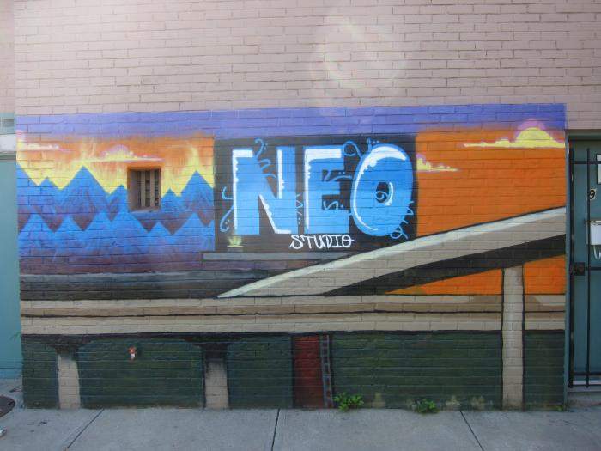
Access Gallery Fellowship Program (UAF.2010.6)
Access Gallery hosted and promoted a three-month fellowship program for 10 urban artists, and held 12 structured art classes where teens worked in a variety of art mediums.

Slide 4
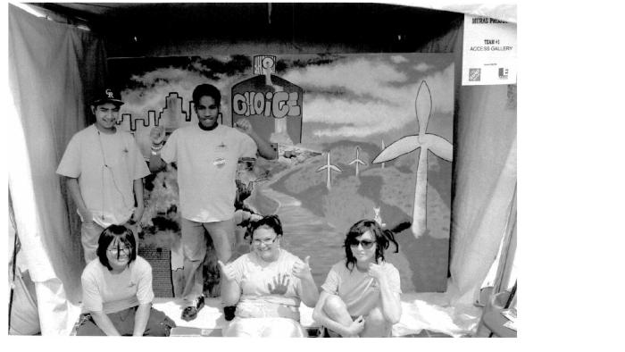
Access Gallery and Capitol Hill People's Fair (UAF.2011.1)
Access Gallery teamed up with Capitol Hill People&#39;s Fair for these murals.

Slide 5
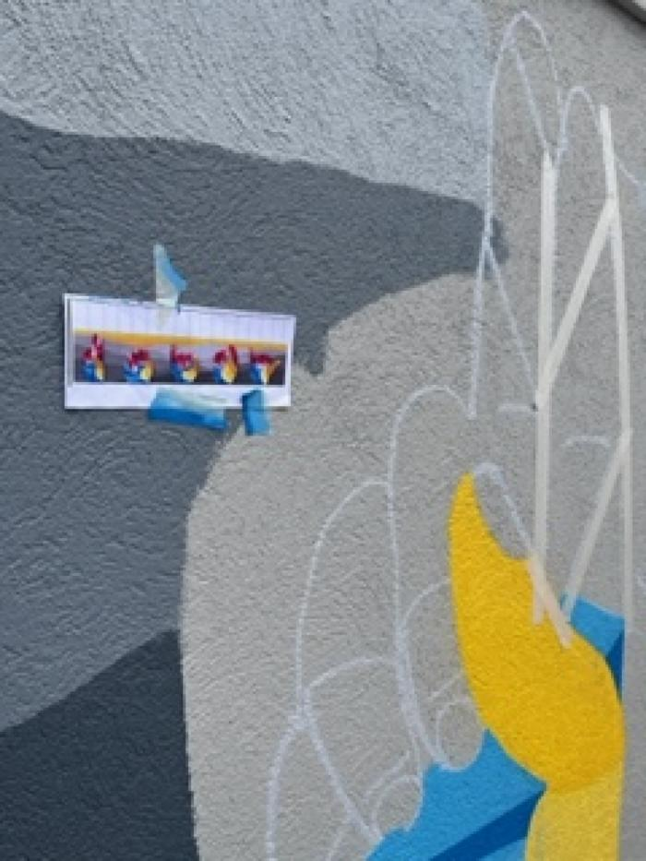
Unity (UAF.2022.3)
This mural, funded through Denver Public Art&#39;s Urban Arts Fund, features the word "unity" in American Sign Language and was inspired by the work of Nancy Rourke. Access Gallery works with artists with disabilities to open doors to creative, educational and economic opportunities. [vimeo src=https://player.vimeo.com/video/739070835]

