Slide 1
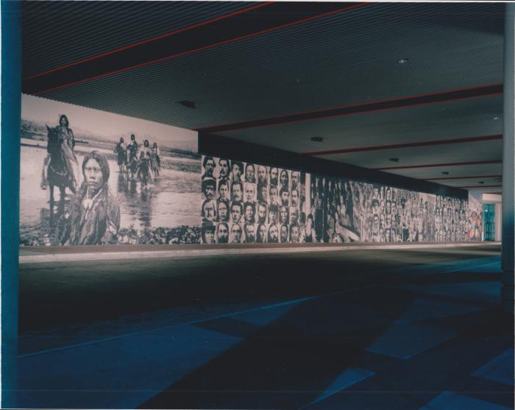
Colorado Panorama: A People's History (1991.1.1)
This ceramic tile mural is composed of abstracted, computer-digitized photographs of more than 120 figures prominent in Colorado&#39;s history.

