Slide 1
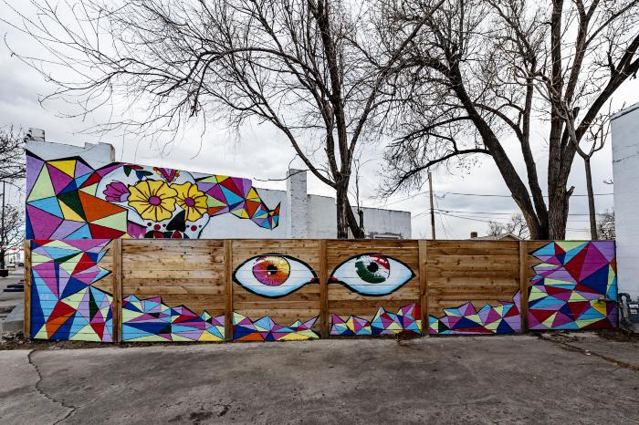
Untitled (Día de los Muertos sugar skull, two large eyes) (UAF.2017.16)
Bold and colorful imagery reflecting Día de los Muertos created by a collaborative artist team. In the background, the building wall features a Día de los Muertos / Day of the Dead sugar skull. The fence in the foreground features two large eyes. The eye on the right contains the colors of the Mexican flag.

