Slide 1
Water in All Its States (L'eau dans tous ses etats) (2015.8.1)
Paris-based light artist Yann Kersalé was selected for a $1 million commission to provide a lighting design for the train and Level 5 canopies, and a unique video-based art installation for the escalator connecting the Public Transit Center to the Level 5 plaza. His work is titled “L’eau dans tous ses états” or “Water in all its states.” Kersalé is an internationally-acclaimed artist who works with light as his primary medium, and he has worked on public and private projects all over the world with acclaimed architects such as Helmut Jahn and Jean Nouvel.

Slide 2
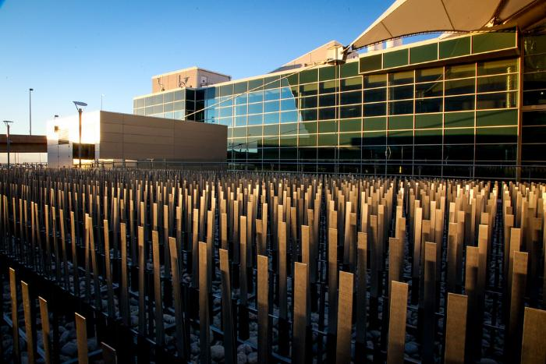
Field of Air (2015.9.1)
California-based sculptor Ned Kahn has created a large wind-activated sculptural installation titled “Field of Air.” For his artwork at DIA, Kahn was inspired by the way the grasses of the plains expose the invisible force of the wind. Each of the thousands of individual blades are made from brushed aluminum and hinged so that the fascinating play of air on the plaza becomes a contemplative or even meditative backdrop to activity.

Slide 3
Shadow Array (2015.10.1)
Denver artist Patrick Marold has created a large-scale installation to enhance the expansive landscape area around the train platform at the Westin Denver International Airport. The sculpture, titled “Shadow Array,” consists of 236 beetle-kill spruce logs from southern Colorado, which will create an active experience for travelers as they enter and exit the valley by train, while also providing a dynamic panorama from the hotel and public spaces to the south of the plaza. The shadows and patterns created by the sculpture will change and shift according to the seasons, daily passage of the sun and with evening lighting.

Slide 4
Colorado River (2015.11.1)
Wopo Holup was commissioned to create a series of sculptural pieces to grace the west wall of the Westin Conference Center pre-function area. The work represents ten continuous sections of the Colorado River running from Grand Lake in the Rocky Mountains to the Gulf of California. Along the way it runs through five states forming Lake Powell, Lake Mead and irrigated lands such as Imperial Valley. The work was cut from aluminum and hand-covered in 24-carat gold leaf.

Slide 5
En-Route (2015.12.1)
Patterson was commissioned to produce nine panels of artwork that compose a large artwork on the east wall of the Westin Conference Center pre-function area. Patterson layered varied imagery through drawing, painting, and collaging sheets of acrylic paint, creating a sense of fragmented time. Her imagery hearkens urban street grids, flight maps and landscapes with bursts of color and energy.

Slide 6
Strange Continents (2015.13.1)
Mindy Bray painted her largest mural commission to date along the 150-foot-long hallway at the entrance to the Westin hotel. The imagery for the work is derived from hundreds of photographs of the Platte River at Confluence Park in Denver, which the artist digitally manipulated to arrive at a vocabulary of shapes that were composed to resemble a global map. The colors recall traditional colors used in maps.

Slide 7
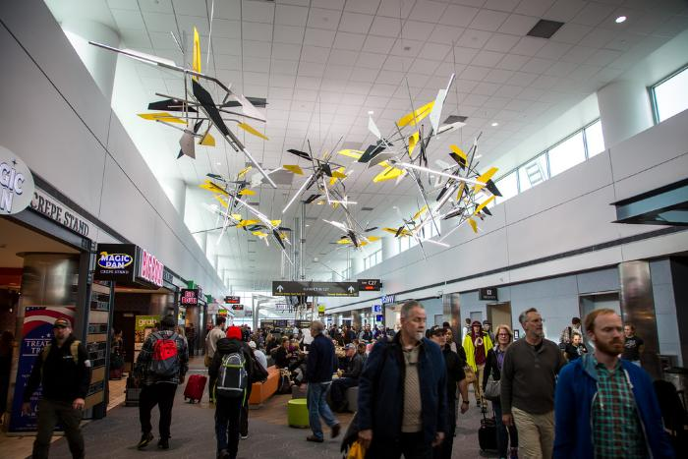
Vorticity (2016.4.1)
The installation is comprised of eleven suspended sculptures arranged in a spiral, the shapes of which were determined by tracing the Rocky Mountains’ dramatic profile. The spiral — or vortex, from which the work’s name is derived — is one of nature’s most common forms, found in elements as small as snail shells or as large as galaxies.

