Slide 1
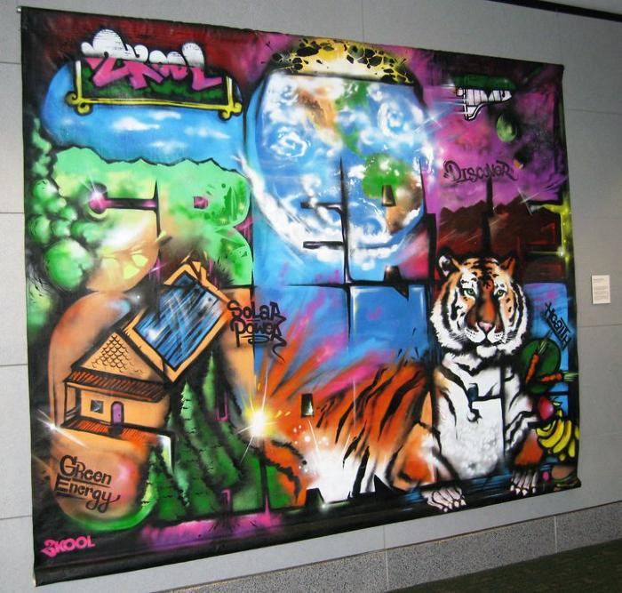
Create Change (UAF.2010.4)
As part of the Denver Urban Arts Fund program, YouthBiz/2Kool hosted and promoted the creation of a community-based “Create Change Mural” for subsequent display at various municipal and public locations, including a visit to Denver International Airport. [vimeo src="https://player.vimeo.com/video/361949530"]

Slide 2
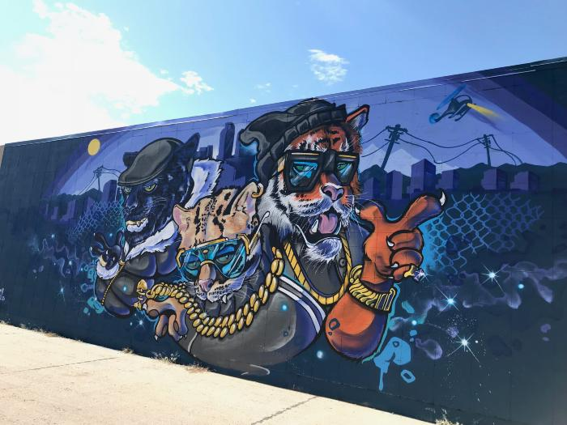
Untitled (stylized anthropomorphic city cats) (UAF.2019.15)

