Slide 1
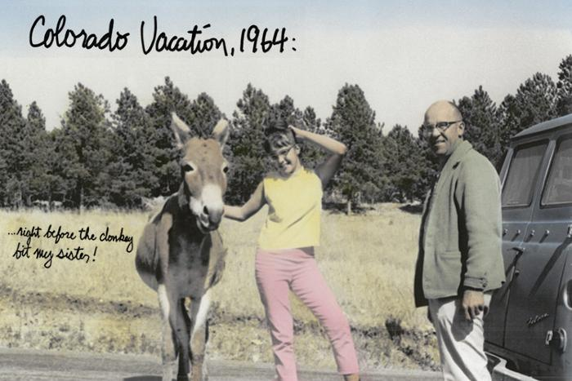
Colorado Vacationland (1991.10.1)

