Slide 1
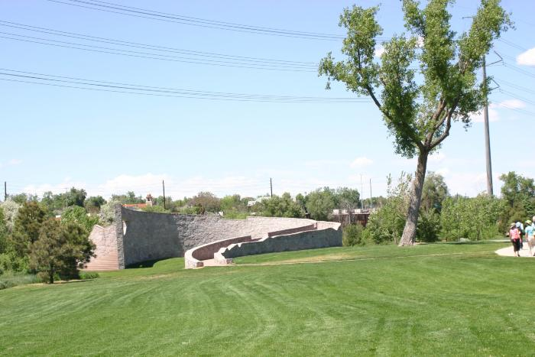
Common Ground (2001.2.1)

Slide 2
Luminous Wind (2020.4.1)
Luminous Wind is a 27’ tall sculpture inspired by innovation, energy and the natural environment. Constructed from environmentally activated materials, the 952 prismatic clear acrylic rods within the piece reflect and refract sunlight during the day and radiate out from a stainless-steel geodesic sphere that is set on a tripod of stainless-steel columns. At night, each rod is illuminated by an individually programmable color-changing LED node, resulting in a mosaic of shifting light colors and patterns to create a myriad of spectacular dynamic and vivid nighttime effects. A different moving light show each night of the week cycles through the sculpture, while holidays are marked by special colors and programs. Additionally, the design incorporates a wind sensor that triggers an increase/decrease to the light movement, creating a barometer that visualizes and broadcasts wind patterns. Luminous Wind creatively draws connections between Peña Station NEXT, a technologically infused master-planned Smart-City, Panasonic technology, and Denver’s former mayor, Federico Peña, the namesake of both Peña Boulevard, which leads to the airport, and the transit station situated on airport property. The artwork includes dedication plaques with quotes from Peña who was elected Mayor of Denver in 1983, making him the city’s first Hispanic mayor, and who led the efforts to replace Denver’s Stapleton International Airport with Denver International Airport (DEN). He also served as the U.S. Secretary of Transportation and U.S. Secretary of Energy.

