Slide 1
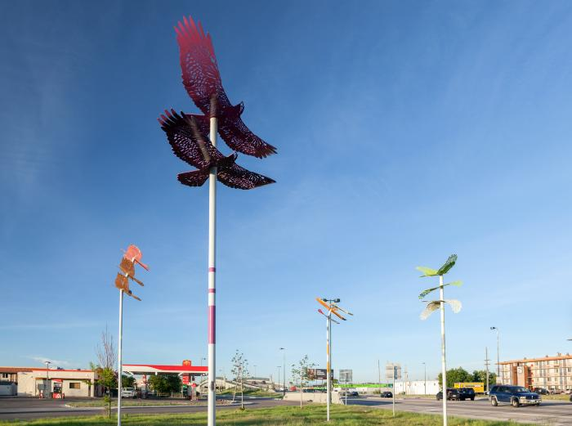
Pinion (2017.1.1)
Looking to native prairie species of birds found in and around Denver’s Montbello neighborhood, Zoccola designed and installed a series of winged sculptures in the teardrop-shaped lot on E 39th Avenue located north of the Peoria Crossing bridge. Inspired by the area’s proximity to the Rocky Mountain Arsenal Wildlife Refuge, the five sculptures depict a bald eagle, a northern harrier, an American kestrel, a red-tailed hawk, and a Swainson's hawk.

Slide 2
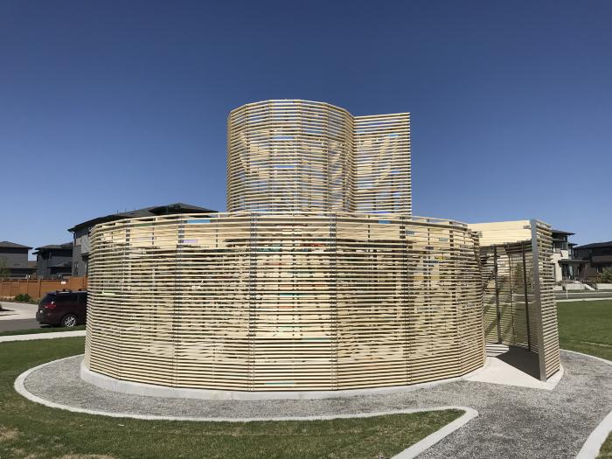
Woven Light (2018.3.1)
Comprised of accoya wood and dichroic glass, Woven Light acts as an outdoor room which constantly changes throughout the day depending on light and shadow. It is an artwork in which people of all ages and abilities may quietly experience the beauty of Colorado’s natural light and surroundings.

