Slide 1
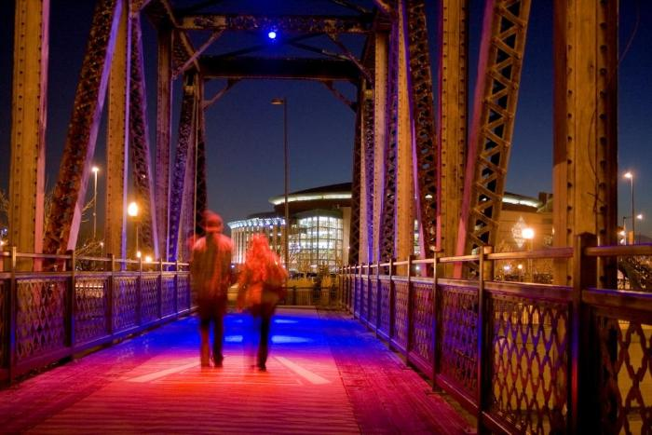
Current³ (2009.9.1)
CURRENT 3 by Virginia Folkestad is a site-specific, interactive light installation, created through a public/private collaboration between Denver Office of Cultural Affairs and LoDo Neighborhood Association called LoDo Lights, formed to celebrate and honor Denver’s 150th birthday. Manny’s Bridge, site of CURRENT 3 and the first LoDo Lights installation, was rebuilt twice as a railroad bridge and more recently preserved for pedestrian use; thereafter known as Manny’s Bridge. It has been a witness to Denver’s history and will continue to be a witness to Denver’s future. CURRENT 3 encourages play and collaboration. Installations like this modify the way a particular space is experienced, and this installation is meant to give users of the bridge an immersive experience. A change from the usual, familiar occurrence of traveling across the bridge, through CURRENT 3, visitors become aware of their place in time and space. [vimeo src=https://player.vimeo.com/video/438259437]

Slide 2
Thought Balloons (2011.1.1)
Thought Balloons is an interactive artwork that playfully inserts software generated text based dialog over seated people&#39;s heads. As people sit on the black bench, thought balloons, like those found in a comic book format, magically appear above their heads. At other times when two or more people sit on the bench a dialog starts up between them. The texts for each balloon or dialog bubble are kept fresh and lively with the help of the local community. Not only were Central Park residents of all ages invited to gather and playfully construct humorous conversations and informative repartee, community members are welcome to continually contribute to the dialog by submitting to www.thoughtballoons.org. In a new town like Central Park, Thought Balloons acts as a catalyst to bring people together. Not only by starting conversations in front of the piece but also by creating opportunities for members of the community to contribute language to the piece itself.

Slide 3
Allies in Life (2015.7.1)
Carved from a solid block of limestone, the work utilizes negative space to convey its message. The limestone block is divided into two pieces signifying the fact that Karmiel Park is part of Denver's Sister City program. The twin blocks represents "sisters" that, together, form a graphic of life.

