Slide 1
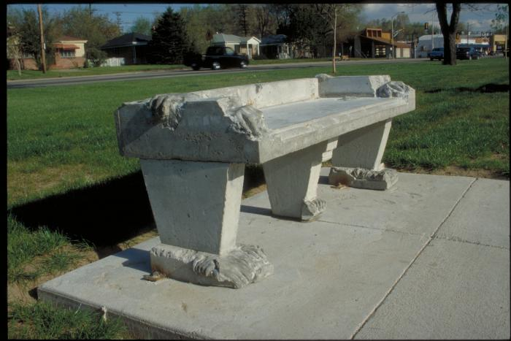
Park and Garden Benches (1990.2.1)
Cast reinforced concrete benches containing impressions of leaves and figurative elements of hands and legs cast from community members. *One Element of Artwork Currently Not on View for Restoration*

Slide 2
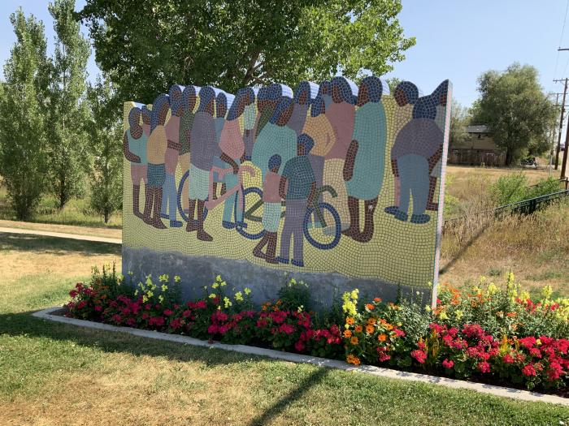
Juntos / Together (1991.18.1)
"Juntos/Together" is a 6 foot by 17 foot freestanding wall with a mosaic mural on each side. Tony Ortega visited neighborhood schools, senior centers and recreation centers, using their visitors as inspiration, and engaging the community in the creation of this piece. The handset porcelain tile mosaic mural brings a human element to the Lakewood / Dry Gulch Park, depicting groups of people interacting and enjoying the outdoors. Ortega draws from individual slices of life to create artwork centered on family and community-what he considers the two major components of the Latino.

Slide 3
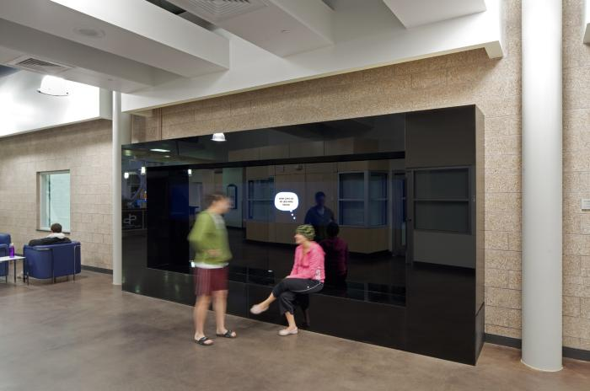
Thought Balloons (2011.1.1)
Thought Balloons is an interactive artwork that playfully inserts software generated text based dialog over seated people&#39;s heads. As people sit on the black bench, thought balloons, like those found in a comic book format, magically appear above their heads. At other times when two or more people sit on the bench a dialog starts up between them. The texts for each balloon or dialog bubble are kept fresh and lively with the help of the local community. Not only were Central Park residents of all ages invited to gather and playfully construct humorous conversations and informative repartee, community members are welcome to continually contribute to the dialog by submitting to www.thoughtballoons.org. In a new town like Central Park, Thought Balloons acts as a catalyst to bring people together. Not only by starting conversations in front of the piece but also by creating opportunities for members of the community to contribute language to the piece itself.

Slide 4
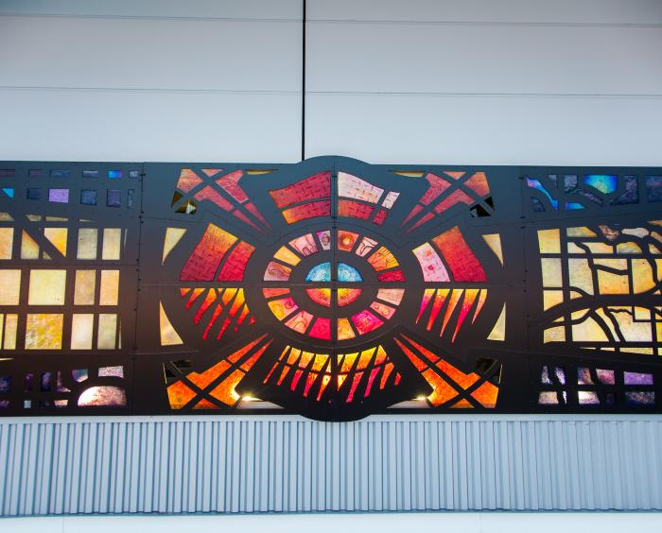
Beacon (2017.5.1)
“Beacon,” by Seattle-based artist Steve Gardner, is a laser-cut aluminum and fused glass work of art installed within the west façade of the Fire Station 35 building. The artwork was inspired by the Denver Fire Department’s connection and service to the airport and its passengers. The $200,000 project was paid for via the City and County of Denver’s “One Percent for Art” ordinance, which dedicates money from certain new construction projects to public art. Backlit at night, the piece is intended to create the sense of a “beacon,” shining over the surrounding area. Aerial views of downtown Denver and airport street grids and geography provide a background to the central image of the traditional firefighters’ Maltese cross. According to the artist, a symbolic beam of light and energy is projected outward and over neighborhood and airport streets, symbolizing the firefighters’ vigilance and protection of the communities they serve. The piece also includes glass cast reliefs of the equipment and tools that the firefighters use.

