Slide 1
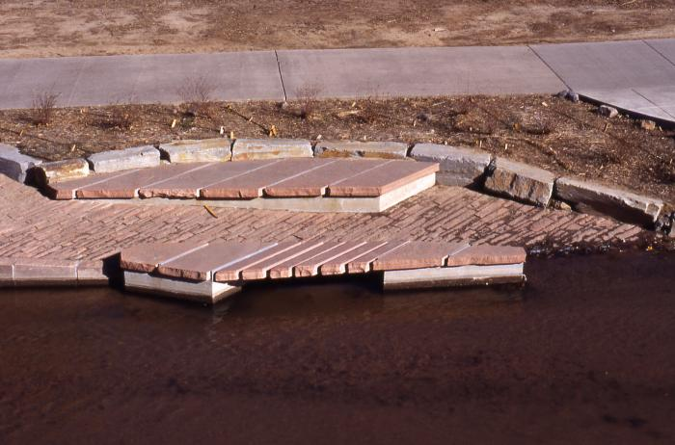
Lost Borders (1994.2.1)
"Lost Borders" is an integrated landscape art project built along the edge of Cherry Creek across from the park built over Speer Tunnel. The edge of the creek has been reconstructed into terraces with large rocks and native vegetation including willows and dogwood, a stone seating area, and stone ramps near the water. The pedestrian bridge that crosses this area offers pedestrians and bicyclists a view of the tall wetland plants. The artist's desire was to recall the original nature of the creek edge within the constraints of its urban context and gives access to the water.

Slide 2
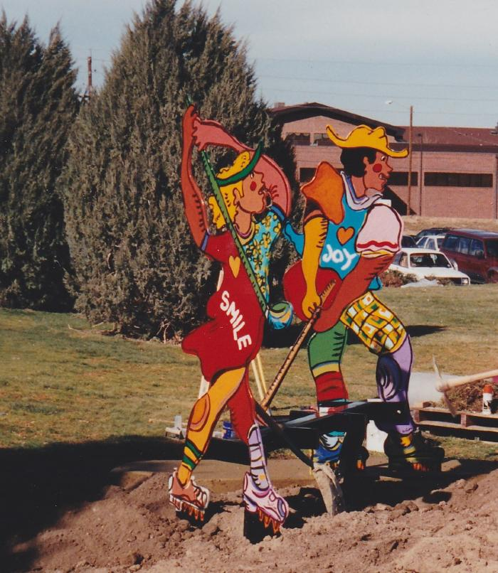
First Round (1994.4.1)
Figurative sculptural design for the golf course tee markers. A man and a woman adorn each side of a bench. The two life-sized sculptures of golf players are connected by a six to seven foot long wooden seat. The male figure is surrounded by a sand trap, and the pose of the sculpture suggests a successful attempt to get the ball out of the sand. The female figure is surrounded by grass and has just hit the ball. The sculpture bench is meant to be humorous and entertaining for people sitting on it or standing around it.

Slide 3
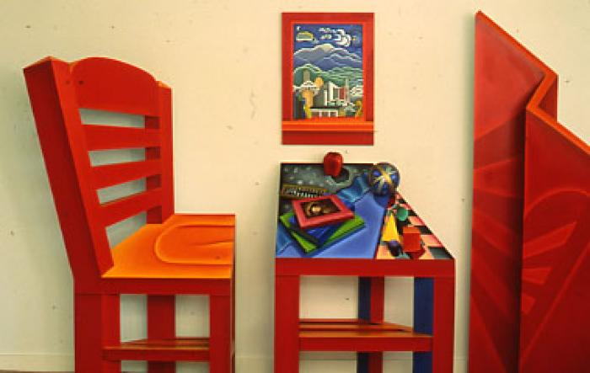
Pursuing Perspectives (1994.5.1)
The sculpture is installed in the entrance of the library and is constructed of painted wood and other materials. The colors are vivid, red being dominant. The objects are symbolic of learning and knowledge. The piece combines and contrasts old and new methods of learning in Eastern and Western cultures. A chair represents a person prepared to learn. The desk is the place of learning. A screen symbolizes Eastern art forms with its Oriental perspective. The painting above the desk appears as a window and presents a view to the outside world. On the desk is an apple, an axillary sphere, an abacus, a stack of books, one of which has a Rembrandt self-portrait on the cover, and a grouping of Euclid's geometric shapes which appear to be building blocks. The painting shows a group of books by Colorado writers, the view of the neighborhood, Downtown Denver, the Front Range, and the Solar System, symbolizing what we do not yet understand.

Slide 4
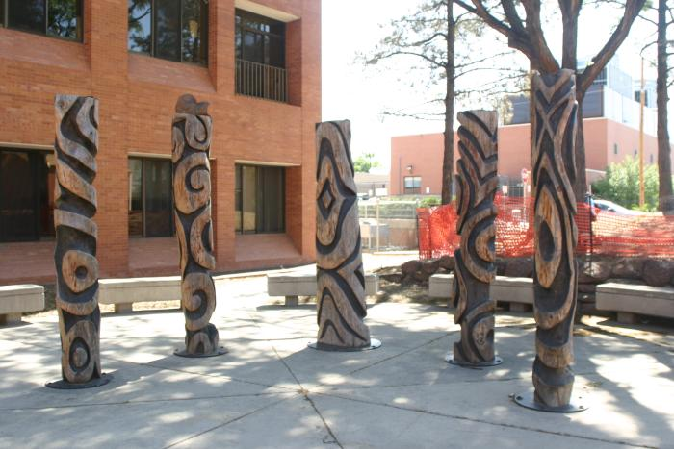
Mountain Streams (1996.2.1)

Slide 5
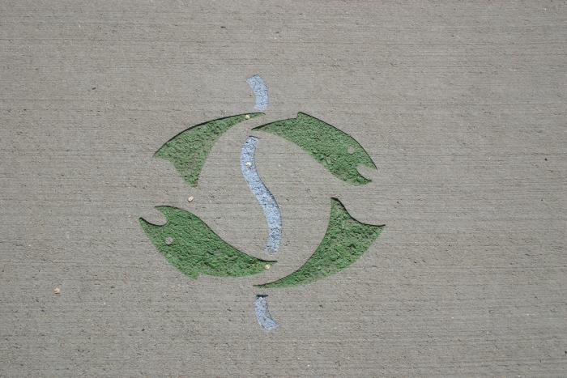
River Glyph (1996.6.1)

