Slide 1
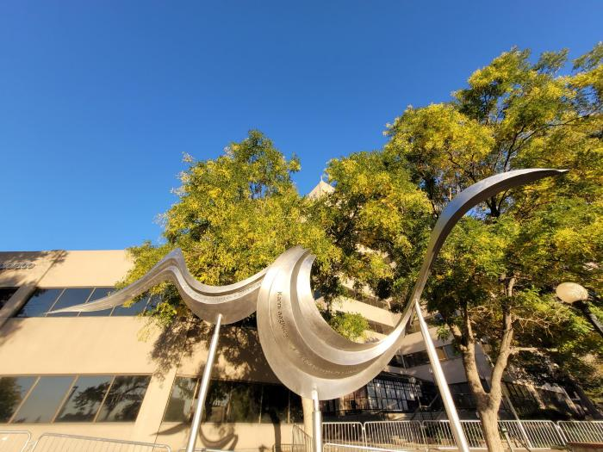
Thread of Words (2024.7.1)
Thread of Words, marks an important location at the confluence of the Cherry Creek and the South Platte River. The South Platte watershed was the ancestral homelands of the Arapaho, Cheyenne and Ute nations. The lands were also the hunting grounds and migration routes of other indigenous nations, including the Lakota, Apache, Comanche and Shoshone. The confluence of the Cherry Creek and the South Platte River was a favorite campground of the Arapaho. For decades, the Arapaho had camped at the two rivers during the winter months. In 1858, the Arapaho returned to find settlers camped in their home. By the end of 1858, 50 cabins had been erected and eventually the Arapaho and other indigenous nations were forcibly removed from their lands. This location is historically connected to the displacement of Indigenous peoples and the beginning of the Colorado Gold Rush. It is also recognized by some historians as the "origin" of the City of Denver. Additionally, during the 1970s the neighborhood of Auraria (which is adjacent to this location) had most of its low-income Latino community displaced in favor of the creation of the Auraria Higher Education Center. Ultimately this site has a long history of displacement and forced removal of the people that once called it their home. Our artwork and poem attempt to reflect that. The sculpture is integrally made of Stainless Steel.

