Slide 1
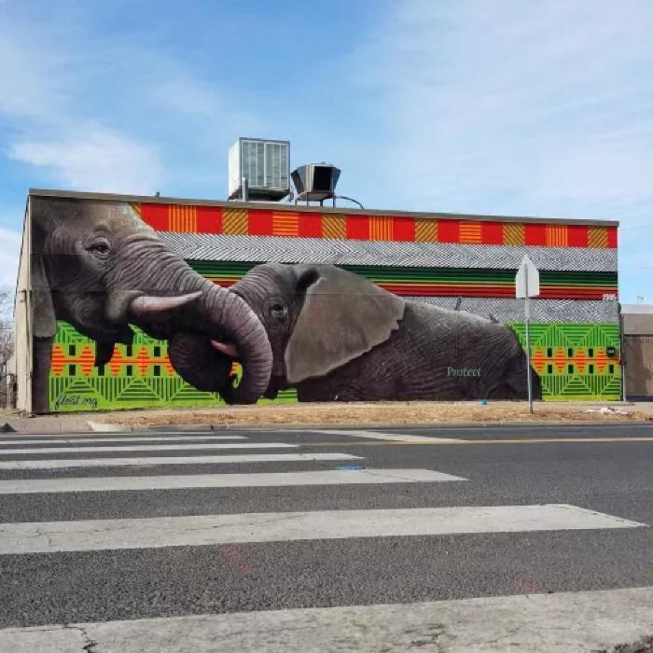
Untitled (elephants with trunks intertwined) (UAF.2017.99)
A collaboration between Patrick McGregor, his son, Tristan McGregor, and Anthony Garcia.

