Slide 1
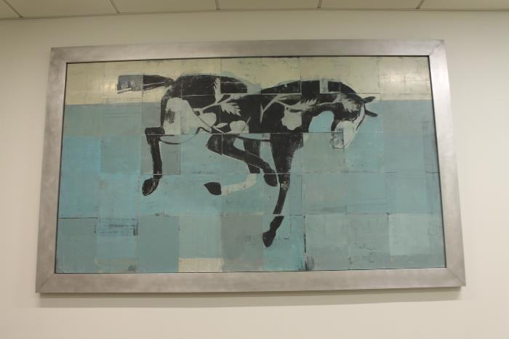
Floating/Falling (2012.12.1)

Slide 2
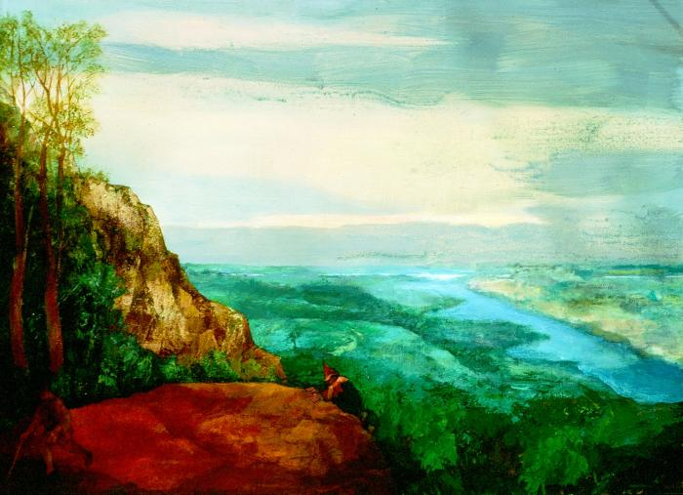
Pursuit (2014.7.1)

