Slide 1
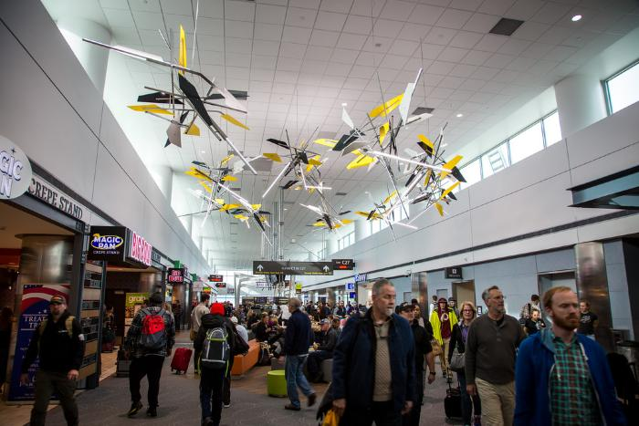
Vorticity (2016.4.1)
The installation is comprised of eleven suspended sculptures arranged in a spiral, the shapes of which were determined by tracing the Rocky Mountains’ dramatic profile. The spiral — or vortex, from which the work’s name is derived — is one of nature’s most common forms, found in elements as small as snail shells or as large as galaxies.

