Slide 1
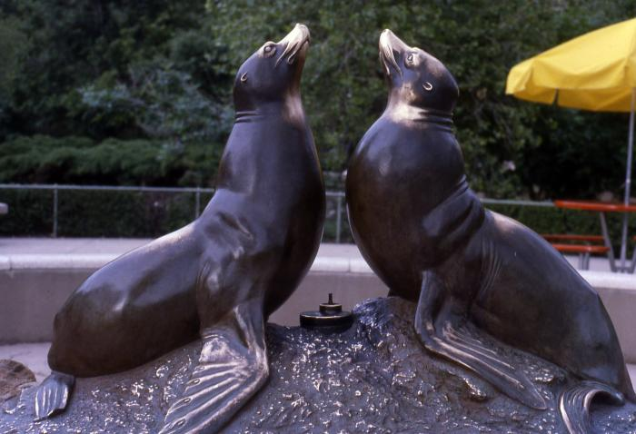
Norgren Fountain (seal fountain)
(1962.1.1)
This bronze sculpture by Louis Paul Jonas is a fountain featuring two seals.

