Slide 1
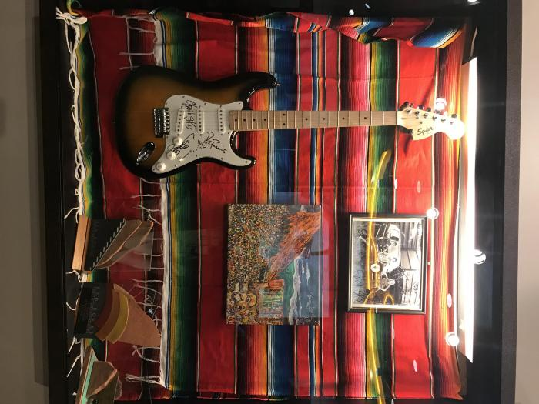
Santana Guitar, signed (2000.01)

Slide 2
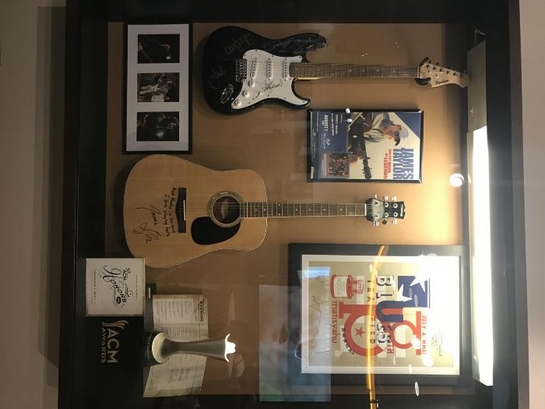
James Taylor Signed Acoustic Guitar (2000.02)

Slide 3
Santana Guitar (12345)

Slide 4
Santana (Mem1)
1

Slide 5
Dispatch (signed by Peter Francis) (Mem2)
1

Slide 6
Red Wood (Mem3)
1

Slide 7
Eric Johnson (Mem4)
1

Slide 8
Firefall (Mem5)

Slide 9
Rolling Stones (Mem6)
1

Slide 10
OAR (Mem7)
1

Slide 11
Big Head Todd (Mem8)

Slide 12
James Taylor (Mem9)
1

Slide 13
Stevie Nicks (Mem10)
1

Slide 14
Counting Crows (Mem11)

Slide 15
Blank Pick Guards (Mem12)
12

Slide 16
Megadeth (Mem13)
1

Slide 17
Anthrax (Mem14)

Slide 18
BOC + Steppenwolf (Mem15)
1

Slide 19
Deep Purple (Mem16)
1

Slide 20
Scorpions + DIO (Mem17)
1

Slide 21
FUN. (Mem18)

Slide 22
Susan Tedeschi (Mem19)
1

Slide 23
Yes (Mem20)
1

Slide 24
Tool (Mem21)

Slide 25
311 (Mem22)

Slide 26
Dispatch (Fender) (Mem23)
1

Slide 27
Stevie Nicks (Martin) (Mem24)
1

Slide 28
Foghat (Mem25)

Slide 29
Barenaked Ladies (Mem26)
1

Slide 30
Depeche Mode Black Celebration - Signed (Mem27)
1

Slide 31
WASP Last Command Tour - Signed (Mem28)
1

Slide 32
Michael Franks Summer Tour - Signed (Mem29)
1

Slide 33
Neil Diamond on Tour - Signed (Mem30)
1

Slide 34
DIO - Signed (Mem31)
1

Slide 35
Red Rocks (white) (Mem32)
1

Slide 36
Red Rocks (blue) (Mem33)
1

Slide 37
Reggae on the Rocks '89 (Mem34)
1

Slide 38
Weird Al (Mem35)
1

Slide 39
Judas Priest - Signed (Mem36)
1

Slide 40
Julian Lennon World Tour Summer - Signed (Mem37)
1

Slide 41
Julio Iglesias America Tour (Mem38)
1

Slide 42
Autograph - Signed (Mem39)
1

Slide 43
Multiple artsists- A Conspiracy of Hope - Signed (Mem40)
1

Slide 44
Nitty Gritty Dirt Band (Mem41)
1

Slide 45
INXS - Signed (Mem42)
1

Slide 46
Reggae on the Rocks III (Mem43)
1

Slide 47
John McEuen's 3rd Rocky Mountain Opry (Mem44)
1

Slide 48
Alabama - Signed (Mem45)
1

Slide 49
Foreigner - Signed/Framed (Mem46)

Slide 50
Shooting Star - Signed/Framed (Mem47)

Slide 51
Van-Zant - Signed (Mem48)

Slide 52
Stryper - Signed (Mem49)

Slide 53
Night Ranger - Signed (Mem50)

Slide 54
Ratt - Signed (Mem51)

Slide 55
Petra - Signed (Mem52)

Slide 56
The Beach Boys - Signed (Mem53)

Slide 57
Ozzy Osbourne - Signed (Mem54)

Slide 58
Beatles Photo Books (stored in plastic sleeves) (Mem55)
2

Slide 59
Beatles Photo (stored in plastic sleeve) (Mem56)
1

Slide 60
Gwen Stefani - Signed/Framed (Mem57)
1

Slide 61
Melissa Etheridge Framed Album with pictures (Mem58)
1

Slide 62
Stevie Nicks - Signed (Mem59)
1

Slide 63
Dispatch - Signed (Mem60)
1

Slide 64
Vanessa Carlton - Framed and labeled (Mem61)

Slide 65
Greg Allman - Framed and labeled (Mem62)

Slide 66
Tori Amos - Framed and labeled (Mem63)

Slide 67
Big Head Todd - Framed (Mem64)

Slide 68
Godsmack - Framed and signed (Mem65)

Slide 69
Arial of RR - Signed by The Police and labeled (Mem66)

Slide 70
Train - Signed (Mem67)
2

Slide 71
Godsmack - Framed and labeled (Mem68)

Slide 72
Deep Purple - Framed and labeled (Mem69)

Slide 73
311 - Framed and labeled (Mem70)

Slide 74
Coldplay - Framed and labeled (Mem71)

Slide 75
Mariah Carey - Framed and labeled (Mem72)

Slide 76
De La Soul - Framed and labeled (Mem73)

Slide 77
Firefall - Framed (Mem74)

Slide 78
Film on the Rocks (including Hazel Miller, etc.) - Framed (Mem75)

Slide 79
311 (Uplifter album cover) (Mem76)
1

Slide 80
311 (Unity tour poster) (Mem77)
1

Slide 81
Blues Traveler (Mem78)
1

Slide 82
Pretty Lights - Framed (Mem79)
1

Slide 83
Pixies (Mem80)

Slide 84
String Cheese Incident (Mem81)

Slide 85
Slightly Stoopid (Signed in 2011) (Mem82)
2

Slide 86
Incubus (Mem83)
1

Slide 87
Umphrey's McGee (Mem84)
2

Slide 88
Umphrey's McGee (Mem85)

Slide 89
The Shins (Mem86)
1

Slide 90
Yonder Moutian String Band (Mem87)
1

Slide 91
FUN. (Mem88)

Slide 92
Bon Iver (Mem89)
1

Slide 93
Los Lonely Boys - Framed (Mem90)

Slide 94
Mariah Carey - Framed (Mem91)

Slide 95
Rush (Mem92)

Slide 96
The Police (Mem93)

Slide 97
Jack White (Mem94)

Slide 98
Foo Fighters (Mem95)

Slide 99
Rodrigo Y Gabriela (Mem96)

Slide 100
Carved in Stone-Vol. 2 (Mem97)
3

Slide 101
My Morning Jacket (Mem98)
2

Slide 102
Widespread Panic - 2013 poster (Mem99)

Slide 103
John Butler Trio (Special RR poster) (Mem100)

Slide 104
Sarah McLachlan (Mem101)

Slide 105
Sigur Ros - Custom (only 100 made) (Mem102)

Slide 106
Jason Mraz w/ Christina Perri (Mem103)
1

Slide 107
Lotus w/ EOTO + Emancipator (Mem104)
1

Slide 108
Thievery Corporation w/ Beats Antique & Afrolicious (Mem105)
1

Slide 109
Deadmau5 w/ Excision + Tommy Lee & DJ Aero (Mem106)
1

Slide 110
Ghostland Observatory and MiMosa w/ Zion I, Free the Robots, and Lunice (Mem107)
1

Slide 111
Neil Young (Mem108)
1

Slide 112
Red Rocks 60th Anniversary (Mem109)
1

Slide 113
Widespread Panic (Mem110)

Slide 114
Sex Pistols (Mem111)

Slide 115
Tool w/ King Crimson (Mem112)

Slide 116
Film on the Rocks (Mem113)

Slide 117
James Taylor (Mem114)

Slide 118
Big Head Todd (Mem115)

Slide 119
Allman Brothers Band (Mem116)

Slide 120
Pat Metheny - Framed (Mem117)

Slide 121
The Samples - Framed (Mem118)

Slide 122
311 (Uplifter album poster) - Framed (Mem119)

Slide 123
2nd Annual Film on the Rocks - Framed (Mem120)

Slide 124
"Mile High Management" (Mem121)
1

Slide 125
The Police - Piece of the Rock (Mem122)

Slide 126
Pennywise - Piece of the Rock (Mem123)

Slide 127
Rusted Root - Piece of the Rock (Mem124)

Slide 128
The Pretenders - Piece of the Rock (Mem125)

Slide 129
Keep It Pure - Piece of the Rock (Mem126)

Slide 130
No Doubt (Mem127)

Slide 131
Diamond Caps by Numo (Mem128)
1

Slide 132
RR Souvenir (Dark Blue) - Signed by Carlos Mencia (Mem129)
1

Slide 133
IE (Mem130)
1

Slide 134
Red Rocks Staff (Mem131)
1

Slide 135
OAR (Mem132)
4

Slide 136
311 (Mem133)
1

Slide 137
King Crimson (Mem134)
1

Slide 138
Tool (Mem135)

Slide 139
Dream Theater (Mem136)

Slide 140
The Pretenders - Piece of the Rock (Mem137)

Slide 141
Sublime with Rome (Mem138)

Slide 142
Amos Lee (Mem139)

Slide 143
Rush (Mem140)

Slide 144
Sublime with Rome (Mem141)

Slide 145
RR's News Clipplings Scrapbook (Mem142)

Slide 146
RR's Memories Scrapbook (Mem143)
1

Slide 147
"McNichols" articles and features (Mem144)
1

Slide 148
RR's News Clippings (Mem145)
1

Slide 149
Red Rocks Program (Mem146)

Slide 150
Red Rocks Postcard (Mem147)

Slide 151
Denver Historical Markers: Memorials, Statues & Parks - by Colorado Historical Society (orange folder) (Mem148)

Slide 152
Inventory and Maintenance Assessment of Public Art (grey folder) (Mem149)

Slide 153
MISC: Fanny packs (Mem150)
2

Slide 154
Opie Gone Bad - Live at RRs (Mem151)
1

Slide 155
Cybershot Digital Camera (Mem152)
1

Slide 156
Tony Hawk/Red Bull skate demo (Mem153)
1

Slide 157
Red Rocks (Mem154)
1

Slide 158
Red Rocks (Mem155)
1

Slide 159
Blues Traveler - Signed (Mem156)

Slide 160
Matisyahu - Signed (Mem157)
1

Slide 161
Boettcher Concert Hall (Mem158)
1

Slide 162
Jaycees vest worn by Beatles (Mem159)
2

Slide 163
Pretty Lights - Signed (Mem160)
1

Slide 164
Yonder Mountain String Band - Signed (Mem161)

Slide 165
Ozzy Osbourne (Mem162)

Slide 166
Denver (Mem163)

Slide 167
Red Rocks (Mem164)

Slide 168
Red Rocks/Red Stag Co-branded guitar (Mem165)

Slide 169
Firefall Platinum Album award - Framed (Mem166)

Slide 170
Souvenier concertguides (Mem167)

Slide 171
Noteworthy news clippings (Mem168)

Slide 172
Souvenier magazines (Mem169)

Slide 173
Newspapers (Mem170)

Slide 174
Magazines (Mem171)

Slide 175
Rush @ Red Rocks (Mem172)

Slide 176
Rush @ Red Rocks (Mem173)

Slide 177
Rush @ Red Rocks (Mem174)

Slide 178
Lynyrd Skynyrd 8/13/01 (Mem175)

Slide 179
Grand Rock n' Roll Opening of Nicholas Sports Arena (Mem176)
1

Slide 180
Rolled-up Poster (Mem177)

Slide 181
Temple Buell Inagural Gala (Mem178)
1

Slide 182
Mayor Webb's Music Festival (Mem179)
13

Slide 183
Rolled-up Poster (Mem180)

Slide 184
Rolled-up Poster (Mem181)

Slide 185
Mayor Webb's Music Festival (Mem182)
22

Slide 186
Poster (Mem183)
1

Slide 187
Concert (Mem184)
1

Slide 188
Film on the Rocks (Mem185)
15

Slide 189
Rolled-up Poster (Mem186)

Slide 190
Orpheus and Eurdices (Mem187)
2

Slide 191
Ariadne Auf Naxos (Mem188)
2

Slide 192
Turandot (Mem189)
2

Slide 193
Poster (Mem190)
6

Slide 194
Maximum R&B (Mem191)
7

Slide 195
14th Denver International Film Festival (Mem192)
1

Slide 196
Coors Light Mountain Jam (Mem193)
3

Slide 197
Kodo One Earth Tour (Mem194)
1

Slide 198
Poster (Mem195)
3

Slide 199
Red Rocks 60th Birthday (Mem196)
12

Slide 200
See What's Hot at Red Rocks (Mem197)
1

Slide 201
Poster (Mem198)
1

Slide 202
Summer of Stars (Mem199)
1

Slide 203
Rolled-up Poster (Mem200)
1

Slide 204
Rolled-up Poster (Mem201)
1

Slide 205
Rolled-up Poster (Mem202)

Slide 206
CCC Opening (Mem203)
1

Slide 207
Poster (Mem204)
1

Slide 208
Viva la Bands Tour (Mem205)
1

Slide 209
Poster (Mem206)
1

Slide 210
Concert (Mem207)
2

Slide 211
Poster (Mem208)
1

Slide 212
Concert (Mem209)
5

Slide 213
Poster (Mem210)
1

Slide 214
Cover Proof (Mem211)
1

Slide 215
FOTR- Road to RR (Mem212)
1

Slide 216
Poster (Mem213)
1

Slide 217
Channel 6 Art & Antique Acution (Mem214)

Slide 218
Coors Light Mountain Jam (Mem215)
1

Slide 219
John Tesh (Mem216)
1

Slide 220
Boettcher Concert Hall (Mem217)
1

Slide 221
6th Annual (Mem218)
Cherry Creek Arts Festival

Slide 222
4th Annual (Mem219)
Cherry Creek Arts Festival

Slide 223
Peter Kater (Mem220)
Earth Year

Slide 224
Henry Fonda (Mem221)

Slide 225
Budweiser (Mem222)
Summer of Stars

Slide 226
Pepsi (Mem223)
Summer of Stars

Slide 227
CO Ballet (Mem224)
Season Preview

Slide 228
Win a Season Pass (Mem225)
Advertisement

Slide 229
Denver "Wow What a Year" (Mem226)

Slide 230
CO Ballet (Mem227)
Swan Lake

Slide 231
US Gymnastics Championship (Mem228)
Gymnastics

Slide 232
Emmanual Martinez (Mem229)
Raza on the Rocks-Eagle/Snake Painting

Slide 233
Denver Art Museum (Mem230)
Winslow Homer Exhibit

Slide 234
Rocky Mountain News (Mem231)
Hockey Schedule

Slide 235
Film Festival (Mem232)
Film Festival

Slide 236
CO Ballet (Mem233)
13th Annual Season

Slide 237
First Night CO (Mem234)
First Night CO

Slide 238
Pollstar (Mem235)
Denver T&A News articles/photos

Slide 239
Performance Spotlight (Mem236)
Denver T&A News articles/photos

Slide 240
Ballet Folklorico de Mexico (Mem237)
Dance Performance

Slide 241
Opera CO (Mem238)
Carmen

Slide 242
The Sound of Music (Mem239)
Musical

Slide 243
Moises Kaufman (Mem240)
The Laramie Project

Slide 244
Boetcher Concert Hall (Mem241)

Slide 245
Foreigner (Mem242)

Slide 246
Van-Zant (Mem243)

Slide 247
Stryper (Mem244)

Slide 248
Beach Boys (Mem245)

Slide 249
Ratt (Mem246)

Slide 250
Night Ranger (Mem247)

Slide 251
Petra (Mem248)

Slide 252
Shooting Star (Mem249)

Slide 253
Premier Even in International Fencing (Mem250)

Slide 254
Tim Curry in Me and My Girl (Mem251)

Slide 255
Denver March Pow Wow (Mem252)

Slide 256
Ballet West (Mem253)

Slide 257
The Doors are Opening (Mem254)

Slide 258
Incubus (Mem255)

Slide 259
Blues Traveler (Mem256)

Slide 260
Slightly Stoopid (Mem257)

Slide 261
Pretty Lights (Mem258)

Slide 262
String Cheese Incident (Mem259)

Slide 263
Umphree's McGee (Mem260)

Slide 264
Convention Center (Mem261)
Old "Convention News" papers and photos

Slide 265
MISC Poster (Mem262)
Posters from various events

Slide 266
RR Summer of Stars (Mem263)
Concert schedules, guides, newspaper schedules, announcements

Slide 267
RR Souvenier Programs (Mem264)
Original and photo-copied programs from 1960 and 1961

Slide 268
Pollstar, Performance Spotlight. Travelhost (Mem265)
Advertisements and publications about venues

Slide 269
Performance Programs (Mem266)
Various programs for venues

Slide 270
Sacred Stones (Mem267)
Cover and pages from book

Slide 271
1 inch tapes from Red Rocks (Mem268)
Buell Basement near engineers office

Slide 272
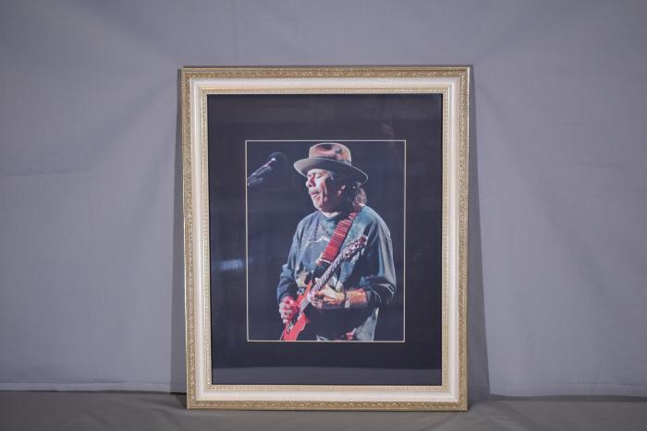
Santana Framed photo (RR.01)

Slide 273
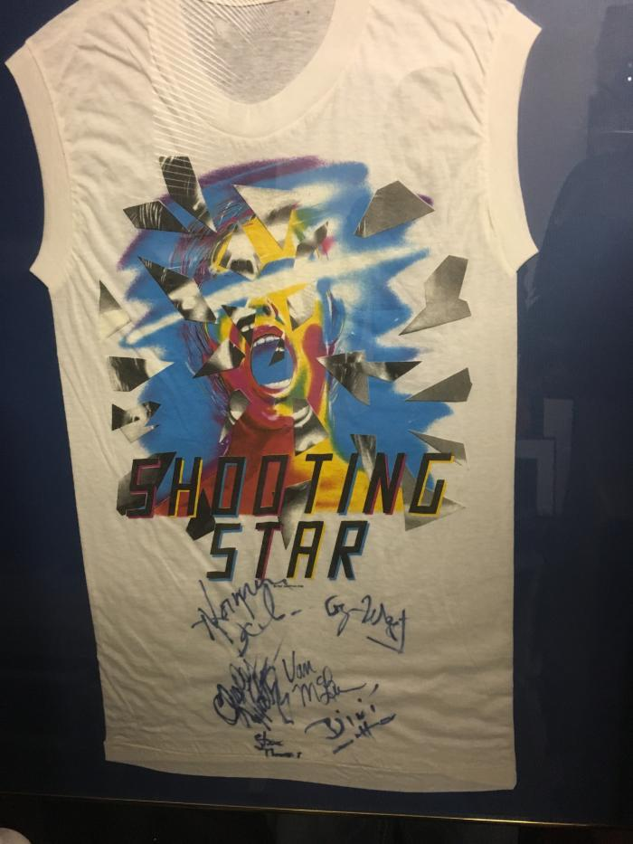
Shooting Star T-Shirt (RR.02)

Slide 274
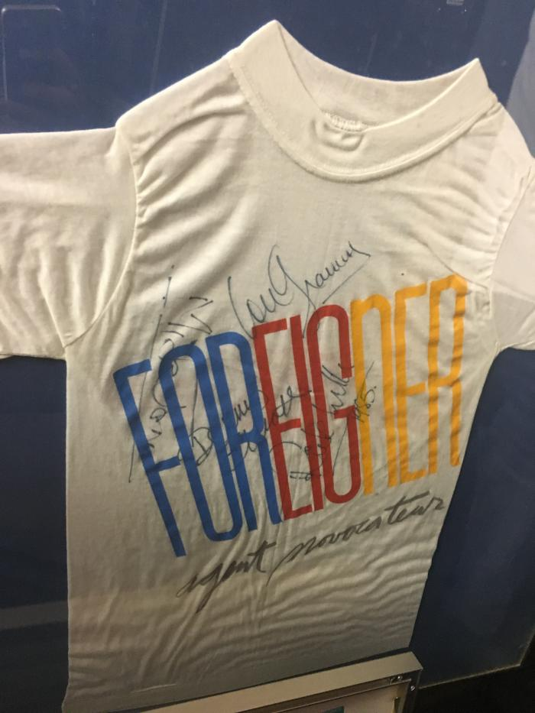
Foreigner T-Shirt (RR.03)

Slide 275
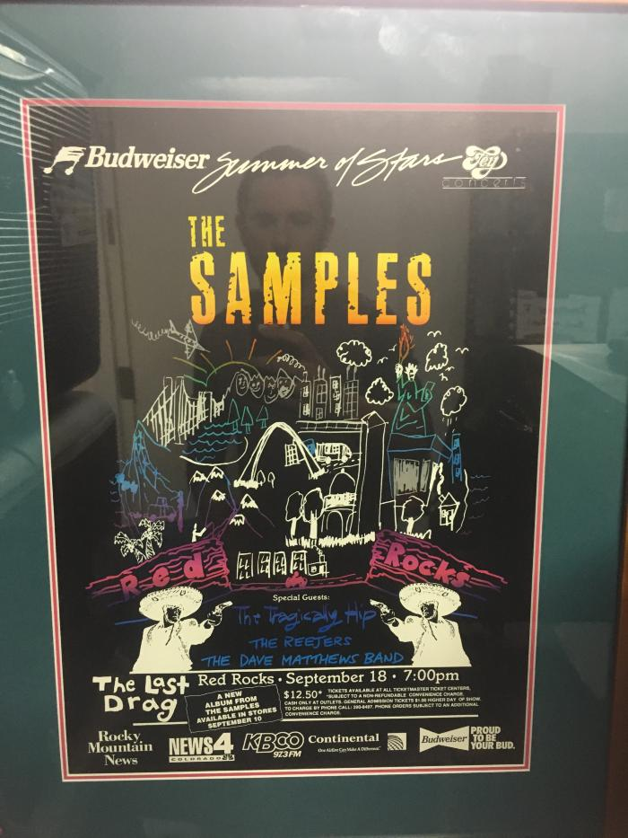
The Samples Poster (RR.04)

Slide 276
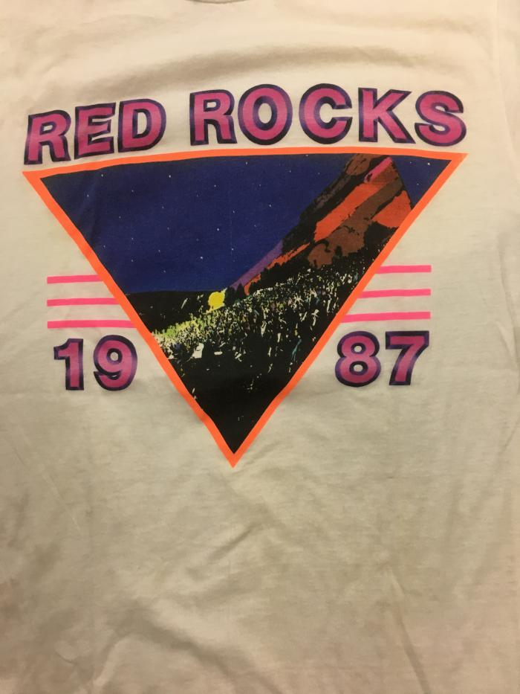
Red Rocks (white) (RR.05)

Slide 277
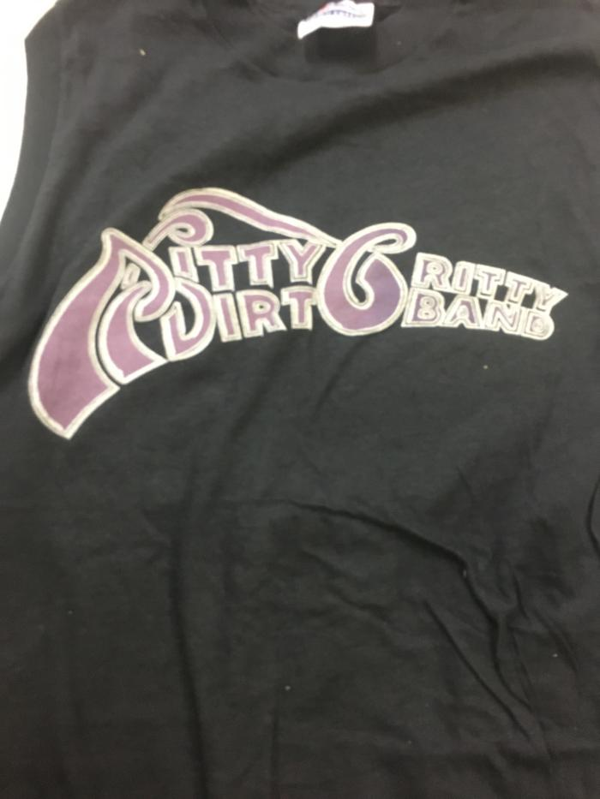
Nitty Gritty Dirt Band T-Shirt (RR.06)

Slide 278
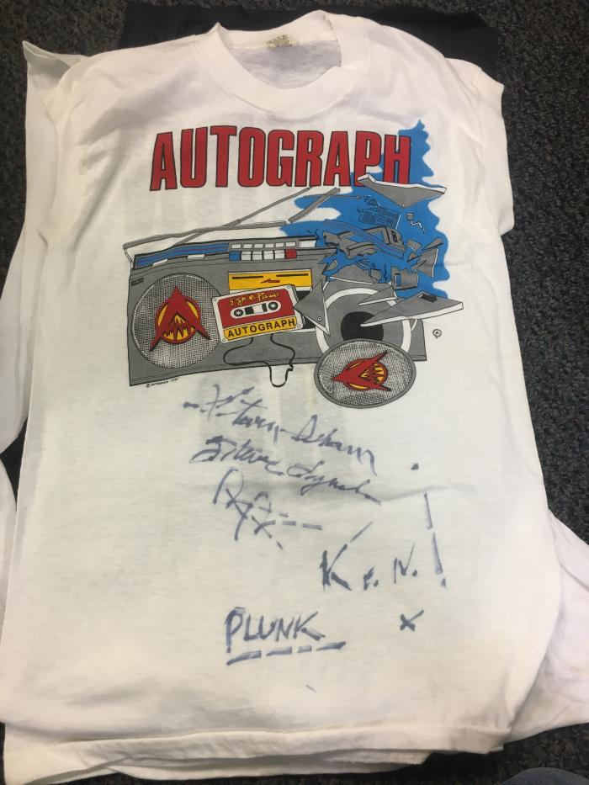
Autograph T-shirt (RR.07)

Slide 279
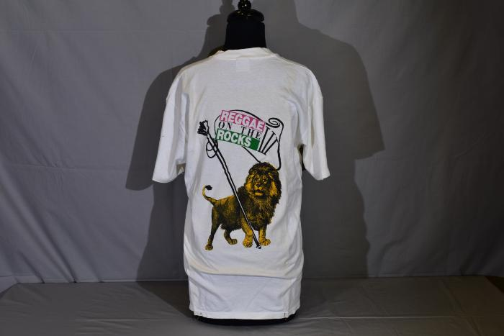
Reggae on the Rocks T-Shirt (RR.08)

Slide 280
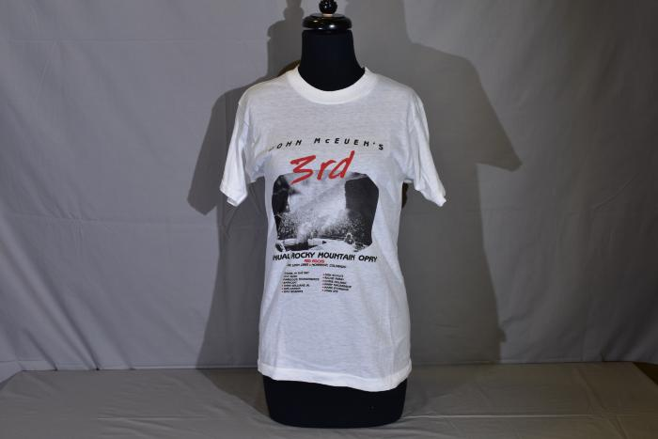
John McEuen's 3rd Rocky Mountain Opry (RR.09)

Slide 281
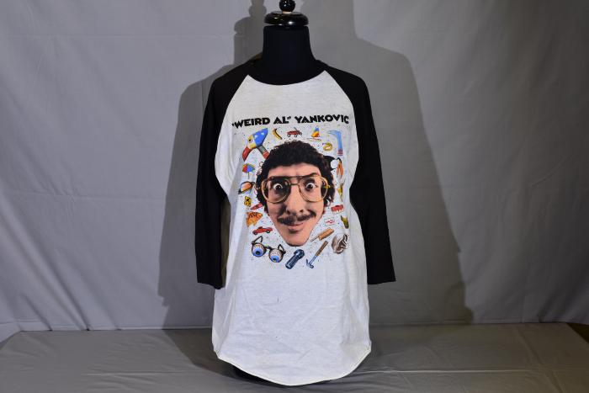
Weird Al T-shirt (RR.10)

Slide 282
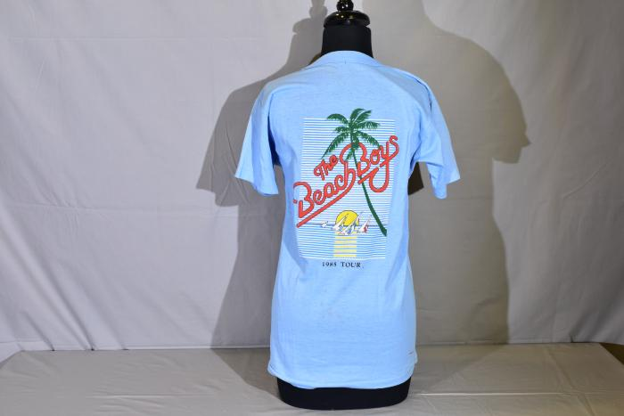
The Beach Boys Signed T-shirt (RR.11 )

Slide 283
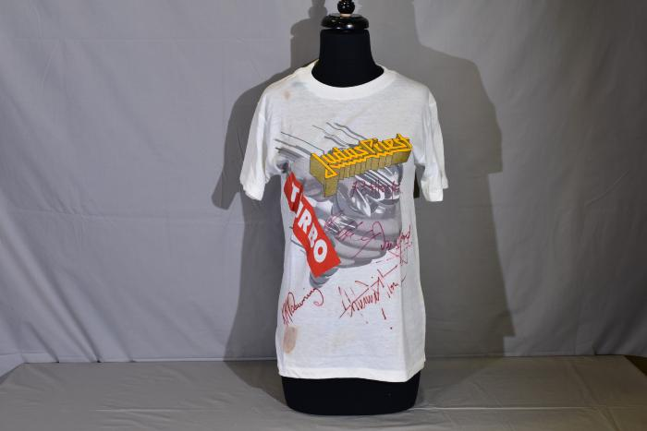
Judas Priest signed T-shirt (RR.12)

Slide 284
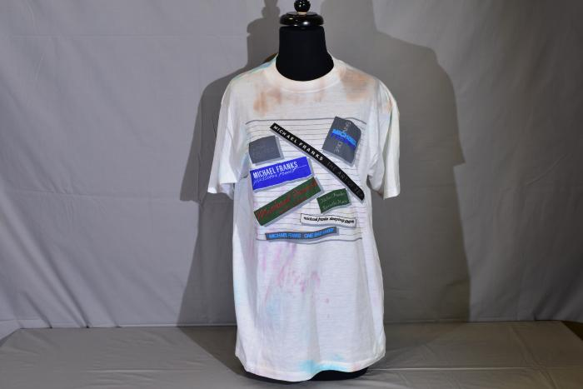
Michael Franks Summer Tour signed T-shirt (RR.13)

Slide 285
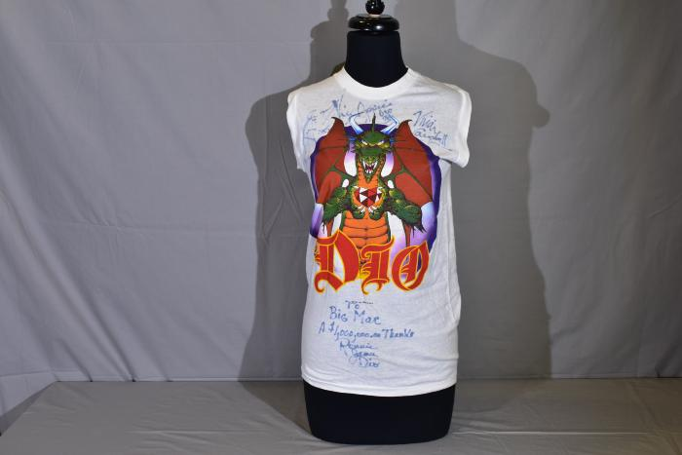
D10 Signed T-shirt (RR.14)

Slide 286
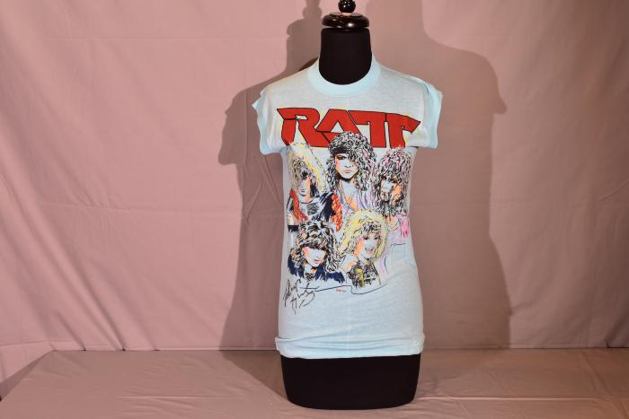
RATT Signed Cutoff T-shirt (RR.15)

Slide 287
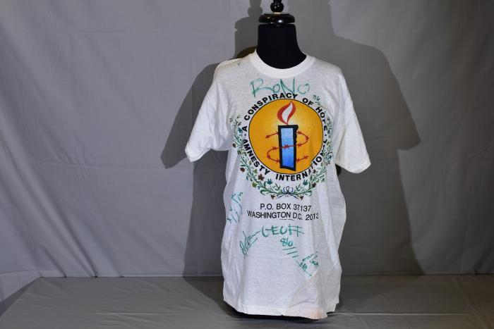
Conspiracy of Hope Signed T-shirt (RR.16)

Slide 288
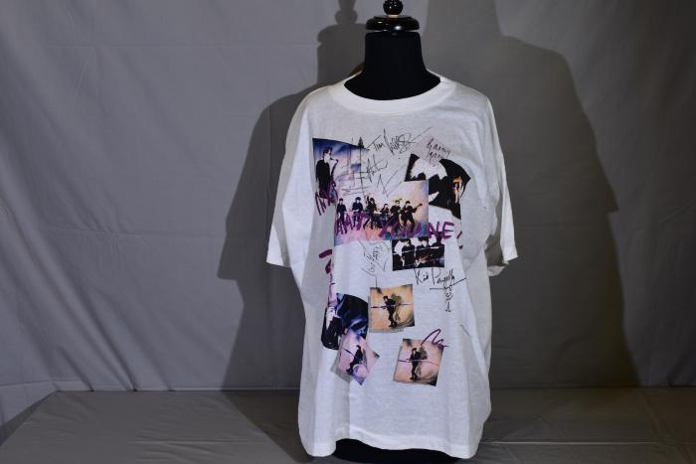
INXS Signed T-shirt (RR.17)

Slide 289
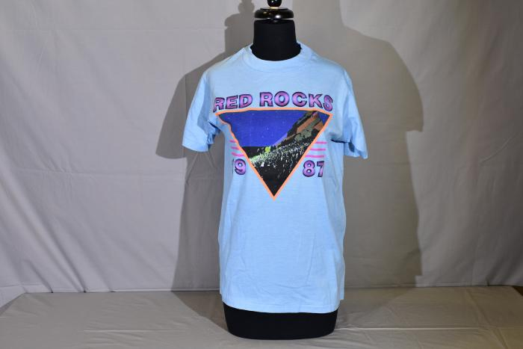
Red Rocks Blue 1987 T-shirt (RR.18)

Slide 290
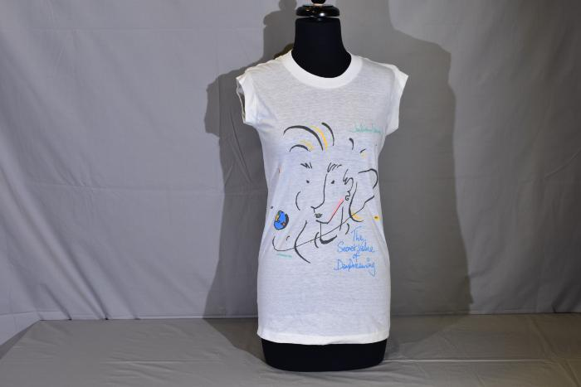
Julian Lennon Signed Cutoff T-shirt (RR.19)

Slide 291
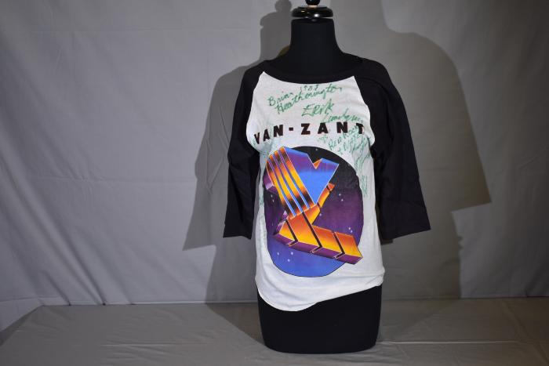
Van Zant Signed T-Shirt (RR.20)

Slide 292
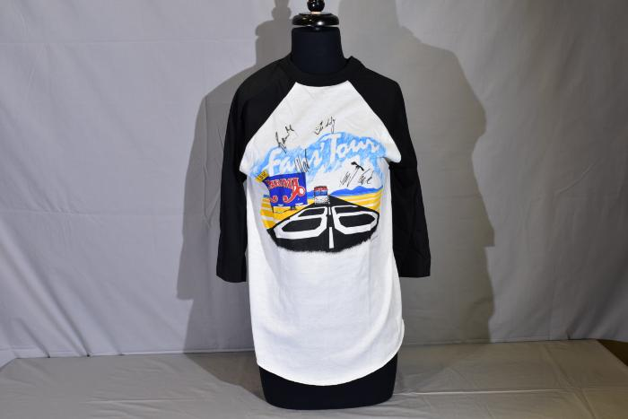
[BLANK] (RR.21)

Slide 293
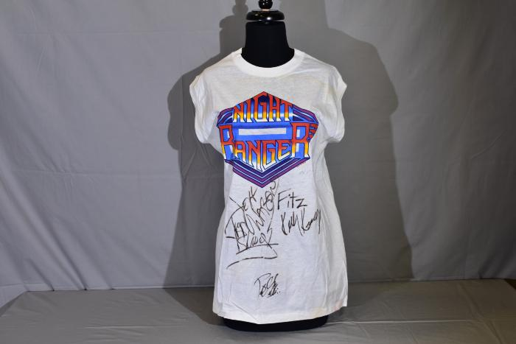
Night Ranger Signed T-shirt (RR.22)

Slide 294
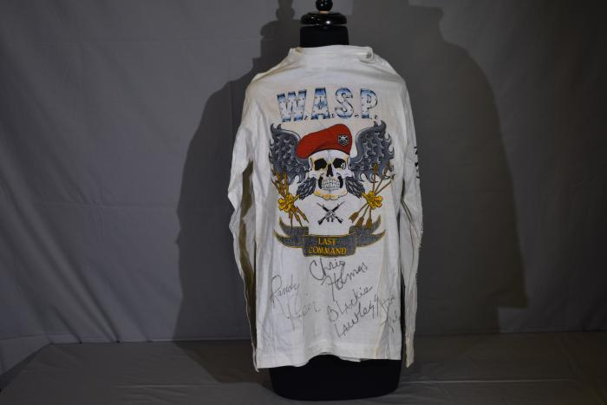
WASP Signed T-shirt (RR.23)

Slide 295
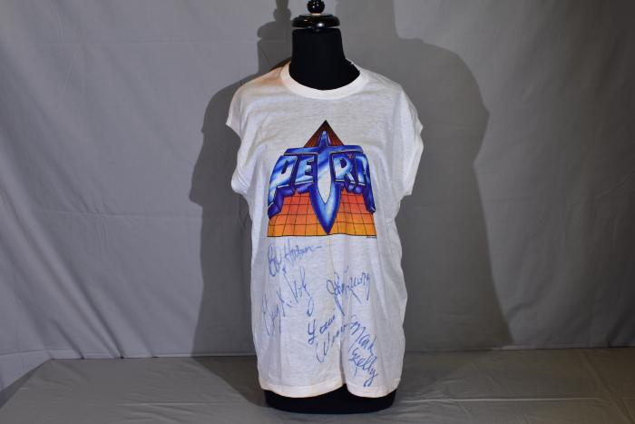
Petra Signed T-shirt (RR.24)

Slide 296
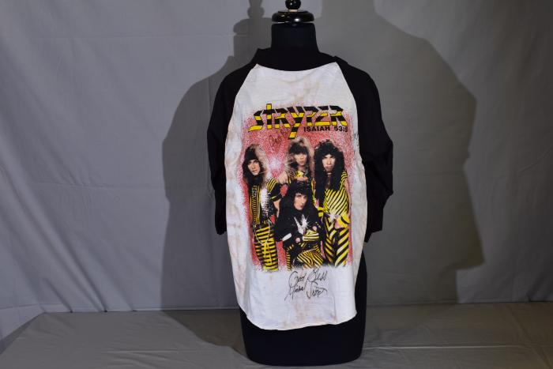
Stryper Signed T-shirt (RR.25)

Slide 297
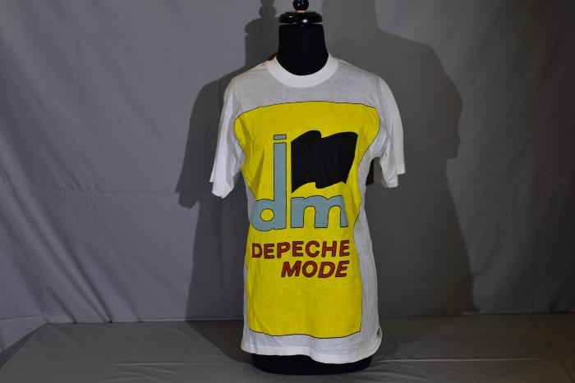
Depeche Mode Black Celebration Signed T-shirt (RR.26)

Slide 298
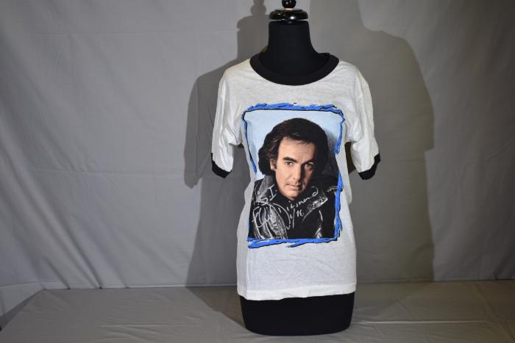
Neil Diamond on Tour Signed T-shirt (RR.27)

Slide 299
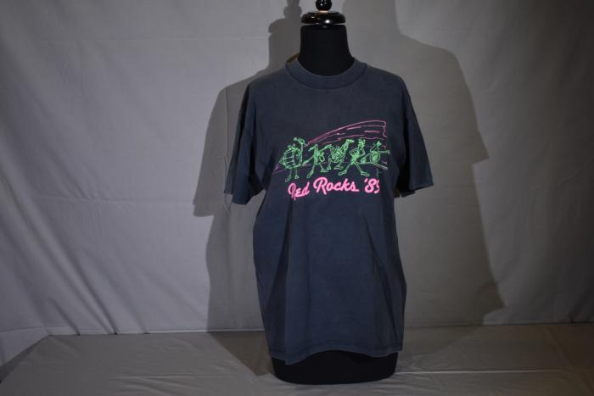
Reggae on The Rocks III (RR.28)

Slide 300
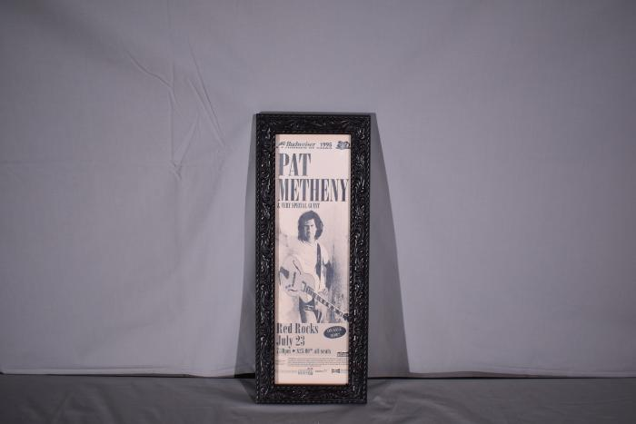
Pat Metheny Framed (RR.29)

Slide 301
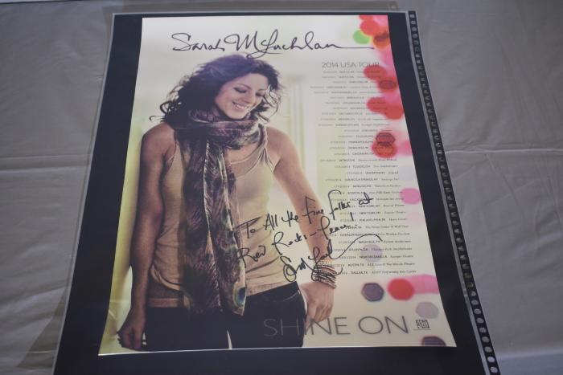
Sarah Mclachlan Signed Poster (RR.30)

Slide 302
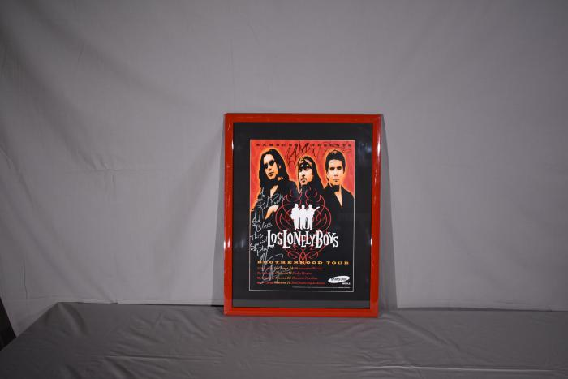
Los Lonely Boys Framed Photo (RR.31)

Slide 303
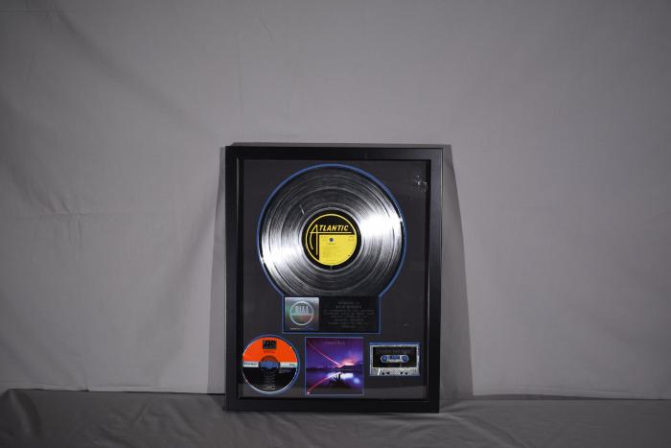
Firefall Platinum Album Award Framed (RR.32)

Slide 304
Mariah Carey Framed and Signed Photo (RR.33)

Slide 305
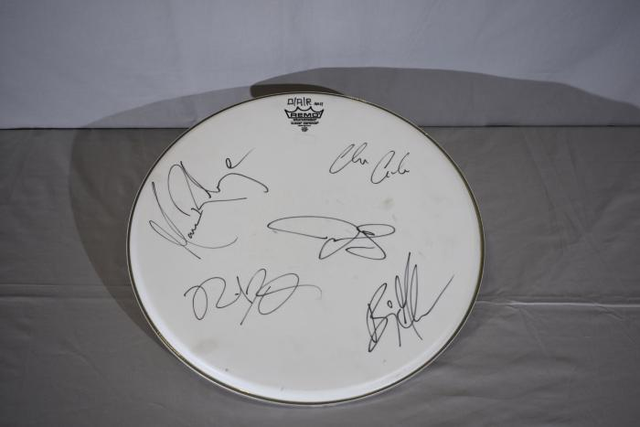
OAR Drumhead Signed (RR.35)

Slide 306
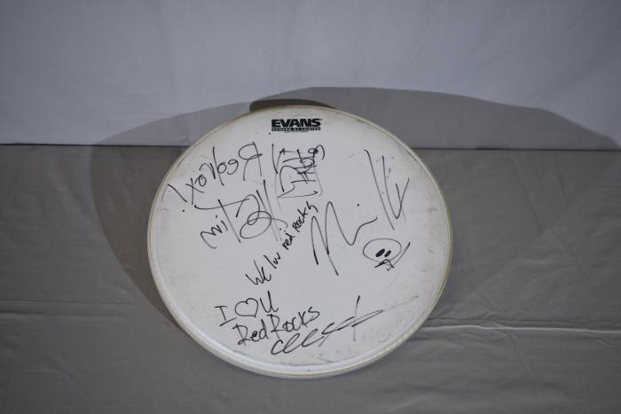
311 Signed Drumhead (RR.36)

Slide 307
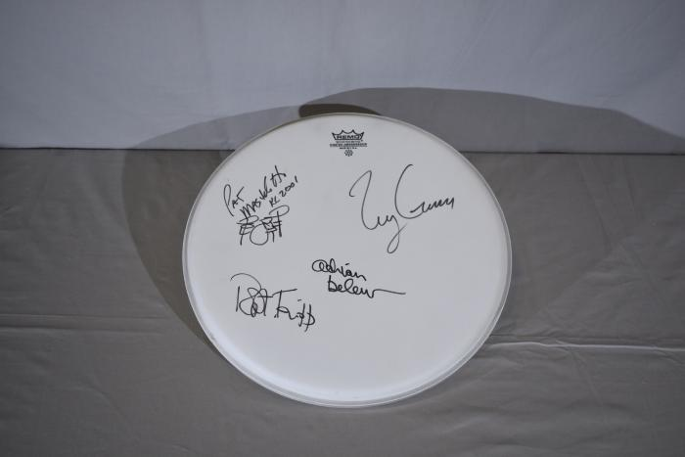
King Crimson Signed Drumhead (RR.37)

Slide 308
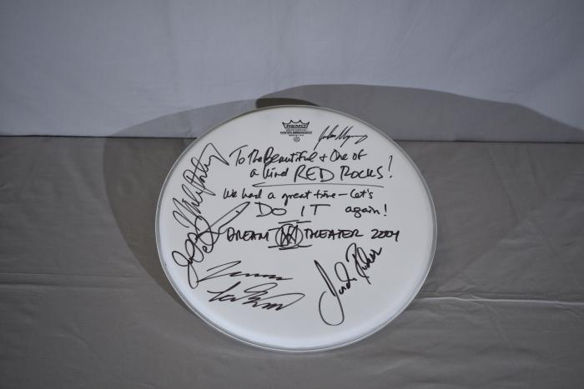
Dream Theater Signed Drumhead (RR.38)

Slide 309
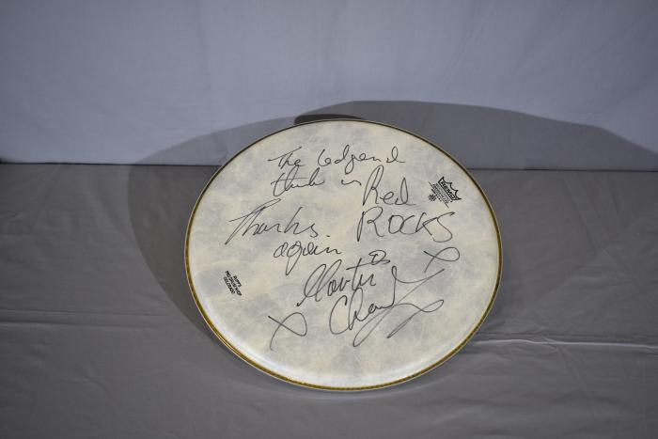
The Pretenders Signed Drumhead (RR.39)

Slide 310
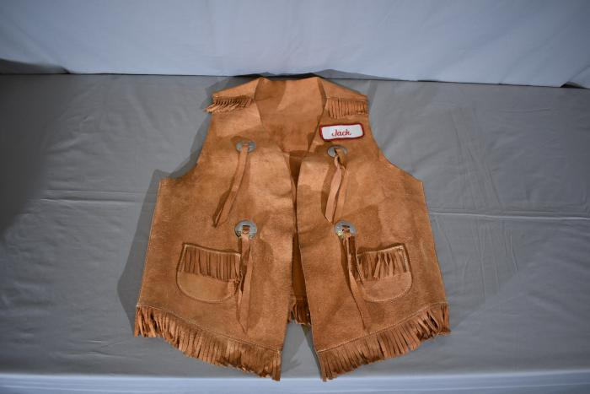
Jaycees Vest Worn by The Beatles (RR.40)

Slide 311
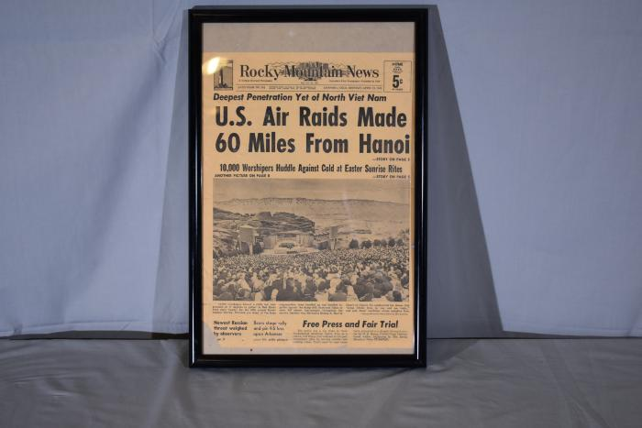
Red Rocks New's Clippings -Framed (RR.41)

Slide 312
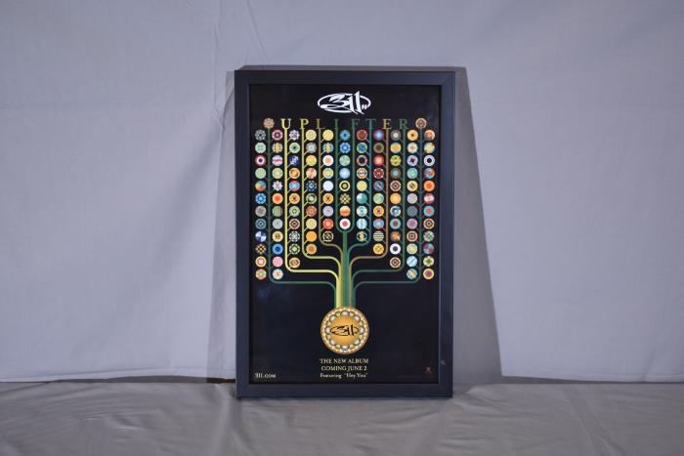
311 (Uplifter Album Poster) Framed (RR.42)

Slide 313
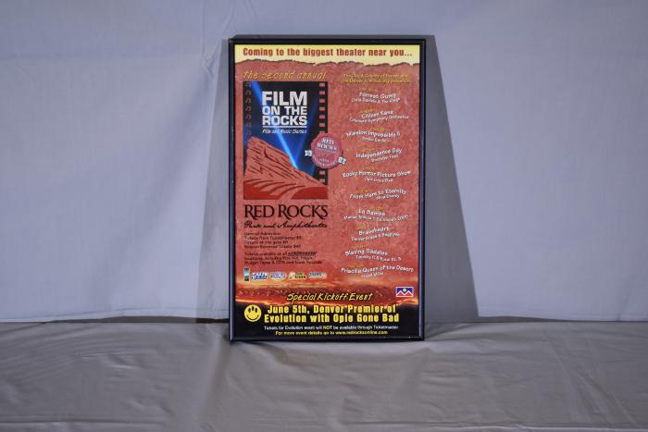
2nd Annual Film on the Rocks -Framed Poster (RR.43)

Slide 314
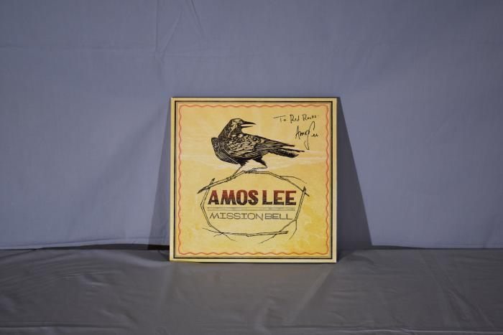
Amos Lee Signed Record LP (RR.44)

Slide 315
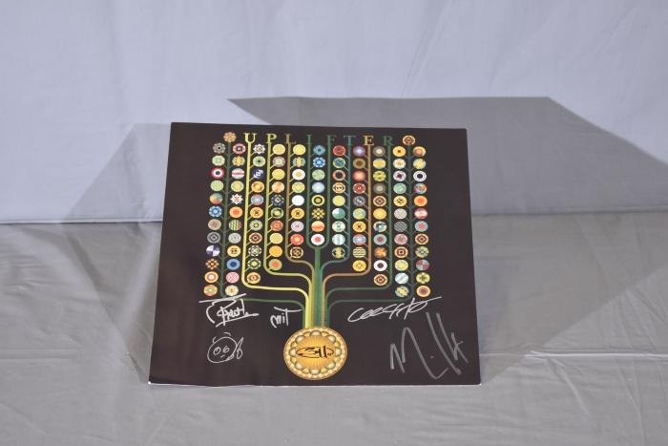
311 (Uplifter Album Cover) Signed Poster (RR.45)

Slide 316
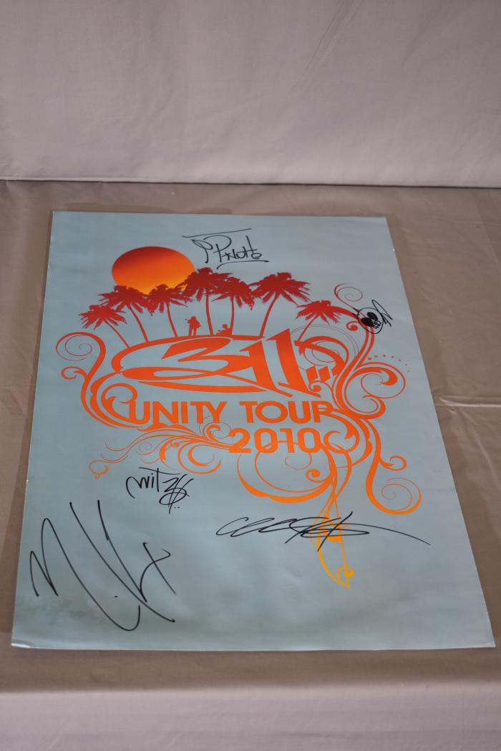
311 (Unity Tour Poster) (RR.46)

Slide 317
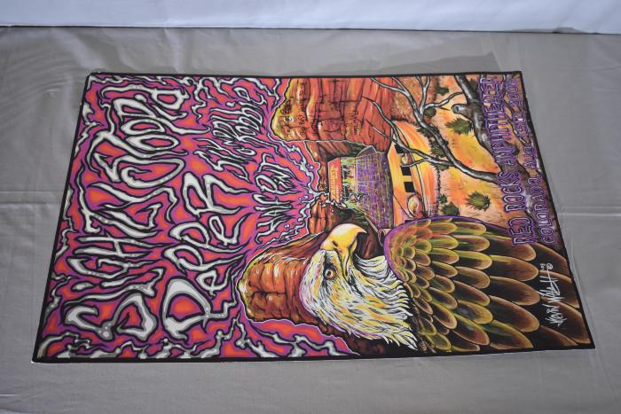
Slightly Stoopid Signed Poster (RR.47)

Slide 318
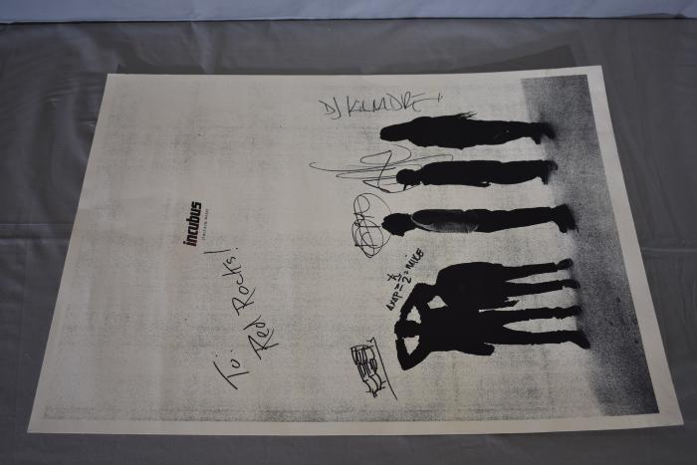
Incubus Signed Poster (RR.48)

Slide 319
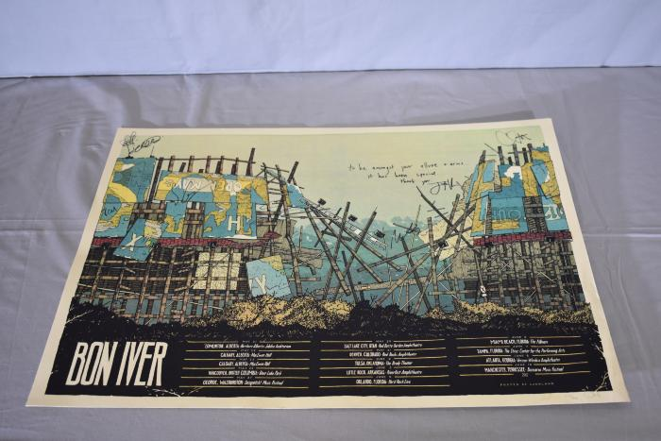
Bon Iver Signed Poster (RR.49)

Slide 320
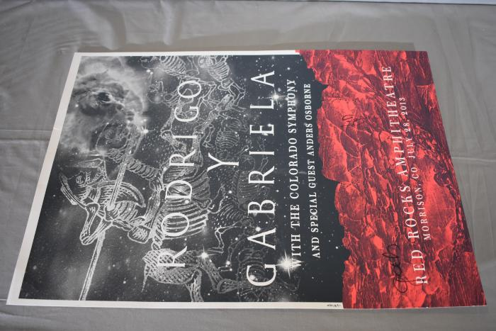
Rodrigo Y Gabriela Signed Poster (RR.50)

Slide 321
Carved in Stone -Volume #2 Signed Posters (RR.51)

Slide 322
My Morning Jacket signed poster (RR.52)

Slide 323
John Butler Trio (Special Red Rocks Signed Poster) (RR.53)

Slide 324
Lotus with EOTO + Emancipator Poster (RR.54)

Slide 325
Thievery Corporation with Beats Antique + Afrolicious (RR.55)

Slide 326
Deadmau5, Excision, TommyLee + DJ Aero poster (RR.56)

Slide 327
Ghostland Observatory, MiMosa, Zion I, + Free the poster (RR.57)

Slide 328
Stevie Nicks Signed Acoustic Guitar (RR.58)

Slide 329
Red Rocks Red Stag Guitar (Electric) (RR.59)

Slide 330
Signed Electric Guitar (RR.60)

Slide 331
King Crimson Pick Guard (RR.61)

Slide 332
Deep Purple Signed Pick Guard (RR.62)

Slide 333
Foghat Signed Pick Guard (RR.63)

Slide 334
Susan Tedeschi signed pick guard (RR.64)

Slide 335
Paramount Theater Signed Pick Guard (RR.65)

Slide 336
Pick Guard (RR.66)

Slide 337
Pretty Lights Midi Controller (signed) (RR.67)

Slide 338
Matisyahu Yarmulke-Signed (RR.68)

Slide 339
Red Rocks Souvenir (Dark Blue) -Signed by Carlos Mencia (RR.69)

Slide 340
Red Rocks Memory Scrap Book (RR.70)

Slide 341
RR's New Clippings Scrapbook (RR.71)

Slide 342
Denver Historical Markers: Memorials, Statues, Parks etc. (RR.72)

Slide 343
McNichols; Articles and Features (RR.73)

Slide 344
The Beatles Photo Book (RR.74)

Slide 345
Beatles Photo (RR.75)

Slide 346
Train -Photo signed (RR.76)

Slide 347
RUSH Cymbal -signed (RR.77)

Slide 348
Red Rocks Program (RR.78)

Slide 349
Red Rocks Post Card (RR.79)

Slide 350
RUSH program -Signed to Jay (RR.80)

Slide 351
Gwen Stefani -Signed framed poster (RR.81)

Slide 352
GodSmack Framed -signed poster (RR.82)

Slide 353
Deep Purple Photo Framed (RR.83)

Slide 354
311 Photo -Framed (RR.84)

Slide 355
Coldplay Framed photo -Mariah Carey + De La Soul (RR.85)

Slide 356
Mariah Carey -Framed Photo (RR.86)

Slide 357
De La Soul framed photo (RR.87)

Slide 358
Mile High Management Award (RR.88)

Slide 359
Film nn the Rock -photo including performers. (RR.89)

Slide 360
Red Rocks Red Fitness (RR.90)

Slide 361
Red Rocks View Master -View reel (RR.91)

Slide 362
Beatles Clippings -Framed photo (RR.92)

Slide 363
Chris Issac -framed photo (RR.93)

Slide 364
Neil Young -framed photo (RR.94)

Slide 365
Jack Johnson -Framed photo (RR.95)

Slide 366
Goo Goo Dolls -Framed photo (RR.96)

Slide 367
The Counting Crows -Framed Photo (RR.97)

Slide 368
Satana signed electric Guitar (Find Photo) (RR.98)

Slide 369
Dispatch signed electric guitar (Find Photo) (RR.99)

Slide 370
Red Wood -Signed electric guitar (find photo) (RR.100)

Slide 371
FireFall -signed electric guitar (find photo) (RR.101)

Slide 372
Rolling Stones -signed electric guitar (find photo) (RR.102)

Slide 373
OAR -signed electric guitar (find photo) (RR.103)

Slide 374
Big Head Todd -signed electric guitar (find photo) (RR.104)

Slide 375
Eric Johnson -signed electric guitar (find photo) (RR.105)

Slide 376
James Taylor Displaycase -Guitar (RR.106)

Slide 377
Counting Crows -signed electric guitar (find photo) (RR.107)

Slide 378
BOC + Steppenwolf -Signed pick Guard (RR.108)

Slide 379
Yes -Signed Pick Guard (find Photo) (RR.109)

Slide 380
Tool -signed pick guard (find Photo) (RR.110)

Slide 381
311 -signed Pick Guard (find photo) (RR.111)

Slide 382
Ozzy Ozbourne -Signed T-shirt (RR.112)

Slide 383
Melissa Etheridge -framed album with pictures (find Photo) (RR.113)

Slide 384
Stevie Nicks -signed photo (find picture) (RR.114)

Slide 385
Dispatch -signed photo(find picture) (RR.115)

Slide 386
Vanessa Carlton -Framed Album and labeled (RR.116)

Slide 387
Greg Allman -Framed Photo right - middle of photo (RR.117)

Slide 388
Tori Amos - Framed labeled photo (Display Case) (RR.118)

Slide 389
Big Head Todd - Framed photo (Display Case) (RR.119)

Slide 390
God Smack Signed -Framed photo Displaycase (RR.120)

Slide 391
Arial view of RR - Signed and labeled by "The Police" (RR.121)

Slide 392
Blues Travelers Framed -Signed poster (RR.123)

Slide 393
Pixies -Display case signed poster (RR.125)

Slide 394
Umphrey's McGee -Display case poster (RR.127)

Slide 395
Umphrey's McGee - Wailers - Galactic -Signed Framed Photo (Display case) (RR.128)

Slide 396
Foo Fighters -Display case (RR.132)

Slide 397
Sigur Ros -Framed Poster (1 of 100) custom (RR.133)

Slide 398
Jason Mraz w/ Christina Perri -Unsigned poster (find picture) (RR.134)

Slide 399
Wide Spread Panic -Framed poster Display case (RR.135)

Slide 400
Sex Pistols -framed poster (RR.136)

Slide 401
Tool w/ King Crimson -poster (find picture) (RR.137)

Slide 402
Tool w/ King Crimson -Poster (find picture) (RR.138)

Slide 403
Red Rocks 3rd annual film on the rocks -framed poster -display case (RR.139)

Slide 404
James Taylor poster -display case (RR.140)

Slide 405
Big Head Todd -Display case (RR.141)

Slide 406
Allman Brothers Band poster (find photo) (RR.142)

Slide 407
The Police- Piece of Rock Award (RR.143)

Slide 408
Piece of Rock - Keep it Pure (Award) -Displaycase (RR.147)

Slide 409
Tool -Display Case (RR.149)

Slide 410
Sublime with Rome-Signed Drumhead (find photo) (RR.150)

Slide 411
Yonder Mountain String Band -Signed Banjo (DisplayCase) (RR.154)

Slide 412
Ozzy Ozbourne Action Figure (RR.155)

