Slide 1
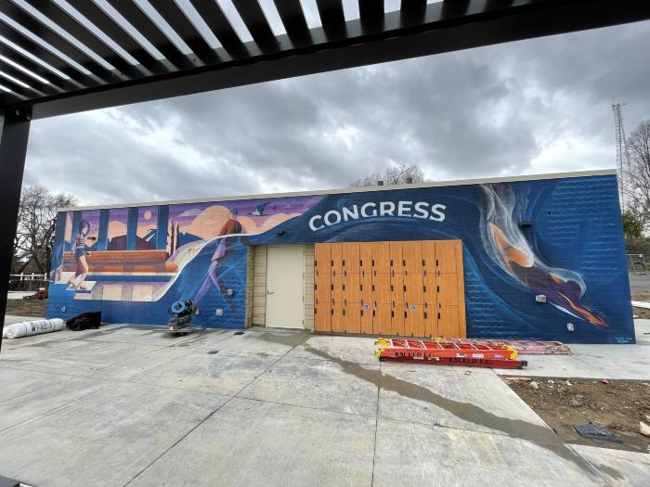
Take a Chance (2022.5.1)

Slide 2
[BLANK] (IN PROGRESS_NATURE PLAY)

Slide 3
[BLANK] (IN PROGRESS_RUBY HILL PHASE 3)

Slide 4
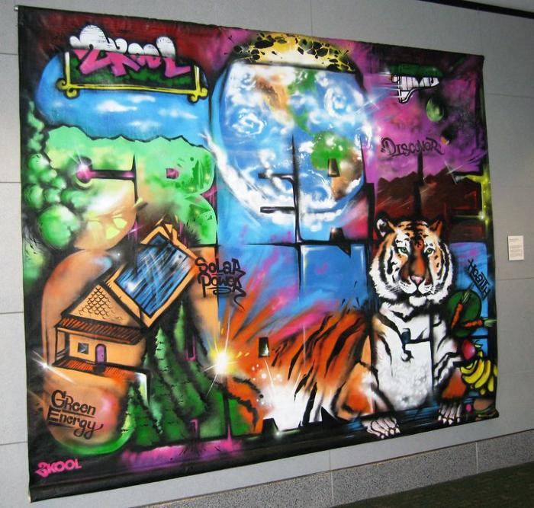
Create Change (UAF.2010.4)
As part of the Denver Urban Arts Fund program, YouthBiz/2Kool hosted and promoted the creation of a community-based “Create Change Mural” for subsequent display at various municipal and public locations, including a visit to Denver International Airport. [vimeo src="https://player.vimeo.com/video/361949530"]

Slide 5
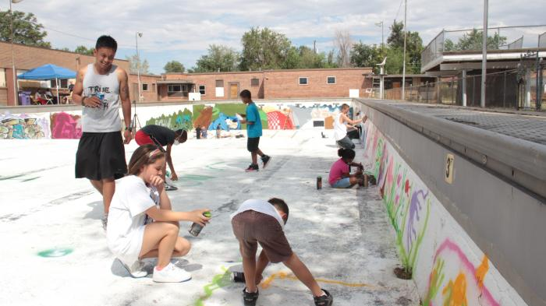
Arts of Mind (UAF.2012.13)
Ratha Sok lead artist along with Gerald Hamel created a Youth Empowerment Program

Slide 6
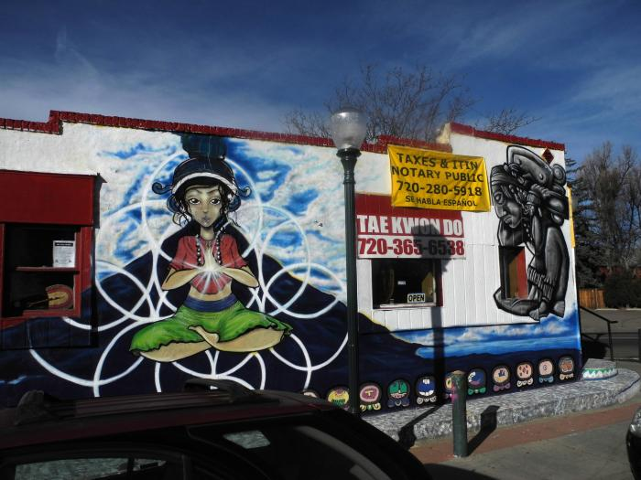
Grandmother's Tea (UAF.2013.6)

Slide 7
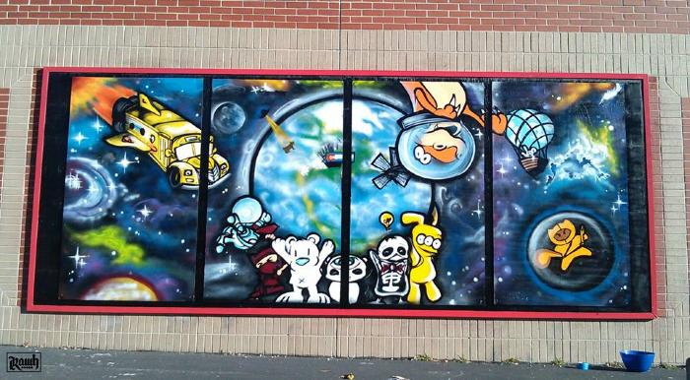
Future World Leaders (UAF.2013.58)

Slide 8
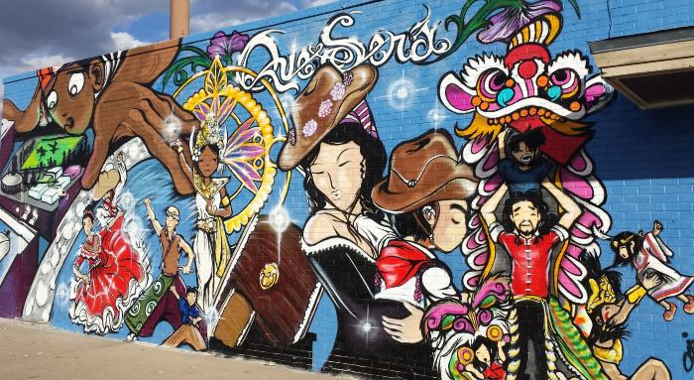
Que Sera (UAF.2014.86)

Slide 9
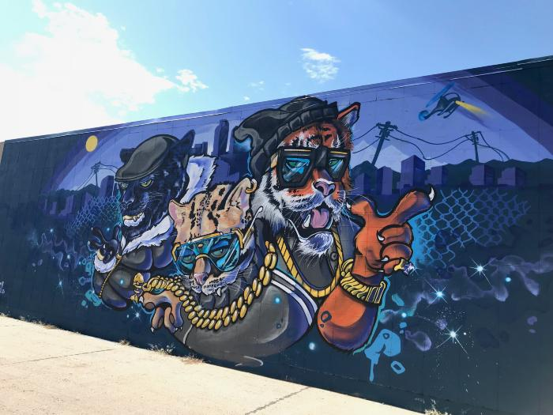
Untitled (stylized anthropomorphic city cats) (UAF.2019.15)

