Slide 1
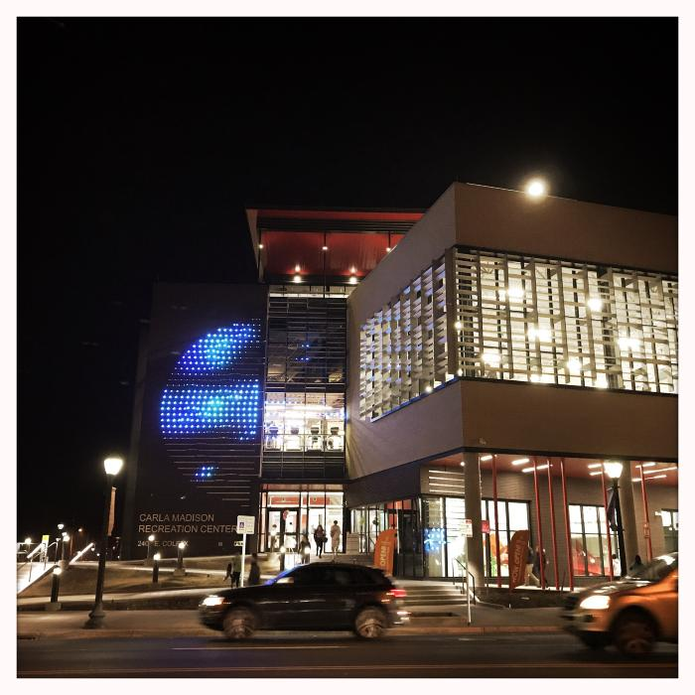
Circuit (2018.2.1)
CIRCUIT is a dynamic, interactive public artwork celebrating the spirit of progress and wellness that lies at the heart of the Carla Madison Recreation Center. Through a monumental light display, the artwork projects on the facility’s exterior facade, the levels of individual effort going on within, reframing these efforts on a communal scale. In breaking down the separation between interior and exterior, between the individual and the group, CIRCUIT seeks to engage the ways in which individual actions can build, grow, and coalesce into a greater whole, and a greater good for all. Check out the video of CIRCUIT in action on Vimeo.

Slide 2
[BLANK] (IN PROGRESS_URBAN FARM)

