Slide 1
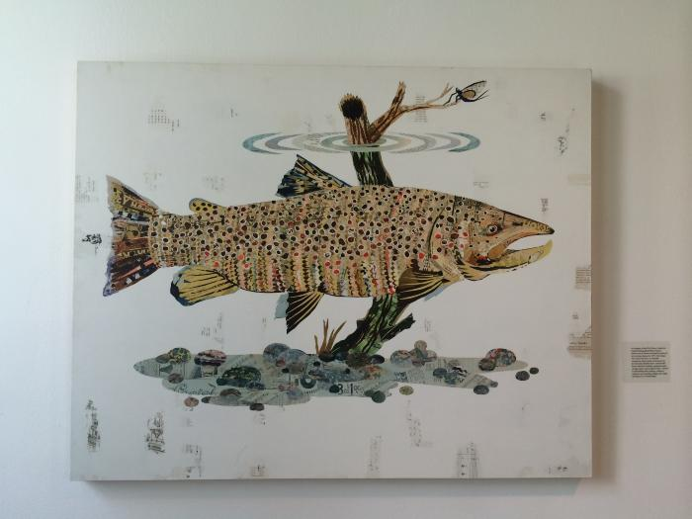
Fish (1234)

Slide 2
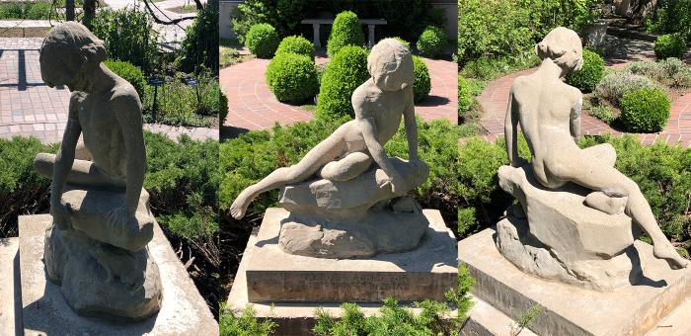
The Boy and a Frog (1898.1.1)
In 1966, Louisa Ward Arps donated a concrete copy of “The Boy and a Frog” to the Denver Botanic Gardens for the opening of the Herb Garden, designed by Mrs. Persis McMurtrie Owen. Elsie Ward Hering created the original plaster statue in 1898 during her stay in Paris. Since Elsie’s death in 1923, Louisa and her family have had the original in their possession, later deciding to have a mold made to create three concrete copies. The mold and copies were created in 1965, but later that year, the mold was destroyed in the historic Denver Flood.
The Denver Botanic Gardens is fortunate to display one of these copies, and the other two enhance the backyard gardens of other Ward family members.

Slide 3
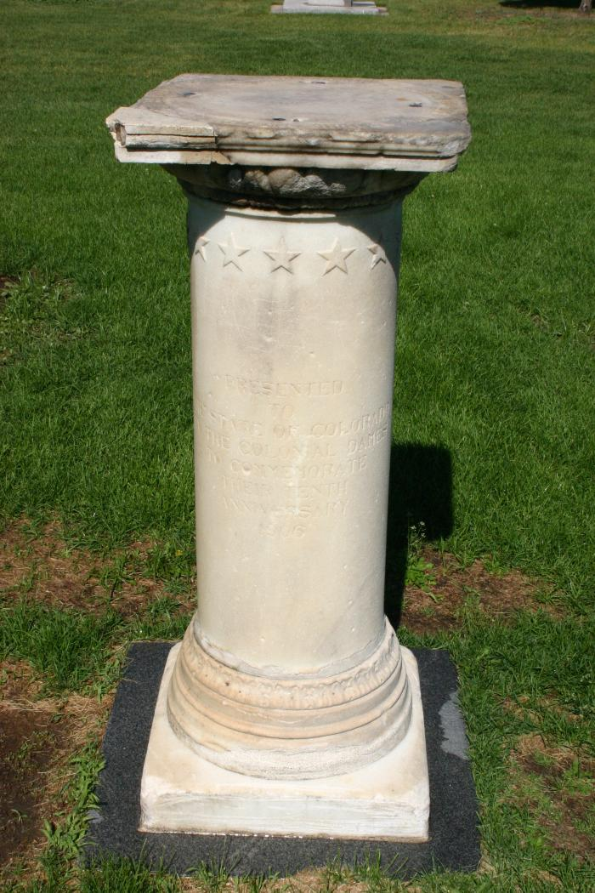
Elizabeth Allen Sopris Memorial (1906.1.1)
The Sopris Memorial originally consisted of a bench statue and pool, however the is not filled in. The granite bench 179" long curves in at each end, ending in a pedestall the same height as the bench. These two pedestals each a have a bronze bracket of the top (these once held bronze fountains that are not gone). At the center of the bench is a granite pedestal (24"x24"x44") with the plaque mentioned before. The bronze sculpture, on the top of the pedestal consists of a 20"x20"2" bronze platform wiht a sundial. At the back left corner stands a full figure 34" nude by who&#39;s body is angles to the center of the platform and is slightly bent. His arms are stretched out at a 30 degree angle from his body. His is looking at his hands which once must have held something.

Slide 4
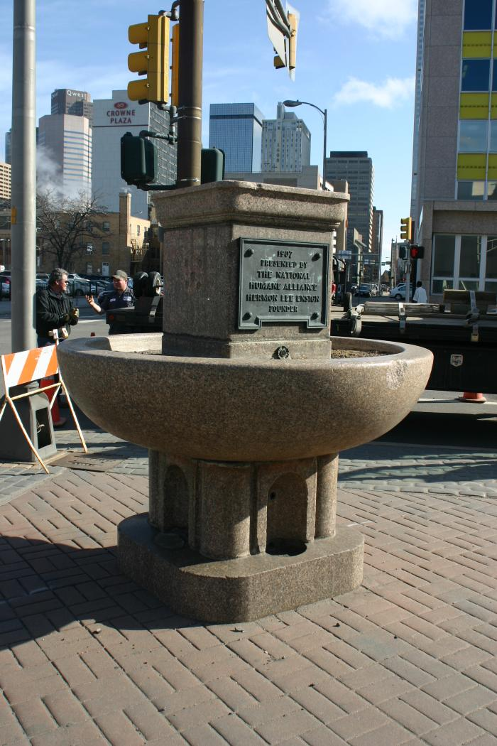
The Ensign Fountain / National Humane Alliance Fountain (1907.1.1)
Between 1906 and 1912, the National Humane Alliance presented somewhere around 125 Horse Watering Troughs to cities and towns across the country, including Denver. Herman Lee Ensign, who died in 1899, dedicated his fortune to funding the National Humane Alliance in order to "spread about humanitarian ideas among the people." Such education, Ensign hoped, would instill in people "especially the young, ideas of humanity both to the lower animals and to each other." The fountains were produced in Vinalhaven, Maine, an island off the coast from Rockland. One of the fountains was relocated to a park in Derby, Connecticut; their community has a web page that offers great information and photographs of the fountains from across the country.
The Denver fountain is located in a small, paved triangle in the Civic Center District, where Colfax Avenue, Tremont Street, and 13th intersect. Although the fountain was refurbished in 2010, unfortunately, the fountain no longer works.

Slide 5
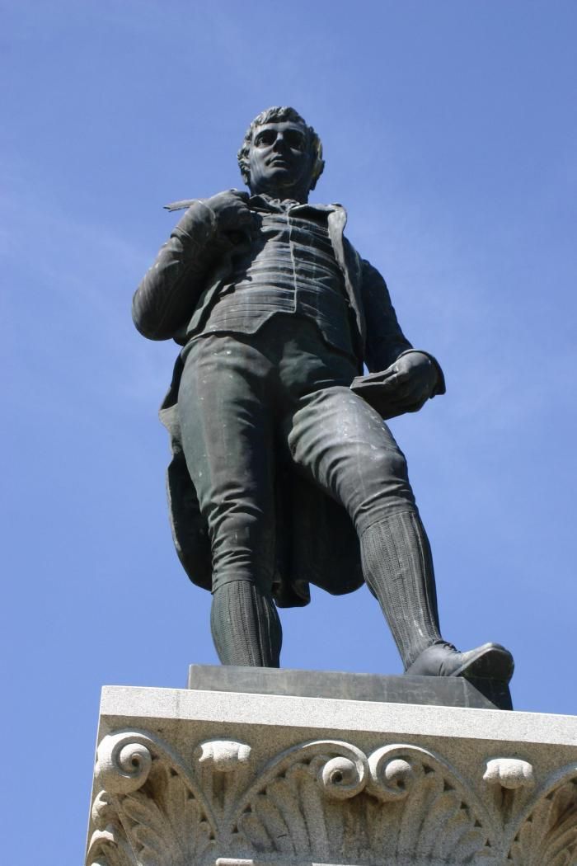
Robert Burns Memorial (1909.1.1)
Robert (Bobbie) Burns, Scottish poet (birth January 25 1759), is depicted in a dramatic stance in this statue which stands in the City Park near the Duck Lake and west of the band shell. Mounted on red and gray granite base the bronze statue was Erected and unvailed by the Caledonian Club #1(Scottish Society) of Denver to commemorate Burns. This is carved into the north stair bottom of the base

Slide 6
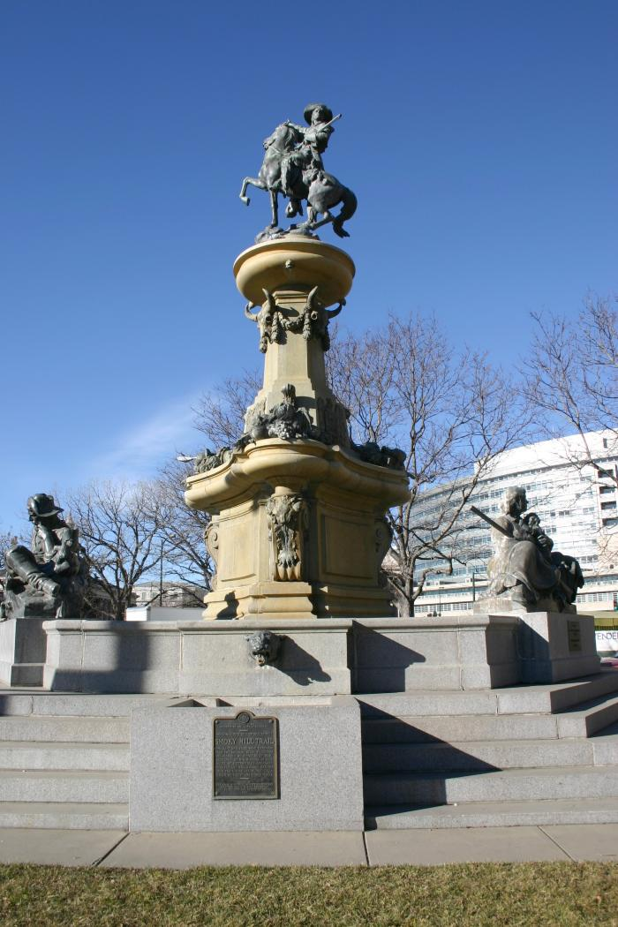
Pioneer Monument (1911.1.1)
The Pioneer Memorial Fountain has a central column featuring an equestrian statue of pioneer guide Kit Carson. Three figural groups around the fountain’s lower basin depict a trapper, a prospector, and a pioneer mother. The figures are cast bronze while the stonework is in granite. The column rises from a plinth set in the fountain basin, and the three figural groups appear at the outer rim of the basin. Carson appears mounted, wearing buckskin clothing and carrying a rifle. The horse&#39;s right front leg is raised, and Carson gestures forward with his right arm while holding the rifle with his left and looking over his left shoulder. Three fish heads and three ox skulls with decorative garlands, also bronze, appear in high relief evenly distributed on or around the base of the upper basin immediately below Carson. The plinth is decorated with three bronze cornucopias which sit on three stone volutes with cast bronze animal pelts. There is a bronze plaque in a shield form representing the State of Colorado between the cornucopias behind the prospector. The prospector reclines on his right side. The pioneer mother appears on the north face of the fountain, holding a rifle in her proper right arm and a child in her left. Her left elbow rests on a cradle and blanket. The trapper appears on south west side. He is dressed in buckskin and holds a rifle in his left arm. He reclines on an animal head with antlers, and is accompanied by a dog. Below these figures there are three mountain lion gargoyles mounted among the steps feeding the horse watering basin. Bronze dedicatory plaques are mounted on the outermost faces of the three basins below the mountain lions&#39; heads.
"Pioneer Monument" was conceived by the Real Estate Exchange and Mayor Speer in 1905. The site was the end of the Smokey Hill trail, which started in Kansas. Before the sculpture was erected, there was a fire station pump house on the site. Frederick MacMonnies was selected to create the sculpture. He was from Philadelphia but living in Paris. He also constructed the fountain at the Columbian Exhibition/World’s Fair in Chicago in the late 1800s. The cornerstone was laid in 1910 and the completed monument was dedicated in 1911. A major restoration occurred in 1983 and a time capsule was discovered containing “Hall’s History of Denver,” a copy of 1911 Municipal Facts and the pen used to sign the Pioneer Monument Bill in 1907. A new time capsule was added in 1983, containing a TV Guide, coins from the Denver Mint, a computer printout and calculator, photographs from 16th Street Mall and of the Denver skyline, the seals of the City and County of Denver, and letters from Governor Lamm and Mayor Pena.

Slide 7
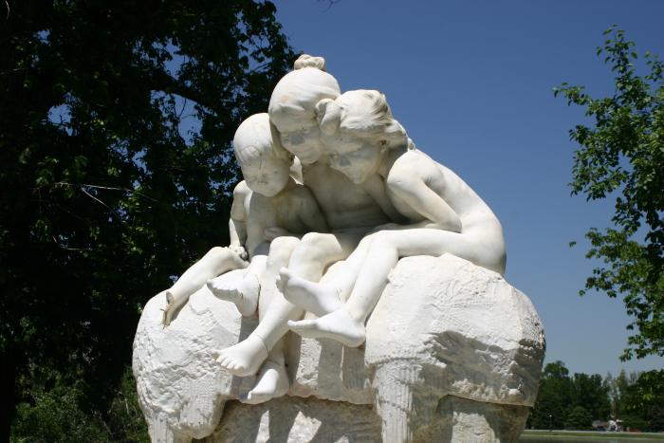
Children's Fountain (1912.1.1)
In 1913, the "Dusseldorf Fountain," as it was then called, was installed near the East 18th Avenue entrance of City Park. This piece was originally all marble, including the three frogs, but later the frogs were recreated in bronze. In 1918, the Dusseldorf Fountain was moved to its present location, and its name was changed to "Children&#39;s Fountain" in 1919. In 1948, Gladis Coldwell-Fisher, a Denver sculptor, restored the fountain with casts taken from her own children. The moat was also built at this time.

Slide 8
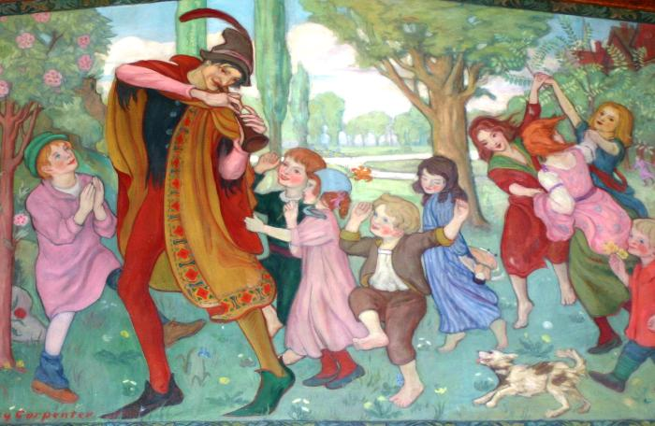
The Pied Piper of Hamelin (1913.1.1)
This painting features the Pied Piper of Hamelin and several children following him.

Slide 9
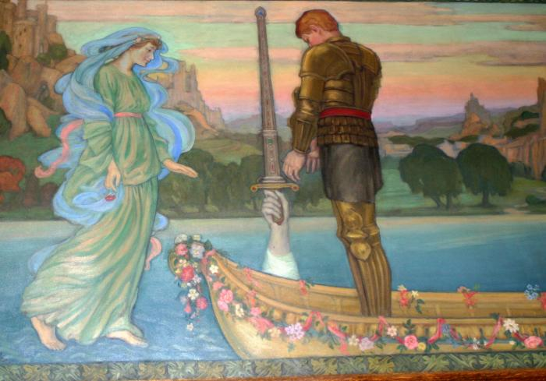
King Arthur Recovering the Magic Sword Excalibur (1913.2.1)
This painting by Dudley Carpenter features King Arthur Recovering the Magic Sword Excalibur.

Slide 10
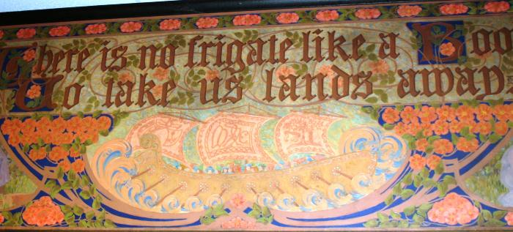
There is no frigate like a Book to take us lands away (1913.3.1)
This painting by Marie Woodson reads "There is no frigate like a Book to take us lands away."

Slide 11
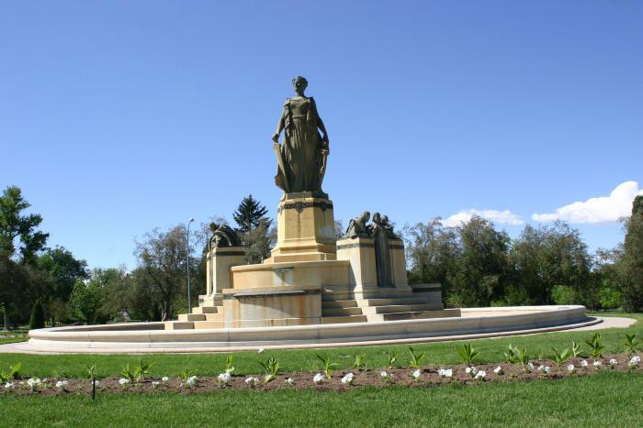
Joseph Addison Thatcher Memorial (1918.1.1)
A colossal central figure representing the State of Colorado is circled by three smaller groups of figures representing the virtues of the state of Colorado: Loyalty, Learning and Love. The central figure is bronze and stands on a granite base; the figure groups are bronze and are set at the base of the central figure, around a marble fountain. Fountain spouts are located between the three groups, with water falling into a circular pool around the whole sculptural group. The central figure is a robed woman holding the sword of state and shield of Colorado.
Loyalty consists of a standing male figure of a knight, wearing armor and leaning upon his broadsword. On his left stands the female figure of peace with an olive branch in her hand. On the knight&#39;s right side is a helmet with laurels representing his past victories.
Learning consists of a standing, robed, female figure, turning her head to her right towards a young boy. The boy looks at the woman while he leans his proper right elbow upon a closed book. On the woman&#39;s left is a young girl perched upon a pile of books while she writes upon a slate.
Love is depicted by a female figure standing at center with a male on her left. The woman&#39;s eyes are lowered modestly. A small figure of cupid also sits on the woman&#39;s left.

Slide 12
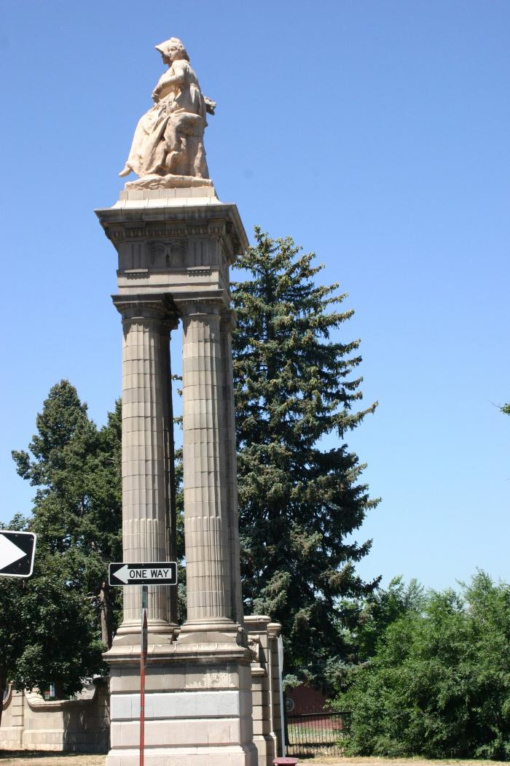
Dennis Sullivan Gateway: Tribute to Agriculture and Mining (1919.1.1)
These sculptural and figurative monuments by Leo Lentelli are a tribute to agriculture and mining.

Slide 13
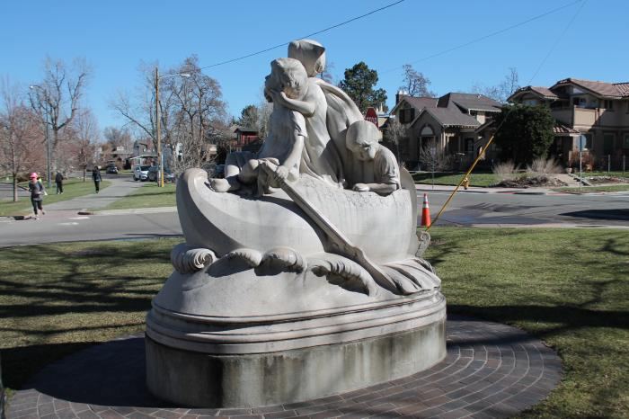
Wynken, Blynken and Nod (1919.2.1)
The statue is a depiction of the Eugene Field Children's poem "Dutch Lullaby" and shows Wynken, Blynken and Nod rowing a wooden shoe through water. Wynken, the larger boy, is towards the front of the shoe in pajamas and is seated with a paddle in his hand. Blynken is a little girl standing behind Wynken in a night dress, her chubby arms clasped around his neck. Nod is a tiny baby seated in the rear of the boat (shoe) nodding sleepily as the waves lap softly against the boat. The entire sculpture is placed on a oval shaped cement base. The sculpture was renovated in 1993.
Learn more about "Wynken, Blynken and Nod" with Public Art docent, Christine D.
[vimeo src="https://player.vimeo.com/video/438259496"]

Slide 14
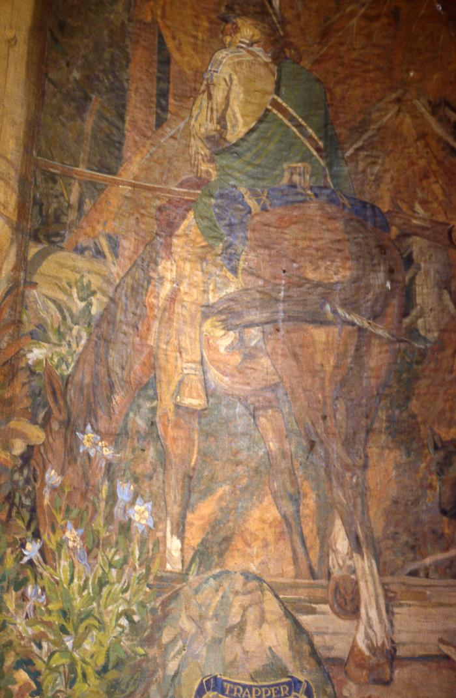
The Trapper (1920.1.1)
This painting by Allen True features a man on a horse.

Slide 15
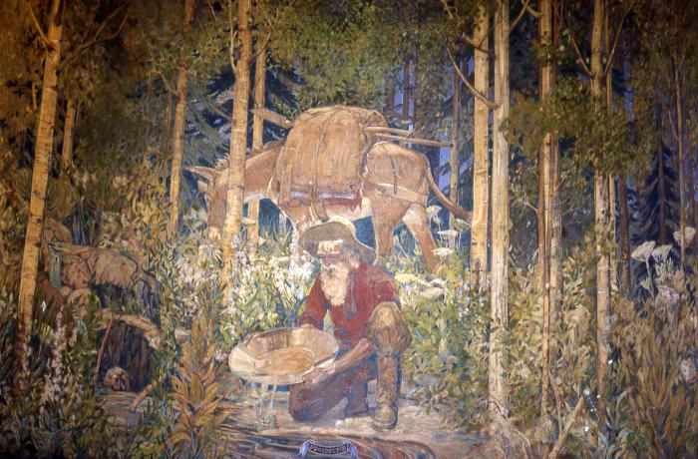
The Prospector (1920.2.1)
This painting by Allen True shows a man panning for gold.

Slide 16
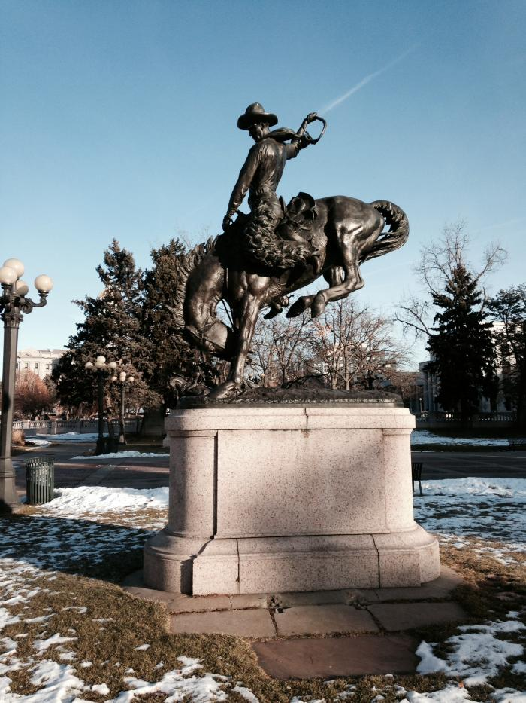
Broncho Buster (1920.3.1)
This bronze by Alexander Phimister Proctor shows a cowboy on a bucking bronco.
[vimeo src=https://player.vimeo.com/video/740500254]

Slide 17
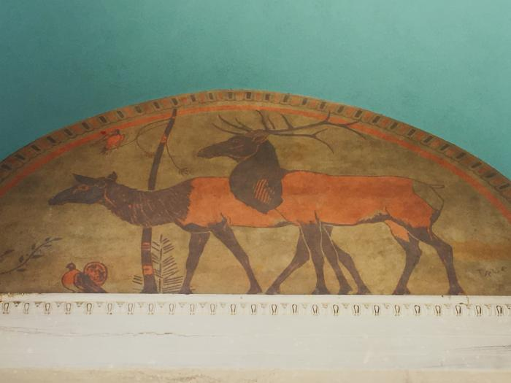
Elk Group and Buffalo (1920.5.1)
This mural painting features a herd of elk and a buffalo.

Slide 18
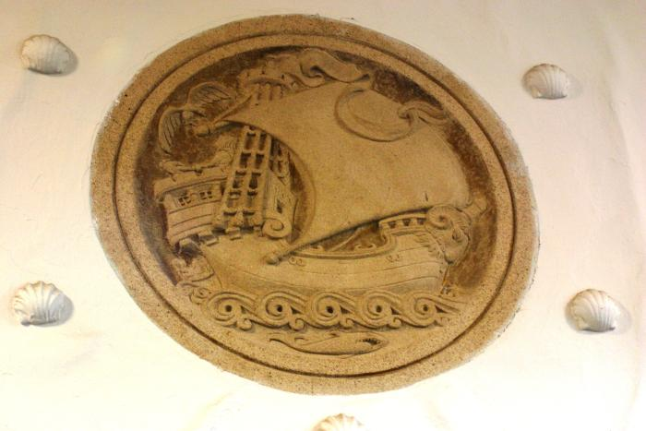
The Ancient Mariner (1920.6.1)
This plaque by Robert Garrison is of a clipper ship.

Slide 19
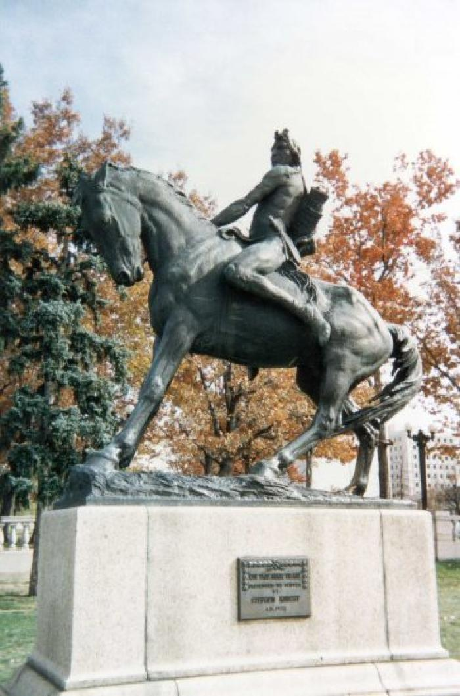
On The War Trail (1922.1.1)
The second of two statues commissioned by renowned sculptor Alexander Phimster Proctor, "On The War Trail" was presented to the City by Stephan Knight and dedicated in 1922.
The bronze sculpture depicts an American Indian riding bareback on a horse with a spear in his hand. According to the IAS, models for the male figure were Jackson Sundown (Nez Perce); followed by Gray Eagle (Blackfoot); and finally Eddie Beaver of Browning, Montana.

Slide 20
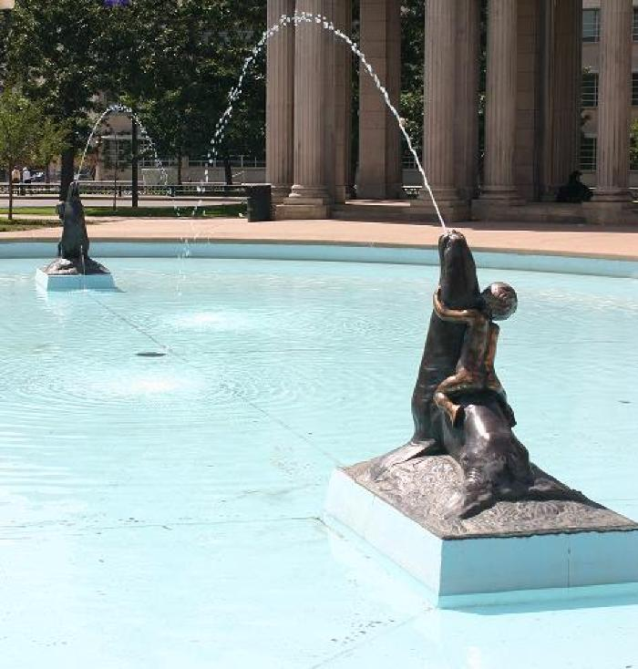
Sea Lion Fountain (1922.3.1)
The Sea Lion Fountain, designed by Robert Garrison, was installed in 1922. The 60-foot by 30-foot basin features two bronze sea lions, being ridden by cherubs, facing each other from opposite sides of the pool.

Slide 21
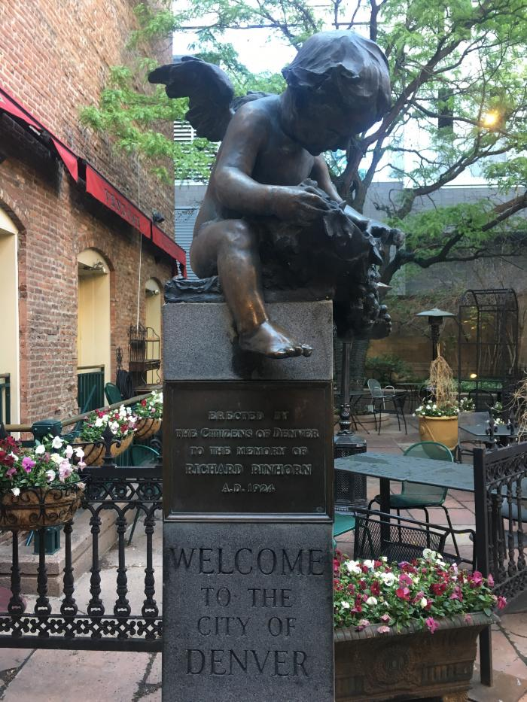
Pinhorn Statue and Fountain (1924.1.1)

Slide 22
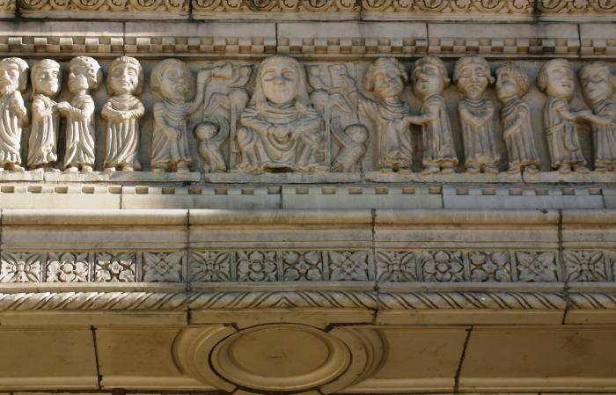
Faculty Row and Animal Spirits (1924.2.1)

Slide 23
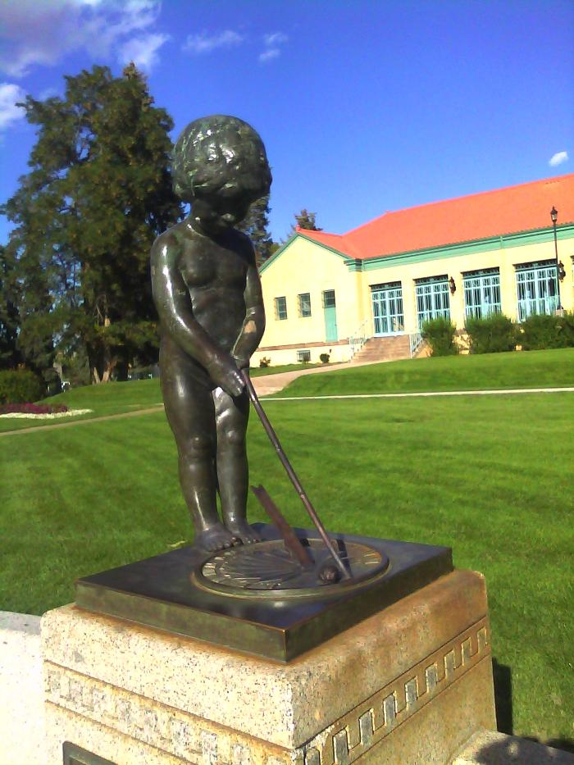
Elizabeth Allen Sopris Memorial; Sundial and Flagpole (1925.1.1)
The Sopris Memorial (a stone seat, a pool, and a small statue of a boy at whose feet is a bronze sundial) was another gift to Denver by S. T. Sopris in memory of his mother Elizabeth Ellen Sopris, in 1925. The memorial is just west of the pavilion, although the pool began to leak and is now a flower bed.

Slide 24
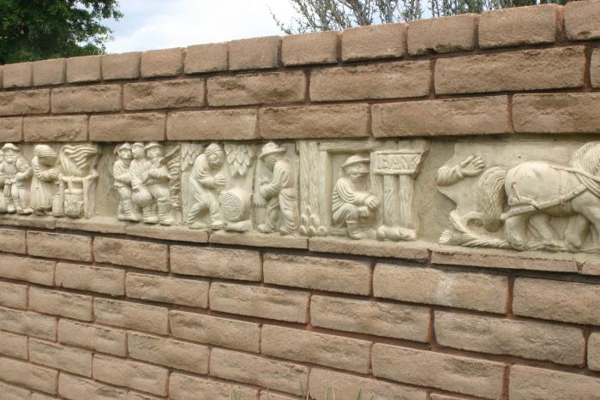
The Story of a Pikes Peaker (1925.2.1)
This relief by Robert Garrison shows the journey of a Pikes Peak traveler. The frieze stretches across the Laura Smith Porter Plains Garden at the Denver Botanic Gardens.

Slide 25
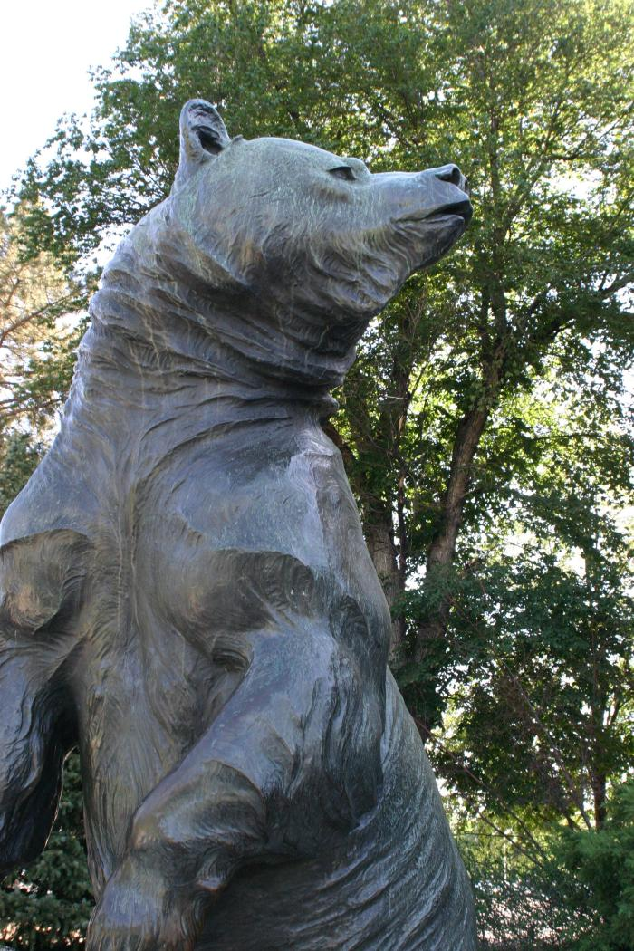
Grizzly's Last Stand (1930.1.1)
Gift, donated by John A. McGuire (Natural History Museum trustee and former editor of Outdoor Life Magazine)
Inscribed at the base of the figure: "Louis Paul Jones Sc. 1930, followed by his insignia a "P" inside a square.
Secondary Inscription: Plaque on the back of the stone base: "When the grizzly is gone, We shall have lost the most sublime specimen of wild life that exalts the western wilderness" (John A. McGuire, Founder, Outdoor Life Magazine)

Slide 26
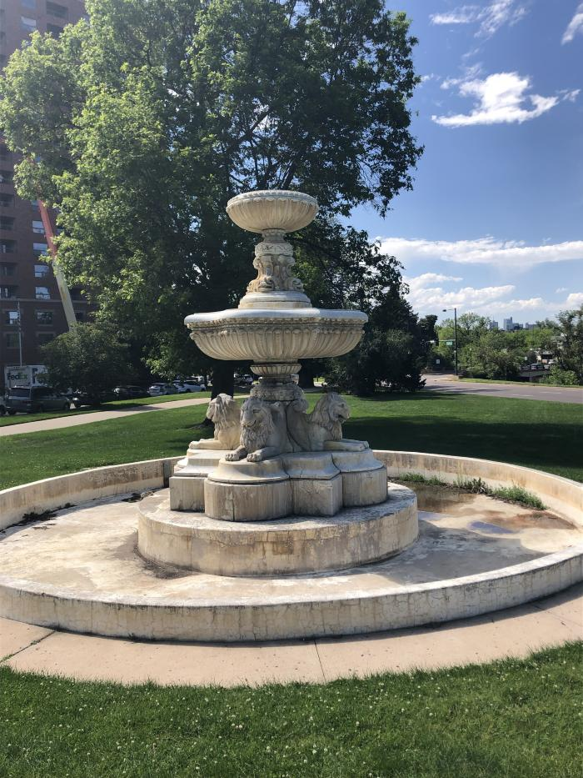
Benedict Fountain (1932.1.1)
This architectural sculpture by Maurice Bardin features a fountain with lions.

Slide 27
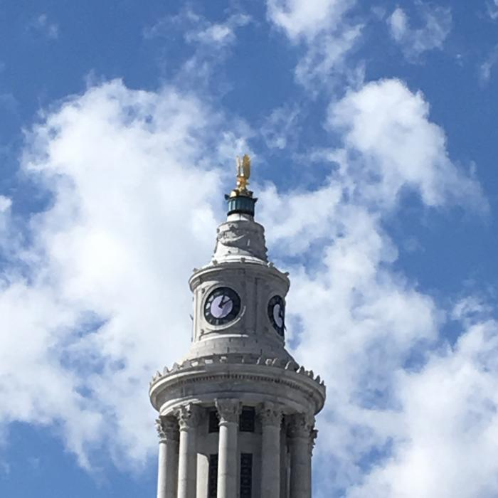
Eagle (1932.2.1)
This sculpture by Joseph Nicolosi is of an eagle that sits atop the City and County Building.

Slide 28
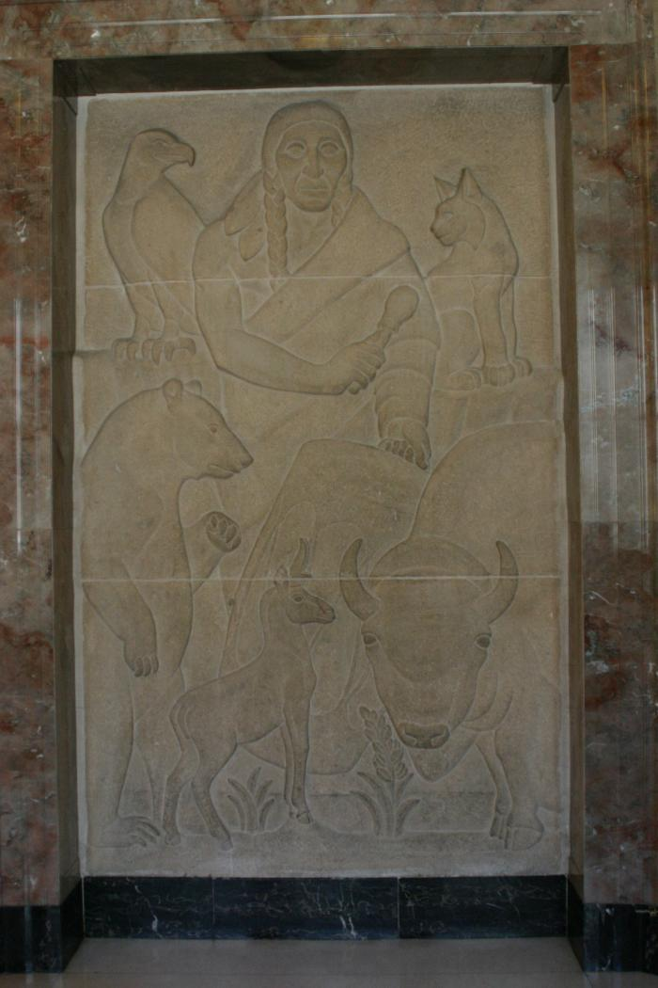
American Indian Orpheus and the Animals (1934.1.1)

Slide 29
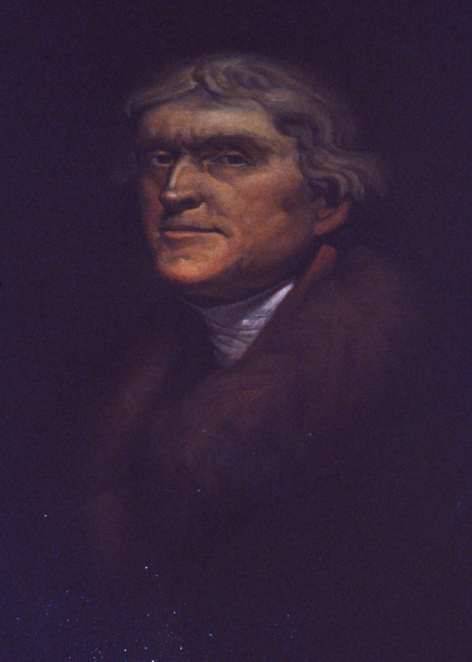
Portrait of Thomas Jefferson (1938.1.1)
Portrait of Thomas Jefferson.

Slide 30
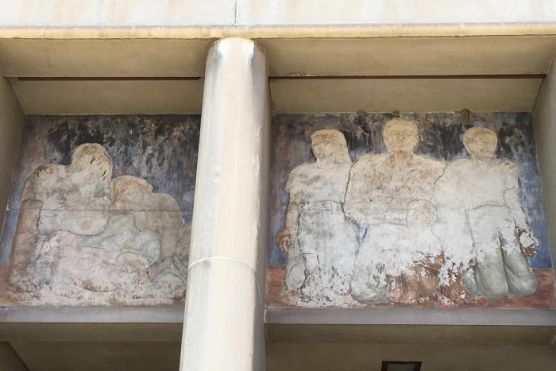
Untitled (figures in pediment) (1939.1.1)
This fresco by Louise Ronnebeck shows men, women and children.

Slide 31
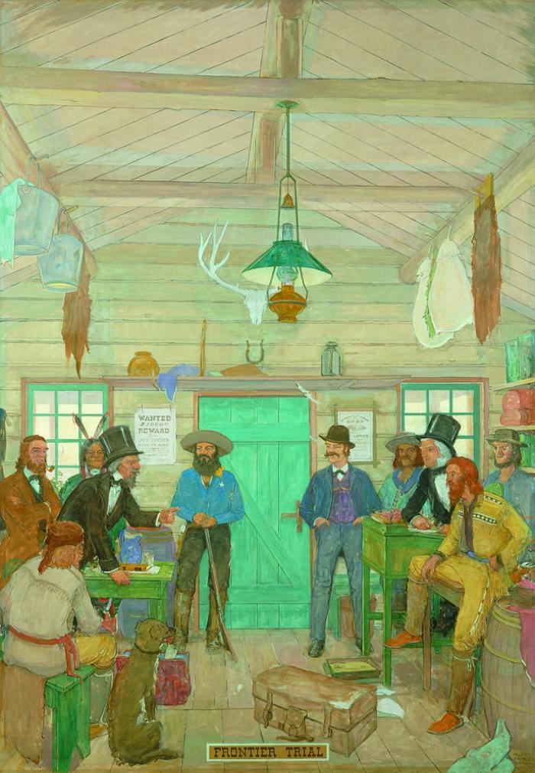
Frontier Trail (1950.1.1)
This oil painting by Allen True shows men of various economic backgrounds and occupations meeting in a room and having a passionate conversation. The bottom of the painting reads "Frontier Trail".

Slide 32
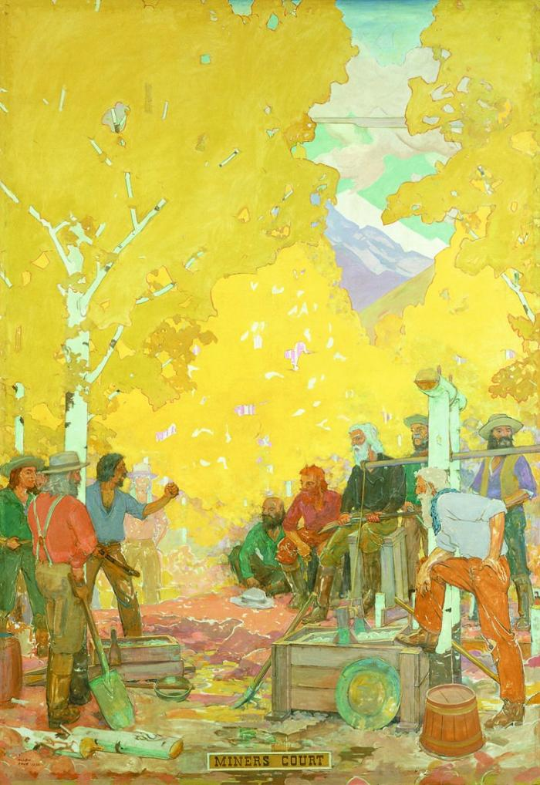
Miner's Court (1950.2.1)
A miners' court was a type of quasi-judicial court common in the American Old West that summoned a subset of the miners in a district when a dispute arose. It was made to retain order and decide punishments within mining communities. A presiding officer or judge was elected and a jury was selected. Other systems that were used included alcaldes and arbitration. In the event a decision was disputed, a mass meeting of the mining camp could be called to allow a dissatisfied party to plead his case and possibly get the decision reversed.

Slide 33
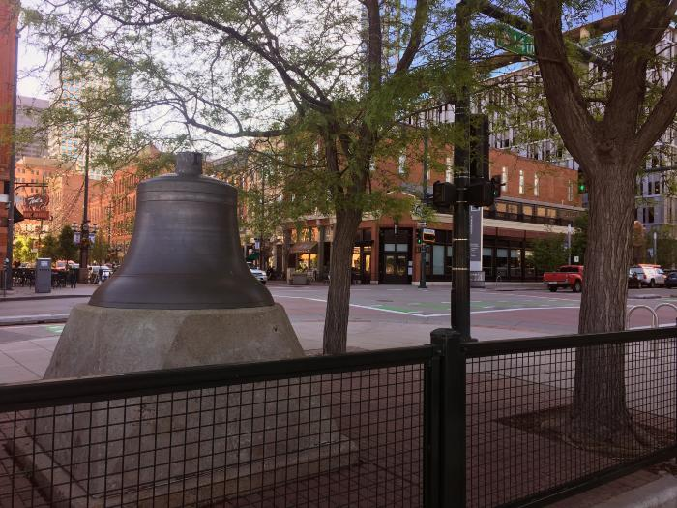
Old City Hall Bell (1953.1.1)
This bronze bell is the only existing relic of Denver’s old City Hall built on this site in 1883 and razed in 1936. The inscription on the bell reads: "The E. Howard Clock Co., Boston - New York - Chicago. 1906."

Slide 34
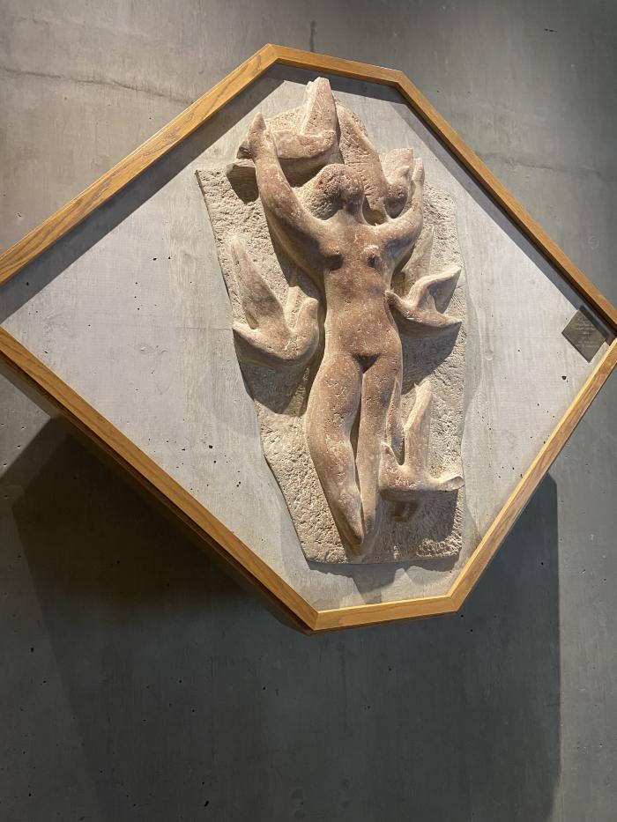
Rima (1953.2.1)
This sculptural stone relief by Edgar Britton features an abstract figure.

Slide 35
Elephant at the Waterhole Mural (1961.1.1)

Slide 36
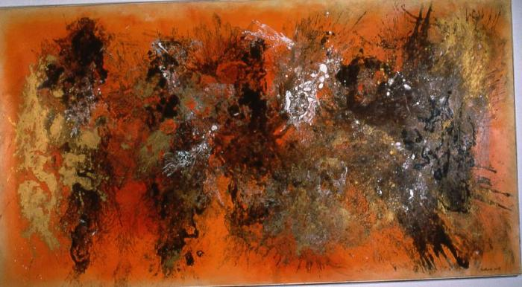
The Burmese Nebula (1961.3.1)
Abstract painting by Vance Kirkland.

Slide 37
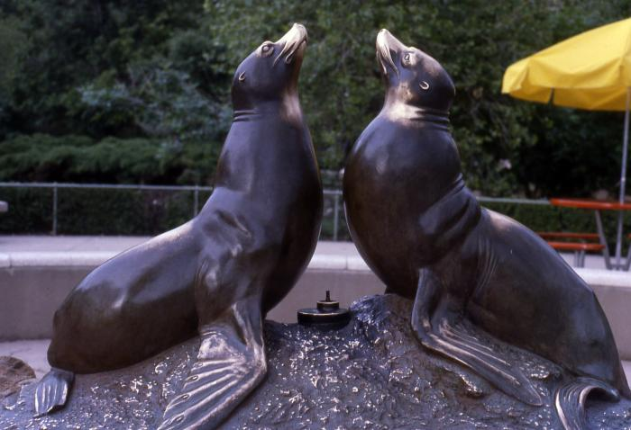
Norgren Fountain (seal fountain)
(1962.1.1)
This bronze sculpture by Louis Paul Jonas is a fountain featuring two seals.

Slide 38
Bears (1965.1.1)
The sculpture by Louis Paul Jones features bears.

Slide 39
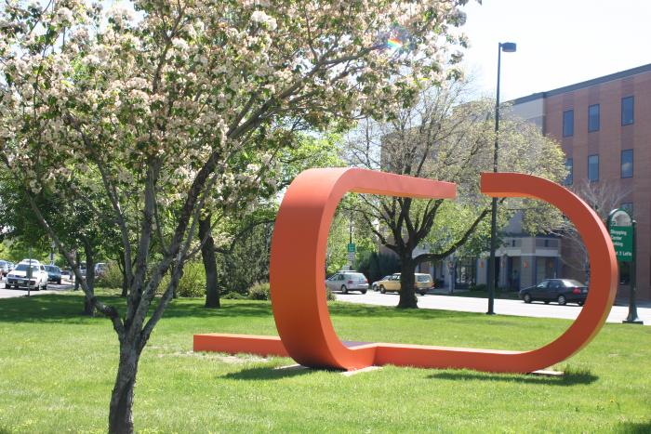
Untitled (U Shape) (1965.2.1)
This sculpture by Anthony Magar features two red abstract "u" shapes.

Slide 40
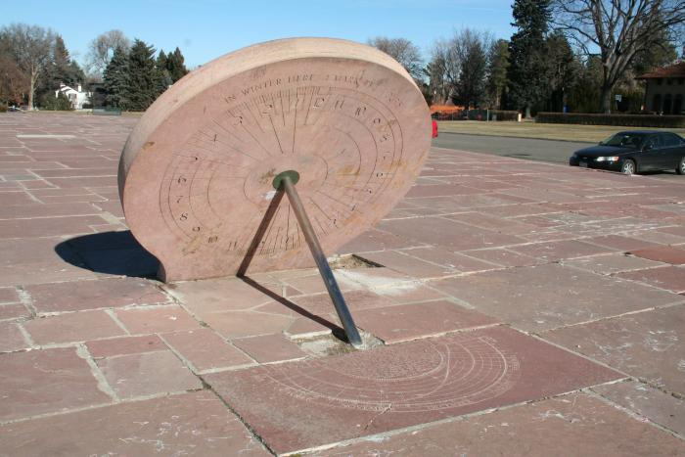
Antique Chinese Sundial (1966.1.1)
Chinese style quartz sundial. The sundial is a replica of the original that was installed in 1941. The the polar chart at its base features Western astrological signs. The chart also includes an explanation of how to calculate the hour based on the position of the gnomon’s shadow. Lastly, there’s also an unmissable clue to one of the more curious features of a sundial like this one. Due to the Earth’s rotation around the sun, the time’s display location changes with the season. The top side of the sundial reads “In summer on this side ~” and the reverse “~ in winter here I mark the hours.” With the coming restoration, it is certain to mark many more.

Slide 41
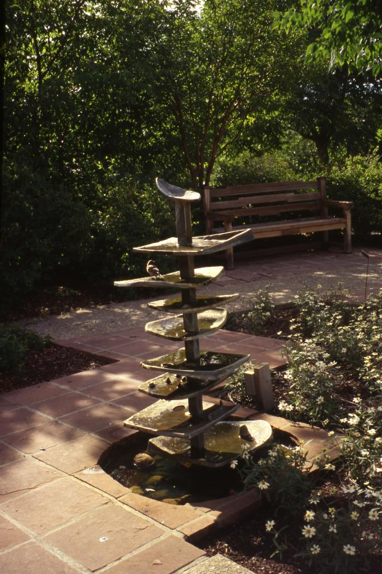
Singing Fountain (1966.2.1)

Slide 42
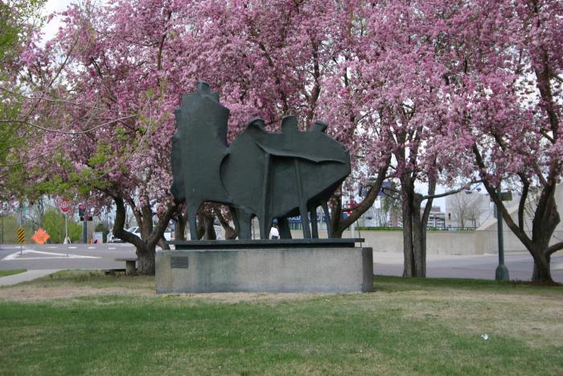
Homage To The Pioneer (1968.1.1)
This sculpture features several abstract bronze figures on a concrete base. According to Cynthia Culver Prescott, author of "Pioneer Mother Monuments: Constructing Cultural Memory," Pogzeba refused to assign meaning to this abstract work, but others see it as evoking family relationships or as an outline of the Rocky Mountains.

Slide 43
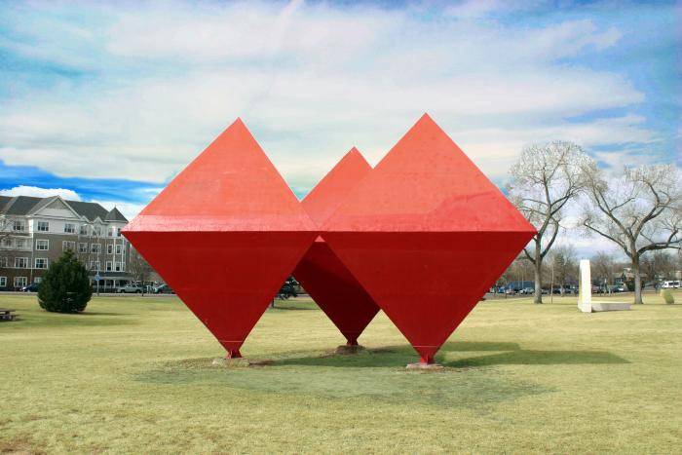
Untitled (red diamonds) (1968.2.1)
In 1968, Roger Kotoske brought artists Robert Morris, Angelo di Benedetto, Richard Van Buren, Peter Forakis, Tony Magar, Dean Fleming, Robert Mangold and Wilbert Verhelst to Denver to create and install outdoor sculptures in Burns Park as part of the Denver National Sculpture Symposium.
This sculpture by Roger Kotoske consists of three octahedrons.
In 2023, this artwork was refurbished Junoworks, who completely rebuilt the piece utilizing measurements and scans of the original artwork by Kotoske. The original artwork was built from plywood and over the years had been repaired using fiberglass. The rebuilt artwork is made of stainless steel to better withstand the elements.

Slide 44
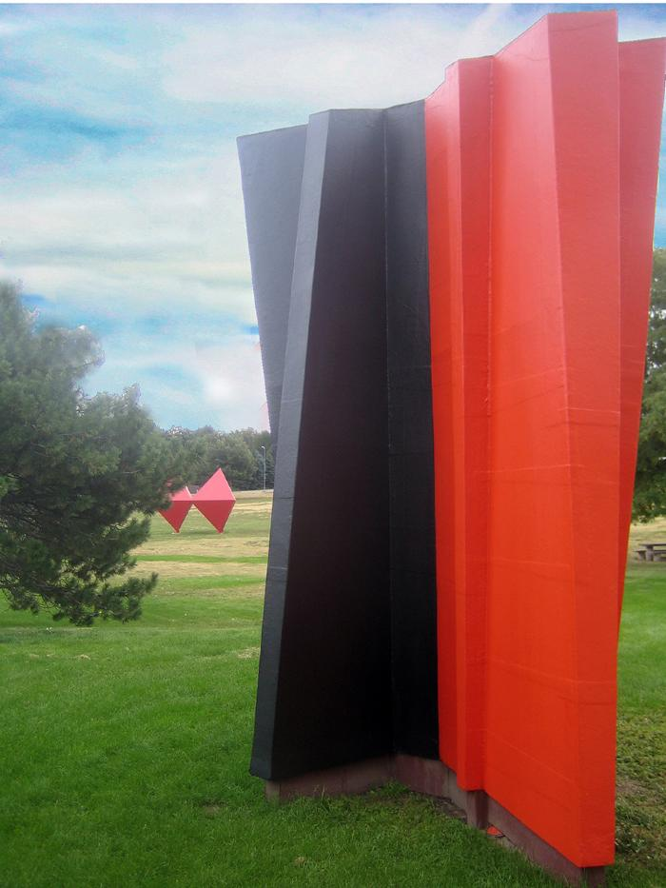
Untitled (vertical black and red) (1968.3.1)
In 1968, Roger Kotoske brought artists Robert Morris, Angelo di Benedetto, Richard Van Buren, Peter Forakis, Tony Magar, Dean Fleming, Robert Mangold and Wilbert Verhelst to Denver to create and install outdoor sculptures in Burns Park as part of the Denver National Sculpture Symposium.

Slide 45
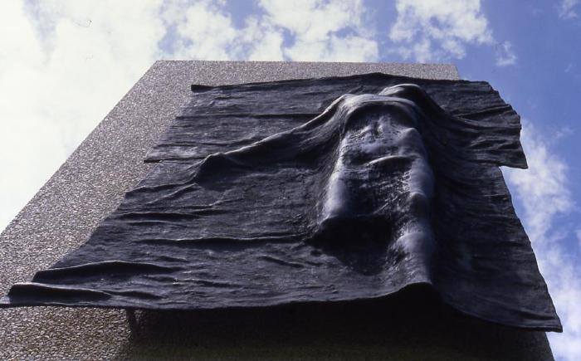
Hungarian Freedom Monument (1968.4.1)
The memorial depicts a bronze figure emerging from a curtain set atop an inscribed concrete stele set into a pad ornamented with metal candle holders.The sculpture shows a young mans body desperately trying to break through a symbolic curtain but is restrained by it. The figure expresses the human aspiration for liberty and the will to survive.

Slide 46
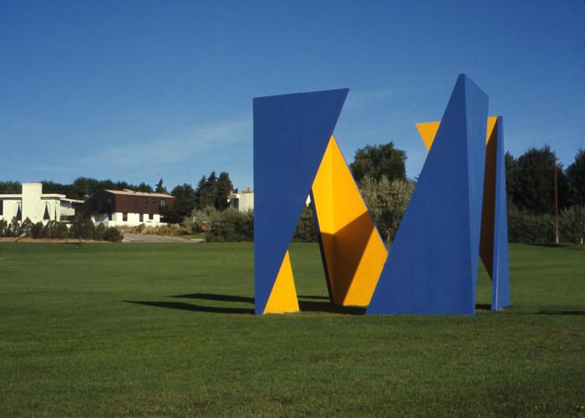
Untitled (blue, yellow cube) (1968.5.1)

Slide 47
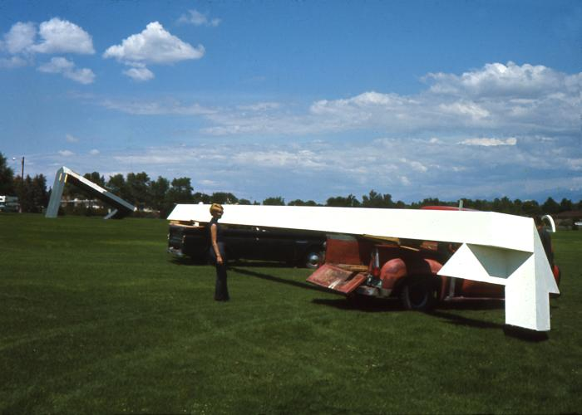
Untitled (White) (1968.6.1)

Slide 48
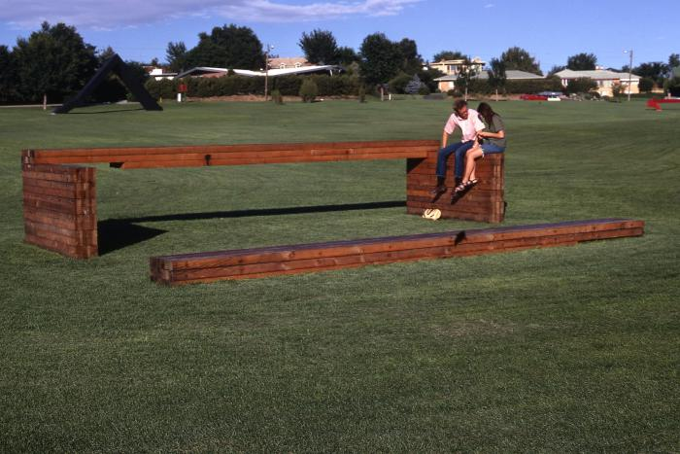
Untitled (Wood Bench) (1968.7.1)

Slide 49
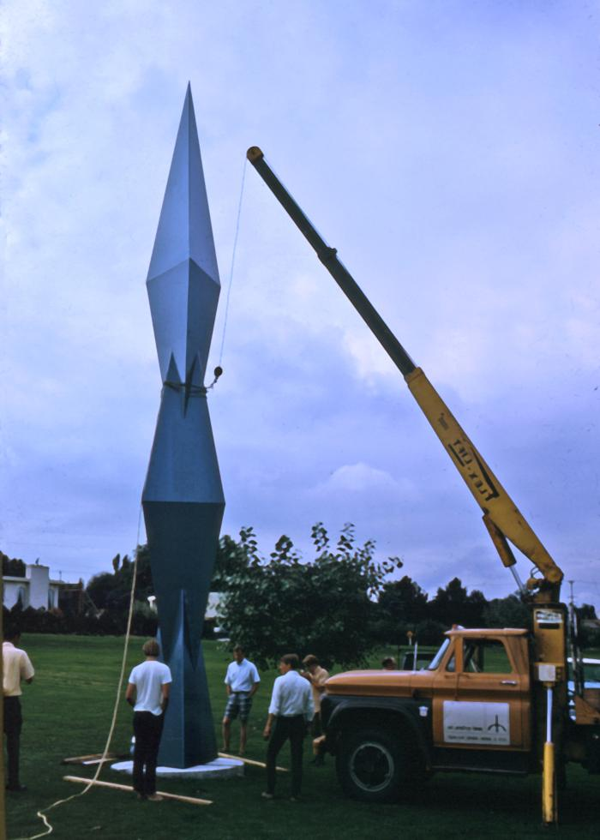
Untitled (Spire) (1968.8.1)

Slide 50
Untitled (1968.9.1)

Slide 51
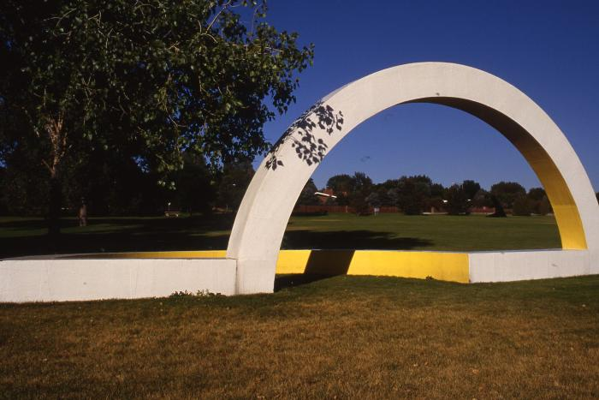
Untitled (yellow semi-circle) (1968.10.1)
Slated2025
In 1968, Roger Kotoske brought artists Robert Morris, Angelo di Benedetto, Richard Van Buren, Peter Forakis, Tony Magar, Dean Fleming, Robert Mangold and Wilbert Verhelst to Denver to create and install outdoor sculptures in Burns Park as part of the Denver National Sculpture Symposium.
This sculpture was created in place starting on 6/12/68 and finished in roughly four weeks. Students from area colleges assisted the artist. M.L. Foss of Denver, the Western Wood Products Association, American Plywood Association donated materials and Valis Colorado Paint Company donated the paint.
In 2004, the sculpture was refabricated in concrete.

Slide 52
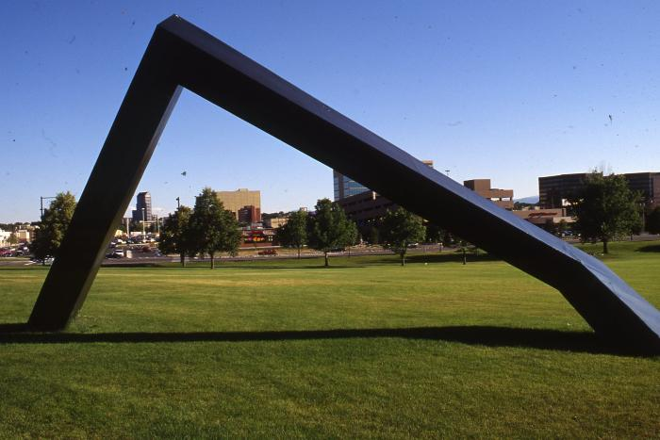
Untitled (black abstract line, dedicated to Martin Luther King, Jr.) (1968.11.1)
Slated2025
In 1968, Roger Kotoske brought artists Robert Morris, Angelo di Benedetto, Richard Van Buren, Peter Forakis, Tony Magar, Dean Fleming, Robert Mangold and Wilbert Verhelst to Denver to create and install outdoor sculptures in Burns Park as part of the Denver National Sculpture Symposium
This piece was dedicated to Martin Luther King, Jr.

Slide 53
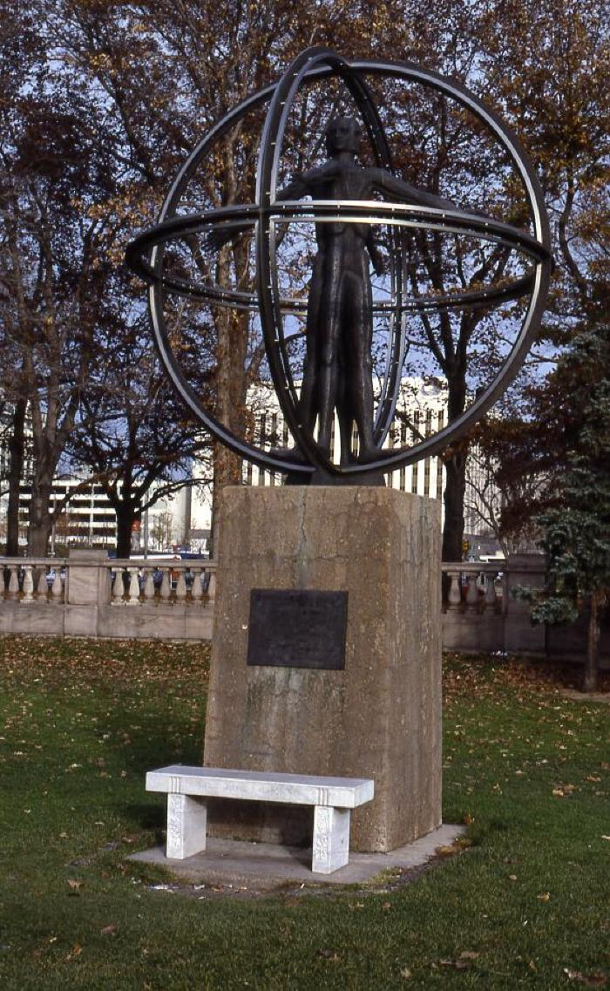
Christopher Columbus (1970.1.1)
* No Longer on View *
This bronze statue depicts a stylistic human form extending arms and legs in four directions - North, South, East and West. The statue is encircled by three spherical stainless steel rings representing the planet earth.
Donated by Alfred P. Adamo and Anna Adamo in 1970.

Slide 54
[BLANK] (1970.2.1)

Slide 55

The Family (1970.3.1)
This bronze sculpture features the figures of a woman and man holding a child. The woman's right arm is around the waist of the man, and the man's left arm is around the woman. The simplified forms face the entrance of the hospital. They are standing on an exposed aggregate concrete base.

Slide 56
Robert S. Kennedy Mural (1970.4.1)

Slide 57
Argo Park Mural (1970.5.1)

Slide 58

Anemotive Tower #6 (1971.1.1)
Artist&#39;s Statement:
My artistic interest in motion is based upon my knowledge and understanding of macro and micro cosmic relationships of time, space and motion. I am fascinated by nature, the motions of clouds and plants in the air; birds and bugs flying, hopping and crawling; fish swimming, water falling, flowing, freezing, thawing; the sun, moon, plants and stars tied in their dance by kinetic and static energies; and the knowledge of unseen, but known, motions of microscopic and atomic activities all interratlated in an eternal birth, life, death, and rebirth cycle.
I am fascinated by man-made mechanical, quasimechanical and electrochemical time, space, motion as I am by the dynamic and energetic activities of nature. All this constantly colors my personality and affects my ego. I incorporate my deep awareness of the simple nature of complex existence into my understanding of man&#39;s efforts and success in controlling nature.
The anemotive kinetic series of sculptures is my best effort to make a simple non-verbal statement about me-us and all that.

Slide 59

Anemotive Tower Children's Playground (1971.1.2)
Artist&#39;s Statement:
My artistic interest in motion is based upon my knowledge and understanding of macro and micro cosmic relationships of time, space and motion. I am fascinated by nature, the motions of clouds and plants in the air; birds and bugs flying, hopping and crawling; fish swimming, water falling, flowing, freezing, thawing; the sun, moon, plants and stars tied in their dance by kinetic and static energies; and the knowledge of unseen, but known, motions of microscopic and atomic activities all interratlated in an eternal birth, life, death, and rebirth cycle.
I am fascinated by man-made mechanical, quasimechanical and electrochemical time, space, motion as I am by the dynamic and energetic activities of nature. All this constantly colors my personality and affects my ego. I incorporate my deep awareness of the simple nature of complex existence into my understanding of man&#39;s efforts and success in controlling nature.
The anemotive kinetic series of sculptures is my best effort to make a simple non-verbal statement about me-us and all that.

Slide 60

Eyes on the Park (1971.2.1)
The Curtis-Mestizo Park mural is a bold reflection of the surrounding community. Represented are four faces that depict a diverse group of people who are each wearing a pair of sunglasses. The sunglasses symbolize unity and summer recreation.

Slide 61

Feature Fountain (1971.3.1)
A depiction of the Rocky Mountain landscape, "Feature Fountain" is located in the Denver Botanic Gardens. It can be found in the south end of the park near the Scripture Gardens. The fifteen foot tall fountain was created with four plyons. Each pylon has a fountain which spills over 1000 gallons of water per minute into the water system. An Egyptian motif is consistent with the definition of a pylon in the Merriam-Webster Dictionary, "a massive gateway especially an Egyptian one flanked by flat topped pyramids."

Slide 62
Lincoln Park Pool Building Mural (1971.4.1)

Slide 63

Valedictorian (1972.1.1)
Slated2025
"Valedictorian", also known as "Redwood", is an abstract tree form constructed of wood and metal. The piece is composed of two fan-like shapes made from wood slats bolted to two metal posts. The wood slats are wrapped with sheet metal so only the end grains of the board are exposed. The wood slats are painted a dark red.

Slide 64

Undulating Pool (1974.1.1)

Slide 65

Beaumont Fountain (1974.2.1)
The sculpture was one of 17 works commissioned to beautify downtown Denver traffic islands. The idea for the project originated in Nov. 1971 at meetings with The Park People and the I-25 Artists' Alliance. Models were submitted in July 1972. The sculpture was fabricated by the William Joseph; the top and bottom pieces were cast by Fedde Bronze.

Slide 66

Untitled (orange and blue) (1975.1.1)
The artist, Gerald Cross, joined the CU-Boulder faculty in 1960, as an instructor of design in the fine arts, architecture and environmental design departments. In 1966, he was named head of the design program. His silkscreen graphic prints were featured in a solo show on campus and he exhibited his art, particularly prints that paid homage to the severe mathematics of 1970s minimalist art. Mr. Cross&#39;s best-known piece is this abstract sculpture of oxidized steel and blue Plexiglas cubes, which is located in a small park near the intersection of Speer Boulevard and West Colfax.

Slide 67
Untitled (Trees I) (1975.2.1)
One of two pieces in this series. Untitled (Trees I) is located on Colfax Avenue, east of Bannock Street, in front of McNichols Civic Center Building in Civic Center Park. Untitled (Trees II) is also located on Colfax Avenue, approximately 1/4 mile west, near Colorado Convention Center.
These pieces are both tree forms made of steel pipe of various diameters, all welded vertically and attached laterally to a center trunk which is composed of thicker pipe. Each tree stands independent of the others and has a different compositional form, although constructed in the same manner. All of the pipes are cut at 45 degree angles and vary in size from about one to three feet and give the feeling of leaves as they are stacked in three dimensions. The trunk is welded to a square plate which is bottled to cement in the ground. There are voids produced by the meandering pipes that allow the viewer to see through each tree. All steel is intentionally rusted.
These works were commissioned by Denver&#39;s "Art in the City Program," an initiative to have art placed near or in traffic medians. The sculptures were funded by the City, with a matching grant from the National Endowment for the Arts.

Slide 68

Untitled (Trees II) (1975.2.2)
One of two pieces in this series. Untitled (Trees I) is located on Colfax Avenue, east of Bannock Street, in front of McNichols Civic Center Building in Civic Center Park. Untitled (Trees II) is also located on Colfax Avenue, approximately 1/4 mile west, near Colorado Convention Center.
These pieces are both tree forms made of steel pipe of various diameters, all welded vertically and attached laterally to a center trunk which is composed of thicker pipe. Each tree stands independent of the others and has a different compositional form, although constructed in the same manner. All of the pipes are cut at 45 degree angles and vary in size from about one to three feet and give the feeling of leaves as they are stacked in three dimensions. The trunk is welded to a square plate which is bottled to cement in the ground. There are voids produced by the meandering pipes that allow the viewer to see through each tree. All steel is intentionally rusted.
These works were commissioned by Denver&#39;s "Art in the City Program," an initiative to have art placed near or in traffic medians. The sculptures were funded by the City, with a matching grant from the National Endowment for the Arts.

Slide 69

Earth Air Crystal (1975.3.1)

Slide 70

Untitled (light blue box) (1975.4.1)
Slated2025
Seven parts to this sculptural work, in front of the library, inside the library and behind the library.

Slide 71

Untitled (gold pieces) (1975.5.1)

Slide 72

Steele Street Fountain (1976.1.1)
Gary Dwyer is an artist with 20 years of international experience working in a variety of landscape, sculpture and photographic genres. He was commissioned by the French Ministry of Culture to articulate the site of an ancient spring in Limousin. The Eastern European Artists Union commissioned him to design and construct a memorial for The Last Battle of World War Two in Slovenia. The State of Minnesota commissioned him to design symbolic courtyards for the Minnesota State Prison for Women and he has just completed a project in Monet's Garden addressing the needs of the disabled.
https://web.calpoly.edu/~gdwyer/bio.html
https://digitalcommons.calpoly.edu/cgi/viewcontent.cgi?article=1000&context=land_fac

Slide 73

Martin Luther King Jr., Prophet For Peace (1976.2.1)

Slide 74

General Pulaski Monument (1976.3.1)
The monument was unveiled and dedicated to the people of Denver, Colorado in commemoration of the 200th anniversary of American independence. The towering gray and rose granite monument pays tribute to six eminent Poles: General Kazimierz Pulaski, General Tadeusz Kosciuszko, Maria Sklodowska Curie, Ignacy Jan Paderewski, Mikolaj Kopernik and Fryderyk Chopin. Inscription: "In Tribute to eminent Poles who, through genius, wisdom, invention and struggle for freedom, served humanity. Dedicated July 4, 1976 by the Polish community of Denver."

Slide 75
Unknown (Mead Memorial) (1976.4.1)

Slide 76

Pasado, Presente, Futuro (1977.1.1)
Denver artist Carlota Espinoza painted this 20-foot mural. The work was commissioned by the Friends of the Denver Public Library and was presented to the Byers Branch Library in October of 1975. The work was designated an official Centennial-Bicentennial project.
Artist&#39;s Statement:
"An awareness of the depth of man and his civilizations makes me feel the need for a measure, a definition that embraces both the past and the onrushing future. I want to share through my art as much as there is to be seen and felt, as much as my brush will allow. &#39;Pasado, Presente, Futuro&#39; embraces a history of everyman, for history belongs to everyone.
&#39;Pasado, Presente, Futuro&#39; blends myth and reality, dream and truth. It is a story of a people: Chicano! It is a story of a people&#39;s romance with history, from Aztec empires, through Spanish imperialism, from alienation to the struggle to re-win a people&#39;s identity, pride and future. In brilliant bursts of highlight, the sweep of human experience that is uniquely Chicano unfolds in this mural. The human lives of yesterday are the grandparents of us today. We are the parents of our children tomorrow. The past, present, future are one blood: Chicano!"
- Carlota Espinoza

Slide 77

The Sentinel (1977.2.1)

Slide 78
Untitled (1978.1.1)

Slide 79

La Alma (1978.2.1)
Slated2025
"The symbolism in this mural reflects the soul of the Westside community. The sun radiates behind the silhouetted city, while an eagle embraces two female faces, one representing the moon and the other, earth. A contemporary figure portrays the strength of our youth, on his shirt, the Mestizo symbolizes the mixture of Spanish, Indian and Mexican descent. The ancient indigenous figure holds two vessels bearing a constantly burning flame conveying the vitality of cultural energy. Clutched in the claws of the eagle, a human fetus and skull, symbolizing both life and death. Perched on the braid of the female figures, an outstretched butterfly represents rebirth. Emerging below, an ear of maize signifies fertility and prosperity."
- Emanuel Martinez

Slide 80
Hell's Guardian Angel (1979.1.1)

Slide 81

Infinite Energy (1980.1.1)
"Infinite Energy" is a bronze sculpture created by Mexican artist, Victor M. Contreras in 1980 and restored in 2005. Its home is under the glass archway of the Denver Performing Arts Complex Galleria near the Boettcher Concert Hall and the Helen Bonfils Theatre Complex.
The artist has interpreted the work in two ways. In 2000 he revealed visual and narrative references, noting, “This sculpture was inspired by two white ‘mariposas’ [butterflies] in flight, which ancient Indian Mexican legends say are souls coming back to comfort their beloved.”

Slide 82

Colorado Miner (1980.2.1)
This life size miner sits on a rock facing the south with his hand on his knee and a pick in his other hand. He sits in front of a semi-circle background that depicts the Rocky Mountains behind him.

Slide 83

The Scripture Gardens (1980.3.1)
The Scripture Gardens is a contemplative space to enrich the soul through interaction with nature.

Slide 84

La Familia Cósmica (1980.4.1)
"La Familia Cosmica" by Jerry Jaramillo, Al Sanchez, Carlos Sandoval and Stevon Lucero was painted in 1980 at La Familia Recreation Center. The mural explores the concept of La Raza Cósmica, the convergence of ethnic groups, by Mexican philosopher, secretary of education, and 1929 presidential candidate José Vasconcelos. Claiming that social Darwinist and racialist ideologies were only created to justify ethnic repression, Vasconelos&#39; theory envisioned a future amalgamation of all the races in the world with no respect to color. Along with several figures, the mural depicts the ocean stretching far into the celestial space.

Slide 85

At the Library (1981.1.1)
In Barry Rose's words: "At the Library" was created with students at Cole Junior High School. Each student sculpted a library book. I filled in with enough to make the rest we needed. I made molds of each and glazed them uniquely, and that was the original project.

Slide 86
Untitled (1981.2.1)
The work is hanging in the lobby of the Denver Performing Arts; Boettcher Concert Hall. The working with it's colors; red, green and blue is suppose to be best seen at night, which most of the shows happen there.

Slide 87

Golden Eagle (1981.3.1)
This sculpture by Thomas H. Dickson features a perched eagle.

Slide 88

Kenneth Mackenzie MacIntosh (1982.1.1)
This sculpture by Dane Romberger features a bust of Kenneth Mackenzie MacIntosh and serves as a eulogy for his years of service on the Denver City Council. He was called "Mr. Denver."

Slide 89

Solar Fountain (1982.2.1)

Slide 90

Babi Yar Park Memorial (1983.1.1)
This 27-acre memorial park was designed by Lawrence Halprin and Satoru Nishita to commemorate the victims of the 1941-1943 Nazi massacre of Ukrainian Jews and others in Kiev.

Slide 91

Reflections (1983.2.1)
This sculptural work by Frank Swanson features three carved stone elements and was commissioned as a eulogy for Sophia and Morris Strear.

Slide 92
Cliff (1984.1.1)

Slide 93

Cares For Her Brothers (1988.1.1)
This bronze sculpture by Veryl Goodnight features a figure holding a deer.

Slide 94

When Legends Run Free (1988.2.1)
A pack of bronze wolves running west outside the Denver Museum of Nature and Science

Slide 95

Brown Flowers, the Mestizo People (1988.3.1)
This mural by Carlota Espinoza features an image of Mestizo people throughout history.

Slide 96

Keepsake Quilt (1988.4.1)
"Keepsake Quilt" is a textile work created by a group of 24 quilters. The name of each quilter is embroidered in red and is located at the center of each “Crossroad” pattern. There are five rows of five names except the third row, which features a “North Star” pattern.
(from left to right)
Row 1: Jim Bannerman, Maureen Cracker, Mary Boris, Jean Edgeworth, Lisa Faulter
Row 2: Bobbie Dormany, Gene H Grier, Stanley Drass, Jen Dausing, Sallie Deirdry
Row 3: Mildred Hall, Ruthel Harper, Janet Jerome, Debbie Jones
Row 4: Betty A. Lawrence, Ahmed Lucas, Roberta Marshall, Alma Menig, Diane Rice
Row 5: Pauliao Robram, Eleanor Sauonartv, Sarah Jappan, Alberta Thomas, Sandra Tanner
Quilting plays a significant role in African-American history. It is believed that quilts aided in the Underground Railroad, providing recognizable coded patterns to guide formerly enslaved people to safety. This Keepsake quilt uses various motifs and symbols from Freedom Quilt traditions, including the central NorthStar and Crossroads patterns. The North Star symbolizes looking to the skies to help navigate the way, and the Crossroads pattern indicates to keep going and travel to the crossroads. The main crossroad along the Underground Railroad was in Ohio, just before crossing into Canada. The red color of the embroidery is also meant to symbolize love, life, energy, and joy.

Slide 97

Beatrix Potter Characters (1989.1.1)
Characters created by English children&#39;s author Beatrix Potter. Peter Rabbit. Mrs Tiggy-Winkle. Squirrel Nutkin.

Slide 98

Town Where the West Went Wild (1989.2.1)
Town Where the West Went Wild is an acrylic mural by Colorado artist Stephen Morath, commissioned by the Public Art Program in 1989. In the mural, Morath explored Denver’s development, industry and way of life in the 1980s. This urban portrait reminds us of a specific time and place in Denver’s history, though some of its iconic images no longer represent how Denver has evolved into a progressive, metropolitan city committed to healthy living and environmental sustainability.

Slide 99

Calculated Risk (1989.3.1)

Slide 100

Hogback (1989.4.1)

Slide 101

The Gorilla (1989.5.1)

Slide 102

Flight of the Eagle Dancer (1989.6.1)

Slide 103

Colorado Icons (1990.1.1)

Slide 104

Park and Garden Benches (1990.2.1)
Cast reinforced concrete benches containing impressions of leaves and figurative elements of hands and legs cast from community members.
*One Element of Artwork Currently Not on View for Restoration*

Slide 105

Colorado Panorama: A People's History (1991.1.1)
This ceramic tile mural is composed of abstracted, computer-digitized photographs of more than 120 figures prominent in Colorado&#39;s history.

Slide 106

A Good Catch (1991.2.1)

Slide 107
Eagles Choice (1991.3.1)

Slide 108
Deer Family Grazing (1991.4.1)

Slide 109
Moose And Baby Grazing (1991.5.1)

Slide 110
Wayward Winds (1991.6.1)

Slide 111

Taking the Heat (1991.7.1)
A life-size firefighter standing proudly with one of the Fire Department's trusted comrades "Chief" the firehouse dog. He is in uniform shirt, bunker pants with suspenders and department issue boots. The firefighter's leg is resting on a fire hose while holding his helmet in one hand and his turnout coat in the other. "Chief" is adorned with the Maltese Cross; the cross represents a symbol of protection and honor. "Chief" was the loving canine that became legend in the Denver Fire Department, as their honorary dog.

Slide 112

Union Spire (1991.8.1)
Union Spire is composed of two spires, commissioned separately. The bottom 13-foot spire is composed of 12-1/2 8-sided blocks. Each side is painted with yellow and black diagonal stripes. The top 9-foot spire is composed of a red painted metal that looks like a Slinky. This is encased by 1-inch wide thin pieces of metal that are in the shape of X's and squares, forming 8 blocks up the spire. There is a white-domed light on top of the spires.

Slide 113

Tail Spin (1991.9.1)
The sculpture Tail Spin was created and reinstalled at the new Colorado Convention Center. Tail Spin is a free hanging suspended steel and fiberglass structure located on the northeast side of the Colorado Convention Center’s entrance. The mild steel sculpture was welded and fabricated as five individual units, with fiberglass sails/ or shovel forms. The surface of the sculptures are metallic black with acrylic enamel with varied color coats of clear pearl essence (on the larger sail forms) and finally clear-coated.

Slide 114

Colorado Vacationland (1991.10.1)

Slide 115

Jade Spire (1991.11.1)
*Artwork Currently Not on View for Relocation*

Slide 116

Chaffee Park Flowers (1991.12.1)

Slide 117

Prismatic Installation (1991.13.1)

Slide 118

At Play (1991.14.1)
At Play and Water Friends are a group of amusing murals at the Congress Park pool. They depict children enjoying water and field sports. Water Friends is 8 feet by 6 feet and is painted onto a brick structure near the pool. At Play is 13.5 feet x 14 feet and is found within the pool house. It is painted on a large trapezoidal structure, mounted on the wall above the front desk.

Slide 119

Water Friends (1991.14.2)
At Play and Water Friends are a group of amusing murals at the Congress Park pool. They depict children enjoying water and field sports. Water Friends is 8 feet by 6 feet and is painted onto a brick structure near the pool. At Play is 13.5 feet x 14 feet and is found within the pool house. It is painted on a large trapezoidal structure, mounted on the wall above the front desk.

Slide 120

Parked Perspectives (1991.15.1)
Park Perspectives consists of two installations. The first is a set of four pieces at the East side of Congress on the West side of Congress Park Playground. Both pieces have a bronze inscription. One is over-sized, the other is miniature, on a child’s scale. This setting of functional seating suggests the diversity of people using the swimming pool at Congress Park.

Slide 121

Jesters (1991.16.1)

Slide 122

Medallions (1991.17.1)

Slide 123

Juntos / Together (1991.18.1)
"Juntos/Together" is a 6 foot by 17 foot freestanding wall with a mosaic mural on each side. Tony Ortega visited neighborhood schools, senior centers and recreation centers, using their visitors as inspiration, and engaging the community in the creation of this piece. The handset porcelain tile mosaic mural brings a human element to the Lakewood / Dry Gulch Park, depicting groups of people interacting and enjoying the outdoors. Ortega draws from individual slices of life to create artwork centered on family and community-what he considers the two major components of the Latino.

Slide 124

Ode to the West Wind (1991.19.1)
"Ode to the West Wind" is located on the mezzanine level of the Buell Theatre and is a series of seven ceramic tile panels on a 150&#39; curved wall. Air, changing light, clouds, and plant forms appear and reappear throughout the mural. The Wild Iris, native to Colorado, is a recurrent motif.

Slide 125

Come on in! (1991.20.1)
MISSING
Various color photos depicting community members working out and enjoying recreation style family time

Slide 126

Personal Icons (1992.1.1)
As a part of West Pines Hospital&#39;s "A Celebration of Cultural Diversity and Unity" program, Barry Rose established a series of workshops at the Ross Barnum Library, working with people in the neighborhood to produce a mural. The result is a 3&#39; x 3&#39; bronze tile artwork that was permanently installed on the front of the building in 1989. Duplicates of these tiles are also a part of a much larger mural that involved eight different organizations, installed in the pavilion at City Park.

Slide 127

Personal Icons; City Park (1992.1.2)

Slide 128

Soundwalk (1992.2.1)

Slide 129

Creekfront (1992.3.1)
"Creekfront" is a series of terracotta plaques, featuring the Creekfront logo, which are placed in pillars and bollards along the Cherry Creek Trail at Creekfront Park.

Slide 130

Dominion (1992.4.1)
The work consists of life-size animal sculptures which the artist creates using explosives. Dentongraphy, a process which Rosenberg innovated, uses various metals such as copper, brass, stainless steel and black anodized aluminum. The metals are exploded into molds in the desert and later refined and treated by the artist at her studio.

Slide 131

20th Century Perspectives: Beginning a Century (1993.1.1)
Two painted wood relief murals measure 14&#39; by 7&#39; 8" each and face each other at opposite sides of the Rotunda. They depict an abstracted view of Denver&#39;s landmarks and symbols during the twentieth century. On the north wall, "Beginning a Century" shows Denver with a low horizon, many churches and several symbols of the City&#39;s aim toward freedom and growth. "Ending a Millennium" on the south wall, projects Denver with a high skyline, as well as other monuments and symbols of the City&#39;s expansion.
Denver Post art critic Steven Rosen wrote this about the pair of murals: "This is not a traditional mural painting. The artist combines vivid painting and playfully agile sculpture, often playing tricks with our sense of perspective, to present commonplace things in a fresh, often illusionistic way."

Slide 132

20th Century Perspectives: Ending a Millennium (1993.1.2)
Two painted wood relief murals measure 14&#39; by 7&#39; 8" each and face each other at opposite sides of the Rotunda. They depict an abstracted view of Denver&#39;s landmarks and symbols during the twentieth century. On the north wall, "Beginning a Century" shows Denver with a low horizon, many churches and several symbols of the City&#39;s aim toward freedom and growth. "Ending a Millennium" on the south wall, projects Denver with a high skyline, as well as other monuments and symbols of the City&#39;s expansion.
Denver Post art critic Steven Rosen wrote this about the pair of murals: "This is not a traditional mural painting. The artist combines vivid painting and playfully agile sculpture, often playing tricks with our sense of perspective, to present commonplace things in a fresh, often illusionistic way."
Denver Post art critic Steven Rosen wrote this about the pair of murals: "This is not a traditional mural painting. The artist combines vivid painting and playfully agile sculpture, often playing tricks with our sense of perspective, to present commonplace things in a fresh, often illusionistic way."

Slide 133

The Day the Wall Came Down (1993.3.1)

Slide 134

Neighborhood Epic (1993.5.1)

Slide 135

Berkeley Park: Past and Present (1993.6.1)

Slide 136

Petros (1993.7.1)

Slide 137

Play Hard (1993.8.1)

Slide 138

Sun Signal and Sun Flag (1993.9.1)

Slide 139

Drums of Peace and Dignity (1993.10.1)

Slide 140
Backward Somersault (1993.11.1)

Slide 141

Family and Community Fun (1993.12.1)

Slide 142

A Life in Harmony With All Of Creation (1993.13.1)
“A Life in Harmony With All Creation” is located at the 15th Street underpass between Little Raven and Wewatta Streets. Pueblo husband-and-wife artists Ken and Judith Williams collaborated with California artist Maria Alquilar to create the mosaic of handmade, hand painted tiles, which portrays a cross section of Denver life and Colorado history alongside Arapaho motifs and imagery.
The murals are comprised of a patchwork-like composition of glazed terracotta geometric abstract tiles and shaped unglazed terracotta tiles and bricks by Judith and Ken Williams, surrounding figural relief panels of glazed tile by Maria Alquilar.
Ken and Judith Williams&#39; Tiles:
These tiles have a terracotta clay body with a wide variety of shapes and surfaces seen in these tiles.
Ken and Judith Williams&#39; Brickwork:
Some elements of the murals are comprised of red terracotta brick, carefully shaped to form undulating organic curves and swells.
Maria Alquilar Tiles:
These tiles were hand made by the artist from a fine beige clay body, built up to form high relief elements such as animals and figures. Found objects were incorporated into these tiles. "As we dug down into the earth to build the underpass, with each layer we would find items that indicated what had been there before: railroad lies, remnants from an old foundry, even animal fossils from an old creek," says urban designer Larry Gibson of BRW Inc., who orchestrated the 15th Street Reconstruction project for the city. With that in mind, the artists chose to create their interpretation of a slice of the earth. "It’s meant to show you the layers beyond the wall," adds Gibson. "That&#39;s why we chose these particular artists - we really liked their concept. It was truly a stroke of genius."
The tile and brick murals are located on the northwest retaining wall of the 15th Street underpass, flanking the railroad trestle and the footbridge which span the roadway. There are three main sections, one on the north side of the footbridge, and one on each side of the trestle.
The mural sections flanking the trestle are each located at the foot of a stairway which leads from the upper ground level down to a pedestrian walkway. The three mural sections are divided into two subsections: one on the retaining wall above the walkway, and one on the retaining wall below the walkway at street level. These subsections are visually united by a section of colored tiles set into the walkway.

Slide 143

Frog (1993.14.1)

Slide 144

Arctic Sojourn (1993.15.1)

Slide 145

Bravery In Arms (1993.16.1)

Slide 146

Clear Concept (1994.1.1)

Slide 147

Lost Borders (1994.2.1)
"Lost Borders" is an integrated landscape art project built along the edge of Cherry Creek across from the park built over Speer Tunnel. The edge of the creek has been reconstructed into terraces with large rocks and native vegetation including willows and dogwood, a stone seating area, and stone ramps near the water. The pedestrian bridge that crosses this area offers pedestrians and bicyclists a view of the tall wetland plants. The artist's desire was to recall the original nature of the creek edge within the constraints of its urban context and gives access to the water.

Slide 148

Flame of Compassion (1994.3.1)
The "Flame of Compassion" is a wind harp which is in constant harmonic communication with the elemental heartbeat of nature. This sculpture stands as a metaphor for the constant vigilance and genuine intent held to create harmony as the preferred outcome in daily drama of city life in Denver.

Slide 149

First Round (1994.4.1)
Figurative sculptural design for the golf course tee markers. A man and a woman adorn each side of a bench. The two life-sized sculptures of golf players are connected by a six to seven foot long wooden seat. The male figure is surrounded by a sand trap, and the pose of the sculpture suggests a successful attempt to get the ball out of the sand. The female figure is surrounded by grass and has just hit the ball. The sculpture bench is meant to be humorous and entertaining for people sitting on it or standing around it.

Slide 150

Pursuing Perspectives (1994.5.1)
The sculpture is installed in the entrance of the library and is constructed of painted wood and other materials. The colors are vivid, red being dominant. The objects are symbolic of learning and knowledge. The piece combines and contrasts old and new methods of learning in Eastern and Western cultures. A chair represents a person prepared to learn. The desk is the place of learning. A screen symbolizes Eastern art forms with its Oriental perspective. The painting above the desk appears as a window and presents a view to the outside world. On the desk is an apple, an axillary sphere, an abacus, a stack of books, one of which has a Rembrandt self-portrait on the cover, and a grouping of Euclid's geometric shapes which appear to be building blocks. The painting shows a group of books by Colorado writers, the view of the neighborhood, Downtown Denver, the Front Range, and the Solar System, symbolizing what we do not yet understand.

Slide 151

Balustrade (1994.6.1)
"Balustrade," located on the north and south bridges of Level 6 in Jeppesen Terminal, divide the lower level into three distinct modules. The sky bridges feature a four-part balustrade constructed of 28 hand-thrown ceramic vases that form a colorful frame for the Great Hall below. The piece reflects the artist's observance and comment on architecture and is unique because the artist turned, modeled, glazed and fired all of the ceramics herself.
This exhibit is being moved to temporary storage due to construction; it will return by the end of the Great Hall Construction Project.

Slide 152

Pivot Emblem, Fenceline Artifact (1994.7.1)
"Pivot Emblem & Fenceline Artifact" intersects the Denver International Airport landscape with the memory of its recent history. The materials used to establish this 1,000-foot linear gesture include installed fence, fossil rocks from the excavation of the site, native cottonwood trees and historic artifacts. These artifacts are primarily agricultural implements collected and purchased from farmers who were relocated by the building of the airport. Porcelain enamel signs contain maps of the farmsteads, and birdhouses architecturally replicate some of the farmhouses that once existed at the site.

Slide 153

21st Century Artifacts (1994.8.1)
The floors of B Gates incorporate the unique geology and geography of Colorado in "21st Century Artifacts." Broad areas of colored terrazzo are inlaid with stone patterns, precast concrete shapes derived from fossil forms found in Colorado, and cast bronze embeds. The bronze images are selectively located throughout the floors and depict indigenous fossils, Native American symbols and names of notable Colorado areas.

Slide 154
21st Century Artifacts (1994.8.2)
The floors of B Gates incorporate the unique geology and geography of Colorado in "21st Century Artifacts." Broad areas of colored terrazzo are inlaid with stone patterns, precast concrete shapes derived from fossil forms found in Colorado, and cast bronze embeds. The bronze images are selectively located throughout the floors and depict indigenous fossils, Native American symbols and names of notable Colorado areas.

Slide 155

Patterns and Figures - Figures and Patterns (1994.9.1)
"Patterns and Figures – Figures and Patterns" utilizes terrazzo and mosaic tile to create figures and patterns on the floors of A Gates. Artist Darrell Anderson has produced eight-foot squares depicting images that, when viewed from above, pop out, representing foreshortened figures of people below. The people represent the cultural diversity of travelers using Denver International Airport. Barb McKee has designed intricate patterns that make reference to the geography, history, time, ethnography and plant life that have become pictorial symbols of Colorado.

Slide 156

A Different Sense of Time (1994.10.1)
This is a video presentation of the art program at DEN. It&#39;s a documentary about all of the artists that were commissioned to create artwork at Denver International Airport before it was opened.

Slide 157

Tribute to Bill Smith (1994.11.1)
This bronze sculpture honors the memory and work of William "Bill" Smith, who was the Manager of Public Works for the City and County of Denver during the time that the airport was being built.
Born in Telephone, Texas, Bill Smith was a civil engineering graduate of the University of Colorado, and spent 28 years in the Denver Public Works Department. He provided crucial leadership for the planning and construction of Denver International Airport, which opened in February of 1995.

Slide 158

America, Why I Love Her (1994.12.1)
Located on Level 5 of Denver International Airport, "America, Why I Love Her" was inspired by family road trips from the artist&#39;s childhood. While traveling around the United States, Gary Sweeney was struck by the beauty and grandeur of the land, as well as the truly bizarre monuments and roadside attractions that dot the American landscape. "America, Why I Love Her" is an attempt to pay homage to family vacations in general, and to tourist spots in particular.
The southern half of this mural is in temporary storage due to construction; it will return by the end of the Great Hall Construction Project.

Slide 159

Train Call (1994.13.1)
Train Call is a 20-second audio segment comprised of various voice messages and musical elements. It can be heard by while traveling from the concourses of Denver International Airport to Jeppesen Terminal. Train Call will remain in its original form besides the "Mayor's Message" that will change.

Slide 160

Great Hall Floor (1994.14.1)
Using a grid similar to those used to create cubist and constructivist paintings, a traditional Native American design appears in the "Great Hall Floor." The river pattern emerging from the wings of the piece suggests the four rivers of Colorado's Great Divide and the history of our state is told through bronze pictographs embedded in the terrazzo.

Slide 161

Deep Time/Deep Space, A Subterranean Journey (1994.15.1)
"Deep Time / Deep Space, A Subterranean Journey" is a mile-long light and sculpture installation sited in the inbound train tunnel. The work is inspired by Colorado's industrial and social history and transforms the tunnel with images drawn from related environments including a mineshaft, a cave and deep space. Train riders experience animated sculptural forms from miners' pickaxes to hovering satellites. Made of more than 5,000 feet of conduit, strips of reflective sheeting, construction materials, steel shapes and light, the highly sophisticated sequence of lighting effects is controlled by an industrial computer and sensor system traditionally used to automate factory assembly lines.

Slide 162

Untitled (Interior Garden) (1994.16.1)
Concourse C of the Denver International Airport was re-imagined as a garden oasis within the steel and concrete cathedral-like core of the building. The garden encompasses the entire circulation space where passengers enter and exit the airport train connecting the concourse to the main airport terminal. On the lower level, adjacent to the trains, is a sculpted 7,000 square foot plaza of patterned inlaid granite and copper. Exiting the train one immediately steps upon this patterned plaza and can see hints of the garden above where the sculpted walls emerge from the platforms above the trains. As one travels up the stairs or escalator to the main concourse level the garden slowly emerges as two surrounding stepped gardens bounded by sculpted walls. The two facing gardens, each built over the train system below, frame the entire circulation core, creating the experience of ascending into the garden from below or descending into the garden from above (when returning to the main terminal). The design of the garden takes advantage of this unique experiential space with a layering of multiple sculptural levels and details that are sequentially revealed by moving through the building and ultimately understood as a whole by viewing the entire interior garden from above.
The two 2,500 square foot gardens are sculpted from stone, wood, concrete panels, stucco, soil and vegetation. The walls of the garden space are fifteen feet high and constructed at an angle, creating the illusion of deep hollow spaces behind the walls. Carefully selected vines climb and weave through the patinated walls and over the ground plane and sculptural elements. A moss garden is placed at the northeast end of the space, in other areas ferns abound. During periods of growth the garden vegetation can overtake the sculptural elements, leaving only traces and glimpses of the complex pieces below, and creating the sense of an archeological ruin. In the original construction irrigation water was allowed to wet the sculptural elements creating small pools of water within the garden, making the interior garden seem as though it were outdoors.

Slide 163

Experimental Aviation (1994.17.1)
In "Experimental Aviation," 140 airplanes suspended from the ceiling greet travelers as they arrive in Jeppesen Terminal from the train platform. The planes, reminiscent of playful, brightly colored paper airplanes, direct people up the escalators and out into the open space of the terminal&#39;s Great Hall.
This exhibit is being moved to temporary storage due to construction; it will return by the end of the Great Hall Construction Project.

Slide 164

Notre Denver (1994.18.1)
Notre Denver features two cast bronze gargoyles, with one located on the east side and the other on the west side of the baggage-claim areas. The gargoyles, roughly the size of a fifth-grade boy, are seated inside suitcases. Historically, gargoyles were placed on buildings to protect the site. These are placed slightly above the travelers&#39; heads to oversee and ensure that baggage will arrive safely at DEN.
[vimeo src=https://player.vimeo.com/video/740925024]

Slide 165

Kinetic Light Air Curtain (1994.19.1)
"Kinetic Air Light Curtain" consists of a grouping of 5,280 propellers laid out on a grid system that changes configurations as the train passes. The propellers are made of reflective stainless steel and are 12-inches in diameter. The work, which includes blue fluorescent lighting, encompasses the entire mile of the train tunnel journey. The propellers are activated by physical phenomena already existing in the tunnel, including light from the train and wind generated by the movement of the train.

Slide 166

Audio Works - Spirit of the People (1994.20.1)
The music of duo “Red Tail Chasing Hawks” (Calvin Standing Bear and James Torres) can be heard while walking over the Concourse A passenger bridge. A 43-minute long series of compositions, specifically written for the airport and the Spirit of the People project, includes Native American chanting, drumming and flute playing in both traditional and contemporary styles.

Slide 167

Art Chronicles (1994.21.1)
"Art Chronicles" is a photographic series based on the evolution of the construction of the airport and the artist&#39;s experience as an observer. Through seven large photomurals, a series of 100 archival photographs documenting the construction process, the installation of public art commissions and the physical environment of the high prairie, the artist has created a record of this important chapter in the history of the region.
The seven images contain iconic eastern plains flora and fauna; buffalo, sunflowers, tall grass, yarrow and picturesque landscape imagery.

Slide 168
Art Chronicles (1994.21.2)
"Art Chronicles" is a photographic series based on the evolution of the construction of the airport and the artist&#39;s experience as an observer. Through seven large photomurals, a series of 100 archival photographs documenting the construction process, the installation of public art commissions and the physical environment of the high prairie, the artist has created a record of this important chapter in the history of the region.

Slide 169
Art Chronicles (1994.21.3)
"Art Chronicles" is a photographic series based on the evolution of the construction of the airport and the artist&#39;s experience as an observer. Through seven large photomurals, a series of 100 archival photographs documenting the construction process, the installation of public art commissions and the physical environment of the high prairie, the artist has created a record of this important chapter in the history of the region.

Slide 170
Art Chronicles (1994.21.4)
"Art Chronicles" is a photographic series based on the evolution of the construction of the airport and the artist&#39;s experience as an observer. Through seven large photomurals, a series of 100 archival photographs documenting the construction process, the installation of public art commissions and the physical environment of the high prairie, the artist has created a record of this important chapter in the history of the region.

Slide 171
Art Chronicles (1994.21.5)
"Art Chronicles" is a photographic series based on the evolution of the construction of the airport and the artist&#39;s experience as an observer. Through seven large photomurals, a series of 100 archival photographs documenting the construction process, the installation of public art commissions and the physical environment of the high prairie, the artist has created a record of this important chapter in the history of the region.

Slide 172
Art Chronicles (1994.21.6)
"Art Chronicles" is a photographic series based on the evolution of the construction of the airport and the artist&#39;s experience as an observer. Through seven large photomurals, a series of 100 archival photographs documenting the construction process, the installation of public art commissions and the physical environment of the high prairie, the artist has created a record of this important chapter in the history of the region.

Slide 173
Art Chronicles (1994.21.7)
"Art Chronicles" is a photographic series based on the evolution of the construction of the airport and the artist&#39;s experience as an observer. Through seven large photomurals, a series of 100 archival photographs documenting the construction process, the installation of public art commissions and the physical environment of the high prairie, the artist has created a record of this important chapter in the history of the region.

Slide 174
SkyDance (1994.22.1)
Light projection on the tents in the main terminal.

Slide 175

Dual Meridian (1994.23.1)
"Dual Meridian" pays homage to the architectural heritage of its site by harking back to the grand, vaulted spaces of turn-of-the-century transportation halls and train sheds. On one side, curvilinear train tracks and indigenous Colorado stones reflect an Iron Age sensibility about transportation. The other side, with its concrete landforms and tiled global map projection, envisions the space-age spectacle of flight. A vaulted titanium arch reaches across the space, revealing those elements as if seen from the orbit of some future mode of transportation.

Slide 176

Tribute to Elrey Jeppesen (1994.24.1)
Elrey Jeppesen was an important figure in early aviation and in Colorado history, bringing standards of navigation and safety to the new industry.
There is also a Jeppesen exhibit located on level 6 at the north end of the terminal where aviation enthusiasts can look at see his contributions to the field, his gear, and awards he earned during his career.

Slide 177

Children of the World Dream of Peace (1994.25.1)
"Children of the World Dream of Peace" is a powerful mural expressing the artist&#39;s desire to abolish violence in society. One section of the piece speaks to the tragedy and devastation of war and its impact on humanity. The mural then moves on to images of smiling children, dressed in traditional folk costumes from around the world, celebrating peace prevailing over war.
This exhibit is in temporary storage due to construction; it will return by the end of the Great Hall Construction Project.

Slide 178

Spirit of The People (1994.26)
"Spirit of the People: A Native American Exhibition" tells the story of Native Americans in the Colorado region through paintings, photographs and narratives. The exhibition begins in international arrivals with 53 pieces of artwork depicting life in Colorado approximately 7,000 to 10,000 years ago and continues with the Anasazi people who lived in Colorado 1,000 years ago. Historical tribal images and stories proceed through the corridors and culminate in Jeppesen Terminal with 31 large-scale photographs and murals of contemporary American Indians.

Slide 179

Spirit of The People (1994.26.1.1)
"Spirit of the People: A Native American Exhibition" tells the story of Native Americans in the Colorado region through paintings, photographs and narratives. The exhibition begins in international arrivals with 53 pieces of artwork depicting life in Colorado approximately 7,000 to 10,000 years ago and continues with the Anasazi people who lived in Colorado 1,000 years ago. Historical tribal images and stories proceed through the corridors and culminate in Jeppesen Terminal with 31 large-scale photographs and murals of contemporary American Indians.

Slide 180

Spirit of The People (1994.26.1.2)
"Spirit of the People: A Native American Exhibition" tells the story of Native Americans in the Colorado region through paintings, photographs and narratives. The exhibition begins in international arrivals with 53 pieces of artwork depicting life in Colorado approximately 7,000 to 10,000 years ago and continues with the Anasazi people who lived in Colorado 1,000 years ago. Historical tribal images and stories proceed through the corridors and culminate in Jeppesen Terminal with 31 large-scale photographs and murals of contemporary American Indians.

Slide 181

Spirit of The People (1994.26.1.3)
"Spirit of the People: A Native American Exhibition" tells the story of Native Americans in the Colorado region through paintings, photographs and narratives. The exhibition begins in international arrivals with 53 pieces of artwork depicting life in Colorado approximately 7,000 to 10,000 years ago and continues with the Anasazi people who lived in Colorado 1,000 years ago. Historical tribal images and stories proceed through the corridors and culminate in Jeppesen Terminal with 31 large-scale photographs and murals of contemporary American Indians.

Slide 182

Spirit of The People (1994.26.1.4)
"Spirit of the People: A Native American Exhibition" tells the story of Native Americans in the Colorado region through paintings, photographs and narratives. The exhibition begins in international arrivals with 53 pieces of artwork depicting life in Colorado approximately 7,000 to 10,000 years ago and continues with the Anasazi people who lived in Colorado 1,000 years ago. Historical tribal images and stories proceed through the corridors and culminate in Jeppesen Terminal with 31 large-scale photographs and murals of contemporary American Indians.

Slide 183

Spirit of The People (1994.26.1.5)
"Spirit of the People: A Native American Exhibition" tells the story of Native Americans in the Colorado region through paintings, photographs and narratives. The exhibition begins in international arrivals with 53 pieces of artwork depicting life in Colorado approximately 7,000 to 10,000 years ago and continues with the Anasazi people who lived in Colorado 1,000 years ago. Historical tribal images and stories proceed through the corridors and culminate in Jeppesen Terminal with 31 large-scale photographs and murals of contemporary American Indians.

Slide 184

Spirit of The People (1994.26.1.6)
"Spirit of the People: A Native American Exhibition" tells the story of Native Americans in the Colorado region through paintings, photographs and narratives. The exhibition begins in international arrivals with 53 pieces of artwork depicting life in Colorado approximately 7,000 to 10,000 years ago and continues with the Anasazi people who lived in Colorado 1,000 years ago. Historical tribal images and stories proceed through the corridors and culminate in Jeppesen Terminal with 31 large-scale photographs and murals of contemporary American Indians.

Slide 185

Spirit of The People (1994.26.1.7)
"Spirit of the People: A Native American Exhibition" tells the story of Native Americans in the Colorado region through paintings, photographs and narratives. The exhibition begins in international arrivals with 53 pieces of artwork depicting life in Colorado approximately 7,000 to 10,000 years ago and continues with the Anasazi people who lived in Colorado 1,000 years ago. Historical tribal images and stories proceed through the corridors and culminate in Jeppesen Terminal with 31 large-scale photographs and murals of contemporary American Indians.

Slide 186

Spirit of The People (1994.26.1.8)
"Spirit of the People: A Native American Exhibition" tells the story of Native Americans in the Colorado region through paintings, photographs and narratives. The exhibition begins in international arrivals with 53 pieces of artwork depicting life in Colorado approximately 7,000 to 10,000 years ago and continues with the Anasazi people who lived in Colorado 1,000 years ago. Historical tribal images and stories proceed through the corridors and culminate in Jeppesen Terminal with 31 large-scale photographs and murals of contemporary American Indians.

Slide 187

Spirit of The People (1994.26.1.9)
"Spirit of the People: A Native American Exhibition" tells the story of Native Americans in the Colorado region through paintings, photographs and narratives. The exhibition begins in international arrivals with 53 pieces of artwork depicting life in Colorado approximately 7,000 to 10,000 years ago and continues with the Anasazi people who lived in Colorado 1,000 years ago. Historical tribal images and stories proceed through the corridors and culminate in Jeppesen Terminal with 31 large-scale photographs and murals of contemporary American Indians.

Slide 188

Spirit of The People (1994.26.1.10)
"Spirit of the People: A Native American Exhibition" tells the story of Native Americans in the Colorado region through paintings, photographs and narratives. The exhibition begins in international arrivals with 53 pieces of artwork depicting life in Colorado approximately 7,000 to 10,000 years ago and continues with the Anasazi people who lived in Colorado 1,000 years ago. Historical tribal images and stories proceed through the corridors and culminate in Jeppesen Terminal with 31 large-scale photographs and murals of contemporary American Indians.

Slide 189

Spirit of The People (1994.26.1.11)
"Spirit of the People: A Native American Exhibition" tells the story of Native Americans in the Colorado region through paintings, photographs and narratives. The exhibition begins in international arrivals with 53 pieces of artwork depicting life in Colorado approximately 7,000 to 10,000 years ago and continues with the Anasazi people who lived in Colorado 1,000 years ago. Historical tribal images and stories proceed through the corridors and culminate in Jeppesen Terminal with 31 large-scale photographs and murals of contemporary American Indians.

Slide 190

Spirit of The People (1994.26.1.12)
"Spirit of the People: A Native American Exhibition" tells the story of Native Americans in the Colorado region through paintings, photographs and narratives. The exhibition begins in international arrivals with 53 pieces of artwork depicting life in Colorado approximately 7,000 to 10,000 years ago and continues with the Anasazi people who lived in Colorado 1,000 years ago. Historical tribal images and stories proceed through the corridors and culminate in Jeppesen Terminal with 31 large-scale photographs and murals of contemporary American Indians.

Slide 191

Spirit of The People (1994.26.1.13)
"Spirit of the People: A Native American Exhibition" tells the story of Native Americans in the Colorado region through paintings, photographs and narratives. The exhibition begins in international arrivals with 53 pieces of artwork depicting life in Colorado approximately 7,000 to 10,000 years ago and continues with the Anasazi people who lived in Colorado 1,000 years ago. Historical tribal images and stories proceed through the corridors and culminate in Jeppesen Terminal with 31 large-scale photographs and murals of contemporary American Indians.

Slide 192

Spirit of The People (1994.26.1.14)
"Spirit of the People: A Native American Exhibition" tells the story of Native Americans in the Colorado region through paintings, photographs and narratives. The exhibition begins in international arrivals with 53 pieces of artwork depicting life in Colorado approximately 7,000 to 10,000 years ago and continues with the Anasazi people who lived in Colorado 1,000 years ago. Historical tribal images and stories proceed through the corridors and culminate in Jeppesen Terminal with 31 large-scale photographs and murals of contemporary American Indians.

Slide 193

Spirit of The People (1994.26.1.15)
"Spirit of the People: A Native American Exhibition" tells the story of Native Americans in the Colorado region through paintings, photographs and narratives. The exhibition begins in international arrivals with 53 pieces of artwork depicting life in Colorado approximately 7,000 to 10,000 years ago and continues with the Anasazi people who lived in Colorado 1,000 years ago. Historical tribal images and stories proceed through the corridors and culminate in Jeppesen Terminal with 31 large-scale photographs and murals of contemporary American Indians.

Slide 194

Spirit of The People (1994.26.1.16)
"Spirit of the People: A Native American Exhibition" tells the story of Native Americans in the Colorado region through paintings, photographs and narratives. The exhibition begins in international arrivals with 53 pieces of artwork depicting life in Colorado approximately 7,000 to 10,000 years ago and continues with the Anasazi people who lived in Colorado 1,000 years ago. Historical tribal images and stories proceed through the corridors and culminate in Jeppesen Terminal with 31 large-scale photographs and murals of contemporary American Indians.

Slide 195

Spirit of The People (1994.26.1.17)
"Spirit of the People: A Native American Exhibition" tells the story of Native Americans in the Colorado region through paintings, photographs and narratives. The exhibition begins in international arrivals with 53 pieces of artwork depicting life in Colorado approximately 7,000 to 10,000 years ago and continues with the Anasazi people who lived in Colorado 1,000 years ago. Historical tribal images and stories proceed through the corridors and culminate in Jeppesen Terminal with 31 large-scale photographs and murals of contemporary American Indians.

Slide 196

Spirit of The People (1994.26.1.18)
"Spirit of the People: A Native American Exhibition" tells the story of Native Americans in the Colorado region through paintings, photographs and narratives. The exhibition begins in international arrivals with 53 pieces of artwork depicting life in Colorado approximately 7,000 to 10,000 years ago and continues with the Anasazi people who lived in Colorado 1,000 years ago. Historical tribal images and stories proceed through the corridors and culminate in Jeppesen Terminal with 31 large-scale photographs and murals of contemporary American Indians.

Slide 197

Spirit of The People (1994.26.1.19)
"Spirit of the People: A Native American Exhibition" tells the story of Native Americans in the Colorado region through paintings, photographs and narratives. The exhibition begins in international arrivals with 53 pieces of artwork depicting life in Colorado approximately 7,000 to 10,000 years ago and continues with the Anasazi people who lived in Colorado 1,000 years ago. Historical tribal images and stories proceed through the corridors and culminate in Jeppesen Terminal with 31 large-scale photographs and murals of contemporary American Indians.

Slide 198

Spirit of The People (1994.26.1.20)
"Spirit of the People: A Native American Exhibition" tells the story of Native Americans in the Colorado region through paintings, photographs and narratives. The exhibition begins in international arrivals with 53 pieces of artwork depicting life in Colorado approximately 7,000 to 10,000 years ago and continues with the Anasazi people who lived in Colorado 1,000 years ago. Historical tribal images and stories proceed through the corridors and culminate in Jeppesen Terminal with 31 large-scale photographs and murals of contemporary American Indians.

Slide 199

Spirit of The People (1994.26.1.21)
"Spirit of the People: A Native American Exhibition" tells the story of Native Americans in the Colorado region through paintings, photographs and narratives. The exhibition begins in international arrivals with 53 pieces of artwork depicting life in Colorado approximately 7,000 to 10,000 years ago and continues with the Anasazi people who lived in Colorado 1,000 years ago. Historical tribal images and stories proceed through the corridors and culminate in Jeppesen Terminal with 31 large-scale photographs and murals of contemporary American Indians.

Slide 200

Spirit of The People (1994.26.1.22)
"Spirit of the People: A Native American Exhibition" tells the story of Native Americans in the Colorado region through paintings, photographs and narratives. The exhibition begins in international arrivals with 53 pieces of artwork depicting life in Colorado approximately 7,000 to 10,000 years ago and continues with the Anasazi people who lived in Colorado 1,000 years ago. Historical tribal images and stories proceed through the corridors and culminate in Jeppesen Terminal with 31 large-scale photographs and murals of contemporary American Indians.

Slide 201

Spirit of The People (1994.26.1.23)
"Spirit of the People: A Native American Exhibition" tells the story of Native Americans in the Colorado region through paintings, photographs and narratives. The exhibition begins in international arrivals with 53 pieces of artwork depicting life in Colorado approximately 7,000 to 10,000 years ago and continues with the Anasazi people who lived in Colorado 1,000 years ago. Historical tribal images and stories proceed through the corridors and culminate in Jeppesen Terminal with 31 large-scale photographs and murals of contemporary American Indians.

Slide 202

Spirit of The People (1994.26.1.24)
"Spirit of the People: A Native American Exhibition" tells the story of Native Americans in the Colorado region through paintings, photographs and narratives. The exhibition begins in international arrivals with 53 pieces of artwork depicting life in Colorado approximately 7,000 to 10,000 years ago and continues with the Anasazi people who lived in Colorado 1,000 years ago. Historical tribal images and stories proceed through the corridors and culminate in Jeppesen Terminal with 31 large-scale photographs and murals of contemporary American Indians.

Slide 203

Spirit of The People (1994.26.1.25)
"Spirit of the People: A Native American Exhibition" tells the story of Native Americans in the Colorado region through paintings, photographs and narratives. The exhibition begins in international arrivals with 53 pieces of artwork depicting life in Colorado approximately 7,000 to 10,000 years ago and continues with the Anasazi people who lived in Colorado 1,000 years ago. Historical tribal images and stories proceed through the corridors and culminate in Jeppesen Terminal with 31 large-scale photographs and murals of contemporary American Indians.

Slide 204

Spirit of The People (1994.26.1.26)
"Spirit of the People: A Native American Exhibition" tells the story of Native Americans in the Colorado region through paintings, photographs and narratives. The exhibition begins in international arrivals with 53 pieces of artwork depicting life in Colorado approximately 7,000 to 10,000 years ago and continues with the Anasazi people who lived in Colorado 1,000 years ago. Historical tribal images and stories proceed through the corridors and culminate in Jeppesen Terminal with 31 large-scale photographs and murals of contemporary American Indians.

Slide 205

Spirit of The People (1994.26.1.27)
"Spirit of the People: A Native American Exhibition" tells the story of Native Americans in the Colorado region through paintings, photographs and narratives. The exhibition begins in international arrivals with 53 pieces of artwork depicting life in Colorado approximately 7,000 to 10,000 years ago and continues with the Anasazi people who lived in Colorado 1,000 years ago. Historical tribal images and stories proceed through the corridors and culminate in Jeppesen Terminal with 31 large-scale photographs and murals of contemporary American Indians.

Slide 206

Spirit of The People (1994.26.1.28)
"Spirit of the People: A Native American Exhibition" tells the story of Native Americans in the Colorado region through paintings, photographs and narratives. The exhibition begins in international arrivals with 53 pieces of artwork depicting life in Colorado approximately 7,000 to 10,000 years ago and continues with the Anasazi people who lived in Colorado 1,000 years ago. Historical tribal images and stories proceed through the corridors and culminate in Jeppesen Terminal with 31 large-scale photographs and murals of contemporary American Indians.

Slide 207

Spirit of The People (1994.26.1.29)
"Spirit of the People: A Native American Exhibition" tells the story of Native Americans in the Colorado region through paintings, photographs and narratives. The exhibition begins in international arrivals with 53 pieces of artwork depicting life in Colorado approximately 7,000 to 10,000 years ago and continues with the Anasazi people who lived in Colorado 1,000 years ago. Historical tribal images and stories proceed through the corridors and culminate in Jeppesen Terminal with 31 large-scale photographs and murals of contemporary American Indians.

Slide 208

Spirit of The People (1994.26.1.30)
"Spirit of the People: A Native American Exhibition" tells the story of Native Americans in the Colorado region through paintings, photographs and narratives. The exhibition begins in international arrivals with 53 pieces of artwork depicting life in Colorado approximately 7,000 to 10,000 years ago and continues with the Anasazi people who lived in Colorado 1,000 years ago. Historical tribal images and stories proceed through the corridors and culminate in Jeppesen Terminal with 31 large-scale photographs and murals of contemporary American Indians.

Slide 209

Spirit of The People (1994.26.1.31)
"Spirit of the People: A Native American Exhibition" tells the story of Native Americans in the Colorado region through paintings, photographs and narratives. The exhibition begins in international arrivals with 53 pieces of artwork depicting life in Colorado approximately 7,000 to 10,000 years ago and continues with the Anasazi people who lived in Colorado 1,000 years ago. Historical tribal images and stories proceed through the corridors and culminate in Jeppesen Terminal with 31 large-scale photographs and murals of contemporary American Indians.

Slide 210

Spirit of The People (1994.26.1.32)
"Spirit of the People: A Native American Exhibition" tells the story of Native Americans in the Colorado region through paintings, photographs and narratives. The exhibition begins in international arrivals with 53 pieces of artwork depicting life in Colorado approximately 7,000 to 10,000 years ago and continues with the Anasazi people who lived in Colorado 1,000 years ago. Historical tribal images and stories proceed through the corridors and culminate in Jeppesen Terminal with 31 large-scale photographs and murals of contemporary American Indians.

Slide 211

Spirit of The People (1994.26.1.33)
"Spirit of the People: A Native American Exhibition" tells the story of Native Americans in the Colorado region through paintings, photographs and narratives. The exhibition begins in international arrivals with 53 pieces of artwork depicting life in Colorado approximately 7,000 to 10,000 years ago and continues with the Anasazi people who lived in Colorado 1,000 years ago. Historical tribal images and stories proceed through the corridors and culminate in Jeppesen Terminal with 31 large-scale photographs and murals of contemporary American Indians.

Slide 212

Spirit of The People (1994.26.1.34)
"Spirit of the People: A Native American Exhibition" tells the story of Native Americans in the Colorado region through paintings, photographs and narratives. The exhibition begins in international arrivals with 53 pieces of artwork depicting life in Colorado approximately 7,000 to 10,000 years ago and continues with the Anasazi people who lived in Colorado 1,000 years ago. Historical tribal images and stories proceed through the corridors and culminate in Jeppesen Terminal with 31 large-scale photographs and murals of contemporary American Indians.

Slide 213

Spirit of The People (1994.26.1.35)
"Spirit of the People: A Native American Exhibition" tells the story of Native Americans in the Colorado region through paintings, photographs and narratives. The exhibition begins in international arrivals with 53 pieces of artwork depicting life in Colorado approximately 7,000 to 10,000 years ago and continues with the Anasazi people who lived in Colorado 1,000 years ago. Historical tribal images and stories proceed through the corridors and culminate in Jeppesen Terminal with 31 large-scale photographs and murals of contemporary American Indians.

Slide 214

Spirit of The People (1994.26.1.36)
"Spirit of the People: A Native American Exhibition" tells the story of Native Americans in the Colorado region through paintings, photographs and narratives. The exhibition begins in international arrivals with 53 pieces of artwork depicting life in Colorado approximately 7,000 to 10,000 years ago and continues with the Anasazi people who lived in Colorado 1,000 years ago. Historical tribal images and stories proceed through the corridors and culminate in Jeppesen Terminal with 31 large-scale photographs and murals of contemporary American Indians.

Slide 215

Spirit of The People (1994.26.1.37)
"Spirit of the People: A Native American Exhibition" tells the story of Native Americans in the Colorado region through paintings, photographs and narratives. The exhibition begins in international arrivals with 53 pieces of artwork depicting life in Colorado approximately 7,000 to 10,000 years ago and continues with the Anasazi people who lived in Colorado 1,000 years ago. Historical tribal images and stories proceed through the corridors and culminate in Jeppesen Terminal with 31 large-scale photographs and murals of contemporary American Indians.

Slide 216

Spirit of The People (1994.26.1.38)
"Spirit of the People: A Native American Exhibition" tells the story of Native Americans in the Colorado region through paintings, photographs and narratives. The exhibition begins in international arrivals with 53 pieces of artwork depicting life in Colorado approximately 7,000 to 10,000 years ago and continues with the Anasazi people who lived in Colorado 1,000 years ago. Historical tribal images and stories proceed through the corridors and culminate in Jeppesen Terminal with 31 large-scale photographs and murals of contemporary American Indians.

Slide 217

Spirit of The People (1994.26.1.39)
"Spirit of the People: A Native American Exhibition" tells the story of Native Americans in the Colorado region through paintings, photographs and narratives. The exhibition begins in international arrivals with 53 pieces of artwork depicting life in Colorado approximately 7,000 to 10,000 years ago and continues with the Anasazi people who lived in Colorado 1,000 years ago. Historical tribal images and stories proceed through the corridors and culminate in Jeppesen Terminal with 31 large-scale photographs and murals of contemporary American Indians.

Slide 218

Spirit of The People (1994.26.1.40)
"Spirit of the People: A Native American Exhibition" tells the story of Native Americans in the Colorado region through paintings, photographs and narratives. The exhibition begins in international arrivals with 53 pieces of artwork depicting life in Colorado approximately 7,000 to 10,000 years ago and continues with the Anasazi people who lived in Colorado 1,000 years ago. Historical tribal images and stories proceed through the corridors and culminate in Jeppesen Terminal with 31 large-scale photographs and murals of contemporary American Indians.

Slide 219

Spirit of The People (1994.26.1.41)
"Spirit of the People: A Native American Exhibition" tells the story of Native Americans in the Colorado region through paintings, photographs and narratives. The exhibition begins in international arrivals with 53 pieces of artwork depicting life in Colorado approximately 7,000 to 10,000 years ago and continues with the Anasazi people who lived in Colorado 1,000 years ago. Historical tribal images and stories proceed through the corridors and culminate in Jeppesen Terminal with 31 large-scale photographs and murals of contemporary American Indians.

Slide 220

Spirit of The People (1994.26.1.42)
"Spirit of the People: A Native American Exhibition" tells the story of Native Americans in the Colorado region through paintings, photographs and narratives. The exhibition begins in international arrivals with 53 pieces of artwork depicting life in Colorado approximately 7,000 to 10,000 years ago and continues with the Anasazi people who lived in Colorado 1,000 years ago. Historical tribal images and stories proceed through the corridors and culminate in Jeppesen Terminal with 31 large-scale photographs and murals of contemporary American Indians.

Slide 221

Spirit of The People (1994.26.1.43)
"Spirit of the People: A Native American Exhibition" tells the story of Native Americans in the Colorado region through paintings, photographs and narratives. The exhibition begins in international arrivals with 53 pieces of artwork depicting life in Colorado approximately 7,000 to 10,000 years ago and continues with the Anasazi people who lived in Colorado 1,000 years ago. Historical tribal images and stories proceed through the corridors and culminate in Jeppesen Terminal with 31 large-scale photographs and murals of contemporary American Indians.

Slide 222

Spirit of The People (1994.26.1.44)
"Spirit of the People: A Native American Exhibition" tells the story of Native Americans in the Colorado region through paintings, photographs and narratives. The exhibition begins in international arrivals with 53 pieces of artwork depicting life in Colorado approximately 7,000 to 10,000 years ago and continues with the Anasazi people who lived in Colorado 1,000 years ago. Historical tribal images and stories proceed through the corridors and culminate in Jeppesen Terminal with 31 large-scale photographs and murals of contemporary American Indians.

Slide 223

Spirit of The People (1994.26.1.45)
"Spirit of the People: A Native American Exhibition" tells the story of Native Americans in the Colorado region through paintings, photographs and narratives. The exhibition begins in international arrivals with 53 pieces of artwork depicting life in Colorado approximately 7,000 to 10,000 years ago and continues with the Anasazi people who lived in Colorado 1,000 years ago. Historical tribal images and stories proceed through the corridors and culminate in Jeppesen Terminal with 31 large-scale photographs and murals of contemporary American Indians.

Slide 224

Spirit of The People; Pueblo - Anasazi Site 1 (1994.26.1.46)
"Spirit of the People: A Native American Exhibition" tells the story of Native Americans in the Colorado region through paintings, photographs and narratives. The exhibition begins in international arrivals with 53 pieces of artwork depicting life in Colorado approximately 7,000 to 10,000 years ago and continues with the Anasazi people who lived in Colorado 1,000 years ago. Historical tribal images and stories proceed through the corridors and culminate in Jeppesen Terminal with 31 large-scale photographs and murals of contemporary American Indians.

Slide 225

Spirit of The People (1994.26.1.47)
"Spirit of the People: A Native American Exhibition" tells the story of Native Americans in the Colorado region through paintings, photographs and narratives. The exhibition begins in international arrivals with 53 pieces of artwork depicting life in Colorado approximately 7,000 to 10,000 years ago and continues with the Anasazi people who lived in Colorado 1,000 years ago. Historical tribal images and stories proceed through the corridors and culminate in Jeppesen Terminal with 31 large-scale photographs and murals of contemporary American Indians.

Slide 226

Spirit of The People (1994.26.1.48)
"Spirit of the People: A Native American Exhibition" tells the story of Native Americans in the Colorado region through paintings, photographs and narratives. The exhibition begins in international arrivals with 53 pieces of artwork depicting life in Colorado approximately 7,000 to 10,000 years ago and continues with the Anasazi people who lived in Colorado 1,000 years ago. Historical tribal images and stories proceed through the corridors and culminate in Jeppesen Terminal with 31 large-scale photographs and murals of contemporary American Indians.

Slide 227

Spirit of The People (1994.26.1.49)
"Spirit of the People: A Native American Exhibition" tells the story of Native Americans in the Colorado region through paintings, photographs and narratives. The exhibition begins in international arrivals with 53 pieces of artwork depicting life in Colorado approximately 7,000 to 10,000 years ago and continues with the Anasazi people who lived in Colorado 1,000 years ago. Historical tribal images and stories proceed through the corridors and culminate in Jeppesen Terminal with 31 large-scale photographs and murals of contemporary American Indians.

Slide 228

Spirit of The People (1994.26.1.50)
"Spirit of the People: A Native American Exhibition" tells the story of Native Americans in the Colorado region through paintings, photographs and narratives. The exhibition begins in international arrivals with 53 pieces of artwork depicting life in Colorado approximately 7,000 to 10,000 years ago and continues with the Anasazi people who lived in Colorado 1,000 years ago. Historical tribal images and stories proceed through the corridors and culminate in Jeppesen Terminal with 31 large-scale photographs and murals of contemporary American Indians.

Slide 229

Spirit of The People (1994.26.1.51)
"Spirit of the People: A Native American Exhibition" tells the story of Native Americans in the Colorado region through paintings, photographs and narratives. The exhibition begins in international arrivals with 53 pieces of artwork depicting life in Colorado approximately 7,000 to 10,000 years ago and continues with the Anasazi people who lived in Colorado 1,000 years ago. Historical tribal images and stories proceed through the corridors and culminate in Jeppesen Terminal with 31 large-scale photographs and murals of contemporary American Indians.

Slide 230

Spirit of The People (1994.26.1.52)
"Spirit of the People: A Native American Exhibition" tells the story of Native Americans in the Colorado region through paintings, photographs and narratives. The exhibition begins in international arrivals with 53 pieces of artwork depicting life in Colorado approximately 7,000 to 10,000 years ago and continues with the Anasazi people who lived in Colorado 1,000 years ago. Historical tribal images and stories proceed through the corridors and culminate in Jeppesen Terminal with 31 large-scale photographs and murals of contemporary American Indians.

Slide 231

Spirit of The People - Lakota Bison Run at Mt. Neva
(1994.26.1.53)
"Spirit of the People: A Native American Exhibition" tells the story of Native Americans in the Colorado region through paintings, photographs and narratives. The exhibition begins in international arrivals with 53 pieces of artwork depicting life in Colorado approximately 7,000 to 10,000 years ago and continues with the Anasazi people who lived in Colorado 1,000 years ago. Historical tribal images and stories proceed through the corridors and culminate in Jeppesen Terminal with 31 large-scale photographs and murals of contemporary American Indians.

Slide 232

Beaded Circle Crossing (1994.27.1)
The sculpture derives its form from the lodges, tipis, and beadwork of Native Americans, as well as from the bridges of Eiffel and Calatrava. The central upper rectangle is symbolic of the iridescent screens of spliced glass tubes alternating with "bugle bead" shapes. The gathering of the poles around the helix of yellow glass may be seen as a sun symbol or as the central hole at the top of a tipi.

Slide 233

Mustang/Mesteño (1994.28.1)
Luis Jiménez was a regionally and nationally known artist, making use of the aesthetic and colors of the sign-making industry to create pop culture-inspired images of the Southwest. The flowing lines and florid colors make his work instantly recognizable. Works that exemplify Jiménez’s style are sculptures made of fiberglass or plastic with exaggerated curves and vivid colors. Subject matter often contains figures of vaqueros, dancing couples, cowboys and horses in active, dramatic poses. The subject work depicts a wild horse rearing up, with exaggerated musculature and veins in high relief. The blue color is very vivid and the pose is highly dramatic. These are typical elements of the artist’s best work.
"Mustang/Mesteño", a 32-foot tall cast fiberglass sculpture by New Mexico artist Luis Jiménez, made its long-awaited debut at Denver International Airport. "Mustang/Mesteño" was one of the original public art commissions for DEN from 1993. The 9,000-pound sculpture was his masterpiece—by far the largest sculpture of the artist&#39;s career. Tragically, Jiménez died while working on the sculpture, having completed the painting of the head of the horse. The final sanding and painting of "Mustang/Mesteño" was completed posthumously by his studio staff and family, along with professional lowrider/race-car painters Richard LaVato and Camillo Nuñez. Once the work was complete, the sculpture was shipped in three pieces to Kreysler and Associates in California. There, "Mustang/Mesteño" was finally assembled, reinforced and wrapped for shipment to its final home atop a windswept knoll between the inbound and outbound lanes of Peña Boulevard at DEN.
[vimeo src=https://player.vimeo.com/video/619067098]

Slide 234

Continuum (1994.29.1)
Edward Clay Wright Jr., known professionally as Clay Wright, was a native of Denver, Colorado, and a 1970 graduate of Manual High School. He was largely self-taught, though he briefly attended the Colorado Institute Of Art, The Art Students League of Denver, and majored in art at the University Of Colorado at Boulder. Always one with a unique sense-of-humor, he referred to himself as being "99.9% self-taught-----like fine gold," and without conceit, referred to his art as: "Denver&#39;s best kept secret." ​
"Continuum" features athletes such as Babe Ruth, Chris Evert, Wilt Chamberlain, Kareem Abdul-Jabbar, Muhammad Ali, Alex English, John Elway and Wilma Rudolph, among others.

Slide 235

In Peace and Harmony with Nature (1994.30.1)
Leo Tanguma&#39;s "In Peace and Harmony with Nature" references the social realist murals of Mexico while addressing a modern theme: the destruction of the environment. The first half of the mural shows children displaying great sadness over the destruction and extinction of life, as the second half of the artwork depicts humanity coming together to rehabilitate and celebrate nature.

Slide 236

Saco DeBoer (1995.1.1)

Slide 237

Mayor Robert Speer (1995.2.1)

Slide 238

Legend (1995.4.1)

Slide 239

Platte Valley Time Vanes (1995.5.1)

Slide 240

Argento Piattino con Pesci (1995.7.1)
6th Ave., Speer Blvd. and Lincoln St.

Slide 241

Untitled (Wooden Arch) (1995.8.1)

Slide 242

Leap of Faith (1995.9.1)

Slide 243

The Evolution of the Ball (1995.10.1)

Slide 244

Bottom of the Ninth (1995.11.1)

Slide 245

Bridge of Recycling Fountains (1996.1.1)
This artwork accentuates the visibility of the Wastewater Management Facility from the interstate. While the artist considered the idea of wastewater management, the idea of recycling or reclamation of water emerged. The design utilizes a series of recycling fountains, one feeding into the next, symbolizing the transference of water from one place to the next in an endless cycle of reclamation.

Slide 246

Mountain Streams (1996.2.1)

Slide 247

Tribute to African American and Women Firefighters (1996.4.1)

Slide 248

A Rolling Historical Landscape (1996.5.1)

Slide 249

River Glyph (1996.6.1)

Slide 250

Jack Swigert (1997.1.1)
John L. "Jack" Swigert, Jr. was born in Denver in 1931 and died in Washington, D.C. in 1982. He was a star football player at the University of Colorado and obtained a B.S. Degree in Mechanical Engineering. He became a Fighter Pilot in Korea and Japan and was a test pilot for two aviation companies. When he applied for astronaut training, NASA turned him down. He then decided he needed more education and attended two universities and received two master&#39;s degrees. He applied again and NASA accepted him as one of the few civilians in the program and he become the command module pilot on the moon flight Apollo XIII. The space ship was 250,000 miles from earth when an oxygen tank exploded. The tank fed the fuel cell. "Houston, we have a problem here" was his calm voice regarding the situation. With the help of Mission Control in Houston and fellow astronauts James Lovell, Jr. and Fred Haise, Jr., he maneuvered the crippled space ship around the moon and steered the ship to a safe landing. He was later elected to Congress, but died of cancer seven days before assuming office. This statue is an exact replica of the one in the U.S. Capitol in Washington, D.C.

Slide 251

Big Wheel (1997.2.1)
Broadway is one of the main approaches to downtown from Denver International Airport. As one passes along Broadway through the industrial outskirts into the high-rise city, the roadway is depressed, and a pump facility is required to drain the boulevard. Ed Carpenter has designed a gateway sculpture that uses the pumphouse as a pedestal to achieve monumental stature. It is seen silhouetted against the city’s skyline by travelers entering the city. Its imagery celebrates the transportation and manufacturing industries that have occupied that part of the city over the years and serve as a reminder of the hardworking, gritty character of this vital neighborhood.

Slide 252

Three Wild Spaces, 1 of 3 (1997.3.1)
The artist&#39;s vision for this project was a series of three contemplative spaces, all located on the Goldsmith Gulch. These places are islands of wild in the urban park fabric. They each have their own theme and native feeling. Each space contains a sculptural seating stone, oriented for the unique features of the site.
Goldsmith Gulch, and the adjacent trail, is the ribbon that connects the three wild spaces.

Slide 253

Three Wild Spaces, 2 of 3 (1997.3.2)
The artist&#39;s vision for this project was a series of three contemplative spaces, all located on the Goldsmith Gulch. These places are islands of wild in the urban park fabric. They each have their own theme and native feeling. Each space contains a sculptural seating stone, oriented for the unique features of the site.
Goldsmith Gulch, and the adjacent trail, is the ribbon that connects the three wild spaces.

Slide 254

Three Wild Spaces, 3 of 3 (1997.3.3)
The artist&#39;s vision for this project was a series of three contemplative spaces, all located on the Goldsmith Gulch. These places are islands of wild in the urban park fabric. They each have their own theme and native feeling. Each space contains a sculptural seating stone, oriented for the unique features of the site.
Goldsmith Gulch, and the adjacent trail, is the ribbon that connects the three wild spaces.

Slide 255

Monumental Intentions (1997.4.1)

Slide 256

Twi-Lights (1997.5.1)
"Twi-Lights" is a permanent installation on the parking structure for the Denver Performing Arts Complex.

Slide 257

Family Pillar (1997.7.1)

Slide 258

Visions Born by This River (1997.8.1)

Slide 259

Sign Posts (1997.9.1)

Slide 260

The Yearling (1998.1.1)
Slated2025
This giant steel chair has a life-sized bronze horse standing on the seat, looking out as if on a promontory. It was conceived for children, to give them a jarring experience of scale, reminiscent of such literature as Gullliver’s Travels, or Alice’s Adventures in Wonderland. It resides outside the Children’s Wing of The Denver Public Library. Voted Denver resident&#39;s favorite sculpture, it has graced the covers of their phone book and road atlas, and was a question on Jeopardy!
Read more about this beloved sculpture in Denver Westword.

Slide 261

Man, Woman (1998.2.1)
Fernando Botero Angulo (born 19 April 1932) is a Colombian figurative artist and sculptor, born in Medellín. His signature style, also known as "Boterismo", depicts people and figures in large, exaggerated volume, which can represent political criticism or humor, depending on the piece. He is considered the most recognized and quoted living artist from Latin America, and his art can be found in highly visible places around the world, such as Park Avenue in New York City and the Champs-Élysées in Paris.

Slide 262

Full Play (1998.3.1)

Slide 263

Empathy (1998.4.1)

Slide 264

The Elements (1998.5.1)

Slide 265

Jazz (1999.1.1)

Slide 266

Confluent People (1999.2.1)

Slide 267

Mountain Mirage (1999.3.1)

Slide 268

La Memoria de Nuestra Tierra (1999.4.1)
The 10 foot by 50 foot mural tells the Hispano-Mexicano history of the Southwest with specific emphasis on the Four-Corners area of the United States and Northern Mexico. The mural illustrates the migration of Mexicans through the Juarez-El Paso border region towards the north, a migration taken by Baca’s grandparents who settled in La Junta, Colorado. A landmark work in the history of Digital Murals, "La Memoria de Nuestra Tierra" combines a beautifully hand-painted landscape with historic photographs in a seamless blend imprinted upon the holographic-like surface of a metallic coated substrate. The mural was completed in the UCLA-SPARC Digital/Mural Lab in 2000 and is currently on permanent display at the Denver International Airport.

Slide 269

Mile High and Rising (1999.5.1)
This artwork was created through the Cultural Perspective project administered by the African American arts organization, ULOZI (Swahili word for "black art"). "Mile High and Rising," in the artist&#39;s words, "depicts the spirit of adventure, optimism and triumph that African Americans brought to Colorado and the old West. Despite the tumultuous Middle Passage and the decades of their enslavement, they mastered skills that enabled the survival of their people. "Go West!" came the call, and armed with the knowledge of better days, they sought freedom, human progress and prosperity. Barney Ford, Aunt Clara Brown, and many others staked their claims alongside the rivers of opportunity."

Slide 270

Santana Guitar, signed (2000.01)

Slide 271

James Taylor Signed Acoustic Guitar (2000.02)

Slide 272

I Have a Dream (2001.1.1)
Each tier of the pedestal features a different theme surrounding the struggle for freedom and civil rights.
The Bottom Tier
The front bottom tier features a tribute to Dr. King&#39;s Nobel Peace Prize, which he won in 1964. The side panels on the bottom tier feature depictions of the struggle of African Americans from 1619-1960.
The Middle Tier
Each of the four corners of the middle tier features one of four important inspirations in the life of Dr. King: Rosa Parks, Frederick Douglass, Mahatma Gandhi and Sojourner Truth. Metaphorically, Dr. King stands on the shoulders of these four historical figures who inspired his life.
The Surrounding Panels
The sculpture of Dr. King is surrounded by four panels, each measuring six-and-a-half-feet-tall, with contemplating benches in front of the panels. The panels depict various themes of the African American struggle for freedom and civil rights throughout history, and feature engraved quotes from Dr. King&#39;s life.
The first panel depicts the journey from slavery to freedom.
The second panel is dedicated to the civil rights struggle and includes key events and laws passed.
The third panel is dedicated to justice and features a depiction of Lady Justice and engravings of Dr. King&#39;s most important quotes.
The fourth panel is dedicated to the present and the future. The theme, living the dream, features the presence of love, hope and truth.
"The intent of this monument is to provide a visual inspiration of Dr. King and his life," said Mr. Dwight. "There is only so much that our history books can describe about the struggle for freedom and civil rights. A visual memorial can help define the living legacy of the history and of Dr. King."
Ed Dwight has created thousands of sculptures including a series of bronzes dedicated to black pioneers in the American Frontier. He has also created a series of sculptures depicting the evolution of jazz music from its roots to contemporary jazz.
He has completed more than 65 large-scale commissioned installations throughout the United States and more than 6,000 other sculptures. He is represented in more than 20 galleries throughout the United States and has works on permanent display at the Smithsonian Institute.
Ed Dwight Studios, Inc. is located in Denver, Colorado.

Slide 273

Common Ground (2001.2.1)
Slated2025

Slide 274

Lowry Trios (2001.3.1)
Artist&#39;s Statement
In Webster&#39;s New Collegiate Dictionary, one definition of the word "hearth" is "a vital or creative center". For the Schlessman Library Project, the proximity of the fireplace to the art was my identifying concern. I imagined a group of family portraits arranged over a mantle; a gathered community in one sense, yet each retaining its own individual characteristics. While a viewer of the mural might initially gravitate toward a particular image or images, repeated viewings will gently reveal connections that unite all of the images, knitting them together into a "vital and creative" collective. For myself, this seems an ideal aspiration for all libraries.

Slide 275

Cowboy on Bronco (2001.4.1)

Slide 276

Untitled (Sentimientos) (2002.1.1)

Slide 277

American Flag (2002.2.1)
American Flag, is a bronze sculpture created by the artist team of Giancarlo Biagi and Jill Burkee. Based upon a concept created by Biagi, the piece depicts the story of America in sculpted relief.
Biagi and Burkee have used images of events and people to represent periods of American history. Their expansive new piece is designed for audiences young and old to view and touch, so that they may understand some of the important events in America&#39;s dynamic and diverse history.
Partners for 29 years, Biagi and Burkee work exclusively on public art and private commissions. Burkee was born in Denver and raised in Aspen, while Biagi is a native of Pietrasanta, Italy. They have studios in New York and Pietrasanta, where they produce both marble and bronze sculpture.

Slide 278

Hereford Cows (2002.3.1)

Slide 279

Historic Denver Coliseum Colorful Colorado (2002.4.1)

Slide 280

East 2 West Source Point (2003.1.1)
Artist Statement:
Centrally located in the South Entry Plaza of the Webb Municipal Building are two carved gray marble heads. Suggested by the ancient Janus figure on Roman gateways and portals, the heads look to the past and the future to remind us of this moment in time. The heads are made of thick slabs of stone stacked together. These layers of stone suggest the striations of the earth, and the building-up of layers in the creation of a city and our communities. The carving reveals both rough and smooth tactile surfaces in the stone. The heads are only a portion of an entire head form, and they are designed to reveal only a portion of the face. There is a window in the middle of the two heads that is 6’ square.
A cast bronze bob is suspended in the window of the heads. The surface bears the imprints of hands and fingers, those who have helped to create and build this building and the city, suggesting the participation of the many citizens it takes to build a city.

Slide 281

The Ensemble (2003.2.1)
Until 2003, Denver’s various City departments were spread around the City at various locations. This meant doing business with the City was a multi-stop experience. The consolidation of Denver’s agencies into a one-stop location has not only saved the City money, it has created a place where we can base an understanding of how the City works.
With this in mind, the City selected a location for Wellington E. Webb Municipal Building adjacent to Civic Center Park. The addition of the Webb building to the Civic Center landscape brought together all the agencies that work to build the city and to administer the ordinances that define city life.
The Public Art Program for the Webb Building was based on this set of understandings.
Twelve artists were hired to each do an artwork for one of the floor’s elevator landings. Each artist was asked to create a unique work that represented an important element of Denver and its place on this landscape.
From the bottom to the top the artists are:
First Floor: Darrell Anderson, “Workers”
Second Floor: Sue Quinlan, "Antiquities and Revisited”
Third Floor: Bonnie Lhotka, “Whole Life”
Fourth Floor: Steve Altman, “Civic Centerized”
Fifth Floor: Darrell Anderson, “Construction”
Sixth Floor: Bill Starke, “Ascent”
Seventh Floor: Scott Greenig, “South Gateway”
Eighth Floor: Nathaniel Bustion, “Inter Spirit of the Created Colorado Vision”
Ninth Floor: Oyedele Oginga, “The Ensemble”
Tenth Floor: Jim Colbert, “Civic Center Floating Island”
Eleventh Floor: Daniel Salazar, “Grand Poobah & Office Fairy cut through red tape”
Twelfth Floor: Judith Trager, “Canyon Walls”

Slide 282

Civic Centerized (2003.10.1)
Until 2003, Denver’s various City departments were spread around the City at various locations. This meant doing business with the City was a multi-stop experience. The consolidation of Denver’s agencies into a one-stop location has not only saved the City money, it has created a place where we can base an understanding of how the City works.
With this in mind, the City selected a location for Wellington E. Webb Municipal Building adjacent to Civic Center Park. The addition of the Webb building to the Civic Center landscape brought together all the agencies that work to build the city and to administer the ordinances that define city life.
The Public Art Program for the Webb Building was based on this set of understandings.
Twelve artists were hired to each do an artwork for one of the floor’s elevator landings. Each artist was asked to create a unique work that represented an important element of Denver and its place on this landscape.
From the bottom to the top the artists are:
First Floor: Darrell Anderson, “Workers”
Second Floor: Sue Quinlan, "Antiquities and Revisited”
Third Floor: Bonnie Lhotka, “Whole Life”
Fourth Floor: Steve Altman, “Civic Centerized”
Fifth Floor: Darrell Anderson, “Construction”
Sixth Floor: Bill Starke, “Ascent”
Seventh Floor: Scott Greenig, “South Gateway”
Eighth Floor: Nathaniel Bustion, “Inter Spirit of the Created Colorado Vision”
Ninth Floor: Oyedele Oginga, “The Ensemble”
Tenth Floor: Jim Colbert, “Civic Center Floating Island”
Eleventh Floor: Daniel Salazar, “Grand Poobah & Office Fairy cut through red tape”
Twelfth Floor: Judith Trager, “Canyon Walls”
Artist&#39;s Statement:
For this artwork, the artist took a very public place (Civic Center Park) and painted it as a landscape in a nontraditional format. His concept centers on perspective. By changing the perspective of something very familiar to us, it can become unfamiliar. In other words, because of the change in perspective, you notice things that otherwise tend to go unnoticed, such as the way light areas are transformed into dark areas and how these areas create intriguing shapes.
Aerial photographs of Civic Center Park were used, so that the finished project is both a realistic and abstract painting. Because an aerial view has the tendency to eliminate different planes such as foreground and background, and because the perspective from above is so unfamiliar, we are easily deceived and tend to see this as complete abstraction. This event invites the viewer to decide between the two genres as they explore.

Slide 283

South Gateway (2003.11.1)
Until 2003, Denver’s various City departments were spread around the City at various locations. This meant doing business with the City was a multi-stop experience. The consolidation of Denver’s agencies into a one-stop location has not only saved the City money, it has created a place where we can base an understanding of how the City works.
With this in mind, the City selected a location for Wellington E. Webb Municipal Building adjacent to Civic Center Park. The addition of the Webb building to the Civic Center landscape brought together all the agencies that work to build the city and to administer the ordinances that define city life.
The Public Art Program for the Webb Building was based on this set of understandings.
Twelve artists were hired to each do an artwork for one of the floor’s elevator landings. Each artist was asked to create a unique work that represented an important element of Denver and its place on this landscape.
From the bottom to the top the artists are:
First Floor: Darrell Anderson, “Workers”
Second Floor: Sue Quinlan, "Antiquities and Revisited”
Third Floor: Bonnie Lhotka, “Whole Life”
Fourth Floor: Steve Altman, “Civic Centerized”
Fifth Floor: Darrell Anderson, “Construction”
Sixth Floor: Bill Starke, “Ascent”
Seventh Floor: Scott Greenig, “South Gateway”
Eighth Floor: Nathaniel Bustion, “Inter Spirit of the Created Colorado Vision”
Ninth Floor: Oyedele Oginga, “The Ensemble”
Tenth Floor: Jim Colbert, “Civic Center Floating Island”
Eleventh Floor: Daniel Salazar, “Grand Poobah & Office Fairy cut through red tape”
Twelfth Floor: Judith Trager, “Canyon Walls”
Artist&#39;s Statement:
A majority of people who move to the Denver area move here to be close to the mountains. Even if they find themselves so busy that they seldom get to go to the mountains, they feel better for being near them.
In landscape paintings, I have found that by leaving very small strips of sky, or sometimes no sky, and filling most of the space with the landscape, a vastness of space is created. The six-foot square space at the end of the passage will open as if a window were there.... a window with a view of Colorado, not a parking structure, building edifice or people.

Slide 284

Whole Life (2003.12.1)
Until 2003, Denver’s various City departments were spread around the City at various locations. This meant doing business with the City was a multi-stop experience. The consolidation of Denver’s agencies into a one-stop location has not only saved the City money, it has created a place where we can base an understanding of how the City works.
With this in mind, the City selected a location for Wellington E. Webb Municipal Building adjacent to Civic Center Park. The addition of the Webb building to the Civic Center landscape brought together all the agencies that work to build the city and to administer the ordinances that define city life.
The Public Art Program for the Webb Building was based on this set of understandings.
Twelve artists were hired to each do an artwork for one of the floor’s elevator landings. Each artist was asked to create a unique work that represented an important element of Denver and its place on this landscape.
From the bottom to the top the artists are:
First Floor: Darrell Anderson, “Workers”
Second Floor: Sue Quinlan, "Antiquities and Revisited”
Third Floor: Bonnie Lhotka, “Whole Life”
Fourth Floor: Steve Altman, “Civic Centerized”
Fifth Floor: Darrell Anderson, “Construction”
Sixth Floor: Bill Starke, “Ascent”
Seventh Floor: Scott Greenig, “South Gateway”
Eighth Floor: Nathaniel Bustion, “Inter Spirit of the Created Colorado Vision”
Ninth Floor: Oyedele Oginga, “The Ensemble”
Tenth Floor: Jim Colbert, “Civic Center Floating Island”
Eleventh Floor: Daniel Salazar, “Grand Poobah & Office Fairy cut through red tape”
Twelfth Floor: Judith Trager, “Canyon Walls”
Artist&#39;s Statement:
Laid out beneath the pure azure skies of Colorado, spreading from the foot of the Rocky Mountains, Denver&#39;s city grid is rooted in its regional geography, isolated by the beauty of our natural environment, yet part of the earth as a whole - a universal place in time and space.
Time freezes; a momentary window of vision and enlightenment opens, providing a structure against a background of natural forms. Crisp, pure colors reflect the construction of man, against the beauty of nature.
Reflecting the essence of beauty under the Colorado skies, we live without being bound, yet are tied to the essence of this place. As custodians of the land, we alter it for our needs, and yet strive to live in harmony with the grandeur around us.
Buildings live within two separate environments: the city grid and the ecology of nature. Successful architecture uses aspects of both, combined by the people into a form of both function and beauty.
The relationship between man, nature and society is imbued in every aspect of the work; artificial and virtual realty create a visually transparent window, transcending the traditional two-dimensional media hanging flat upon a wall.
"Whole Life" echoes the sophistication of the building design and the essence of life in Denver - man&#39;s achievements living side by side in harmony with the grandeur of nature.

Slide 285

Antiquities Revisited (2003.13.1)
Until 2003, Denver’s various City departments were spread around the City at various locations. This meant doing business with the City was a multi-stop experience. The consolidation of Denver’s agencies into a one-stop location has not only saved the City money, it has created a place where we can base an understanding of how the City works.
With this in mind, the City selected a location for Wellington E. Webb Municipal Building adjacent to Civic Center Park. The addition of the Webb building to the Civic Center landscape brought together all the agencies that work to build the city and to administer the ordinances that define city life.
The Public Art Program for the Webb Building was based on this set of understandings.
Twelve artists were hired to each do an artwork for one of the floor’s elevator landings. Each artist was asked to create a unique work that represented an important element of Denver and its place on this landscape.
From the bottom to the top the artists are:
First Floor: Darrell Anderson, “Workers”
Second Floor: Sue Quinlan, "Antiquities and Revisited”
Third Floor: Bonnie Lhotka, “Whole Life”
Fourth Floor: Steve Altman, “Civic Centerized”
Fifth Floor: Darrell Anderson, “Construction”
Sixth Floor: Bill Starke, “Ascent”
Seventh Floor: Scott Greenig, “South Gateway”
Eighth Floor: Nathaniel Bustion, “Inter Spirit of the Created Colorado Vision”
Ninth Floor: Oyedele Oginga, “The Ensemble”
Tenth Floor: Jim Colbert, “Civic Center Floating Island”
Eleventh Floor: Daniel Salazar, “Grand Poobah & Office Fairy cut through red tape”
Twelfth Floor: Judith Trager, “Canyon Walls”
Artist&#39;s Statement:
The series of bas-reliefs is focused on creating a world of fused symbolism and icon imagery taken from many cultures. I hope to show that, as we incorporate diversity into our lifestyles, we enrich our own world. My concept of diversity includes examinations of different time periods and cultures. Exposure to these images, and witnessing their harmony in various artistic media, can teach tolerance and the need to embrace our differences. Understanding between diverse groups will be increasingly important in the new millennium, since global communication and understanding will become more vital.
I hope to find the world ahead harmonious and evolved, and as an artist I feel I can help pave the way. In showing the synthesis of diverse images, I hope my audience will see a positive future that he or she can help create.
The project consists of bas-reliefs made of concrete and steel. Each of the ten panels is a fusion of symbols and icons of each chosen culture, taking on the appearance of artifacts. To unify the panels, one design element runs throughout the panels, made of a rust patina steel frame with concrete icons and symbols.

Slide 286

Denver True (2003.14.1)
A plumb bob is one of the oldest of construction tools. A cone shaped metal “bob” is suspended by the plumb line. It is used to establish a “true” vertical using gravity&#39;s pull. Similarly, a surveyor&#39;s target is used to establish an exact point on the ground.
These two tools described above are combined in a suspended artwork in the center of the Denver Civic Center Atrium. The bob is made from 1.25" rings of aluminum gilded with 23-karat gold and palladium leaf. Below the bob is the target suspended by four points, made from gilded aluminum and dichroic glass. The brilliant color of the glass will trace a colored pattern of the floor and map the sun as it tracks across the sky.
The artwork is illuminated by both natural light from the atrium skylights and artificial light within the atrium ceiling. The floor pattern below is a map of the civic center, surrounded by a more abstract grid of city streets.

Slide 287

Building Blocks (2003.15.1)
Artist, Robert Murase was asked to consider the Park entrance to the building off of Colfax. Nestled under the trees and engaging the pedestrians along the park on 15th street are intimate and monumental stone objects. Murase took on the concept of the “Building Blocks” of the City and created a minimal work that is reminiscent of an archeological dig. Bridging the gap between the Civic Center’s Romanesque and Beaux-Arts architecture and the International Style architecture of the historic Annex One, Murase strives to bring these two building styles together with similar materials and the idea that form is forced from nature in these two forms of architecture.

Slide 288

Tools (2003.16.1)
Selected for his work with found object sculptures, Lipski was asked to look at the “tools” that we use to build the City and create art that reference this work. The result is an array of constellations of tools in geometric shapes that populate the wall from floor to ceiling. Safety vests, wheel barrels, hammers, computer screens, mop buckets and calipers all take on new meaning as we consider them as beautiful objects as well as important tools in the creation of the City.

Slide 289

World Family (2003.18.1)

Slide 290

Color Wind (2003.19.1)

Slide 291

House Play (2003.19.2)
This artwork by Boulder, Colorado-based artist team, George Peters and Melanie Walker, is one of five pieces that were created for the Denver Family Crisis Center in 2003. The artwork plays on the building&#39;s "three houses" rooftop silhouette, and the colors help transform an institutional environment into a warm and welcoming kid-friendly experience.

Slide 292

They Drive in Beauty (2003.20.1)
*Artwork Currently Not on View for Relocation*

Slide 293

Photo-Illustrations (2003.21.1)
24 photo prints

Slide 294

Bird House, Light House and Tree House (2003.22.1)

Slide 295

Fire House (2003.24.1)

Slide 296

Portrait of William Scheitler (2003.25.1)

Slide 297

The Spirit of Togetherness (2003.26.1)
"The Spirit of Togetherness" mural features prominent figures from the national civic rights movement as well as historical figures from Colorado, Denver and the West.
"The people in the painting are displaying the figures from the civil rights movement who fought and died for our rights to be free. The true power in the piece is not only the visual imagery of some of the greatest African Americans to fight for civil rights, but also in the individuals who carry those images. It is also in the hope to re-ignite the fire that is the legacy called freedom that African Americans struggled their entire existence for." - Yvonne Muinde

Slide 298

Cultural Tapestries (2003.27.1)

Slide 299

Bluecityjungle (2003.28.1)

Slide 300

The Park of the Red Rocks,1932 (2003.29.1)

Slide 301

Portrait of Hiawatha Davis (2003.30.1)
In the words of Cindy Brovsky, staff writer for Denver Post (June 1, 2000):
"Former Denver City Councilman Hiawatha Davis Jr. never served in a war, but he was eulogized Wednesday as Denver's 'soldier' who battled racism, sexism and poverty.
Davis, 56, died of prostate cancer last week. More than 700 people - including Denver Mayor Wellington Webb and Colorado Lt. Gov. Joe Rogers - packed New Hope Baptist Church to say their goodbyes.
'He listened not to just the big people but the people who didn't feel comfortable coming down to the City and County Building,' Denver first lady Wilma Webb said.
[...]
Davis, a Denver native, graduated from Manual High School and won his first term on the council in 1983. He represented northeast Denver until last fall, when Webb appointed him director of the Office of Human Rights and Community Relations.
'There are not too many people who can shake the tree and also catch the apples,' the Rev. Acen Phillips said of Davis' ability to promote change that benefited the community. 'We've all had applesauce and some apple pie because of Hiawatha Davis.'
Jackie Sample of New Hope Baptist Church said Davis' life was committed to chipping away at racism.
'This man lifted some bruised brothers and sisters to a higher and more notable life,' she said. 'He didn't sing in the choir or serve as an usher, but his service to God went beyond the doors of this church. He was a servant of the people.'
[...]
City Councilman Ed Thomas gave the shortest eulogy for Davis.
'There is a difference between a gentleman and gentle man,' Thomas said. 'He was both.'
[...]
Other people recalled Davis' deep commitment to civil rights and social programs. Before entering politics, Davis helped train Vista volunteers to work in poor communities. As director of Denver Opportunity Neighborhood Programs, he helped organize employment services for city youth.
Davis' work on council included helping to create the Police Review Commission and Public Nuisance Ordinance. He helped promote several social programs, including services for grandparents who are raising their grandchildren."

Slide 302

Davis Rec in Motion (2003.31.1)
Slated2025

Slide 303

Red Rocks Park; Gorge and Creek (2003.32.1)

Slide 304

Red Rocks, Early Spring (2003.33.1)

Slide 305
A Masterpiece in Stone (2003.34.1)

Slide 306

Yucca and Paintbrush (2003.35.1)

Slide 307

Red Rocks Overlook (2003.36.1)

Slide 308

Untitled (Red Rocks) (2003.37.1)

Slide 309

Walk the Rocks (2003.38.1)

Slide 310

Dancers (2003.39.1)
This 60 foot tall sculpture was the first installation in Denver’s Performing Arts Sculpture Park. The park is the “front door” to the second largest performing arts complex in America. The sculpture is seen against Denver’s new Convention Center. “Dancers” is an artwork created to capture the energy of the complex.

Slide 311

Workers (2003.40.1)
Until 2003, Denver’s various City departments were spread around the City at various locations. This meant doing business with the City was a multi-stop experience. The consolidation of Denver’s agencies into a one-stop location has not only saved the City money, it has created a place where we can base an understanding of how the City works.
With this in mind, the City selected a location for Wellington E. Webb Municipal Building adjacent to Civic Center Park. The addition of the Webb building to the Civic Center landscape brought together all the agencies that work to build the city and to administer the ordinances that define city life.
The Public Art Program for the Webb Building was based on this set of understandings.
Twelve artists were hired to each do an artwork for one of the floor’s elevator landings. Each artist was asked to create a unique work that represented an important element of Denver and its place on this landscape.
From the bottom to the top the artists are:
First Floor: Darrell Anderson, “Workers”
Second Floor: Sue Quinlan, "Antiquities and Revisited”
Third Floor: Bonnie Lhotka, “Whole Life”
Fourth Floor: Steve Altman, “Civic Centerized”
Fifth Floor: Darrell Anderson, “Construction”
Sixth Floor: Bill Starke, “Ascent”
Seventh Floor: Scott Greenig, “South Gateway”
Eighth Floor: Nathaniel Bustion, “Inter Spirit of the Created Colorado Vision”
Ninth Floor: Oyedele Oginga, “The Ensemble”
Tenth Floor: Jim Colbert, “Civic Center Floating Island”
Eleventh Floor: Daniel Salazar, “Grand Poobah & Office Fairy cut through red tape”
Twelfth Floor: Judith Trager, “Canyon Walls”

Slide 312

Ascent (2003.41.1)
Until 2003, Denver’s various City departments were spread around the City at various locations. This meant doing business with the City was a multi-stop experience. The consolidation of Denver’s agencies into a one-stop location has not only saved the City money, it has created a place where we can base an understanding of how the City works.
With this in mind, the City selected a location for Wellington E. Webb Municipal Building adjacent to Civic Center Park. The addition of the Webb building to the Civic Center landscape brought together all the agencies that work to build the city and to administer the ordinances that define city life.
The Public Art Program for the Webb Building was based on this set of understandings.
Twelve artists were hired to each do an artwork for one of the floor’s elevator landings. Each artist was asked to create a unique work that represented an important element of Denver and its place on this landscape.
From the bottom to the top the artists are:
First Floor: Darrell Anderson, “Workers”
Second Floor: Sue Quinlan, "Antiquities and Revisited”
Third Floor: Bonnie Lhotka, “Whole Life”
Fourth Floor: Steve Altman, “Civic Centerized”
Fifth Floor: Darrell Anderson, “Construction”
Sixth Floor: Bill Starke, “Ascent”
Seventh Floor: Scott Greenig, “South Gateway”
Eighth Floor: Nathaniel Bustion, “Inter Spirit of the Created Colorado Vision”
Ninth Floor: Oyedele Oginga, “The Ensemble”
Tenth Floor: Jim Colbert, “Civic Center Floating Island”
Eleventh Floor: Daniel Salazar, “Grand Poobah & Office Fairy cut through red tape”
Twelfth Floor: Judith Trager, “Canyon Walls”

Slide 313

Civic Center Floating Island (2003.42.1)
Until 2003, Denver’s various City departments were spread around the City at various locations. This meant doing business with the City was a multi-stop experience. The consolidation of Denver’s agencies into a one-stop location has not only saved the City money, it has created a place where we can base an understanding of how the City works.
With this in mind, the City selected a location for Wellington E. Webb Municipal Building adjacent to Civic Center Park. The addition of the Webb building to the Civic Center landscape brought together all the agencies that work to build the city and to administer the ordinances that define city life.
The Public Art Program for the Webb Building was based on this set of understandings.
Twelve artists were hired to each do an artwork for one of the floor’s elevator landings. Each artist was asked to create a unique work that represented an important element of Denver and its place on this landscape.
From the bottom to the top the artists are:
First Floor: Darrell Anderson, “Workers”
Second Floor: Sue Quinlan, "Antiquities and Revisited”
Third Floor: Bonnie Lhotka, “Whole Life”
Fourth Floor: Steve Altman, “Civic Centerized”
Fifth Floor: Darrell Anderson, “Construction”
Sixth Floor: Bill Starke, “Ascent”
Seventh Floor: Scott Greenig, “South Gateway”
Eighth Floor: Nathaniel Bustion, “Inter Spirit of the Created Colorado Vision”
Ninth Floor: Oyedele Oginga, “The Ensemble”
Tenth Floor: Jim Colbert, “Civic Center Floating Island”
Eleventh Floor: Daniel Salazar, “Grand Poobah & Office Fairy cut through red tape”
Twelfth Floor: Judith Trager, “Canyon Walls”

Slide 314

Canyon Walls (2003.44.1)
Until 2003, Denver’s various City departments were spread around the City at various locations. This meant doing business with the City was a multi-stop experience. The consolidation of Denver’s agencies into a one-stop location has not only saved the City money, it has created a place where we can base an understanding of how the City works.
With this in mind, the City selected a location for Wellington E. Webb Municipal Building adjacent to Civic Center Park. The addition of the Webb building to the Civic Center landscape brought together all the agencies that work to build the city and to administer the ordinances that define city life.
The Public Art Program for the Webb Building was based on this set of understandings.
Twelve artists were hired to each do an artwork for one of the floor’s elevator landings. Each artist was asked to create a unique work that represented an important element of Denver and its place on this landscape.
From the bottom to the top the artists are:
First Floor: Darrell Anderson, “Workers”
Second Floor: Sue Quinlan, "Antiquities and Revisited”
Third Floor: Bonnie Lhotka, “Whole Life”
Fourth Floor: Steve Altman, “Civic Centerized”
Fifth Floor: Darrell Anderson, “Construction”
Sixth Floor: Bill Starke, “Ascent”
Seventh Floor: Scott Greenig, “South Gateway”
Eighth Floor: Nathaniel Bustion, “Inter Spirit of the Created Colorado Vision”
Ninth Floor: Oyedele Oginga, “The Ensemble”
Tenth Floor: Jim Colbert, “Civic Center Floating Island”
Eleventh Floor: Daniel Salazar, “Grand Poobah & Office Fairy cut through red tape”
Twelfth Floor: Judith Trager, “Canyon Walls”

Slide 315

Inter Spirit of the Created Colorado Vision (2003.45.1)
Until 2003, Denver’s various City departments were spread around the City at various locations. This meant doing business with the City was a multi-stop experience. The consolidation of Denver’s agencies into a one-stop location has not only saved the City money, it has created a place where we can base an understanding of how the City works.
With this in mind, the City selected a location for Wellington E. Webb Municipal Building adjacent to Civic Center Park. The addition of the Webb building to the Civic Center landscape brought together all the agencies that work to build the city and to administer the ordinances that define city life.
The Public Art Program for the Webb Building was based on this set of understandings.
Twelve artists were hired to each do an artwork for one of the floor’s elevator landings. Each artist was asked to create a unique work that represented an important element of Denver and its place on this landscape.
From the bottom to the top the artists are:
First Floor: Darrell Anderson, “Workers”
Second Floor: Sue Quinlan, "Antiquities and Revisited”
Third Floor: Bonnie Lhotka, “Whole Life”
Fourth Floor: Steve Altman, “Civic Centerized”
Fifth Floor: Darrell Anderson, “Construction”
Sixth Floor: Bill Starke, “Ascent”
Seventh Floor: Scott Greenig, “South Gateway”
Eighth Floor: Nathaniel Bustion, “Inter Spirit of the Created Colorado Vision”
Ninth Floor: Oyedele Oginga, “The Ensemble”
Tenth Floor: Jim Colbert, “Civic Center Floating Island”
Eleventh Floor: Daniel Salazar, “Grand Poobah & Office Fairy cut through red tape”
Twelfth Floor: Judith Trager, “Canyon Walls”

Slide 316

Grand Poobah & the Office Fairy Cut Through the Red Tape (2003.46.1)
Until 2003, Denver’s various City departments were spread around the City at various locations. This meant doing business with the City was a multi-stop experience. The consolidation of Denver’s agencies into a one-stop location has not only saved the City money, it has created a place where we can base an understanding of how the City works.
With this in mind, the City selected a location for Wellington E. Webb Municipal Building adjacent to Civic Center Park. The addition of the Webb building to the Civic Center landscape brought together all the agencies that work to build the city and to administer the ordinances that define city life.
The Public Art Program for the Webb Building was based on this set of understandings.
Twelve artists were hired to each do an artwork for one of the floor’s elevator landings. Each artist was asked to create a unique work that represented an important element of Denver and its place on this landscape.
From the bottom to the top the artists are:
First Floor: Darrell Anderson, “Workers”
Second Floor: Sue Quinlan, "Antiquities and Revisited”
Third Floor: Bonnie Lhotka, “Whole Life”
Fourth Floor: Steve Altman, “Civic Centerized”
Fifth Floor: Darrell Anderson, “Construction”
Sixth Floor: Bill Starke, “Ascent”
Seventh Floor: Scott Greenig, “South Gateway”
Eighth Floor: Nathaniel Bustion, “Inter Spirit of the Created Colorado Vision”
Ninth Floor: Oyedele Oginga, “The Ensemble”
Tenth Floor: Jim Colbert, “Civic Center Floating Island”
Eleventh Floor: Daniel Salazar, “Grand Poobah & Office Fairy cut through red tape”
Twelfth Floor: Judith Trager, “Canyon Walls”

Slide 317

Construction (2003.47.1)
Until 2003, Denver’s various City departments were spread around the City at various locations. This meant doing business with the City was a multi-stop experience. The consolidation of Denver’s agencies into a one-stop location has not only saved the City money, it has created a place where we can base an understanding of how the City works.
With this in mind, the City selected a location for Wellington E. Webb Municipal Building adjacent to Civic Center Park. The addition of the Webb building to the Civic Center landscape brought together all the agencies that work to build the city and to administer the ordinances that define city life.
The Public Art Program for the Webb Building was based on this set of understandings.
Twelve artists were hired to each do an artwork for one of the floor’s elevator landings. Each artist was asked to create a unique work that represented an important element of Denver and its place on this landscape.
From the bottom to the top the artists are:
First Floor: Darrell Anderson, “Workers”
Second Floor: Sue Quinlan, "Antiquities and Revisited”
Third Floor: Bonnie Lhotka, “Whole Life”
Fourth Floor: Steve Altman, “Civic Centerized”
Fifth Floor: Darrell Anderson, “Construction”
Sixth Floor: Bill Starke, “Ascent”
Seventh Floor: Scott Greenig, “South Gateway”
Eighth Floor: Nathaniel Bustion, “Inter Spirit of the Created Colorado Vision”
Ninth Floor: Oyedele Oginga, “The Ensemble”
Tenth Floor: Jim Colbert, “Civic Center Floating Island”
Eleventh Floor: Daniel Salazar, “Grand Poobah & Office Fairy cut through red tape”
Twelfth Floor: Judith Trager, “Canyon Walls”

Slide 318

Colorado Pioneers; Ute Elder (2004.1.1)

Slide 319

Colorado Pioneers; Cowboy (2004.1.2)

Slide 320

Colorado Pioneers; Miner (2004.1.3)

Slide 321

Colorado Pioneers; Mother and Child (2004.1.4)

Slide 322

Colorado Pioneers; Trapper (2004.1.5)

Slide 323

Colorado Pioneers; Merchant (2004.1.6)

Slide 324

Wood Water Rock (2004.2.1)
Trine Bumiller’s "Wood Water Rock" is made of eighteen separate wood panels painted in oils. The work is located at the new Colorado Convention Center, and is installed on the curved wall outside the amphitheater on the ground floor of the Speer Boulevard side. The location has high visibility. It is at the end of a long hallway connecting the 14th Street lobby and meeting rooms with the amphitheater. A balcony overlooks the space from the second floor. It is also the lobby space for the amphitheater and a natural gathering place with a bar directly across. The paintings are also visible from outside of the Colorado Convention Center.
Bumiller uses the old technique of oil glazing - applying as many as forty-five layers of oil films per painting. She also utilizes traditional materials for preparing her paintings, including rabbit-skin glue, pure spirits of gum turpentine and Damar varnish. The result is a rich, glowing, luminescent effect.
"Wood Water Rock" combines various abstract images based on themes from Colorado’s landscape. Different panels show mountain ridges, pools of water, snow, trees, grasses and rivers. Colors such as sandstone, ocher, slate blue, cerulean blue, and pine green emphasize the rich earth tones prevalent in Colorado.
Bumiller states: “The effect will be a montage of Colorado concepts, in details and perspectives that express the whole. They will be iconic and universal and evocative of the state of Colorado.”

Slide 325

Indeterminate Line (2004.3.1)
In the context of Venet’s sculptural work on the theme of “the line,” the “Indeterminate Line” is of central importance. Up to 1979, Venet’s activity was based on principles which accorded considerable importance to the presentation of “mathematical objects” such as arcs, angles and straight lines. Their measurements in degrees were written directly on the works.
“By introducing the ‘Indeterminate Line’ (a line that is not mathematically determined) into my work, I was allowing myself a supplementary freedom with the positive result that my work was both formally and conceptually enriched. This opened a doorway to fundamental principles such as indeterminacy, chance, accident, unpredictability, chaos and, even, incompleteness,” stated Venet.
The “Indeterminate Line” in Denver is one of the most characteristic manifestations of this part of Venet’s work. It’s the first of his pieces to be made on an architectural scale. There is nothing arbitrary about the piece—belying the considerable bulk of the sculpture, its curved forms and apparent lightness stand in complementary contrast to the angular, horizontal and linear forms of the building.

Slide 326

Laughing Escalator (2004.4.1)
Visitors descending an escalator into the ballroom pre-function area encounter an unexpected serenade of laughter mysteriously rising from beneath their feet. Recorded laughs come up through the small cracks between steps, with a different voice heard every eight feet of the ride. Inside the escalator, a 4-channel sound system broadcasts a call and response volley of laughter between the speakers. The resulting open-air mix of sound creates a continually changing pattern of rhythms constructed from laughter.

Slide 327

Model State: A Local Cosmology (2004.5.1)
There are three wall mounted constructions that make up "Model State: A Local Cosmology." They each measure 16’x24’x8’, with some dimensions varying. The materials used are polyester resin and fiberglass coating over hand-modeled and cast forms, in addition to fiberglass tubing and metal brackets. All elements are painted entirely in flat black. All three pieces are located in the same general area on the 14th St. side lobby, exhibition level. One of the pieces hangs dramatically over a stairwell and the other two flank the main entrance to the vast convention hall.
The construct of each piece is similar to that of a snap-apart sprue system found in toy model car kits. Instead of car parts, these are objects that are relevant to the state of Colorado. Some objects in the piece refer to the land (no mountains though). Some refer to industry, the people, our history and prehistory, other art works, and some objects are less identifiable. The system of tubing, elbows and “T’s” that connect the objects together, in composition, are both physical and metaphorical. Through the use of physical connections, the notion of interdependence is brought to bare among the disparate facets of Colorado.
To bring some cohesion to the many different aspects of our state, each of the three pieces has a title and a theme. The first is "Marking the Land." It focuses on the way people, animals, industry and others have marked the landscape. The second is "Survival." This piece concentrates on the species, past and present, who have played a pivotal role in shaping the identity of Colorado. Finally, "Artifacts." This is the most abstracted of the three in the way that its objects mimic some of the icons in our state.
Some of the parts are readily identifiable, such as a man with a shovel seen in "Marking the Land." There are other objects which suggest things seen in our local collective memory. For example, one form in "Artifacts" could either be a snow fence or a railroad trellis.

Slide 328

Aqua Portal (2004.6.1)
“Aqua Portal” is a free-standing gateway consisting of two monumental blocks of limestone, each measuring 10’high, 5’wide 3’thick. The sculpture shows a male and female figure swimming upward. The sculpture represents the uplifting and positive rewards of physical fitness through swimming. The proportions of the male and female figures are designed to show health and vitality. The composition of the entire sculpture echoes the main shape and sub-motifs of the new center. The sculpture was designed to be accessible and enjoyable to the widest range of the community members.

Slide 329

Silver Sky (2004.7.1)
Dayton Claudio’s piece, “Silver Sky,” is a series of painted panels. Each panel depicts a fragment of athletic motion. The panels have been constructed and placed in diminishing sizes and spaces leading toward the entrance. They begin on the large curved wall, wrap around the corner to the entrance and continue through to the interior. They are constructed of a composite material and sealed with an anti-graffiti coating and framed in powder coated aluminum channel.

Slide 330
African American Spirit of the West (2004.8.1)
Two 15-foot bronze and mosaic reliefs represent the noble strength and bearing pioneer spirit of African American men and women in the West.

Slide 331

Swimming Under the Trees
Autumn Leaves (2004.9.1)
“Swimming Under the Tree” and “Autumn Leaves” echoes the atmosphere of the recreation center and creates an interaction of shape, color and light. The contemporary sculpture medium of cold casting glass is an innovative approach to public art material. The color elements in the artwork create unique visual movements that uplift the spirit and draw on the imagination.

Slide 332

March of Progress (2004.10.1)
"March of Progress" was created to pay homage to the construction of the Red Rocks Amphitheatre in the era in which it was born, the Great Depression. A sweeping panorama, it features workers in the forefront looking over the Great Plains, the foothills of the Rockies to Red Rocks and the amphitheatre itself. It is imagined as a flowing historic overview -- with the foreground figures representing the Civilian Conservation Corps.

Slide 333
Art Films - Film/Video Grant Project for Students (2004.11.1)

Slide 334

Cottonwood Leaf (2004.13.1)
A duck, cottonwood leaf, and fish punctuate this urban river plaza. A paving of ripples expands to become seats, benches, shade structures, and sky. River and city life merge to create beauty, activity, and play. Forged bronze accents granite sculptures for this urban plaza along the Platte riverfront corridor.

Slide 335

I See What You Mean (2005.1.1)
Colloquially known as “The Big Blue Bear,” the artist has described "I See What You Mean" as a stylized representation of native fauna. As the bear peeks inside the enormous facility at the conventioneers, displacement and wonder pique curiosity and question a greater relationship of art, technology and whimsy.

Slide 336

Stone Garden (2005.2.1)
The artist’s concept for "Stone Garden" was to create a “room” that is inviting and comfortable. The work consists of twelve granite, oval-shaped seating stones; each two feet high and of various diameters. The stones will be set in casual groupings, welcoming conventioneers to sit and talk with each other at lunch and between events.
“The curved forms and color of the pieces, a warm pink speckled with black and gray, stand in complementary contrast to the angular nature and steel and glass facade of the Colorado Convention Center,” stated artist Jonathan Bonner.

Slide 337

Rehearsal (2005.3.1)
For Rehearsal, the artist’s task was to create a mural that would provide an appropriate transition from the lobby of the Ellie Caulkins Opera House to the performance space. His first objective was to portray the range of activities that might go on in advance of a grand night of opera. Ultimately, the artist selected each person and detail from hundreds of films, old photographs, paintings, illustrations, as well as new photographs of stage workers, friends, family and arts patrons. His second objective was for the mural to be as interesting from two hundred feet as from twenty. To meet this objective, the artist’s solution was to use a familiar four part image of a theater curtain, stage, orchestra pit and audience seating, and then give it a beehive-like quality.
“My paintings often use historical photographs as their source,” stated the artist. “I’m not much interested in the representation of history, but the recurring activities and themes in the photos. My handling of paint and surfaces reflects my interest in twentieth century painting.”
Stephen Batura is a Denver native. After receiving a Bachelor of Fine Arts degree from the University of Colorado at Boulder, he traveled to Barcelona where he studied art and worked as an English teacher. For five years, Batura was a member of the North Denver co-op gallery, Pirate. Currently, he is represented by Robischon Gallery, and his work has been exhibited both nationally and in Europe. In 2000, Batura was awarded his first public art commission for the Schlessman Family Branch. His work is also exhibited at Union Station and the Red Rocks Visitor Center. Batura’s mural at the Ellie Caulkins Opera House is his largest work to date.

Slide 338

Ancient Colorado; Pole Forest (2005.4.1)
Pole Forest
Garden of the Gods
300 million years ago
Our world changed dramatically over the last 300 million years. In the Pennsylvanian Period, Colorado was home to a long-lost mountain range known as the Ancestral Rockies. The mountain slopes were forested with lycopod trees that captured sunlight not only with their leaves, but also with their trunks and roots.
The Fountain Formation is a thick layer of dark red sandstone and conglomerate that formed as rivers flowed away from the Ancestral Rockies. Lycopod roots and gravel from the Ancestral Rockies are among the fossils found at the Garden of the Gods near Colorado Springs.

Slide 339

Ancient Colorado; Slimy Shoreline (2005.4.2)
Slimy Shoreline
Roxborough State Park
250 million years ago
The Permian extinction destroyed most of Earth’s marine species just over 250 million years ago, and a lot of life on land as well. At the time, there was beachfront property in Colorado. The post-extinction Colorado coastline was home to single-celled bacteria and algae, living together in mounded colonies known as stromatolites.
The Lykins Formation consists of cream-colored layers of wavy limestone amid thick piles of brick-red mudstone. The thin limestone layers—remnants of ancient stromatolites—stick out like short, white walls at Roxborough State Park.

Slide 340

Ancient Colorado; Triassic Thickets (2005.4.3)
Triassic Thickets
Rifle Falls State Park
225 million years ago
Armored plant-eaters known as aetosaurs once rummaged through a Colorado understory filled with Sanmiguelia plants. Dense thickets of giant rushes rose overhead. This otherworldly 225 million-year-old landscape also was home to the small, carnivorous Coelophysis, Colorado’s oldest known dinosaur.
The brick-red Chinle Formation occurs throughout the Four Corners area, including southwestern Colorado. This Triassic Period scene is based on plant and animal fossils collected near Telluride and Rifle Falls State Park, not far from the western slope town of New Castle.

Slide 341

Ancient Colorado; Stegosaurus Snacks (2005.4.4)
Stegosaurus Snacks
Dinosaur National Monument
145 million years ago
Mysterious landscapes covered with fern-like bennetite bushes and full-size tree ferns were home to some of the largest animals ever to walk the planet—right here in Colorado. Stegosaurus and many other dinosaurs once browsed this pan-flat terrain.
The Morrison Formation was named for the town of Morrison, Colorado, where dinosaurs were discovered in 1877. But the big find came in 1909 with the discovery of a magnificent outcrop full of dinosaur bones in northwestern Colorado, now on display at Dinosaur National Monument. Fossil leaves complete the picture of Jurassic-Period Colorado.

Slide 342

Ancient Colorado; Maritime Colorado (2005.4.5)
Maritime Colorado
Pueblo Reservoir State Park
85 million years ago
Colorado was underwater millions of years ago—not a mile high, but 500 feet below the sea! Air-breathing marine reptiles called plesiosaurs roamed the waters, surfacing occasionally for air. Schools of fish beneath the waves drew the attention of soaring pterosaurs with their eye on a quick meal.
It’s hard to imagine Colorado as a seafloor, but a mile-thick layer of evidence in the form of marine mud and limestone lies under downtown Denver. You can see the Pierre Shale and other Cretaceous Period formations, containing fossils of fish and other marine life, at Pueblo Reservoir State Park.

Slide 343

Ancient Colorado; Triceratops Swamp (2005.4.6)
Triceratops Swamp
Marshall Mesa
68 million years ago
Three-horned dinosaurs aptly called Triceratops foraged in Colorado swamps during the Cretaceous Period. Similar swamps exist today along the U.S. Gulf Coast—minus the dinosaurs. The first known Triceratops fossil was discovered in a creek bank in downtown Denver in the late 1880s, with many more found over time.
The Laramie Formation lies 500 feet beneath the Colorado Convention Center. It rises to the surface near Boulder, where it is exposed at Marshall Mesa. The remains of Cretaceous swamp forests form into deposits of underground coal, which was once mined at several Boulder-area locations.

Slide 344

Ancient Colorado; After Armageddon (2005.4.7)
After Armageddon
Plains Conservation Center
65.5 million years ago
A giant asteroid the size of Denver struck the shallow seas covering Mexico’s Yucatán Peninsula more than 65 million years ago. Dinosaurs and their ecosystems vanished in a flash. Within a few years of the catastrophe, vast meadows of ferns blanketed charred Colorado landscapes bisected by alligator-infested creeks.
On the banks of West Bijou Creek, Denver Museum of Nature & Science paleontologists discovered a thin layer of debris that was left behind by the asteroid impact. Such deposits have been found worldwide. The site is owned by the Plains Conservation Center.

Slide 345

Ancient Colorado; Rainforest Eruption (2005.4.8)
Rainforest Eruption
South Table Mountain
64 million years ago
Volcanic eruptions poured lava across Colorado’s landscape during the formation of the current Rocky Mountains, some 64 million years ago. The Front Range was mantled with tropical rainforest, and lava cut fiery swathes through the dense vegetation—much as it does on the big island of Hawaii today.
The flat top of South Table Mountain near Golden, Colorado, is actually the remains of Paleocene lava flows. The lava solidified into rock that was much harder than the underlying soil, and erosion has since sculpted the landscape into the familiar shapes of rock-capped mesas.

Slide 346

Ancient Colorado; Redwood and Roses (2005.4.9)
Redwoods and Roses
Florissant Fossil Beds
34 million years ago
Giant redwoods grew in Colorado 34 million years ago, the way they do along the coast of northern California today. Brilliant shafts of sunlight pierced the forest, illuminating patches of wild roses and palmetto shrubs. Tiny and timid oreodonts, distant relatives of today’s goats, nibbled rosehips among the trees.
Massive fossil trees provide mute testimony that Colorado hosted redwood forests during the Eocene Epoch. Massive tree trunks, foliage, ancient insects, and other fossils are preserved within the Florissant Formation at Florissant Fossil Beds National Monument.

Slide 347

Ancient Colorado; Ghost Predator (2005.4.10)
Ghost Predator
Bonney Lake State Park
30,000 years ago
Prehistoric lions hunted among Colorado sand dunes during the Pleistocene Epoch, surveying the drifting landscape for potential prey. A nearby river drained from the distant Rockies into the dry terrain. The landscape was in constant motion, as windy conditions caused dunes to migrate across the land.
The northwestern corner of Colorado is still covered with lightly vegetated sand dunes, remnants of an ancient dustbowl. The dunes are best seen from the air, but you can also see them as you approach Bonney Lake State Park, near the town of Wray, from the northwest.

Slide 348

Camino (2005.5.1)

Slide 349

The Denver (2005.6.1)

Slide 350

Meeting of Minds (2005.7.1)
“Meeting of Minds” is made up of two heroically-sized steel heads symbolizing two different ways of thinking. The upright head looks out to the adjacent North Denver neighborhood. The second head appears to be partially buried.
This work was commissioned by the City of Denver in 2004 and symbolizes the diversity of North Denver and those who use City Park and its golf course. The sculpture, located in City Park near the corner of 26th Avenue and York Street, is Douglas Kornfeld's second commission in Denver. The first, a large ceramic mural entitled “Welcome,” is located in the Civic Center Bus Station, in downtown Denver, and was commissioned by the RTD in 2001.
Douglas Kornfeld was born and raised in Denver. He has exhibited and completed public artworks throughout the United States including: Colorado, Maine, Massachusetts, Rhode Island, Texas and Washington State.

Slide 351

Good Fortune is Here to Stay (2005.8.1)
In 1985, the cities of Denver and Kunming, China, became Sister Cities in the hopes of building a strong relationship of mutual respect, understanding and sharing. To honor the 15th anniversary of the successful Denver-Kunming Sister Cities relationship, the Municipal Government of Kunming commissioned the renowned Chinese master artist and sculptor, Yuan Xiao-cen, who crafted of a family of three peacocks and titled it “Good Fortune Is Here To Stay.” In 2001, Kunming presented the City of Denver with the gift of this magnificent bronze.
The bronze peacock sculpture brings the wishes of peace and peaceful co-existence for mankind in the 21st century. The artist’s creation forms graceful flowing lines of beauty and rhythm evoking a sense of warmth and harmony. It signifies the people of Kunming’s wish for good fortune for the American people, and peace and harmony among mankind for generations to come.

Slide 352

ENGI (2006.1.1)
Central to the artist’s vision for ‘ENGI’ was the direct involvement of the people of Denver, making it a truly public piece of art.
The workshop to create ‘ENGI’ took place on August 9, 2006. At the workshop, 80 diverse members of the community each were given a simple digital LED numeric device, set within a mirror, to adjust for the artist. The LEDs, blue or white, count from 1 to 9 or 9 to 1. Each participant set the rate at which their device counts.
The workshop gave life to Miyajima’s ‘ENGI’. After the workshop, the 80 LEDs, as set by the people of Denver, were installed throughout the museum atrium and began counting.
The work figuratively displays a microcosm of our city and our residents. It is a remarkable addition to Denver’s already impressive public art collection.
All residents of metro Denver were invited to apply to participate in ‘ENGI’, with the intention to reflect the diverse backgrounds, ideas and individuals that make up the community.
Miyajima is interested in using numbers and counting as a universal language which not only
conveys the idea of time but also allows the viewer insight into the idea of time as a means for connecting to
and reflecting on the human condition. Miyajima in interested in exploring three core concepts:
1 – Continuous Change: all things constantly change, nothing stays the same.
2 – Connection with Everything: there is a unity and harmony between all things.
3 – Infinite Continuation: all things continue forever in a constant evolution.
These concepts are being explored within the context of “ART IN YOU”. This is Miyajima’s belief that art is only
art with the involvement of others, for Miyajima art is a true collaboration, and can be created and appreciated
by anyone.

Slide 353

Prairie Dogs and One-Room Schoolhouse (2006.2.1)

Slide 354

Channeled Energy Flow (2006.3.1)

Slide 355

Promenade (2006.4.1)

Slide 356

Martin Luther King, Jr. (2006.5.1)

Slide 357

Combustion (2006.6.1)

Slide 358

Untitled (Abstract Red Painting) (2006.7.1)

Slide 359

O' Truth of the Earth (2006.8.1)
The Hyatt Regency Denver is adorned with a poem by John Ruskin, "O Truth of Earth," using stainless steel set into the black granite of the perimeter of the building. The piece was installed during construction of the hotel in 2005. The poem reads:
Mountains are the bones of the earth, their highest peaks are invariably those parts of its anatomy which in the plains lie buried under five and twenty thousand feet of solid thickness of superincumbent soil, and which spring up in the mountain ranges in vast pyramids or wedges, flinging their garment of earth away from them on each side. The masses of the lower hills are laid over and against their sides, like the masses of lateral masonry against the skeleton arch of an unfinished bridge, except that they slope up to and lean against the central ridge: and, finally upon the slopes of these lower hills are strewed the level beds of sprinkled gravel, sand and clay; which form the extent of the champaign. Here then is another grand principle of the truth of earth, that the mountains must come from under all, and be the support of all; and that everything else must be laid in their arms, heap above heap, the plains being the uppermost.

Slide 360

Field Report (2006.9.1)

Slide 361

Maria Mosina and Igor Vassine (2006.10.1)

Slide 362

Gratis and Aegis (2006.11.1)

Slide 363
Untitled (Elevator Video) (2006.14.1)

Slide 364
Untitled (Elevator Video) (2006.15.1)

Slide 365
Untitled (Elevator Video) (2006.16.1)

Slide 366
Untitled (Elevator Video) (2006.17.1)

Slide 367
Untitled (Elevator Video) (2006.18.1)

Slide 368
Untitled (Elevator Video) (2006.19.1)

Slide 369
Untitled (Elevator Video) (2006.20.1)

Slide 370
Untitled (Elevator Video) (2006.21.1)

Slide 371
Untitled (Elevator Video) (2006.22.1)

Slide 372
Untitled (2006.23.1)

Slide 373
Untitled (2006.24.1)

Slide 374
Untitled (2006.25.1)

Slide 375

Antique Gold and Aquamarine Chandelier (2006.26.1)
Artist Dale Chihuly, born in 1941, lives and works in Seattle. He received a B.A. from the University of Washington, an M.S. from the University of Wisconsin at Madison, and an M.F.A. from the Rhode Island School of Design (RISO). In 1969, he established the glass program at RISO, where he taught full time for more than a decade. He cofounded Pilchuck Glass School near Stanwood, Washington, in 1971.
Chihuly&#39;s work is included in more than 200 museum collections worldwide, including the Metropolitan Museum of Art, the Smithsonian American Art Museum, the Musee des Arts Decoratifs, Palais du Louvre, and the Corning Museum of Glass.
Among the many museums in which his work has been exhibited are the Smithsonian&#39;s Renwick Gallery, the Louvre&#39;s Musee des Arts Decoratifs, the National Gallery of Australia, the Corcoran Gallery of Art, and the Victoria and Albert Museum, London.

Slide 376

222.5° Arc x 5 (2006.27.1)

Slide 377

Forgotten Landscape (2006.28.1)

Slide 378

Hope Trellis (2006.31.1)

Slide 379

Aerial (2007.1.1)

Slide 380

Life of the Mind (2007.2.1)

Slide 381

Villa Park Gateway (2008.1.1)

Slide 382

Fault Shadows (2008.2.1)

Slide 383
The New Worlds of the Globeville Pool (2008.3.1)

Slide 384

Stimuli (2008.4.1)

Slide 385

Westwood Renaissance (2008.5.1)

Slide 386

Untitled (Aqua Golf) (2008.6.1)
Aqua Golf’s six whimsical sculptures in the Aqua Golf driving range lake were created by local sculptor Conor Patrick Hollis, and are part of Denver’s Public Art Program. The artwork was created and inspired by the area, and features elements from the history of the site, such as train wheels that teeter like a child’s toy and iconic water towers that sit cockeyed atop space framing structures. The steel structures highlight the social reconstruction in the area and recognize the area’s industrial history. The artist chose a color palette that was inspired by train cars and the sculptures will be allowed to age naturally over time, similar to the many trains still passing through the area.

Slide 387

National Velvet (2008.7.1)
Created by artist John McEnroe, "National Velvet" is an Obelisk standing 20 feet tall near Highline Pedestrian Bridge. It is comprised of two parts: an aluminum base and a red fiberglass sculpture. The work was constructed using sand filled nylon, which was coated in resin, then drained of its sand to make a translucent "candy" shell. The hollow interior is lit internally by a "tree" of compact florescent lights.
"National Velvet" won the People&#39;s Choice Award for best new public art in 2008.
[vimeo src=https://player.vimeo.com/video/371495463]

Slide 388

Tradition (2008.8.1)

Slide 389

Camarasaurus and Ceratosaurus (2008.9.1)

Slide 390

Three Dancers (2008.10.1)

Slide 391

Global Rhythms (2009.1.1)

Slide 392

Trade Deficit (2009.2.1)
Three sculptures, titled "Trade Deficit," are located along Broadway from Blake Street to Lawrence Street. These artworks create both a literal and conceptual gateway for the industrial/residential neighborhood of River North (RiNo) and activate a main route into downtown Denver from the airport and beyond.
Joseph Riché’s sculptural works are often created from salvaged, discarded objects that are considered unusable. Riché rescues these objects and gives them a renewed life in a new form. As an artist who lived and worked in the neighborhood, he chose to create his trio of sculptures from the metal shipping containers that are commonplace in the RiNo area. The colorful, bold artworks symbolize both the history and bright future of RiNo, as well as Denver’s connection to the rest of the world through both commerce and culture.

Slide 393

Tulga (2009.3.1)
In addition to being a symbol of warmth and comfort, the Tulga sculpture represents the spirit of the home. The three rings represent the sun, the moon, and the stars. The top of the four legs are sculpted to imitate the head of a bird, which protects the fire. The base mount of the sculpture incorporates the symbol of the endless knot pattern in the center of the circular base platform, representing infinity and eternal bliss, foretelling an eternity of good omens for our children and the people who visit the park. The specific positioning of the sculpture also equates the Tulga in alignment with the earth, as each of its four legs are aligned to the four cardinal directions.

Slide 394

Avian Front (2009.4.1)
"Avian Front", by Patrick Marold, is located on the southwestern boundary of the Denver Zoo and is visible from City Park. This work was commissioned to establish a creative boundary between City Park and the Denver Zoo’s Avian Propagation Center, an innovative breeding and conservation facility for endangered birds that opened in 2008.
Inspired by the micro-architecture of a bird’s feather, Marold approached this commission with the intention of revealing a sense of depth and visual movement, drawing on the specific characteristics of the site. He incorporated over 15,000 feet of salvaged steel pipe, fabricating each individual vertical element at his studio in Denver with a team of local fabricators. The entire piece measures over 400 feet in length and averages about 10 feet in height. Two extensions were sited in City Park along the axis of the Zoo’s boundary, inviting the attention of the public to the greater composition.

Slide 395

Leaves of Grass (2009.5.1)
Artist Tyler Aiello's "Leaves of Grass" consists of a group of sculptures, inspired by the blades of prairie grasses and yucca leaves native to Red Rocks Park. The three oversized “blades” are fabricated from discs of durable, hand-forged, stamped steel. The discs are welded together and molded into the blade shapes, then wire-brushed and powder-coated in a patina that will complement the surrounding landscape. The angular and arched shapes will echo the rock strata in the area and the ascending ramp to the Amphitheatre. Aiello’s artwork is an elegant and harmonious addition to the Red Rocks landscape.

Slide 396

Garden Stories (2009.7.1)
Artist Statement:
Lars Stanley writes, “In the garden, we bear delighted witness to life cycles. From seed to sprout, from blossom to fruit and again to seed, the vegetables we thought we knew from brightly lit grocery bins reveal their complexity: the spike of an okra pod, the delicate bloom of a squash plant, the spiraling geometry of cabbage leaves. In the blacksmith’s shop, we guide the transformation of raw material into artifact. The form emerges and with it, a story. Outside the garden, a path begins to emerge, following the flow past the site. The flow pauses and eddies, drawing the activity of the surrounding area and the curiosity of passersby into a place of exchange. Along the path, forged steel story poles announce the garden and reference the cycles at work within…”

Slide 397

Untitled (yellow bench) (2009.8.1)

Slide 398

Current³ (2009.9.1)
Slated2025
CURRENT 3 by Virginia Folkestad is a site-specific, interactive light installation, created through a public/private collaboration between Denver Office of Cultural Affairs and LoDo Neighborhood Association called LoDo Lights, formed to celebrate and honor Denver’s 150th birthday.
Manny’s Bridge, site of CURRENT 3 and the first LoDo Lights installation, was rebuilt twice as a railroad bridge and more recently preserved for pedestrian use; thereafter known as Manny’s Bridge. It has been a witness to Denver’s history and will continue to be a witness to Denver’s future.
CURRENT 3 encourages play and collaboration. Installations like this modify the way a particular space is experienced, and this installation is meant to give users of the bridge an immersive experience. A change from the usual, familiar occurrence of traveling across the bridge, through CURRENT 3, visitors become aware of their place in time and space.
[vimeo src=https://player.vimeo.com/video/438259437]

Slide 399

(Imaginary) Space/Time Tunnels (2009.10.1)
The location of the work near the entrance is intended to operate as a sign signifying the activity and energy that is generated by the users of the center. The elements of the sculpture are arranged like a whirlwind around a center vortex of energy. Wave-like elements and curvelinear ribbons suggest patterns of motion.

Slide 400

Un Corrido para la Gente (A Ballad for the People) (2009.11.1)
Carlos Fresquez’s "Un Corrido Para La Gente" is an assemblage of sculptural forms inspired by items you might find in the surrounding neighborhood shops, or mercado district. An oversized guitar, hand-painted with a representation of an eagle, is topped by a wheel and a crown. These sculptural forms connect to a sculpture of a shovel through a colorful, kinetic papel picado swinging in the breeze. The artwork creates a playful and vibrant gateway to the Morrison Road and Sheridan Boulevard streetscape.

Slide 401

Dream Green (2010.1.1)
The Dream Green, is an original art installation by local artist Kathy Bradford Bradford created a three-panel art glass installation for the sitting room of the clubhouse at Williw Case Golf Course. The sand-blasted, free-standing glass screen depicts mountain forest imagery, animals and a putting green off in the distance. The Dream Green is an imaginative artwork that further adds to the elegance of the Willis Case Golf Course clubhouse.

Slide 402

1.26 (2010.2.1)
This artwork engages with issues of temporality and interconnectedness surrounding the 1.26-microsecond shortening of the day that resulted from the February 2010 Chile earthquake’s redistribution of the earth’s mass. Echelman constructed a large netted aerial sculpture—inspired by a National Oceanic and Atmospheric Administration (NOAA) simulation of the earthquake’s ensuing tsunami—that floated high above the traffic of downtown Denver, suspended between CivicCenter’s Greek Amphitheatre and the DenverArt Museum. The art was designed to move dynamically, choreographed by the wind. At night, a looped program of colored light illuminated the sculpture, an interpretation of sunrise-to-sunset colorimeter readings of days in Santiago and Denver.
Janet Echelman’s installation was the City of Denver’s signature commission to celebrate the re-awakening of Civic Center Park and to mark the inaugural Biennial of the Americas.
The artwork translated two epiphenomena of the Chilean earthquake—its impacts on the day's length and the ocean's surface—into a dynamic visual form to underscore the interdependence of earth systems and the global community as revealed by natural disasters.
In the course of researching 1.26, Echelman consulted with scientists from NASA's Jet Propulsion Laboratory and the NOAACenter for Tsunami Research to obtain data in order to create the first three-dimensional model of the tsunami. Using her proprietary net-building software, the artist transformed an outline of the tsunami’s higher amplitude area into a netted sculptural form, which is being woven with Spectra® fiber, one of the world's strongest and lightest man-made fibers. The sculpture’s lightweight structure is optimized for taking the form of wind patterns, and is engineered to withstand gusts up to 90 mph. This was accomplished using original software that calculates the sum of wind loads on each of the quarter-million knots and half-million yarn lengths as the net deflects in the wind.

Slide 403

Untitled (blue and red glass awning) (2010.3.1)
Martin Donlin (UK) was selected to create the design for the 75-foot-long colored laminated glass canopy that marks the entrances along the north façade of the Post Office and Parking Garage building. The design and fabrication of the steel canopy was overseen by Peter Kaufmann (Portland, OR), and its irregular pattern “unhinges” the colorful art glass from the rigid masonry façade of the building. The unique abstract floral and avian patterns of red, yellow, blue and white "jump" off the framework and the steel canopy cantilevers out, like a gesture of "arms" outstretched to release a colorful bird. Thus, the canopy artwork becomes a statement and an experience—much more than merely a functional object.

Slide 404

Cloudbreak (2010.4.1)
The east wall of the jury assembly room is a colored glass image of light bursting from behind dramatic storm clouds seen through a layer of over 13,500 glass tubes that “push” like a cloud through the metal frame of the wall in low relief. Each tube catches the bits of color of the pixelated image and causes them to swirl like a kaleidoscope animating the whole as the viewer moves. Lit by the sun in the morning, Cloudbreak changes throughout the day with the changing light. At night the image is visible through the exterior glass as it glows from the interior lighting.
In Cloudbreak, light is a metaphor for insight and clarity in justice. As potential jurists sit and wait for their selection and instruction, the sun from the outside glows from behind the clouds as if from a higher plane of awareness. The shifting color and light as it plays over and through the glass is a meditation on transcendent beauty and it calls on each individual to reach for his or her higher self while taking on the serious responsibility as a juror.
Cloudbreak is 14’ high and 41’ wide and approximate 18” deep, made of glass and steel.

Slide 405

Light Chamber (2010.5.1)
New York-based artist Dennis Oppenheim created a large-scale sculptural installation for the north end of the DaleTooleyPlaza, at the terminus of Tremont and Colfax. The sculpture&#39;s title, Light Chamber, comes from two sources: the judge&#39;s chambers and light. Oppenheim was inspired by the people who work in the courts and his concept was to create a sculpture to serve as a chamber or sanctuary for individual reflection on the plaza. Transparent steel floral petal forms on an architectural scale will create an enclosure like a "quiet room" to be entered and experienced, provoking contemplation and inspiration.
;Slated2025

Slide 406

Denver Convergence (2010.6.1)
Convergence is a diaphanous funnel-shaped steel sculpture composed of 1,344 laser-cut human profiles. There are twelve jurors on a typical jury, and the silhouettes are multiples of twelve Denver citizens representing a variety of ages and ethnicities. Viewed from the ground floor entry looking up, one is immersed in an optical vortex as the ascending silhouettes converge and overlap.

Slide 407

Acumen (2010.7.1)
Boulder-based artist Garrison Roots was selected to create an epoxy resin terrazzo art floor for the new Van Cise-Simonet Detention Center. To create his design, Roots layered patterns and images from nature (water, fire, tree rings and a hurricane) to create a richly colored, interlaced work that defines this public place of interaction and ever-changing community.” Roots’ goal was to activate a thought process and invite dialogue regarding subject matters ranging from beauty to indifference, from education to faith, from history to investigation, from action to reality. Roots hopes that his artwork reaches far beyond the boundaries of words and becomes a contemplative centerpiece for the facility.

Slide 408

Albedo (2010.8.1)
Mr. Akan’s work often utilizes fiber optics and light in the natural environment allowing the elements (wind, natural light, etc) to enhance the piece. His pieces force the question of synthetic vs. natural environments. Albedo is an undulating sculptural wall that includes the fiber optic elements used in previous pieces for a night-time presence. The wall consists of multiple glass panels to resemble an abstract form of a greenhouse.

Slide 409

Current (2010.9.1)
Denver artist Michael Clapper created a sculpture and seating element inspired by the existing nature found along Cherry Creek Trail. The sculpture was created from stainless steel and forms abstract tree trunks topped by rusted steel "nests." The seating element mimics the bend in the nearby creek. "Current" sits atop a crest of the trail looking out on the creek.

Slide 410

Chorus (2010.10.1)
This installation is composed of 19 earthcast vessels on their sides, which are adjacent to circulation nodes between the bridges at East 26th Avenue and Martin Luther King Boulevard. These vessels demonstrate the delicate balance between human interaction and nature. Each of the five nodes features a different grouping of vessels in arrangements that relate to human movement and the movement of the sun – celebrating these intersections. There are 19 vessels spread across Central Park

Slide 411

Red Forest (2010.11.1)

Slide 412

Central Platte Construction Fence (2010.12.1)

Slide 413

Central Platte Construction Fence (2010.12.2)

Slide 414

We the People (2010.13.1)

Slide 415

Pathways (2010.14.1)

Slide 416

Reconciliation Bench (2010.15.1)
This sculpture is made of Colorado rose red granite and can be used as a “reconciliation bench” where two children sit to talk through disagreements. The bench has the shape of a love seat with two opposite facing seats immediately next to each other, so the children see each other up close. The seats are connected in the middle with a notched armrest to indicate an opening in feelings, understanding and logic. The natural material supports the idea that reconciliation is a natural process if people talk to each other. The stone is about 50 inches long, 26 inches wide and 18 inches high--very low because it is intended specifically for very young children. Seats are ground smooth with areas of polish. The majority of the sides are split-face stone to show its natural character.

Slide 417

Cloudscape (2010.17.3)
"Cloudscape" consists of multiple large-scale sculptural objects. Each cloud sculpture is perched on top of a steel tower reminiscent of the oil well towers and utility towers that are scattered across the landscape of rural Colorado. Originally designed for a location along Peña Boulevard near Denver International Airport, the artist, Christopher Lavery, considered that the viewers would initially see the work as they drove by, impacted as they first see the artwork from a distance, allowing time for curiosity and imagination.
At night, the experience shifts as the works are illuminated from within, with colors representative of the Colorado sunrise and sunset.
Artist&#39;s Statement:
I believe that it is part of my responsibility to project an image of Colorado in a positive light. The work "Cloudscape" has been influenced by some factors that make Colorado a place that captures the imagination and how I interpret the phrase "Colorful Colorado." The first influence is the sky. From the first day I spent in Colorado, my imagination was captured by how vast the sky appears. Specifically, clouds seem like objects floating in the sky. The second major factor is the landscape. Colorado has magnificent mountains and vast plains. On the plains, I feel very inspired by the structures people have built to develop farms, harness wind-power, store water and extract oil. Some of these structures are in use, while others hold a place that attests to the history of the people in the landscape. The last factor is the beauty of the sunsets and sunrises that hold the spirit and magic in the phenomena of light. The intense pinks and oranges produced in Colorado skies during these times of day are awe-inspiring and beautiful and I believe that they are responsible for the idea of the state motto: "Colorful Colorado."

Slide 418

Thought Balloons (2011.1.1)
Thought Balloons is an interactive artwork that playfully inserts software generated text based dialog over seated people&#39;s heads.
As people sit on the black bench, thought balloons, like those found in a comic book format, magically appear above their heads. At other times when two or more people sit on the bench a dialog starts up between them.
The texts for each balloon or dialog bubble are kept fresh and lively with the help of the local community. Not only were Central Park residents of all ages invited to gather and playfully construct humorous conversations and informative repartee, community members are welcome to continually contribute to the dialog by submitting to www.thoughtballoons.org.
In a new town like Central Park, Thought Balloons acts as a catalyst to bring people together. Not only by starting conversations in front of the piece but also by creating opportunities for members of the community to contribute language to the piece itself.

Slide 419

Staplefield (2011.2.1)

Slide 420

Cloud Seeding (2011.3.1)

Slide 421

Sun Spot (2011.4.1)
Sun Spot is a multi-piece artwork for Denver’s new Municipal Animal Shelter at the South Platte Campus. The primary piece is a 25’-tall iconic dog sculpture located at the southeast corner of the site, adjacent to the South Platte Trail and visible from Interstate-25. The form of the dog is an amalgam of many different dogs, in effect becoming “every dog.” Its pet-like, “sitting dog” pose expresses a friendly, playful, and welcoming nature. The sculpture is made from a structural steel skeleton overlaid with stainless steel mesh that is then covered with more than 90,000 individual stainless steel pet tags. The accumulation of pet tags is a symbol of the thousands of pet adoptions that occur at the shelter every year. In addition to metaphoric meaning, the pet tags will have phenomenological effects. The tags hang from hooks and flutter in the breeze.
The second piece of Sun Spot is a suspended sculpture located in the front lobby and adoption waiting room of the Animal Shelter. Its principal ele­ment is a 6’-diameter collar, sized to fit the exterior dog sculpture. Hanging from the collar is an oversized pet tag etched with the name “Sun Spot.” The collar is made from blackened steel and gold aluminum, with stainless steel buckle and spike details. Decorative patterns cut and etched into the collar are derived from the leaves and berries of the plants used around the dog sculpture. The stainless steel chain used to suspend the collar from the ceiling references dog leashes. Hanging from the lower side of the collar are approximately 100 individual strands of chain, ranging in length from 30” to 66”. Every time a pet is adopted from the shelter the new owner will be given an opportunity to have a pet tag engraved with the name of the pet and date of the adoption, and then attached to a link of the chain. While the tags used on the dog sculpture are all stainless steel circles, the tags for the collar will be a variety of shapes and colors. Over the years the sculpture will accumulate more and more tags, becoming a communal gesture of animal stewardship. The sculpture is designed to accommodate up to 7,000 tags.
The final element of the artwork is another set of approximately 50 pet tags, subtly marking native plants along the South Platte Trail west of the South Platte Campus. These tags are engraved with botanical and common plant names. Using pet tags to “name” the plants links their value with the societal value placed on pets. The artists hope that the tree tags may eventually inspire an “adopt-a-tree” program, whereby non-native plants are replaced with native plants in an effort to regenerate the riparian plant zone similar to how the adjacent brownfield has been reclaimed by the municipal facility, and linking back to the pet adoptions that occur at the Animal Shelter.
The three pieces of Sun Spot each work on an individual basis but are tied together by their common use of pet tags as an inspirational material that has a direct link to the function of the Animal Shelter.

Slide 422

Lake Totem (2011.5.1)

Slide 423

Twilight Twist (2011.6.1)
Artist Erick Johnson created this sculptural beacon for the neighborhood to mimic a telescope’s tripod and navigational instrument. The kinetic design includes wind-driven and lighting elements.

Slide 424

Peace Bird (2011.7.1)

Slide 425

Up, Up and Away (2011.7.2)
This artwork consists of eight quilted panels. Multiple applications of soy wax resist and other techniques were used to create circular lines and patterns for the background and fabric dyes and paints were applied to color the background fabric. The palette was chosen based on the landscaping plants around the Denver Human Services building.
The composition consists of various sizes of circles emphasized with couching and decorative machine stitching using a variety of threads. Hand stitching adds texture and emphasizes the lines and shapes, and machine stitching was used to further define the dimension.
Each panel was finished with a rattail binding affixed to a 12" x 48" black wooden panel creating the illusion that the piece is "floating" off of the wall.

Slide 426

Things That Make You Smile, I-IV (2011.7.3)

Slide 427

Dream Big (Denver) (2011.7.4.1)
One of four collages created by Carlos Frésquez for the Eastside Human Services Building.
The series of four includes:
“Dream Big (Denver)”
“Cubist Roots No Bull”
“Ya Need Culture Dog”
“Sweet After Bitter”

Slide 428

Cubist Roots “No Bull” (2011.7.4.2)
One of four collages created by Carlos Frésquez for the Eastside Human Services Building.
The series of four includes:
“Dream Big (Denver)”
“Cubist Roots No Bull”
“Ya Need Culture Dog”
“Sweet After Bitter”

Slide 429

Ya Need Culture Dog (2011.7.4.3)
One of four collages created by Carlos Frésquez for the Eastside Human Services Building.
The series of four includes:
“Dream Big (Denver)”
“Cubist Roots No Bull”
“Ya Need Culture Dog”
“Sweet After Bitter”

Slide 430

Sweet After Bitter (2011.7.4.4)
One of four collages created by Carlos Frésquez for the Eastside Human Services Building.
The series of four includes:
“Dream Big (Denver)”
“Cubist Roots No Bull”
“Ya Need Culture Dog”
“Sweet After Bitter”

Slide 431

Imagination is Key (2011.7.5)
Guerlilla Garden artists Quentin Rice (a.k.a. OMNI) and Jeremy Ulibarri (a.k.a. Jolt) created this large-scale mural for Eastside Human Services Building.

Slide 432

Colorado Prints (2011.7.6)
Jess E. DuBois was born on July 6, 1934, in Denver, Colorado. He graduated from the inaugural class of The Art Institute of Colorado in 1957. DuBois then traveled the country to study with several established artists, including Ray Vanilla, David Lafel, and Daniel Greene. As a Creole of Cherokee ancestry, Dubois was passionate about Indian art. He showcased it in his successful DuBois Gallery in Estes Park, Colorado until he was forced to close following the town&#39;s devastating 1982 flood. He subsequently returned to his native Five Points neighborhood in Denver, Colorado, where he cultivated the arts of glassblowing and sculpture, combining those skills with his existing media.
DuBois received The Lifetime Achievement Award at the 1988 Denver Black Arts Festival, where he was lauded for his ability to "project the soul of his subjects onto canvas.”
The Denver-area Regional Transportation District commissioned him to cast a bronze statue of Denver&#39;s first African-American doctor, obstetrician Dr. Justina Ford, which was dedicated in 1998. It can be viewed at the 30th & Downing Light Rail Station in Denver.
DuBois was one of three artists who received the Denver Mayor&#39;s Awards for Excellence in the Arts in 2004. He was inducted into the Art Institute of Colorado Hall of Fame that same year.
He was also recognized by the City and County of Denver as a Five Points Jazz Festival honoree in 2019.
DuBois taught children&#39;s art in a number of local settings, continued to take art classes himself, and said his goal in life was “to get better and better.”
DuBois died on December 28, 2022, at the age of 88.

Slide 433

The Flying Horse Carries Me Across the Sky (2011.7.7)

Slide 434

Two Views from Above (2011.8.1)
Two murals were designed and created for the Events Center at the Roslyn Building in Denver, CO. They depict views of the City of Denver and the mountains from the air. They are windows on our beautiful urban and natural landscape. The viewer will feel the spaciousness of these vistas as they are drawn into a contemplative atmo­sphere.

Slide 435

Sunlight (2011.9.1)

Slide 436

Virga (2011.10.1)
virga |ˈvərgə|noun ( pl. -gae |-gē; -gī|) Meteorologya mass of streaks of rain appearing to hang under a cloud and evaporating before reaching the ground.ORIGIN 1940s: from Latin, literally ‘rod, stripe.’
This sculptural work was inspired by the cycle of water in Colorado and the creek that flows under the bridge; and also by the site and the bridge itself. Titled "Virga," this work refers to the rain that never quite reaches the ground, appearing like a cloud anchored by the Delgany Pedestrian Bridge. Consisting of over 300 stainless steel tubes, suspended in the structural steel, this piece is intended to eventually support the growing vines that have climbed the West end of the bridge. Like a topiary armature, the sculptural installation may eventually become a living canopy. As the installation reflects the changing qualities of sunlight throughout the day and season, this work changes character as well, subtly popping out and blending back into the environment.

Slide 437

Virga: the Sound Performance (2011.10.2)
"Virga: the Sound Performance" was envisioned from a novel approach to some remaining percent-for-art project dollars: "Virga" (the sculpture) was created by Patrick Marold and dedicated in the fall of 2011; a project with a $88,000 budget consisting of over 300 stainless steel tubes suspended in the upper infrastructure of the Delgany Pedestrian Bridge. This subtle installation reflects the changing qualities of sunlight throughout the day and season, which changes in character itself, popping in and out and blending into its environment. Rather than traditionally closing out the project with $3,000 remaining in funds to go towards maintenance, the artist and project manager opted for a more engaging approach - closing the project out with a site-specific performance on a hot June night.
Marold worked closely with intermedia artist Morton Waller to create a composition specifically for the Delgany Pedestrian Bridge in response to Marold’s sculpture "Virga." Promotion about the event was left quite vague: "The event will begin shortly after sunset, producing a brief interruption of light and sound." The roughly 200 attendees could not have anticipated being greeted by 12 bagpipers and 2 drummers, performing as silhouettes stationed in front of glaring, vertical lights.
Referencing the daily chromatic transition of the sculpture, "Virga: the Sound Performance" was comprised of harmonics that can only be attained by reaching the space between a sharp and the next note&#39;s flat, perpetually fluctuating in and out of dissonance. The bagpipers played these droning sounds for 10-15 minutes before disappearing into the night from which they emerged. Spectators were then invited to join the artist (Marold), the composer (Waller), and the project manager (Rudi Cerri) for a discussion about the performance and its role in the world of public art.
[vimeo src="https://player.vimeo.com/video/281891558"]

Slide 438

Connections (2011.11.1)
Sited at the corner of 15th Street and Arapahoe Street, the 32-foot-tall kinetic work made entirely of titanium was donated to the City of Denver by Frank Bingham in memory of his wife, Rebecca, and two children, Macie and Garrison, who were tragically killed at this intersection in November 2006.
Several years in the making, the project was initially explored by Mr. Bingham and former Denver Mayor, John Hickenlooper. With generous donations from friends and family, as well as continuing support from local businessman Lanny Martin, the project was completed in 2011.
This kinetic sculpture reflects the connections and interdependencies a family attains through activities together.
The sculpture is kinetic; its multiple elements are carefully balanced to allow minimal wind conditions to initiate movement. The individual elements of the work rotate freely and interdependently on nine axes, providing endless configurations of form and orientation.
As any one element is influenced by the prevailing environmental forces, it in turn influences the movements and orientation of other elements. Thus, the elements of the sculpture continually break symmetry, when wind‐driven, and gyrate in harmonious concert.
The sculpture is composed of materials that are lightly reflective. As such, the sculpture integrates visually by reflecting the local colors surrounding it. As this effect is tempered, the overall brightness of the sculpture is muted and provides a visual complement to the adjacent building along the north side of the park. The curvilinear form and movement of the sculpture provide a graceful contrast to the static geometric buildings in the vicinity and an appealing accent that anchors the west end of the park.

Slide 439

Rex Morgan Tribute Sculpture (2011.12.1)

Slide 440

Playing Apart (2011.13.1)
On Saturday, Oct. 29, 2011, over one square mile area of downtown Denver, artists Jon Rubin and Lee Walton worked with the Bear Creek High School Marching Band to present "Playing Apart," a one-of-a-kind musical event that dismantled an entire 90-piece marching band into single performers who collectively use the whole city as a playing field. Each band member started on a different corner and walked a specific route, collectively covering one-square mile of downtown Denver. Mimicking the experience of city life, band members intersected randomly in an unpredictable mash-up of instruments and sounds. Viewers throughout the city— sitting in cafes, walking the sidewalks and working in the offices, saw one band member after another passing by, like solitary pieces of a larger puzzle. The performance was both subtle and obvious, small and large. Disrupting and re-imagining the normal flow of the city, this project invited viewers to contemplate social and auditory patterns within the chaos of the city.
Jon Rubin is a multi-disciplinary artist whose work explores the social dynamics of public places and the idiosyncrasies of individual and group behavior. His projects include starting a radio station that only plays the sound of an extinct bird, training a hypnotized human robot army, operating a restaurant that produces a live talk show with its customers, and running an ongoing take-out joint that only sells food from countries the United States is in conflict with. Rubin’s project Thinking About Flying is currently at the MCA Denver, and consists of a group of young homing pigeons that are trained by museum’s visitors continually taking home the birds and releasing them to fly back to the loft on the museum’s roof.
Lee Walton is an artist who playfully questions the world we live in. His work takes many forms and often involves collaboration with numerous participants from artists and non-artists alike. Walton once played an entire round of golf by taking only one shot a day, competed in a season-long free throw competition with Shaquille O'Neal and started a competitive residency program inside an international supermarket.
Rubin and Walton have each created commissioned projects for museums and cities both nationally and internationally. Their work can be viewed at jonrubin.net and leewalton.com
The Bear Creek HS Instrumental Music program boasts one of the strongest music programs in the Jefferson County School District and in the state of Colorado. The Bear Creek HS Band as an all-inclusive program which is home to the Bear Creek HS Marching Band, a 2010 state finalist and a nine-time state semi-finalist. Bear Creek has one of the strongest percussion programs in the state. They are a four time World Class Percussion State Champions (2008, 2009, 2010, 2011) and the two-time WGI World Concert Class Percussion National Finalist. The Winter Guard program has been a national finalist and is the 2010 RMCGA state Color Guard 3rd place champion and a 2011 state finalist. The Bear Creek Band has performed throughout the state, most recently with the Denver Brass and the Metropolitan Jazz Orchestra.
[vimeo src="https://player.vimeo.com/video/255942353"]

Slide 441

Untitled (abstracted American flag mosaic) (2012.1.1)
Abstract American flag.

Slide 442

Face the Sun (2012.2.1)

Slide 443

Suspect (2012.3.1)
Artist&#39;s Statement
Each sculpture for the Crime Lab is a purposeful pairing of two forms, as I quickly realized that what the lab does on a day-to-day basis is to match one piece of evidence against another. This is true at a human scale, such as a fingerprint, as well as at the most fine-grained scale; where digital archives are searched for a DNA match. "Bullet" in the central atrium references ballistics -- the mark of a firing pin or the riffling of a barrel and its bullet. I thought that the record of motion and friction in the materials and images I saw in the ballistics lab are similar to sculpture, where material is transformed and a new state of matter is observed. Like sculpture, these observations can be quite visceral and quite intuitive. The narrowing down of evidence now extends to the very substance of genetic material. "Suspect" in the north atrium is composed of two inverted strands of spiraling material, that imply an infinite motion whose process ends, in the view of the Crime Lab, when the two strands are matched through the Lab’s immense computerized data base, as demonstrated for me during my visit.
Responding to the work that goes on within the Lab also means using the sculpture to respond to the architecture itself. The buildings are designed so that the circulation around a north atrium visible from the street and a central atrium inside the building insures that everyone sees everyone who works in the building. It was clear to me that these atriums offered maximum impact for the sculpture within the collaborative nature of the Crime Lab. The atriums also had the advantage of scale, allowing the sculpture to run through the building over 38’ in the case of the north atrium. Perhaps more importantly, these spaces allowed the sculpture to interact with light, both natural and LED. Energy efficient LED lights are placed throughout the atrium to illuminate the sculptures by day and night. During times of shadow in the atriums or at dusk, the sunlight influences the LED light, producing a subtle glow to the sculptures with each changing hue.

Slide 444

Bullet (2012.3.2)
Artist&#39;s Statement
Each sculpture for the Crime Lab is a purposeful pairing of two forms, as I quickly realized that what the lab does on a day-to-day basis is to match one piece of evidence against another. This is true at a human scale, such as a fingerprint, as well as at the most fine-grained scale; where digital archives are searched for a DNA match. "Bullet" in the central atrium references ballistics -- the mark of a firing pin or the riffling of a barrel and its bullet. I thought that the record of motion and friction in the materials and images I saw in the ballistics lab are similar to sculpture, where material is transformed and a new state of matter is observed. Like sculpture, these observations can be quite visceral and quite intuitive. The narrowing down of evidence now extends to the very substance of genetic material. "Suspect" in the north atrium is composed of two inverted strands of spiraling material, that imply an infinite motion whose process ends, in the view of the Crime Lab, when the two strands are matched through the Lab’s immense computerized data base, as demonstrated for me during my visit.
Responding to the work that goes on within the Lab also means using the sculpture to respond to the architecture itself. The buildings are designed so that the circulation around a north atrium visible from the street and a central atrium inside the building insures that everyone sees everyone who works in the building. It was clear to me that these atriums offered maximum impact for the sculpture within the collaborative nature of the Crime Lab. The atriums also had the advantage of scale, allowing the sculpture to run through the building over 38’ in the case of the north atrium. Perhaps more importantly, these spaces allowed the sculpture to interact with light, both natural and LED. Energy efficient LED lights are placed throughout the atrium to illuminate the sculptures by day and night. During times of shadow in the atriums or at dusk, the sunlight influences the LED light, producing a subtle glow to the sculptures with each changing hue.

Slide 445

Cloud Formations and its Weather Cycles (2012.4.1)
Colorful abstract imagery representing a cloud formation and weather cycles was included as part of a waterslide at La Alma Pool.

Slide 446

Linden (2012.5.1)

Slide 447

Beckoning and Cascade (2012.6.1)

Slide 448

Great Sand Dunes I & II (2012.7.1)

Slide 449

Untitled 5-10 & 5-12 (2012.8.1)

Slide 450

Three Songs III (2012.9.1)

Slide 451

Aspen Aspens II (2012.10.1)

Slide 452

Clear Air I-IV (2012.11.1)

Slide 453

Floating/Falling (2012.12.1)

Slide 454

A Walk in the Forest (2012.13.1)
This laser-etched glass wall stands in the lobby of Denver Health Medical Pavilion A.

Slide 455

Lamina Light (2012.14.1)

Slide 456

The Bridge (2012.15.1)
Artist&#39;s Statement:
I’m constantly seeking to explore form and design from a visual pallet of my artistic vocabulary of forms and techniques. In short, the sculptures I create circulate with aesthetics in contemporary arrangement with influences and inspiration from science, architecture, landscape design, illumination, and realizations from the world around us.
My current aesthetics are focused on the presence of large stoic forms, gateway pieces, primarily monoliths, and their relationship of form and space. These forms address the play and balance between space that is physically occupied and designed. Often, the sculptural forms use natural light to unveil another dimension or personality of the piece; as form, perspective, and shadows merge to produce an element of surprise.
- Stephen Shachtman
Winner of Denver Westword&#39;s Best New Public Art - 2013.

Slide 457

Chromatae (2012.16.1)
Marc Fornes and his studio, THEVERYMANY, are deeply rooted in the development of computational protocols and means of digital fabrication. Over the last ten years, the studio has invented and further developed "Structural Stripes," a building system by which custom-designed parts form complex, self-supporting curvilinear surfaces.
Applying their unique approach to design, engineering and construction, the studio has designed and built a collection of "Crawling Assemblies" across United States, Canada and Europe -- fantastical structures at a scale between art and architecture, and which unify surface, structure and spatial experience into a single system. Calling to mind different organic references depending on viewer, the undulating, often brightly-colored structures craft unique spaces that manipulate light and our typical understanding of depth.
https://theverymany.com/public-art/11-denver-botanicalgarden

Slide 458

Coral Sphere (2012.17.1)
A reflection of the macro and micro world. Domenge refers to the works as marbles thrown from the cosmos to earth, related to the beauty and order of nature.
Yvonne Domenge was born in Mexico City in 1946. She studied plastic arts at the Outremont School in Montreal, Canada, at the Corcoran School of Art, Washington, D.C., and in Mexico City. Working in materials as diverse as wood, stone, clay, marble, cement, steel, porcelain, silver, and resin, Domenge has had more than 40 solo shows and participated in nearly 200 group exhibitions in cities across Mexico, United States, Canada, Europe and China, including the Musee du Louvre in Paris. Her sculpture Lily recently won a gold medal at the Olympic Landscape Sculpture Design Contest in Beijing, China, and her work was selected to represent Mexico for the International Sculpture Biennale in Vancouver, Canada.

Slide 459

Compassion, Strength & Honor (2013.1.1)
Compassion, Strength, & Honor is a sculpture located outside of the Denver County Jail. It includes two representations of the sheriff badge. The upright badge has a mirror-like star, inviting the onlooker to become a part of the work. It also includes 21 rivets symbolizing the 21-gun salute performed at the annual Fallen Officer Memorial honoring fallen deputies. The leaning badge represents our fallen officers. This sculpture combines the past and the future of the Denver Sheriff Department in one piece of art.

Slide 460

14th Street Overlay (2013.2.1)
"14th Street Overlay" is a civic artwork occupying 12 blocks of 14th street between Market Street and Colfax Avenue in Downtown Denver.
The piece consists of 23 individual cast metal sculptures, optical components, mounting foundations and QR tag signage. Each piece has been speciﬁcally designed to align with its selected site.
Each casting was based on a historically signiﬁcant optical device and cast in aluminum or bronze. The castings consist of a smartphone, a motion picture camera, a spyglass, a twin lens reﬂex camera, a coin-operated telescope, an instant camera and a television set.
The optical content featured in each piece was derived from manipulated historic photographs or commissioned illustrations.
Along with the physical presence of the pieces, viewers can visit 14thSt.org to find information about each site and its relevant story. Each element also includes a stainless steel QR code tag.
As a whole, "14th Street Overlay" was designed to act as a sort of treasure hunt for pedestrians along the street.

Slide 461

City of Dreams (2013.3.15)
"The Decatur/Federal Light Rail Station project represents our evolution. The sculpture expresses our advancement. Our transition to an ecologically balanced society will be inspiring: there will be innovation, planning, and discovery that will make it so our cities have virtually no negative impact on the planet. This sculpture illustrates a city with no environmental impact. It is designed to look like it is growing from within. The piece articulates what the light rail means to our future. At one point our cities were entirely defined by the waterways, and then they took shape in relationship to our highways. The light rail is guiding our future."
- Joshua Wiener

Slide 462

Plane of Existence (2013.4.1)
Kelton Osborn was intrigued by the rich history of Berkeley Lake, and gravitated toward the remaining wood pilings (that typically are concealed under water) from the original historic swimming pier. The concept was to recreate the “presence” of the historic pier with visual markers. Hand formed metal buoys are tethered to each piling to create the “structure” of the pier. “Suspended” between the buoys are vessels that contain water lilies that have been cultivated from the original lilies of the lake. People are encouraged to “inhabit” the pier by entering the viewing platform. Once on board, it is possible to look across the surface of the lily pads and recall the presence of the original pier.

Slide 463

Relax (2013.5.1)
An environmental light installation contained within five bays. Each installation is "voiced" to reflect the different emotional experiences of travel: relax, caution, vacation and advertising, infinite inspection/reflection zones, and finally arrival and departure.

Slide 464

Havana Lanterns (2014.1.1)
This piece consists of three iconic elements located on a narrow strip of landscape on Havana Street directly in front of the Denver County Jail. Intended to express the ever-present opportunity for transformation and rejuvenation, these luminous sculptures serve as beacons of hope for all those who live and work in the area. Stretching up to 21 feet tall, the sculptures are made of painted steel supports and translucent fiberglass panels. At night, the integrated LED lighting turns these icons into luminous beacons, embodying a guiding light.
The design is focused on the promise of new beginnings. It seeks to offer “hope,” the potential for rejuvenation to all those who come upon the Havana and Smith Road site. Lanterns are emblems for hope, expressing the bright prospect of making a fresh start and embracing new perspectives. Uplifting icons to the human spirit, “Havana Lanterns” represents the ever-present possibility for renewal.

Slide 465

Iridescent Cloud (2014.2.1)
Art for the south arrival plaza at the Denver Museum of Nature and Science’s new educational wing draws on museum exhibits about light, optics and minerals, combining them with the dynamic Colorado sunlight to create an embodied aesthetic experience. The main feature, “Iridescent Cloud,” is a suspended sculpture built from hundreds of tetrahedral clear acrylic prisms woven into a web of mirrored stainless steel rods in a design loosely derived from the molecular structure of hexagonal quartz crystals. As sunlight shines on the prisms, they sparkle with iridescent colors that move across the sculpture as one walks around it. Leading up to the plaza is a 270 foot-long glass lithocrete paving arc that transitions through all the colors of the visible light spectrum and terminates in a pyrite specimen set in a blackened bronze “pot of gold,” a treasure for children to discover at the end of the rainbow.

Slide 466

History and Tradition (2014.3.1)
"History and Tradition" celebrates the contributions of Denver Firefighters. This terra-cotta mural was researched and developed through many visits to the Denver Firefighters Museum (1326 Tremont Pl.).
Figures Left to Right
Chief George Duggan became one of the first Denver Fire Department chiefs, making the way from the volunteer fire department to the paid firemen of Hook & Ladder # 1 in 1881. He is depicted in his volunteer parade uniform wearing the high eagle helmet and caring the speaking trumpet, used to communicate during a fire.
Heather Larson became the first female Denver Fire Department first responder in 1985. She is depicted in her working gear with a small nozzle "finish hose" over her shoulder.
In the foreground is "every firefighter of today" in the casual uniform dress and badge.
Following the integration of the Denver Fire Department, Captain George Brooks became the first black officer. He died in the line of duty in 1928.
The horse's driver is John Hannah, who served as a volunteer from 1866 to 1885. Note: his iconic red suspenders were eventually discontinued in 1936.
Behind the figures is a horse-drawn chemical wagon, used from the early 1880s until 1924.
In the background is the original fire station #18, built in 1911 and disbanded in 1988 when it was deemed too small to house modern fire engines.

Slide 467

Upper Main Street Clothesline (2014.4.1)
This sculpture was built with six kinetic discs suspended on a steel cable between two swaying upright poles. The discs were fashioned from 22-gauge mild steel and fitted bearings with finishes ofe brightly colored powder coats and enamel paints. The support poles were fabricated in polished stainless steel and rolled to create an effortless sway.
The mix of kinetic movement, color and bouncing patterns reflects the ‘moving energy” of Colfax Avenue – it’s commerce, culture, events, townships and people.
In a historical consideration, US Hwy. 40 (Colfax Avenue) is a clothesline connecting commerce, culture, events, townships and people. The construction of US Highway 40 meant that Denver continued to grow as the highway became a major corridor from east to west. It ensured that Denver would have the benefit of being a major crossroad. Colfax Avenue is an epicenter of a “moving culture” filled with automobiles, bikes, pedestrians and businesses. In its lifetime, the tide of business, gentrification and redevelopment has ebbed and flowed like the roadway’s daily traffic jams.
As Colfax Avenue is a major vehicular and pedestrian thoroughfare, the sculpture was designed to be simple in nature, while still generating a bold statement. The background of evergreen trees created a strong canvas to a piece which calls to mind the neighborhood culture that is dramatically shifting with renewed energy. The sculpture dances in a whimsical fashion. Discs moving in different directions, at different speeds reflect the daily engagement of light, sound and people, going places, doing things – having a good time on Colfax Avenue.

Slide 468

The Stream Rises Above the Fountain (2014.5.1)
The artwork is installed on the south wall of the Montbello Recreation Center. The work is 32 feet tall, 60 feet wide. The two dimensional aluminum and ceramic fountain symbolizes the positive and healing forces at work in the community. There are eight giant brightly glazed figures (seven animals and one human) tumbling around in the vertically plunging flow of aluminum.
Through a series of free hands-on workshops at the Montbello Recreation Center, the community created additional tiles reflecting positive personal and collective expressions of Montbello. These tiles were incorporated into the final artwork.

Slide 469

Atmosphere No. 43 (2014.6.1)

Slide 470

Pursuit (2014.7.1)

Slide 471

We Belong (2015.1.1)
Andrea Moore was the “Artist-in-Residence” for the Bridge Project at La Alma Neighborhood House. Over a four-week period, she worked directly with students after school and on weekends, leading poetry workshops to generate content for a permanent WORD ART installation.

Slide 472

First Rose (2015.2.1)
A freestanding bench and windscreen with four images each representing qualities of Mamie Eisenhower (first lady) who grew up in Denver after the age of seven: a lady’s fan, a landscape with water activity, a five pointed star, and a heart of roses.

Slide 473

A Mindful Bridge (2015.3.1)
Slated2025
With two hundred and ninety six (296), eight inch discs, and a little over a quarter of the discs hosting quotes on the experience of walking, the experience of cycling, and the experience of being mindful of ones surroundings, A Mindful Bridge celebrates the pedestrian and the cyclist and is meant to send messages of confirmation to those crossing the bridge, turning the crossing a twelve lane interstate into a more meaningful experience.
In these turbulent times, it is important to remember the value of focusing inward. A Mindful Bridge celebrates pedestrians and cyclists, and it is meant to send messages of confirmation to those crossing Denver&#39;s interstate. Vehicles are speeding beneath you, the noise is intense and anyone with the slightest tinge of acrophobia crosses with some trepidation. The anxiety of crossing the bridge provided the inspiration behind our design that incorporates 296 discs that line the bridge, with a ¼ of the disks hosting quotes from writers, singers, politicians, and practitioners of mindfulness about the experience of walking, the experience of cycling, and the experience of being mindful. Our goal was to create a visually captivating piece that makes crossing the freeway a thoughtful experience. As one begins their trek they see a bounty of shimmering spheres that escort the trekker throughout their journey. And as they quickly discover the accompanying quotes, many will slow down and focus their attention inward.

Slide 474

White Mirror (2015.4.1)
Denver Arts & Venues’ Public Art Program commissioned "White Mirror," an original site-specific public dance performance for Babi Yar Park, by internationally renowned choreographer Robert Sher-Machherndl of Lemon Sponge Cake Contemporary Ballet. The performance took place on October 4, 2015 at Babi Yar Park in Denver, marking the first time Denver Public Art had commissioned dance as public art. Babi Yar Park serves as a memorial to those lost during the massacre at Babi Yar, Ukraine, and other victims of the Holocaust.
On International Holocaust Remembrance Day 2015, Denver Arts & Venues’ Public Art Program and the Mizel Museum presented the short films on the making of Denver’s first original, public and site-specific dance performance at Babi Yar Park.
These four films tell the story of the creation of "White Mirror":
[vimeo src=https://player.vimeo.com/video/138643113]
[vimeo src=https://player.vimeo.com/video/139370941]
[vimeo src=https://player.vimeo.com/video/140208321]
[vimeo src=https://player.vimeo.com/video/140685675]
Watch the full performance.
[vimeo src=https://player.vimeo.com/video/153537246]

Slide 475

Beyond the Sky of Memories (2015.5.1)
Beyond the Sky of Memories is an 8 by 4 feet sculpture installed in the two-story atrium of the Elbra M. Wedgeworth Municipal building (Denver Motor Vehicle building). The artwork consists of five layers of steel and plexiglass cascading into the space.
With this piece, Aell wanted to create a mood describing the vividly changing energy pattern of the district. She used historical photographs, and rephotographed and exposed them twice. She did the same with photographs from the present. With the photographs strung between the frames, Aell creates an atmosphere making the visitors feel special and also connecting the district's history to the neighbors today.
From the artist:
“For many years one of my favorite shapes has been a leaf-like shape. This leaf-like shape refers to the intersection of two circles. Two entities are coming together and sharing a common space. They connect with each other and mingle. What they leave behind is the best of their interaction, which by itself will develop its own identity. When the shapes are grouped together, they remind me of a flock of birds or a swarm of fish. They basically depict energy flow.”

Slide 476

On Display (2015.6.1)
On Display is a series of glowing enclosures that reference window-shopping displays. By interacting with these sculptures the visitor is highlighted within the illuminated frame and becomes the object of interest in the ‘window display’. We are celebrating the South Broadway business district by putting the public ‘on display’.
These highly interactive sculptures will encourage social collaboration and self-expression as each display is a unique shape and opportunity to engage visitors.
On Display is meant to be enjoyed both day and night. Each display is made up of acrylic, with color added either by a powder-coated stainless steel wrap or a layer of colored acrylic. During the day sunlight streams through the acrylic walls creating a diffused glow of color and shadow patterns, adding visual interest to the streetscape. The stainless steel designs are text and imagery that relates to local interests and chosen by the community. In the evening, touch activated sensors trigger localized light patterns creating powerful sources of color for the surrounding area.
S. Broadway (three pieces between Louisiana St. and Florida St.)

Slide 477

Allies in Life (2015.7.1)
Carved from a solid block of limestone, the work utilizes negative space to convey its message. The limestone block is divided into two pieces signifying the fact that Karmiel Park is part of Denver's Sister City program. The twin blocks represents "sisters" that, together, form a graphic of life.

Slide 478

Water in All Its States (L'eau dans tous ses etats) (2015.8.1)
Paris-based light artist Yann Kersalé was selected for a $1 million commission to provide a lighting design for the train and Level 5 canopies, and a unique video-based art installation for the escalator connecting the Public Transit Center to the Level 5 plaza. His work is titled “L’eau dans tous ses états” or “Water in all its states.” Kersalé is an internationally-acclaimed artist who works with light as his primary medium, and he has worked on public and private projects all over the world with acclaimed architects such as Helmut Jahn and Jean Nouvel.

Slide 479

Field of Air (2015.9.1)
California-based sculptor Ned Kahn has created a large wind-activated sculptural installation titled “Field of Air.” For his artwork at DIA, Kahn was inspired by the way the grasses of the plains expose the invisible force of the wind. Each of the thousands of individual blades are made from brushed aluminum and hinged so that the fascinating play of air on the plaza becomes a contemplative or even meditative backdrop to activity.

Slide 480

Shadow Array (2015.10.1)
Denver artist Patrick Marold has created a large-scale installation to enhance the expansive landscape area around the train platform at the Westin Denver International Airport. The sculpture, titled “Shadow Array,” consists of 236 beetle-kill spruce logs from southern Colorado, which will create an active experience for travelers as they enter and exit the valley by train, while also providing a dynamic panorama from the hotel and public spaces to the south of the plaza. The shadows and patterns created by the sculpture will change and shift according to the seasons, daily passage of the sun and with evening lighting.

Slide 481

Colorado River (2015.11.1)
Wopo Holup was commissioned to create a series of sculptural pieces to grace the west wall of the Westin Conference Center pre-function area. The work represents ten continuous sections of the Colorado River running from Grand Lake in the Rocky Mountains to the Gulf of California. Along the way it runs through five states forming Lake Powell, Lake Mead and irrigated lands such as Imperial Valley. The work was cut from aluminum and hand-covered in 24-carat gold leaf.

Slide 482

En-Route (2015.12.1)
Patterson was commissioned to produce nine panels of artwork that compose a large artwork on the east wall of the Westin Conference Center pre-function area. Patterson layered varied imagery through drawing, painting, and collaging sheets of acrylic paint, creating a sense of fragmented time. Her imagery hearkens urban street grids, flight maps and landscapes with bursts of color and energy.

Slide 483

Strange Continents (2015.13.1)
Mindy Bray painted her largest mural commission to date along the 150-foot-long hallway at the entrance to the Westin hotel. The imagery for the work is derived from hundreds of photographs of the Platte River at Confluence Park in Denver, which the artist digitally manipulated to arrive at a vocabulary of shapes that were composed to resemble a global map. The colors recall traditional colors used in maps.

Slide 484
Bust of César E. Chávez (2015.14.1)
The removal of public art and memorials dedicated to César Chávez follows a series of highly disturbing allegations of sexual abuse including a statement by labor leader and co-founder of the National Farm Workers Association Dolores Huerta. These actions reflect a commitment by the City of Denver to supporting survivors and a decision that his legacy is no longer compatible with the values of public honor.

Slide 485

No Shoes Too Big (2015.15.1)
Denver artist Frank Garza created a large scale mural for the south facing exterior wall of the Elbra M. Wedgeworth Municipal Office Building at 2855 Tremont St. The mural depicts the ethnic diversity of the Five Points neighborhood, and is painted on Polytab, which is a cloth-like material, and adhered directly to the brick surface of the building.

Slide 486

Flower Girl (2016.1.1)
Madeline Wiener created a carved marble sculpture of a girl holding a bouquet of flowers in her left hand and a lotus in her right hand. Her uplifted face is welcoming and her gesture is of joy in the experience of engaging with flowers. A joyful, interactive sculpture celebrating the natural world. Located at the Denver Botanic Gardens, visitors can find her inside the "Sensory Garden" and even sit on her lap. Carved from a solid block of Colorado Yule Marble she represents a garden visitor experiencing happiness through all her senses.

Slide 487

El Viaje / The Journey (2016.2.1)
From the artist:
This mural composition is titled “El Viaje” or “ The Journey.” It’s a story about life. In this composition, I focus on expressing the Mexican peoples’ journey from creation to the present and into the future. To tell this story, I have used certain instances, elements and symbols that reflect history, tradition and social movements. Elements found in this mural should not be taken literally but more as metaphors. An example of this is the use of skeletons for death. I use death as a metaphor to engage the viewer to think about life. My overall goal is to tell a story that portrays a feeling of movement, spirituality, curiosity, character, strength, struggle, beauty, growth and positive energy.

Slide 488

Vorticity (2016.4.1)
The installation is comprised of eleven suspended sculptures arranged in a spiral, the shapes of which were determined by tracing the Rocky Mountains’ dramatic profile. The spiral — or vortex, from which the work’s name is derived — is one of nature’s most common forms, found in elements as small as snail shells or as large as galaxies.

Slide 489
Vorticity (2016.4.2)
The installation is comprised of several suspended sculptures arranged in a spiral, the shapes of which were determined by tracing the Rocky Mountains’ dramatic profile. The spiral — or vortex, from which the work’s name is derived — is one of nature’s most common forms, found in elements as small as snail shells or as large as galaxies.

Slide 490
Vorticity (2016.4.3)
The installation is comprised of several suspended sculptures arranged in a spiral, the shapes of which were determined by tracing the Rocky Mountains’ dramatic profile. The spiral — or vortex, from which the work’s name is derived — is one of nature’s most common forms, found in elements as small as snail shells or as large as galaxies.

Slide 491
Vorticity (2016.4.4)
The installation is comprised of several suspended sculptures arranged in a spiral, the shapes of which were determined by tracing the Rocky Mountains’ dramatic profile. The spiral — or vortex, from which the work’s name is derived — is one of nature’s most common forms, found in elements as small as snail shells or as large as galaxies.

Slide 492
Vorticity (2016.4.5)
The installation is comprised of several suspended sculptures arranged in a spiral, the shapes of which were determined by tracing the Rocky Mountains’ dramatic profile. The spiral — or vortex, from which the work’s name is derived — is one of nature’s most common forms, found in elements as small as snail shells or as large as galaxies.

Slide 493
Vorticity (2016.4.6)
The installation is comprised of several suspended sculptures arranged in a spiral, the shapes of which were determined by tracing the Rocky Mountains’ dramatic profile. The spiral — or vortex, from which the work’s name is derived — is one of nature’s most common forms, found in elements as small as snail shells or as large as galaxies.

Slide 494
Vorticity (2016.4.7)
The installation is comprised of several suspended sculptures arranged in a spiral, the shapes of which were determined by tracing the Rocky Mountains’ dramatic profile. The spiral — or vortex, from which the work’s name is derived — is one of nature’s most common forms, found in elements as small as snail shells or as large as galaxies.

Slide 495
Vorticity (2016.4.8)
The installation is comprised of several suspended sculptures arranged in a spiral, the shapes of which were determined by tracing the Rocky Mountains’ dramatic profile. The spiral — or vortex, from which the work’s name is derived — is one of nature’s most common forms, found in elements as small as snail shells or as large as galaxies.

Slide 496
Vorticity (2016.4.9)
The installation is comprised of several suspended sculptures arranged in a spiral, the shapes of which were determined by tracing the Rocky Mountains’ dramatic profile. The spiral — or vortex, from which the work’s name is derived — is one of nature’s most common forms, found in elements as small as snail shells or as large as galaxies.

Slide 497
Vorticity (2016.4.10)
The installation is comprised of several suspended sculptures arranged in a spiral, the shapes of which were determined by tracing the Rocky Mountains’ dramatic profile. The spiral — or vortex, from which the work’s name is derived — is one of nature’s most common forms, found in elements as small as snail shells or as large as galaxies.

Slide 498
Vorticity (2016.4.11)
The installation is comprised of several suspended sculptures arranged in a spiral, the shapes of which were determined by tracing the Rocky Mountains’ dramatic profile. The spiral — or vortex, from which the work’s name is derived — is one of nature’s most common forms, found in elements as small as snail shells or as large as galaxies.

Slide 499

clerestory (2016.6.1)
clerestory is an architecturally integrated optical work that brings views of the sky into a library’s vaulted Storytime Tower, a place used for storytelling in the children’s collection. When the outdoor sky is bright, the vault is illuminated by images of the sky, clouds, treetops and neighboring building. The imagery changes constantly, a direct live projection of what is happening immediately outside. The projection is natural, with no electronics or power source other than the light outside. It is bright enough to be seen even with the ambient lights of the library.
[vimeo src="https://player.vimeo.com/video/363426849"]

Slide 500

Pinion (2017.1.1)
Looking to native prairie species of birds found in and around Denver’s Montbello neighborhood, Zoccola designed and installed a series of winged sculptures in the teardrop-shaped lot on E 39th Avenue located north of the Peoria Crossing bridge. Inspired by the area’s proximity to the Rocky Mountain Arsenal Wildlife Refuge, the five sculptures depict a bald eagle, a northern harrier, an American kestrel, a red-tailed hawk, and a Swainson's hawk.

Slide 501

Mine Craft (2017.2.1)
Mine Craft is the result of studying of the iconic imagery associated with Colorado. Inspiration was drawn from the geography, industry and global presence of the state, and explored a variety of methods to represent these abstracted elements through the application of the current advancements in fabrication technology. The geography and landscape of Colorado is unique and exceptionally beautiful. Mine Craft uses the topography of the state, cut from a variety of materials embedded with significance to the region and stacked in order to create an abstracted scale map of Colorado. Decades ago, like many of the states that were on the frontier, Colorado was wild and beautiful and free for the taking. This artwork delves into the increasingly relevant subject of our responsibility to the environment. Conscientious extraction and use of the earth’s resources has implications not only for the residents of the region, but also on a much larger, global scale. The striations seen in the piece are intended to represent materials that are locally sourced. The overall design is tactile and nuanced - distinctly modern, both in its formal representation and materiality - and sits in subtle contrast to the neo-classical architecture of the McNichols Building. Mine Craft acts as an invitation to entice visitors into the building to explore its contemporary art exhibitions.

Slide 502

Sky Song (2017.3.1)
Sky Song, an interactive art installation, was designed and fabricated by Denver-based artists Nick Geurts and Ryan Elmendorf. The mirror-polished stainless steel 8-foot structure invites passersby to press any combination of its 33 buttons which will activate lights on the amphitheater building facade during a concert and activate bells when all’s quiet. Check out video of the piece in action on Vimeo here and here.

Slide 503

Ascent (2017.4.1)
The Denver Arts & Venues Public Art Program commissioned an original musical composition for Denver’s City and County Building Chime. The composition will act as a signature piece for Denver; something that will be memorable to identify Denver to residents and visitors. The composition is celebratory in nature (e.g., uplifting, lively, positive: evoking the spirit of Denver). The composition will announce important events that take place in the City and County Building and adjacent Civic Center Park.
Listen to the tune:
[vimeo src=https://player.vimeo.com/video/256666182]

Slide 504

Beacon (2017.5.1)
“Beacon,” by Seattle-based artist Steve Gardner, is a laser-cut aluminum and fused glass work of art installed within the west façade of the Fire Station 35 building. The artwork was inspired by the Denver Fire Department’s connection and service to the airport and its passengers. The $200,000 project was paid for via the City and County of Denver’s “One Percent for Art” ordinance, which dedicates money from certain new construction projects to public art.
Backlit at night, the piece is intended to create the sense of a “beacon,” shining over the surrounding area. Aerial views of downtown Denver and airport street grids and geography provide a background to the central image of the traditional firefighters’ Maltese cross. According to the artist, a symbolic beam of light and energy is projected outward and over neighborhood and airport streets, symbolizing the firefighters’ vigilance and protection of the communities they serve. The piece also includes glass cast reliefs of the equipment and tools that the firefighters use.

Slide 505

Portrait of Carla Madison (2018.1.1)
From a City of Denver news release (April 6, 2011):
"Denver City Council lost one of their most vibrant members as District 8 Councilwoman Carla Madison lost her battle with cancer late Tuesday. Madison was elected in June 2007 and known for her bold style and outlook on life. She was passionate about neighborhoods and strengthening the community spirit of her East-Denver district. An ardent environmentalist, Carla was often seen riding around town on her cruiser bike or jetting to Council meetings on her orange scooter, sporting a colorful hat and a warm smile.
In her work as a Councilwoman, she carried on the District 8 community traditions of the Hiawatha Davis Senior Luncheon and the King Trimble Tea. She started her own tradition, hosting an old-fashioned Ice Cream Social in City Park each summer, complete with historic costumes and activities. Adoption of the City's new zoning code in 2010 was due in large part to her efforts to shepherd the massive overhaul through the political process, while being attuned to the needs of Denver's business and neighborhood organizations."
Statement from Denver Mayor Guillermo (Bill) Vidal:
"Carla was a dear friend who always had a warm smile and a kind word to share, and in turn, her positive energy and attitude brought happiness to others. She was a true and tireless champion for the many and diverse issues brought forward by her constituents in Council District 8, as well as a steadfast supporter of city-wide economic development and an outspoken advocate for the arts. Never too busy to take a moment to discuss an issue or a concern, Carla was known for her kind and selfless spirit. Carla will be greatly missed at City Hall but never forgotten in our thoughts. May peace be with her loved ones at this time of their loss."
Artist's statement:
"Being able to work on the Carla Madison portrait for her recreation center is a true honor and humbling experience. It was great to be able to meet her husband and sister and learn more about Carla’s adventurous life and colorful personality. After hearing about many of the wonderful things Carla did in her life, I feel even more excited to have the opportunity to showcase that through my work."

Slide 506

Circuit (2018.2.1)
CIRCUIT is a dynamic, interactive public artwork celebrating the spirit of progress and wellness that lies at the heart of the Carla Madison Recreation Center. Through a monumental light display, the artwork projects on the facility’s exterior facade, the levels of individual effort going on within, reframing these efforts on a communal scale. In breaking down the separation between interior and exterior, between the individual and the group, CIRCUIT seeks to engage the ways in which individual actions can build, grow, and coalesce into a greater whole, and a greater good for all.
Check out the video of CIRCUIT in action on Vimeo.

Slide 507

Woven Light (2018.3.1)
Slated2025
Comprised of accoya wood and dichroic glass, Woven Light acts as an outdoor room which constantly changes throughout the day depending on light and shadow. It is an artwork in which people of all ages and abilities may quietly experience the beauty of Colorado’s natural light and surroundings.

Slide 508

Sing and Glide (2018.4.1)
"Rivers flow not past, but through us; tingling, vibrating, exciting every cell and fiber in our bodies, making them sing and glide." John Muir
Artist's Statement:
"Confluence park brings together two rivers, the South Platte and Cherry Creek. It is also an urban park, a place where nature and city life are married; Fifteenth Street and Speer Boulevard run on either side of the park, operating as urban rivers.
I was inspired by landscape architect William Wenk's desire to bring people down to the level of the water, to entice them to the confluence, with his design for the park. I thought about what might draw people to the water. I decided to employ narrative-- when we read, we want to find out what happens next. I found this text by John Muir, the great environmentalist, and thought it spoke beautifully to the idea of rivers converging with us, that we become the river. We are, in fact, inseparable from our environment.
I used this text over an image of a river, divided into eleven panels, to flow down the ramp that leads to the river. The image is created using glass mosaic. As one walks down the ramp, the image of the flowing river leads down, and the Muir text embedded in the river image helps us anticipate the wonder and joy of the river itself.
In June of 2018, I added seven large concrete "bubbles," covered with glass mosaic, at the top of the ramp. The largest is 30" in height, and they join one another in playful groupings. They are a place to rest and to play, to see where one might access the river, and enjoy the view from above."

Slide 509

Aegis (2018.5.1)
Architecturally integrated artwork on the facade of the Carla Madison Recreation Center.

Slide 510

Crossroads / Encrucijada (2018.6.1)
Slated2025
“Crossroads / Encrucijada” marks the intersection of 6th Avenue and Federal Boulevard with four brightly colored monuments, one at each corner. With patterns reminiscent of serapes, each piece also bears bronze sconces with cutout chevron designs lit with solar powered LED lights.
The title of the artwork was deliberate, as was the serape theme. “This installation acts as a “crossroad” or “gateway” into this culturally diverse community area of Barnum, Villa Park, Valverde and Sun Valley,” explains artist Anthony Garcia, Sr. “The free-floating look of the “serape” and meaning incorporates intricate designs which represent how communities are strong and free to express emotions and ideas while still feeling protected. The outer bronze designs represent strength within the community and how a strong forefront protects its people.”
A poem written in relationship to the artwork was read at the dedication on Aug. 23, 2018. Check out the video on Vimeo.

Slide 511

Blue Print (2018.7.1)
"Blue Print" is a series of sculptural forms inspired by the industrial past of the River North neighborhood in Denver. Consisting of four sculptures that cast interesting shadows and illuminate interesting patterning, “Blue Print” creates repetition along Brighton Blvd. As the day changes to night, the project begins capturing the movement and activity of all kinds of traffic, vehicular or other, as a glowing time stamp in the evening hours. Utilizing sensors that capture the activity to be replicated via color-changing LED lights, "Blue Print" responds to the movement around each form. The steel armature of each piece combined with the apertures for the light, "Blue Print" captures the beauty of the Colorado Blue Columbine and the majesty of the Rockies with the artistic spirit of the RiNo district, thereby creating a luminous temporal sculptural experience to be enjoyed in the day as well as at night.

Slide 512

La Veleta / The Weathervane (2019.1.1)
Slated2025
“La Veleta / The Weathervane” is a playful depiction of seven animal faces composed of colorful mosaic tiles stacked nearly forty feet high, much like a totem pole. The seven animals; a bear, a lynx, a fox, a mountain lion, an owl, a ram and a snake, symbolize the diverse ecosystems found in Colorado as well as the diversity found in the surrounding neighborhoods. This artwork is meant to “watch” over and protect the communities that surround it. “La Veleta” means “weathervane” in Spanish and this piece is also meant to track the weather from the four directions.
Denver Artist Jaime Molina and Tres Birds collaborated to design, build, and install the 36-foot tall mosaic totem pole in Barnum Park, Denver.
Jaime provided the concept behind the artwork, animal design, and carefully tiled each animal head in house at the Tres Birds workshop.
“These animals represent the diverse cultures and people of Colorado and all of the histories that come with them. Despite the brutal nature of predators and prey, these native creatures live in harmony with each other, coexisting within a bigger ecosystem where everything stays in balance…This totem pole serves as a gauge of our ability to survive ourselves. I think of it as a reminder of which way the wind is blowing.”- Jaime Molina
Tres Birds designed and fabricated the totem, engineered its structural system, material integration, managed the site work and installation for the project. Material and structural detailing were key to providing a solid and long-lasting canvas for Jaime to work with. The use of waterproof epoxy-based grout, polystyrene formwork, and a steel structural system that places no stress on the tile work, was all designed by Tres Birds to ensure this sculpture lasts hundreds of years. Tres Birds installation of the heads took from dawn to dusk on December 14, 2019.
“Collaborating on the creation of these animal beings in our workshop has had a deep impact on me. I have loved coming to work every day and seeing these animal spirits come alive. We built this totem to last for at least seven generations for Denver’s people” - Michael M. Moore
[vimeo src=https://player.vimeo.com/video/378409943]

Slide 513

Connecting Points: Alluvial (2019.2.1)
The Alluvial artwork consists of two benches composed to mirror the bedding planes of adjacent rocks and are carved from Lyons Red Sandstone. Seats were carved in to the tops to provide a smooth seating surface. These benches are located at the base of the Red Rocks Funicular Trail.

Slide 514

Connecting Points: Deep Time (2019.2.2)
This art bench highlights the great unconformity and adds a third in the form of masonry that mimics the great work done by the Civilian Conservation Corps crews during the construction of the amphitheater. A large Precambrian boulder transitions into fountain formation stone, but in between those two formations, a recess of honed black granite creates the void of time. Fast-forward and the end of the bench is hand crafted ashlar stone. This art bench is located on the steps between the upper north lot and the top circle lot.

Slide 515

Connecting Points: Strata (2019.2.3)
Strata is sited at the geologic overlook and leverages the interpretive information at that site by adding the additional consideration of current ecology. This piece is made up of layered stone that mimics the stack of ancient layering and uplifting that occurred during the land’s epic history. Carved into the stacked strata of centuries is a layer of relief details that depict the flora that has adapted to the unique geography and soil chemistry of each layer.

Slide 516

Connecting Points: Snakeskin Bench (2019.2.4)
Snakeskin Bench is located near Red Rocks Will Call, ideally situated to take advantage of the extraordinary view of the Red Rocks valley. The carved bench features a back support and is imprinted with the pattern of the rattle snake indigenous to the area.

Slide 517

Community Nature Dance (2020.1.1)
This artwork was created in partnership with Trust for Public Land. Check out the video to see 3D view.
Artist's Statement:
“Community Nature Dance” highlights the butterfly to both accent the pollinator gardens found on-site and to respect what the butterfly symbolizes around the world; endurance, change hope, and life. Around the waist of the flamenco dancer, the stages of the life of a butterfly are depicted, larva, pupa, and adult. The mariachi also has the stages of the butterfly rendered on his clothing. Music and dance are an expression of culture. By combining these elements in a celebratory way, I worked toward creating a project that reveals the strength of the community. Placed near the park kiosk, to me, the flamenco dancer and mariachi figures dance together in appreciation of park festivities.
Creating public projects for over 20 years, I hope that each one brings as much joy to the community it belongs to as the experience of creating it does for me. I approach public projects by respectfully engaging and accenting the surrounding environment. My goal is to build creative placemaking combining both abstract and realistic elements to engage the largest audience possible. This can be accomplished by referencing historical and timeless features.

Slide 518

Bows (2020.2.1)
Artist Patrick Marold used stone and steel to create arching lines of light and space, complementing and enhancing how the public sees and engages with the landscape. With additional funding from The Park People, this artwork at Cranmer Park was created to enhance the panoramic perspectives of the front range and sky. Located on the eastern edge of the park, trees line public passageway from the neighborhood and frame the artwork for visitors.
Artist&#39;s Statement:
My intention with "Bows" was to draw arching lines of reflected light through space, complementing, and enhancing how the public sees and engages with the landscape. Cranmer Park is a uniquely situated public space located in the Hilltop neighborhood of Denver, where the viewer can experience wide panoramic perspectives of the front range and sky. The "Bows" are located on the eastern edge of the park, where there are trees and a public passageway from the neighborhood into the park, framing the artwork and particular western perspectives. The eastern public stretches of lawn are ideal for weekly volleyball and croquet tournaments, sunbathing and marching band practice. The art is intended to encourage the people of Denver to make way to this often overlooked end of Cranmer Park and to crank their boom boxes in the name of peace, love and equality.

Slide 519

Leaf (2020.3.1)
In celebration of the art and science collections housed within the Freyer-Newman Center at the Denver Botanic Gardens, this sculpture blends the beauty of nature with the rigor of scientific inquiry. Each of its 251 cells contain a silhouette of a Colorado native plant specimen held by Denver Botanic Gardens’ Kathryn Kalmbach Herbarium. Included is the identification number of that specimen, which allows anyone in the world access to information about the plant, including scientific name and where it was collected. Each specimen is a snapshot in time, capturing the biodiversity of a particular place and creating a permanent record of the past that serves as a resource to help protect our future. The sculpture also attracts visitors to the center as an oversized depiction of a leaf, an easily recognizable icon for the Denver Botanic Gardens and the Freyer-Newman Center.

Slide 520

Luminous Wind (2020.4.1)
Luminous Wind is a 27’ tall sculpture inspired by innovation, energy and the natural environment. Constructed from environmentally activated materials, the 952 prismatic clear acrylic rods within the piece reflect and refract sunlight during the day and radiate out from a stainless-steel geodesic sphere that is set on a tripod of stainless-steel columns. At night, each rod is illuminated by an individually programmable color-changing LED node, resulting in a mosaic of shifting light colors and patterns to create a myriad of spectacular dynamic and vivid nighttime effects. A different moving light show each night of the week cycles through the sculpture, while holidays are marked by special colors and programs. Additionally, the design incorporates a wind sensor that triggers an increase/decrease to the light movement, creating a barometer that visualizes and broadcasts wind patterns.
Luminous Wind creatively draws connections between Peña Station NEXT, a technologically infused master-planned Smart-City, Panasonic technology, and Denver’s former mayor, Federico Peña, the namesake of both Peña Boulevard, which leads to the airport, and the transit station situated on airport property.
The artwork includes dedication plaques with quotes from Peña who was elected Mayor of Denver in 1983, making him the city’s first Hispanic mayor, and who led the efforts to replace Denver’s Stapleton International Airport with Denver International Airport (DEN). He also served as the U.S. Secretary of Transportation and U.S. Secretary of Energy.

Slide 521

On the Rise (2020.5.1)
On The Rise, designed by Wendy Khawaja, is installed inside Denver Zoo’s The Edge, where more than an acre of land provides habitat for its two Amur tigers, Yuri and Nikita.
The artwork consists of circular, tiered platforms, designed to provide the magnificent Amur tigers a place to climb, jump, lounge, splash and play. The design was driven by a desire to provide tigers with a range of possibilities for interaction with the sculpture in their environment.
The large curved platforms and pedestals were cast in reinforced concrete and sited next to the exhibit's water feature. The tigers enjoy the sight, sound and feel of the water as they splash between platforms, guided by platforms' curvatures and varied inclines.

Slide 522

Silent River (2020.6.1)
Silent River is a mixed-media installation made from oil and acrylic paint on hand- and laser-cut materials that layer over each other, creating varying depths and the illusion of a semi three-dimensional waterscape.
Artist's Statement:
My projects depict made-up landscapes that are inspired by the unfathomable universe and our natural Earthly environment. The nature portrayed in the artwork, and in the real world, offers us endless amazement and beauty, and aids in learning and imagination — when we stare at art and nature, our brain function is enhanced and pleasant feelings are increased. We are each of us, made from, and a part of, the universe; all of our resources and knowledge are based on the abundance provided by this astounding and unknowing planet. I’m so mystified by the universe and humanity’s presence here on Earth that I feel a need to express my admiration for the natural world by creatively showcasing its generosity of riches that quietly nourish our wellbeing and peace of mind. By featuring a visual depiction of nature in my work, this installation offers the viewer an opportunity for a contemplative, restorative and enchanting break from life’s everyday stressors.

Slide 523

Bridging the Community (2020.7.1)
This brightly colored mural installed on 32 columns and several walls of the 47th and York Bicycle and Pedestrian Bridge, Bridging the Community is modeled after Anthony Garcia, Sr.'s continuing goal of bringing communities together in a positive way. The artwork references the residents of the surrounding area by utilizing a vibrant array of colors or “cultures.”
The chromatic blending of the paint colors symbolizes the importance of communities working, or "blending”, together to prosper in a brighter future. The work also references the many colors or “identities” it takes to create a vibrant community as well as the inspirational "unifying force,” such as art, to bring it all together.

Slide 524

Infinite Span (2020.8.1)
Suspended by stainless steel cables, a mirror-polished stainless steel diamond floats over the plaza in Grant Frontier Park. Infinite Span is symbolic of the infinite nature of time and the fleeting present moment. “If time is infinite, past and future, then the present moment itself becomes infinitely rare. That we are here, witnessing this moment now, is a miracle.”
[vimeo src=https://player.vimeo.com/video/575569078]

Slide 525

Connecting Points: Community Fountain (2020.9.1)
The final piece of Connecting Points artworks is a carved rock fountain behind the Red Rocks Trading Post. Carved stone seats surround a carved stone fountain, the designs mimick the jagged lines of the rock formations nearby and flowing lines mimic water. The seating faces a spectacular view of the park to the south. The fountain and steps are carved from Lyons red sandstone and Navajo red sandstone.

Slide 526

Rondure (2020.10.1)
"Rondure" by Nikki Pike (Denver, CO) consists of a 7&#39;5" spherical sculpture cast in bronze with a texture taken from tree bark. The sculpture contains a motion-activated sound component of wildlife found in Colorado. Pike collaborated with bARTer Collective, a collective of artists, educators and service workers, to offer outreach opportunities to create a community connection with the artwork and the Denver Museum of Nature & Science.
[vimeo src=https://player.vimeo.com/video/834593935]
[vimeo src=https://player.vimeo.com/video/827309599]

Slide 527

Time is a Friend of the Future, Not an Enemy of the Past (2021.1.1)
"Time is a Friend of the Future, Not an Enemy of the Past" is a large functional clock created from a vintage encyclopedia set. Each piece has a silhouette profile cut from the cover with layers of exposed pages building the scene. The profiles are of people of various ages, genders and ethnicities. Some are library staff, others are from the community in the Santa Fe Art District, selected by the artist.
Artist Statement:
Libraries are the keepers of time – they preserve the past, engage us in the present and keep us moving towards the future. Libraries are filled with stories – the written words one finds on the page as well as the memories created from those that found solace within the libraries itself. People of all ages, genders, religions as well as ethnic, cultural and economic backgrounds can find safety within the library’s stacks. People can escape the weight of the world and find the tools to create a better tomorrow.
[vimeo src=https://player.vimeo.com/video/732498364]

Slide 528

Que Viva Paco (2021.2.1)
Que Viva Paco honors Francisco “Paco” Sanchez, who in 1954 launched Denver’s first Spanish language radio station. The artwork consists of three stainless-steel music records, approximately five feet in diameter, painted in the colors of the United States and Mexican flags. The disks represent the Mexican and Latin music Paco would “spin” over the local airwaves.

Slide 529

A Life Cycle Story (2021.3.1)
"A Life Cycle Story" is an interactive sculpture of steel screen panels located near the south-facing exterior of Denver’s Smiley Branch Library. The artist, Maureen Hearty, plasma cut by hand a six-part story of the dandelion’s life cycle from steel sheet metal. The panels contain cut-outs of dandelion imagery that reflect a playful storyline of dandelions and small birds. The six sculptural screens are linked together by aluminum pipes which act as an interactive sound component. "Dandelion Love," a short, illustrated story book, also created by Maureen Hearty, accompanies the sculpture as a place-making endeavor; connecting the community to the sculpture and the sculpture to Smiley Library and Berkeley Park. Visitors may borrow a hand mallet from the main library desk to “play” the sculpture and access the book at the front desk inside Smiley Library.
Artist&#39;s statement:
“&#39;A Life Cycle Story&#39; creates a moment of reflection on the beauty of common simplicity, a break from a world full of sadness and strain. Each illustration was framed into a panel to come together like a short, fold-out book, or Japanese screen. I chose the dandelion flower for its easily recognizable form; often under celebrated and under-appreciated, just like our libraries. And like our libraries, the dandelion can bring beauty, joy, mindfulness, and wellness to our communities. Each panel has a playful bird enjoying the dandelions&#39; growing process, with two loving birds comforting each other in the final phase."
[vimeo src=https://player.vimeo.com/video/676453761]

Slide 530

Resonance (2021.4.1)
"Resonance" is a wall‐relief illumination artwork that signifies and celebrates the Temple Hoyne Buell Theatre at Denver Performing Arts Complex in Downtown Denver, Colorado. It intends to be a soaring, luminescent threshold that captures the attention and imagination of those who walk beneath prior to attending a performance or simply when exploring the downtown area as well as those utilizing the microphone on an adjacent publicly accessible balcony. Spanning approximately 150 feet across the southeast façade of the theater, Resonance is composed of 145 powder‐coated aluminum branching fans resembling a frozen sound wave of vertical lines similar to an equalizer or audio histogram. The branching fans traverse the length of the Buell theatre façade facing Champa Commons and its new public plaza. The work is interactive and viewers can alter the light show with sound at a public microphone on the nearby balcony. By using voices or other means to create sound, the work will change color, speed and movement for an interactive light show.
[vimeo src=https://player.vimeo.com/video/806822387]

Slide 531

True West (2021.5.1)
“True West” by Nick Geurts and Ryan Elmendorf of yetiweurks (Denver, CO) is an 11′ stainless steel, interactive, touch-based sculpture at Green Valley Ranch Town Center Park designed to inspire wonder and collaborative playfulness. This immersive, participatory art is comprised of a larger-than-life overhead compass, with its needle pointing west. Participants will see four stainless steel pad elements, each attached to one of four columns. Once a visitor approaches or touches one of the pads, the compass needle will start turning, drawn in the pad’s direction. Once the participant retreats or leaves the area, the needle slowly finds its way back to west. “True West” reflects artists' passions to invoke a sense of discovery, play, wonder and learning for children and adults alike.

Slide 532

We Are Future Strata (2021.6.1)
People who use the High Line Canal Trail at S. Colorado Boulevard and E. Hampden Ave. will notice a cluster of three large granite boulders on the west side of the underpass painted with brightly colored stripes depicting strata.
From the artist:
We Are Future Strata is symbolic of a post-human future where the man-made environment has become strata in stone. Comparing a geologic time scale with a human time scale reminds us of the temporary nature of existence. As Mary Oliver asked in The Summer Day, “Tell me, what is it you plan to do / With your one wild and precious life?”

Slide 533

Eastgate (2021.7.1)
The large-scale, site-specific, public sculptures emphasize relational existence of forms within contexts of material, process, public space, and collaboration. The work is grounded in responding to the environment of the physical site, the abstract geometry of the natural world, and community engagement. Combining cutting edge digital design with custom craftsmanship, DeWitt Godfrey&#39;s process of packing and stacking conical steel forms, like other kinds of stacking and arranging – from beehives, to soap bubbles, to dry-stack stonewalls – gives rise to extraordinary beauty and complexity. "Eastgate" marks a departure and expansion of this methodology: rather than relying on discrete conical elements, the artist created an extruded ribbon-like structure that loops on itself, creating an organic truss-like structure. C-Channels were added to achieve the stiffness and structural performance required to span 39th Avenue and also add a new dimension of texture and shadow. Materially, the rich patina of the Corten steel ties "Eastgate" to the industrial and rail history of its location. "Eastgate" provides both a literal and metaphorical portal, an invitation to playful exchange, discovery and inquiry.

Slide 534

You Matter / You Are Important (2022.1.4)
Artist&#39;s Statement:
When I first approached this project, I was struck by the vastness of the space as a whole. I was challenged to find a way to lift up this space while knowing I could not affect every part that seemed to need it. I focused on three main areas; the entrance and exit hallways, the adjacent room, and the larger communal room. The works I designed are intended to bring focus back to the humanity of those who utilize this shelter. The mural “You Matter / You are Important” is the first thing that someone will see when entering the building and the last thing they’ll see as they leave. This matter-of-fact statement is ubiquitous among all people in its acknowledgement that everyone is, or can be, positively meaningful to others. In the adjoining room, a person will find two additional works, a mural titled “Handshake,” and a small interactive audio piece called “Affirmation Station.” “Handshake” continues the focus on one’s humanity with two stylized hands clasping, a near universal symbol of cooperation and equality. The “Affirmation Station” is a smaller version of my public sculpture of the same name. It features a push button that activates a speaker that will play one of more than 240 recorded messages meant to enliven, inspire, and encourage the listeners to be their best selves. The final piece, “The View From Here,” is above a communal area often used for meals. It is a stylized rendering of what may be seen on the horizon from this exact spot if the view was unobstructed. This mural incorporates the famous mountains of Colorado to bring about a sense of place and belonging to those who view it.

Slide 535

La Raza Unida (2022.2.1)
La Raza Unida is a bronze and painted steel artwork that is a synthesis of symbols that depict Mestizaje, racial unity, and the struggle for equal justice in America. The dominant symbol is the wings of the American eagle that is defined as the spirit of being open to everyone. The bottom half of the eagle&#39;s body is a combined design of four different races of arms and hands that come together in harmony to represent unity.

Slide 536

Talk to the Birds (2022.3.1)
Artist John King created a 16’ mild steel kinetic sculpture titled “Talk to the Birds.” The artwork is installed in a grassy triangle formed by the junction of the Cherry Creek Trail with the trail spurs from South Havana Street. The goal of the artwork is to celebrate the community, uniqueness, and diversity of the students of the Joe Shoemaker School and engage with the users, ecology, and natural environment of the Cherry Creek Trail. Councilwoman Kendra Black generously contributed to the project budget, supplemented by a grant from the Colorado Parks Foundation and a donation from the Greenway Foundation.

Slide 537

Markers: Flood (2022.4.1)
The artist team of Walczak & Heiss created four stainless steel and aluminum sculptures (Whereami, Flood, Zephyr and Conversation) with the overall project titled Markers depicting the culture and history of the Cole and Clayton neighborhoods. The artwork aims to celebrate the neighborhoods and help instill a sense of continuity throughout the Greenway by providing a progression and narrative to unify the public spaces. The artists worked closely with students from the Bruce Randolph School to design the “Whereami” sculpture elements.
39th Avenue Greenway is more than a park—it is an essential part of infrastructure that collects and directs rainwater during a flood. This piece is connected to the park by highlighting a catastrophic Denver flood from 1965, a projected 100-year flood that has yet to happen, and the impact of Denver’s history of flooding on the local neighborhoods. Housed below a ghostly water tower shaped structure reminiscent of one removed nearby, a map of Denver has the flood events marked with glass marbles. “We wanted to do a piece that had a direct connection to the actual function of the site,” the artists say. “It’s a playful way of reminding everyone why they’re there.”
The works explore the evolving significance of the Clayton and Cole neighborhoods, the area that is home to the park, to residents past and present. All of the works are interactive and allow visitors to engage with each piece. Though each work is unique, they all share the same distinctive red-orange hue. They are also grounded in their connection to the site—whether it marks a direction, references local history, or embodies community connections. Markers was inspired by a diversity of sources, including the local community and historical research.
Learn more about Markers on the artists&#39; website.

Slide 538

Markers: Conversation (2022.4.2)
The artist team of Walczak & Heiss created four stainless steel and aluminum sculptures (Whereami, Flood, Zephyr and Conversation) with the overall project titled Markers depicting the culture and history of the Cole and Clayton neighborhoods. The artwork aims to celebrate the neighborhoods and help instill a sense of continuity throughout the Greenway by providing a progression and narrative to unify the public spaces. The artists worked closely with students from the Bruce Randolph School to design the “Whereami” sculpture elements.
This sculpture consists of two metal horns that resemble larger than life megaphones. The familiar form invites visitors to come closer and explore. Positioned across from each other and separated by a field, the megaphones allow people to speak to each other at a distance. A German engineer consulted on the project so that even a quiet whisper would be amplified and projected through space. At once reminiscent of playful childhood games, "Conversation" also points to the critical contemporary dialogue on race. Inscribed on the surface of each horn are references to two important court decisions in Denver concerning race–Clayton v. Hallett (1898) and Dunbar v. Clayton (1969). The earlier case specified founding principles for Clayton College, establishing it as a school for orphaned white boys. In the second case, the discriminatory nature of the school was successfully challenged.
The works explore the evolving significance of the Clayton and Cole neighborhoods, the area that is home to the park, to residents past and present. All of the works are interactive and allow visitors to engage with each piece. Though each work is unique, they all share the same distinctive red-orange hue. They are also grounded in their connection to the site—whether it marks a direction, references local history, or embodies community connections. Markers was inspired by a diversity of sources, including the local community and historical research.
Learn more about Markers on the artists&#39; website.

Slide 539
Markers: Whereami (2022.4.3)
The artist team of Walczak & Heiss created four stainless steel and aluminum sculptures (Whereami, Flood, Zephyr and Conversation) with the overall project titled Markers depicting the culture and history of the Cole and Clayton neighborhoods. The artwork aims to celebrate the neighborhoods and help instill a sense of continuity throughout the Greenway by providing a progression and narrative to unify the public spaces. The artists worked closely with students from the Bruce Randolph School to design the “Whereami” sculpture elements.
Whereami is a playful, wayfinding sign rising 16 feet into the air and featuring 37 student-designed arrows all pointing in different directions. It was a collaboration with sixth through twelfth graders at the Bruce Randolph School located in the Cole neighborhood. Walczak & Heiss visited the school and challenged students to create their own arrow designs that pointed to sites meaningful to them.
Each of the arrows selected for the project points to a unique location—everywhere from as close as downtown Denver and nearby playing fields to locals as far and diverse as Germany and that of the Sand Creek Massacre, a site 252 miles away that marks the murder of Cheyenne and Arapaho peoples. Local history is also represented as one arrow nods to Daddy Bruce Randolph, the namesake of the school, by pointing to Daddy Bruce Barb B Que Ribs.
To go from the students’ 2-dimensional drawings to the 3-dimensional metal artwork, the drawings were scanned and traced in a CAD program. From there, Allentown-based DiBello Metal Designs made stainless-steel and orange powder-coated the arrows. All of the arrows are carefully balanced on a singular pole, which proved to be an engineering feat as each one needed to remain clearly legible. The artists explained that, “it makes this kind of prickly looking, confusing, jumbled wayfinding sign. The piece is not really about pointedly letting it be about a location that somebody knows, but about a kind of personal connection to a place.”
The works explore the evolving significance of the Clayton and Cole neighborhoods, the area that is home to the park, to residents past and present. All of the works are interactive and allow visitors to engage with each piece. Though each work is unique, they all share the same distinctive red-orange hue. They are also grounded in their connection to the site—whether it marks a direction, references local history, or embodies community connections. Markers was inspired by a diversity of sources, including the local community and historical research.
Learn more about Markers on the artists&#39; website.
The artist team of Walczak & Heiss created four stainless steel and aluminum sculptures (Whereami, Watertower, Zephyr and Conversation) with the overall project titled Markers depicting the culture and history of the Cole and Clayton neighborhoods. The artwork aims to celebrate the neighborhoods and help instill a sense of continuity throughout the Greenway by providing a progression and narrative that will unify the public spaces. The artists worked closely with students from the Bruce Randolph School to design the “Whereami” sculpture elements.

Slide 540

Markers: Zephyr (2022.4.4)
The artist team of Walczak & Heiss created four stainless steel and aluminum sculptures (Whereami, Flood, Zephyr and Conversation) with the overall project titled Markers depicting the culture and history of the Cole and Clayton neighborhoods. The artwork aims to celebrate the neighborhoods and help instill a sense of continuity throughout the Greenway by providing a progression and narrative to unify the public spaces. The artists worked closely with students from the Bruce Randolph School to design the “Whereami” sculpture elements.
Time and place are united in Zephyr, as its dynamic form points to the site’s history as the location of a former rail line. In conceiving this project, “One of the things that popped up was the Burlington Zephyr, which was arguably the first successful streamliner train,” the artists said. “It set a speed record in 1934, running from Chicago to Denver, and it went right through the site on the rail lines that were extracted and removed from the site for this project to be done. We thought it would be great to bring back the train to this unassuming but historic place.”
The work captures the energetic feeling of a train whooshing through space and time as the metal swoops out, taking on the form of a train craning around a corner. Speaking about its creation, the artists said “We think about time and speed and your place in that relationship. The object is actually a sundial.” The sidewalk below the towering sculpture has been marked to correspond to the sculpture’s shadowy path as the day wears on.
The works explore the evolving significance of the Clayton and Cole neighborhoods, the area that is home to the park, to residents past and present. All of the works are interactive and allow visitors to engage with each piece. Though each work is unique, they all share the same distinctive red-orange hue. They are also grounded in their connection to the site—whether it marks a direction, references local history, or embodies community connections. Markers was inspired by a diversity of sources, including the local community and historical research.
Learn more about Markers on the artists&#39; website.

Slide 541

Celestial Dream Machine (2022.4.4.1)

Slide 542

Take a Chance (2022.5.1)

Slide 543

Course (2022.6.1)
The artwork consists of six vertical column sculptures. The sculptures are fabricated out of 3/16th plate aluminum, hand-painted with a pigment and then fired. A final UV protective coating is applied to each column. The columns lead the viewers along the promenade in a visual narrative that represents the source and demand of water along the South Platte River Watershed.
The descriptions below are arranged as a viewer would encounter the work starting at the southernmost end (South Entry Column #1) of the promenade and ending at the northernmost end (North Entry Clolumn #6) of the promenade.
1. Mountain design indicates the source of the South Platte River Watershed. Blues represent water source and accumulation for downstream usage.
2. Tree design indicates the transition from high mountain region to forest region of South Platte River Watershed. Decreasing use of blue represents water demand from downstream usage.
3. House design indicates transition from forest region to human inhabitant region of South Platte River Watershed. Decreasing use of blue represents water demand from downstream usage.
4. City building design indicates human inhabitant city region of South Platte River Watershed. Decreasing use of blue represents water demand from downstream usage.
5. Suburb/rural design indicates transition from human inhabitant city region of South Platte River Watershed to rural region of South Platte Watershed. Decreasing use of blue represents water demand from downstream usage.
6. Rural/prairie design indicates transition from human inhabitant city region of South Platte River Watershed to rural prairie region of South Platte Watershed. Decreasing use of blue represents water demand from downstream usage. This design is comprised mostly of warm colors to indicate lack of water due to downstream demand.

Slide 544

For the Children (2022.7.1)

Slide 545

Phantom (2022.8.1)
The Phantom is a pavilion which offers both shading and seating elements to visitors while creating a colorful addition to Prairie Basin Park. The canopy of the pavilion features an array of multiple colors while introducing a formal color gradient from left to right and top to bottom. The skin of the pavilion also features a complex pattern of openings which produces playful shadows on the ground and ambiguous visual effects during the day and change of seasons. The symmetrical pavilion consists of three iconic vaults and stands 16 feet tall at its highest point.
This artwork was commissioned by Park Creek Metropolitan District in the Central Park Neighborhood in 2015. It was installed in 2018 and donated to the City and County of Denver in 2022.

Slide 546

Drift Inversion (2022.9.1)

Slide 547

Wind Gates Art Suite: First Light (2022.10.1)

Slide 548

Wind Gates Art Suite: Beyond the Plains (2022.11.1)

Slide 549

Wind Gates Art Suite: The Five (2022.12.1)

Slide 550

The People's Bridge of the Sun (2022.13.1)
The 51st Avenue Bridge is the People’s Bridge of the Sun, and the future Bettie Cram Drive Bridge will be the People’s Bridge of the Moon. The bridges serve as iconic connectors between the National Western Center and neighboring communities in Globeville and Elyria-Swansea, providing inspirational experiences for travelers.
THE ART | EL ARTE
The artwork on the bridges was designed to represent a connection with the Mexican heritage of many long-time—and more recent—area residents, as well as a connection to the larger environment and the cosmos.
The artist’s approach focuses on engaging with the public, in recognition that bridging the river is an act of building community, both among people and with the river itself. David Ocelotl Garcia uses figurative imagery to show that as human beings we come from many different cultural, spiritual and ethnic backgrounds, but ultimately are one people.
Representations of human hands and pottery self-portraits are integrated with other nature-inspired forms to make the bridges both of the people and of the environment.
BUILDING COMMUNITY | CRECIENDO EN COMUNIDAD
Through the creation process, the artists engaged people—especially youth—in discovery and artmaking related to the South Platte River to help them understand more about what they value, their own and other communities, and the environment.
The bridge includes three-dimensional tree sculptures featuring leaves based on tracings of the hands of Denver-area youth, which create a “wooded” setting for the other sculptures. Pottery self-portraits created in community workshops are also incorporated along the bridge.
PEOPLE’S BRIDGE OF THE SUN | PUENTE DEL PUEBLO DEL SOL
Using organic symbolism, tribal philosophy and nature-inspired design, the bridge becomes a space for healing of the mind, body and soul, allowing the viewer to manifest their dreams and aspirations for the future. The art elements are designed to offer viewers meaningful experiences in very different ways, depending on how they experience it: on foot or in a vehicle, from the trail or crossing the bridge.
In addition to a tall central sculpture, opposite ends of each bridge have figures of a horse and a trio of people engaged in struggle. The “loads” they pull are cast from actual artifacts from the National Western Center reclamation project.
The forms in the elements on the bridge grow from David Ocelotl Garcia’s approach to art, which he calls “abstract imaginism.” The People’s Bridge of the Sun is characterized by angular forms representing corn and the sun’s rays in yellows, reds, and oranges. The future People’s Bridge of the Moon at Bettie Cram Drive will feature more rounded shapes, such as wheat and moon rays, in blues and magentas.
THE FUNDING | LA FINANCIACIÓN
The Denver Public Art program was established in 1988, receiving 1% of any capital improvement project over $1 million undertaken by the City to be set aside for the inclusion of art. Funding for The People’s Bridge of the Sun derives from the capital improvement budget for the National Western Center bridges project. As part of the National Western Center development, the 51st Avenue Bridge spans the South Platte River and connects the new campus to the Globeville neighborhood.
ARTIST TEAM OCELOTL | EQUIPO OCELOTL
David Ocelotl Garcia, Public Artist
Alfonso “Piloto” Nieves Ruiz, Community Collaboration Artist
El Laboratorio (Public Engagement, Studio): Nita Gonzales, Jorge Figueroa, Paul Cawood Hellmund
Americas for Conservation and the Arts (Public Engagement, Studio): Irene Vilar
Lincoln Hills Cares (Public Engagement, Field): Shane Wright
Art Fabrication: ID Sculpture, Lee West Studios, Yetiweurks, The Clay Center, Quality Plating
LEARN MORE:
DenverPublicArt.org
NationalWesternCenter.com
OcelotlArt.com/nwcbridge-art-project

Slide 551

Local Voices (2023.1.1)
Artist Duncan Parks collected audio recordings from members of the community as they read passages from books they find meaningful, or told stories that are significant to their family. Using generative software, these audio files were transformed into shapes and patterns, forming the sculptural installation on the exterior of the Hadley Branch Library.
Inside the library, references to these stories and passages can be found in a set of drawers reminiscent of a card catalog.

Slide 552

Montbello Beacon (2023.2.1)
Artist Ray King created a sculpture that acts as a beacon in the entry plaza to the Denver Police District 5 Substation and 911 Call Center located at 12025 East 45th Avenue. The sculpture references the deep human connections in the neighborhood and the complex interplay of data and information housed within the facility. This piece serves as a gateway into the facility and aims to foster civic pride in the area. The goal of the artwork is to create opportunities for community gathering and a sense of place as you enter the facility.

Slide 553

Flower of Knowledge (2023.3.1)
As a functional art piece, "Flower of Knowledge" is a desk in the shape of the streets that make up the intersection that gives Five Points its name. It represents the history, geography and cultural knowledge of the Five Points neighborhood.

Slide 554

For a Moment (2023.4.1)
Commissioned by the Colorado Parks Foundation, this steel kinetic sculpture was inspired by the unique Rocky Mountain Columbine, the state flower of Colorado. This artwork features five larger-than-life Columbine ‘trees’ and 60 flowers, created by Colorado artist team Edward Done and Andrew Patch (a.k.a. AP Dado) and can be found at the south end of Johnson-Habitat Park, directly adjacent to the South Platte River Greenway.

Slide 555

River Runs Through It (2023.5.1)
The vibrant artwork offers an immersive environmental art experience for Denver residents with this permanent wall sculpture in Confluence Park. This artwork highlights the significance of the South Platte River in the history of this notable geographic spot. The 3D design brings a burst of color and vitality to the current retaining wall, establishing an inspirational centerpiece for Confluence Park.

Slide 556

The Good Point (2024.1.1)
Eight whimsical, site-specific artworks along Broadway between 5th and Bayaud avenues were created by Jamie Pawlus. Titled “Happiness,” “I See Neon Lights,” “Mood,” “Signs of Life,” “Somebody/Nobody,” “The Good Point,” “Understanding” and “Understood,” the installations lead viewers along the corridor and inspire moments of contemplation and humor, underscoring the connection between passersby and the spaces they are inhabiting in the moment.

Slide 557

Understood (2024.1.2)
Eight whimsical, site-specific artworks along Broadway between 5th and Bayaud avenues were created by Jamie Pawlus. Titled “Happiness,” “I See Neon Lights,” “Mood,” “Signs of Life,” “Somebody/Nobody,” “The Good Point,” “Understanding” and “Understood,” the installations lead viewers along the corridor and inspire moments of contemplation and humor, underscoring the connection between passersby and the spaces they are inhabiting in the moment.
S Broadway and W Cedar Ave

Slide 558

Somebody/Nobody (2024.1.3)
Eight whimsical, site-specific artworks along Broadway between 5th and Bayaud avenues were created by Jamie Pawlus. Titled “Happiness,” “I See Neon Lights,” “Mood,” “Signs of Life,” “Somebody/Nobody,” “The Good Point,” “Understanding” and “Understood,” the installations lead viewers along the corridor and inspire moments of contemplation and humor, underscoring the connection between passersby and the spaces they are inhabiting in the moment.
S Broadway between W Irvington Pl and W Ellsworth Ave

Slide 559

Happiness (2024.1.4)
Eight whimsical, site-specific artworks along Broadway between 5th and Bayaud avenues were created by Jamie Pawlus. Titled “Happiness,” “I See Neon Lights,” “Mood,” “Signs of Life,” “Somebody/Nobody,” “The Good Point,” “Understanding” and “Understood,” the installations lead viewers along the corridor and inspire moments of contemplation and humor, underscoring the connection between passersby and the spaces they are inhabiting in the moment.
S Broadway between 2nd and 3rd Ave

Slide 560

Understanding (2024.1.5)
Eight whimsical, site-specific artworks along Broadway between 5th and Bayaud avenues were created by Jamie Pawlus. Titled “Happiness,” “I See Neon Lights,” “Mood,” “Signs of Life,” “Somebody/Nobody,” “The Good Point,” “Understanding” and “Understood,” the installations lead viewers along the corridor and inspire moments of contemplation and humor, underscoring the connection between passersby and the spaces they are inhabiting in the moment.
S Broadway between W Irvington Pl and 1st Ave

Slide 561

Signs of Life (2024.1.6)
Eight whimsical, site-specific artworks along Broadway between 5th and Bayaud avenues were created by Jamie Pawlus. Titled “Happiness,” “I See Neon Lights,” “Mood,” “Signs of Life,” “Somebody/Nobody,” “The Good Point,” “Understanding” and “Understood,” the installations lead viewers along the corridor and inspire moments of contemplation and humor, underscoring the connection between passersby and the spaces they are inhabiting in the moment.
S Broadway between W Ellsworth Ave and W Archer Pl

Slide 562

Mood (2024.1.7)
Eight whimsical, site-specific artworks along Broadway between 5th and Bayaud avenues were created by Jamie Pawlus. Titled “Happiness,” “I See Neon Lights,” “Mood,” “Signs of Life,” “Somebody/Nobody,” “The Good Point,” “Understanding” and “Understood,” the installations lead viewers along the corridor and inspire moments of contemplation and humor, underscoring the connection between passersby and the spaces they are inhabiting in the moment.
S Broadway and W Archer Pl

Slide 563

I See Neon Lights (2024.1.8)
Eight whimsical, site-specific artworks along Broadway between 5th and Bayaud avenues were created by Jamie Pawlus. Titled “Happiness,” “I See Neon Lights,” “Mood,” “Signs of Life,” “Somebody/Nobody,” “The Good Point,” “Understanding” and “Understood,” the installations lead viewers along the corridor and inspire moments of contemplation and humor, underscoring the connection between passersby and the spaces they are inhabiting in the moment.
S Broadway between 1st Ave and W Irvington Pl

Slide 564

The Journey (2024.2.1)
THE JOURNEY is an installation of three murals within the Denver County Jail&#39;s Visitors&#39; Room. Intended to support the much-needed connection between people serving their short sentences and their loved ones, these murals symbolize our interconnection and unity, hope for the future, and growth.

Slide 565

GLYPH (2024.5.1)

Slide 566

Dynamic (2024.6.1.)
"Inspiration Point Park is steeped in Denver&#39;s history and has been dynamically used since before Colorado achieved statehood and continues to serve the community today. The sculpture, titled &#39;Dynamic,&#39; celebrates the historical significance of the land and its people across generations and into the future."

Slide 567
Thread of Words (2024.7.1)
Thread of Words, marks an important location at the confluence of the Cherry Creek and the South Platte River. The South Platte watershed was the ancestral homelands of the Arapaho, Cheyenne and Ute nations. The lands were also the hunting grounds and migration routes of other indigenous nations, including the Lakota, Apache, Comanche and Shoshone. The confluence of the Cherry Creek and the South Platte River was a favorite campground of the Arapaho. For decades, the Arapaho had camped at the two rivers during the winter months. In 1858, the Arapaho returned to find settlers camped in their home. By the end of 1858, 50 cabins had been erected and eventually the Arapaho and other indigenous nations were forcibly removed from their lands.
This location is historically connected to the displacement of Indigenous peoples and the beginning of the Colorado Gold Rush. It is also recognized by some historians as the "origin" of the City of Denver. Additionally, during the 1970s the neighborhood of Auraria (which is adjacent to this location) had most of its low-income Latino community displaced in favor of the creation of the Auraria Higher Education Center. Ultimately this site has a long history of displacement and forced removal of the people that once called it their home. Our artwork and poem attempt to reflect that.
The sculpture is integrally made of Stainless Steel.

Slide 568

Forest Woodlands (2024.9.1)
This sculpture features a selection of wildlife native to the alpine and forest woodland habitats of Colorado. Many of these species are currently threatened, and the artwork aims to raise awareness about them. As with all the sculptures, the ceramic work will feature relief elements that protrude up to half an inch from the background, adding an appealing tactile component to the art.
The wildlife depicted on the south-facing side, from top to bottom, includes: Canada Lynx, Mountain Parnassian Butterfly, Subalpine Fir, Snowshoe Hare, Alpine Forget-me-not, Least Chipmunk, Heartleaf Arnica, Moose, and Northern Pocket Gopher.
The wildlife depicted on the north-facing side, from top to bottom, includes: Golden Eagle, Alpine Lily, Pacific Marten, Avalanche Lily, Blue Grouse, Aspen leaves, White-tailed Ptarmigan, Purple Fringe, and Red Squirrel (Chickaree).

Slide 569

Pinyon/Juniper Woodlands (2024.9.4)
This sculpture features a selection of wildlife native to the pinyon and juniper woodland habitats of Colorado. Many of these species are currently threatened, and the artwork aims to raise awareness about them. As with all the sculptures, the ceramic work will feature relief elements that protrude up to half an inch from the background, adding an appealing tactile component to the art.
The wildlife depicted on the west-facing side, from top to bottom, includes: Ringtail, Perky Sue, Blue-gray Gnatcatcher, Prickly Pear Cactus, Scaled Quail, Little Brown Bat, Pinyon Mouse
The wildlife depicted on the east-facing side, from top to bottom, includes: Pinyon Jay, Juniper, Common Collared Lizard, Evening Grosbeak, Kinnikinnic, Pinyon Pine Seeds, Brown Tarantula

Slide 570

Nature's Songs (2024.10.1)
Nature’s Songs was designed with three key elements of ecology: magic, wonder, and the importance of environmental joy, education, and conservation.
1. **Pollinators** - These are essential for ensuring that plants develop fruit, seeds, and new plants. 2. **Seed Dispersal** - This refers to the movement, spread, or transport of seeds away from the parent plant.
3. **Eco & Bioacoustics** - This involves the audio documentation of nature, utilizing modern technology to aid in conservation and explore species interconnectedness.
Nature serves as a rich metaphor for education and personal growth. The ELK Education Center acts as the foundational soil, nurturing and fostering growth. ELK’s programming functions as the pollination process, ensuring that the plants—representing ELK’s students—develop fully. These students are like seeds, growing, blooming, and eventually dispersing to perpetuate the cycle of growth for themselves, their communities, and the environment.

Slide 571

Constellations: Bear (Ursa Major), Crane (Grus), and Fox (Vulpecula) (2024.11.1)
Inspired by Colorado&#39;s night sky and wildlife, these hand-painted stainless-steel sculptures celebrate the connection between celestial constellations and terrestrial animals.
About the bear: Black bears are the only bears found in Colorado. Many black bears in Colorado are black, blonde, cinnamon, honey or brown colored.
Symbolism: protection, commitment, courage, physical strength

Slide 572

Constellations: Fox (Vulpecula) (2024.11.2)
Inspired by Colorado&#39;s night sky and wildlife, these hand-painted stainless-steel sculptures celebrate the connection between celestial constellations and terrestrial animals.
About the fox: There are four fox species that live in Colorado. The red fox, the gray fox, the swift fox, and the kit fox.
Symbolism: adaptability, wise, resistance, obstacle

Slide 573

Constellations: Crane (Grus) (2024.11.3)
Inspired by Colorado&#39;s night sky and wildlife, these hand-painted stainless-steel sculptures celebrate the connection between celestial constellations and terrestrial animals.
About the crane: There are 15 crane species throughout the world but the Greater Sandhill Crane is the only species currently found in Northwest Colorado.
Symbolism: peace, happiness, longevity, good fortune

Slide 574

It's Not What You Take, It's What You Bring Back (2025.1.1)
It’s Not What You Take, It’s What You Bring Back is inspired by the idea that life is always in motion, with our luggage symbolizing the cherished items we carry through our journeys. The sculpture consists of 183 upcycled luggage pieces donated by Colorado residents. During the donation process, contributors were encouraged to share stories about their luggage, offering travelers a chance to connect with the history and significance of each piece.
The sculpture’s shape evokes the take-off and landing of airplanes, representing the movement of passengers, while its colors mirror Colorado’s vibrant sunrises and sunsets. As travelers’ eyes follow the flow of the luggage, they see the bags metaphorically taking off during the day and landing at night, then taking off at night and landing in the day.
Elements surrounding the sculpture highlight key aspects of Colorado’s culture and history, adding layers of meaning to the piece. Designed to be welcoming and engaging, the artwork invites passengers to learn more about Colorado while offering a heartfelt farewell to those departing on their journeys.

Slide 575
The Constellations (2025.2.1)

Slide 576

Untitled (2025.3.1)
A mural by Jasmine Holmes celebrating the role recreation centers play in a thriving community. The artwork is located above the reception desk at the entrance to the Green Valley Ranch Recreation Center.

Slide 577

Kissing Birds (2025.4.1)
Kissing Birds, is a free-standing steel sculptural archway trailhead creating a graceful transition space from the ELK programming patio to the nature trail.
The eco-acoustic sound element; the community engagement aspect of this sculpture, is the creative process of the ELK community connecting with their ecological surroundings – incorporating the truth of technology with surrounding realities to generate interconnectedness. Two ELK student participants worked with professional musician and producer Shawn King, to record sounds of the environment while participating in ELK outdoor programming. The students mixed their sounds to create a sound scape composition that will be available to listen to at the ELK site as well as on-line.

Slide 578
Cultivating Dreams (2025.5.1)
Cultivating Dreams is a dignity-informed diptych of hope and renewal, welcoming families experiencing homelessness to the Theodora Family Hotel on Colfax Avenue. One side features a sculpted hand holding a dandelion beneath a translucent acrylic sun; the other presents an open palm collecting drifting seeds under a luminous moon. Each powder-coated steel seed embeds ash from letters written by families, carrying private hopes across the building’s surface. By day, biophilic murals in sun and moonlit hues echo themes of growth and dignity; by night, integrated lighting transforms the work into a glowing beacon. Crafted in steel, high-density foam, acrylic, paper ash, and UV-stable finishes, Cultivating Dreams stands as a testament to resilience, connecting families and community through the simple, potent gesture of casting wishes into the world.

Slide 579

Aquatics/Riparian (2025.6.1)
This sculpture features a selection of wildlife native to the aquatic and riparian habitats of Colorado. Many of these species are currently threatened, and the artwork aims to raise awareness about them. As with all the sculptures, the ceramic work will feature relief elements that protrude up to half an inch from the background, adding an appealing tactile component to the art.
The wildlife depicted on the west-facing side, clockwise from the bottom left, includes: Blue-winged Olive Mayfly, Northern Leopard Frog, Wilson’s Phalarope, Western River Birch Leaves, Belted Kingfisher, Cattails, and Colorado River Cutthroat Trout.
The wildlife depicted on the east-facing side, clockwise from the bottom left, includes: Artic Rush, Yellow Mud Turtle, Black Crowned Night Heron, Yellow-headed Blackbird, California Darner Dragonfly, Golden Stonefly Nymph, Plains Cottonwood Catkin and Leaf, and Western Tiger Swallowtail.

Slide 580

Grasslands/Shrublands (2025.7.1)
This sculpture features a selection of wildlife native to the semidesert shrubland habitats of Colorado. Many of these species are currently threatened, and the artwork aims to raise awareness about them. As with all the sculptures, the ceramic work will feature relief elements that protrude up to half an inch from the background, adding an appealing tactile component to the art.
The wildlife depicted on the west-facing side, clockwise from the bottom left, includes: Burrowing Owl, Yucca, Pronghorn, Sunflower, Western Meadowlark, Black-footed Ferret, Copper Mallow, Greater Sage-grouse, Yerba Mansa, and Thirteen-lined Ground Squirrel.
The wildlife depicted on the east-facing side, f clockwise from the bottom left, includes: Black-tailed Jackrabbit, Texas Horned Lizard, lark Bunting, Blue Bells, Orange Sulphur, Balsam Root, Swift Fox, Black-billed Magpie, and Bison.

Slide 581

Past, Present, Future (2025.8.1)
I have three requirements for my work: that it is intellectually engaging, emotionally resonant,
and serves the community in which it lives.
The neighborhood means a lot of things to a lot of people, yet what we share is the generational
arc of families and friends that call it home. And, like generations of monarch butterflies, it takes
years to make change and build healthy people and their context.
I think artwork in parks is especially impactful. To quote Mr Rodgers: play is serious business.
Parks are where that happens, and where we learn to be good humans. By considering our ‘Past,
Present, and Future’, I hope to help us all honor those that came before us, be mindful of those
with us, and generous to those that will follow.

Slide 582

Past, Present, Future [Duplicate] (2025.8.2)

Slide 583
Past, Present, Future [Duplicate] [Duplicate] (2025.8.3)

Slide 584
Past, Present, Future [Duplicate] [Duplicate] [Duplicate] (2025.8.4)

Slide 585

Ms. Pauline (2025.9.1)
My intention with this triptych was to convey the cross-generational fun that reading brings into each of our lives. It&#39;s a story for the kids’ corner told through bold lines, color, and movement. A reminder of who Ms. Pauline was and how her legacy continues to transform the lives of the youth and this community.

Slide 586
Ms. Pauline [Duplicate] (2025.9.2)

Slide 587
Ms. Pauline [Duplicate] [Duplicate] (2025.9.3)

Slide 588

Mrs. Pauline Robinson (2025.10.1)
The library has always been rooted and centered in community. Mrs. Pauline Robinson’s work with Denver Public Library has given so many of us a safe, unique and vital space for us to come together, explore the many worlds of literature, dabble in our imaginations and create our own stories. May this art piece, Mrs. Pauline Robinson, be a remembrance and an offering to the community she loved, embraced and poured so much into. And may her legacy continue to be honored and celebrated for generations on end.

Slide 589

Rising Together (Mural: Sacred Threads)
(2025.11.1)
"Rising Together" is a programmable social space at the National Western Center (NWC), designed to serve both the NWC and the surrounding neighborhoods. Historically, the NWC hosted stock shows that celebrated Denver’s role in the cattle industry. "Rising Together" reimagines that legacy by transforming the spirit of “The West” into a symbol of collective strength and creativity, echoing the tradition of a community barn raising where people join forces for the common good.
The installation features four cantilevered walls that evoke a barn in the process of being raised. These open walls invite free pedestrian movement, while suspended seating provides flexible gathering spaces.
The roof mural, titled "Sacred Threads," is a collaboration between artist Matthew Mazzotta and Denver muralist Bimmer Torres. Bimmer’s design celebrates the color, energy, and cultural heritage of the surrounding community, weaving together imagery that reflects local pride, resilience, and creativity. His mural honors the interconnectedness of people and place, symbolizing the community’s shared history and its ongoing evolution.
Serving as both a landmark and a multi-use shade structure, "Rising Together" is envisioned as a venue for poetry readings, classes, music, dancing, and other creative programs developed in partnership between the NWC and local community leaders.

Slide 590
All Twisty (2025.12.1)
All Twisty features colorful mesh screens that overlap to create an optical illusion - a Moiré Effect that causes the surfaces to appear to twist and ripple and dance as the viewers move around the piece. Situated on the corner of Bear Valley Park, the site has a lot of activity as visitors drive, walk, or bike past the sculpture. All Twisty plays with the visitors as it captures their movement to create its own unique rippling display for each of them. At night solar lighting causes the piece to glow from within to create a colorful welcoming beacon for the community around Bear Valley Park.

Slide 591
Sign of the Times (2025.13.1)
Living in an image driven society we are constantly being overloaded with pictures off our phones, logos in adds, demanding apps, billboards clouding our scenery and signs telling us where to go, which way to move or places to avoid. Our sculpture intends to remind us all, when you enter the park, take time to relax and enjoy. Take a deep breath and live life to the fullest. Exit your day-to-day stress and enjoy a walk in the park by yourself or with friends or family. Incorporate physical activity and mindful practices to maintain a healthier life.

Slide 592

El Language de las Flores (2025.14.1)
Created by artist Leticia Darlina Tanguma, this mural reflects the artist&#39;s deep belief in the shared humanity of all people, emphasizing themes of love, grace, hope, faith, and compassion. Families comfort each other, embodying the resilience and strength essential for healing.
The artist expresses a personal connection to the theme through a self-portrait of herself and her daughter, representing those who have endured hardship. This portrayal of their journey through abuse, poverty, and hunger highlights the courage, determination, and resilience it takes to overcome obstacles and strive for a better life, including the pursuit of meaning, dignity, happiness and community.
The mural is a tribute to Volunteers of America Colorado, which provided critical support to the artist when she and her daughter found refuge at the Volunteers of America Colorado Brandon Center during a difficult time in their lives. Through their help, the artist found a path out of pain and darkness, and this artwork serves as a heartfelt expression of gratitude. It also embodies the artist’s hope for a future where all individuals, especially children, can thrive in peaceful, loving communities.
“Las familias se apoyan las unas a las otras, encarnando la resiliencia y fortaleza esencial para la sanación. Dedicated to all, trusting that our hearts embrace our right to equality, dignity, faith and love.” - Leticia Darlina Tanguma

Slide 593

Las Pilares (2025.15.1)
Marco Garcia created twelve original mosaics for Central 70 Cover Park gateways. Each pilar corresponds to attributes and colors of the medicine wheel, which can represent the four directions – north, south, east, and west), the four seasons, and the four elements (fire, earth, water, wind).
About the Artist: My Name is Marco Antonio Garcia and I have been a freelance artist for almost 30 years. I grew up in Colorado in the Park Hill neighborhood and I&#39;m one of 9 kids in my family. I&#39;m number 7. I have a younger brother who is also an artist and has done work for the City of Denver. Before I left Colorado I worked as a Mural Artist and Faux finisher with a company that I started with my younger brother called Artistech Design. A few years after that I wanted to move closer to the beach so I went to work for the Walt Disney World Company as an Independent contractor doing Caricatures and Silhouettes and later becoming a performing Artist for events. When Disney closed because of the Pandemic, I decided it was a good time to move back home and establish my art career and to bring back all my knowledge that I learned with my 20 years at Disney World and share it with my fellow Coloradans.

Slide 594

Talking Horseshoes (2025.16.1)
Talking Horseshoes, interprets the history of The Urban Farm. A large-scale everyday object, the work is playful and recognizable from a distance. It is informed by the natural surroundings of the farm and creates a gathering space for visitors.
The artwork is a universal symbol of good luck and protection. In research, Mary has uncovered both agricultural, travel, and economic systems tied to the horseshoe from various cultures and regions across the globe.
The sculpture invites viewers to move around it and interact not only by sitting in cutout spaces, but through “talking tubes” embedded within the sculpture.

Slide 595
Untitled (2025.18.1)
Artist John Pugh creates a large, hand-painted mural on the façade of the Zoo’s Waste Management Building, transforming an otherwise utilitarian structure into a striking visual experience. The building faces Duck Lake in City Park and is visible to park visitors walking or biking around the lake. The artwork draws inspiration from the historic architecture of City Park and incorporates imagery of Colorado wildlife, park animals, and select zoo animals, blending illusionistic painting techniques to create depth and narrative. The installation also includes a permanent viewfinder positioned across Duck Lake, inviting viewers to engage with the artwork from a distance as they discover hidden details and visual connections within the mural.

Slide 596

Naturaleza en el Campo (2025.22.1)
These four mosaic sculptures honor the legacy of Joe P. Martinez—a
hero of bravery and sacrifice. The Eagle, Bear, Deer, and Bison reflect
virtues drawn from Native American and American cultural imagery.
Each animal symbolizes a part of his story: courage, strength, agility, and
sacrifice. Together, they stand as enduring symbols of peace and a
tribute to the values Joe P. Martinez gave his life to protect.

Slide 597

Habitats (2025.25.1)
Habitat&#39;s design was inspired by concepts around Ecology and Home; and themes around Where We Live. The "we" being all living being in our communities, flora and fauna. The sculpture Habitats is about recognizing that human&#39;s coexistence with other life forms & their habitats.
Habitats celebrates the forms of shelter along with the ecological flora that also creates habitats. The sculpture is composed of 3 archway structures, that are physically engaging while maintaining the feel of outside and nature - large enough to be seen but not dominating the landscape or taking away from the natural beauty of the park and trail.
At the trail edge, there is an interactive listening station with stories collected by Sacred Return from local Native Cheyenne community members and a story collage from neighborhood storytellers; sharing their connections to ecology and where we live.

Slide 598

Mother Earth (2025.26.1)
"Mother Earth" honors the natural world which is the cradle of everything human. Cycles found in all life are hinted at in the artwork: day and night, nocturnal creatures and daylight dwellers, predator and prey, and a playful spinning element.The shape of the steel hints at the profile of a prehistoric fertility goddess as the Earth is the mother of us all.

Slide 599

Community (2025.27.1)
“Community” combines imagery of Sloan’s Lake wildlife, human presence both past and current, and words from local residents into an artwork that celebrates the unifying power of community. The steel structure, made of weathering steel, takes the form of the letter “C,” representing the word “community.” It is adorned with abstract ceramic leaf forms, reflecting the plant life of the lake shore.

Slide 600

Orbit (2025.28.1)
"Orbit" is a dynamic and futuristic artwork that celebrates hope, creativity, and youthful potential and imagination.
The piece acts as part sculpture and part street furniture. It draws inspiration from the vibrant colors and shapes of a shooting star streaking across the beautiful Colorado evening sky. Patrons can climb into, sit on it, and explore it, creating an immersive experience that encourages imaginative play. The structure’s reflective surface mimics the twinkling of stars, evoking a sense of wonder and optimism for all who interact with it.
About the Artist: Volkan Alkanoglu is an artist and designer based in Portland, Oregon and founding principal of VA | DESIGN LLC. His creative focus revolves around the exploration of innovative forms through spatial, material, and technological avenues.

Slide 601
Santana Guitar (12345)

Slide 602

25 Fake Wire Spoke Knock – Off Hubcaps (AV.2019.1.1)

Slide 603

Shibukusa Ryuzo VI (AV.2021.1)

Slide 604
Trojan Horse (Bill Starke)

Slide 605

Butterfly Walk (Butterfly Walk)
The Butterfly Walk in La Alma Lincoln Park, along Mariposa Street between 11th and 12th avenues, activates common space, encouraging people from different cultural and economic backgrounds to build consensus and participate in a positive project for the common good. Inspired by the Spanish word for butterfly (mariposa), this project encourages positive activities in the park and improving overall conditions for the neighborhood.

Slide 606
Take Time (Danial Salazar)

Slide 607
Untitled 1 (Eric Paddock 1)

Slide 608
Untitled 2 (Eric Paddock 2)

Slide 609
Fish (Fish)

Slide 610
Globeville Elyria Swansea Bus Bench Beautification Project (Globeville Elyria Swansea Bus )
Through inspired collaboration and grant support from P.S. You Are Here, Birdseed Collective worked with Globeville Elyria Swansea (GES), LiveWell, RTD, Denver Public Works and community residents to identify six bus stops near the Bruce Randolph School, Swansea Elementary and Garden Place Elementary, and install and beautify bus benches. Lead artist Anthony Garcia Sr. decided the art would be a serape design – based on the long blanket-like shawl, often brightly colored and fringed at the ends. These projects in GES have transformed once vacant spaces into vibrant areas for resident and student transportation.

Slide 611
[BLANK] (IN PROGRESS-HIGH LINE PARKER_M)

Slide 612
[BLANK] (IN PROGRESS_44th & Broadway)

Slide 613
[BLANK] (IN PROGRESS_47THAVEPARK)

Slide 614
Forged Together (IN PROGRESS_56TH AVENUE)

Slide 615
[BLANK] (IN PROGRESS_Athmar Park)

Slide 616
Pathway to Home (IN PROGRESS_BEHAVIORAL HEALTH )

Slide 617
[BLANK] (IN PROGRESS_Bethesda Park)

Slide 618
[BLANK] (IN PROGRESS_Botanic Gardens)

Slide 619
[BLANK] (IN PROGRESS_Colfax BRT)

Slide 620
[BLANK] (IN PROGRESS_DENVER HEALTH OMC)

Slide 621
[BLANK] (IN PROGRESS_DENVERRESCUEMISS)

Slide 622
[BLANK] (IN PROGRESS_DHA)

Slide 623
[BLANK] (IN PROGRESS_DH CAMPUS PLAZA)

Slide 624
[BLANK] (IN PROGRESS_DUNCAN PARKS)

Slide 625
[BLANK] (IN PROGRESS_FEDERAL&25TH)
XX is a towering tribute to Denver’s Chicano culture, crafted from custom panels shaped like vintage lowrider hoods. Created by Los Gatos Locos (Carlos Fresquez and Spencer Eudaly), the three-sided, three-tiered obelisk rises in layers of cultural memory—from Aztec, Arapaho, and Ute motifs at the base, to Chicano and Latinx patterns, topped with western flair and local lowrider iconography. Coated in gleaming candy-flake paint with etched pinstriping, the work nods to car culture along Federal Boulevard and honors the legacy of low and slow. As Fresquez says: Praise the lowered.

Slide 626
[BLANK] (IN PROGRESS_FIRESTATION 40)

Slide 627
[BLANK] (IN PROGRESS_ MIKE BUCKLEY)

Slide 628
[BLANK] (IN PROGRESS_MONTBELLO CENTRAL )

Slide 629
Silver Lining (IN PROGRESS_MOTHERSHIP Ext.)
In the spring of 2025, artist Sujin Lim conducted workshops with Mothership youth to draw outlines of clouds. In the workshop, youth played with the image of clouds on paper and wrote and shared stories about their potential positive futures. The drawings and the stories they created were exhibited as a wall installation and played as photo images on a monitor. Sujin gathered the drawings and based her final design and sculpture for the outdoor façade of the building. This work will be a beacon for youth in their search for safety and support.

Slide 630
[BLANK] (IN PROGRESS_MOTHERSHIP Int.)

Slide 631
[BLANK] (IN PROGRESS_Red Rocks)

Slide 632
[BLANK] (IN PROGRESS_ROCKY MTN LK PARK)

Slide 633
[BLANK] (IN PROGRESS_Ross-Barnum)

Slide 634
[BLANK] (IN PROGRESS_RUBY HILL PHASE 3)

Slide 635
[BLANK] (IN PROGRESS_Sabin Aell)

Slide 636
Wheel of Time (IN PROGRESS_Schlessman Library)

Slide 637

[BLANK] (IN PROGRESS_Swansea Rec Center)

Slide 638
Untitled (Jonothan Borofsky)

Slide 639
Untitled (Judith Trager)

Slide 640
Chromatic Penetration (L.2010.1)

Slide 641
moon (L.2010.2)

Slide 642
chromatic progressions (L.2010.3)

Slide 643
green star (L.2010.4)

Slide 644
white moon on green (L.2010.5)

Slide 645
star (L.2010.6)

Slide 646
ordered accumulation (L.2010.7)

Slide 647
untitled (L.2010.8)

Slide 648
polychrome (warm & cool) (L.2010.9)

Slide 649
polychrome (warm & cool) (L.2010.10)

Slide 650
chromatic composition (L.2010.11)

Slide 651
Chromatic Gate (L.2010.12)

Slide 652
Two Curves with Warm Progressions on Yellow (L.2010.13)

Slide 653
Rainbow Carpet (L.2010.14)

Slide 654
Carpet Mural (L.2010.16)

Slide 655

ordered amassment III (L.2010.17)

Slide 656
Mustang (Luis Jimenez)

Slide 657
Four Seasons (Melinda Laz)

Slide 658
Santana (Mem1)
1

Slide 659
Dispatch (signed by Peter Francis) (Mem2)
1

Slide 660
Red Wood (Mem3)
1

Slide 661
Eric Johnson (Mem4)
1

Slide 662
Firefall (Mem5)

Slide 663
Rolling Stones (Mem6)
1

Slide 664
OAR (Mem7)
1

Slide 665
Big Head Todd (Mem8)

Slide 666
James Taylor (Mem9)
1

Slide 667
Stevie Nicks (Mem10)
1

Slide 668
Counting Crows (Mem11)

Slide 669
Blank Pick Guards (Mem12)
12

Slide 670
Megadeth (Mem13)
1

Slide 671
Anthrax (Mem14)

Slide 672
BOC + Steppenwolf (Mem15)
1

Slide 673
Deep Purple (Mem16)
1

Slide 674
Scorpions + DIO (Mem17)
1

Slide 675
FUN. (Mem18)

Slide 676
Susan Tedeschi (Mem19)
1

Slide 677
Yes (Mem20)
1

Slide 678
Tool (Mem21)

Slide 679
311 (Mem22)

Slide 680
Dispatch (Fender) (Mem23)
1

Slide 681
Stevie Nicks (Martin) (Mem24)
1

Slide 682
Foghat (Mem25)

Slide 683
Barenaked Ladies (Mem26)
1

Slide 684
Depeche Mode Black Celebration - Signed (Mem27)
1

Slide 685
WASP Last Command Tour - Signed (Mem28)
1

Slide 686
Michael Franks Summer Tour - Signed (Mem29)
1

Slide 687
Neil Diamond on Tour - Signed (Mem30)
1

Slide 688
DIO - Signed (Mem31)
1

Slide 689
Red Rocks (white) (Mem32)
1

Slide 690
Red Rocks (blue) (Mem33)
1

Slide 691
Reggae on the Rocks '89 (Mem34)
1

Slide 692
Weird Al (Mem35)
1

Slide 693
Judas Priest - Signed (Mem36)
1

Slide 694
Julian Lennon World Tour Summer - Signed (Mem37)
1

Slide 695
Julio Iglesias America Tour (Mem38)
1

Slide 696
Autograph - Signed (Mem39)
1

Slide 697
Multiple artsists- A Conspiracy of Hope - Signed (Mem40)
1

Slide 698
Nitty Gritty Dirt Band (Mem41)
1

Slide 699
INXS - Signed (Mem42)
1

Slide 700
Reggae on the Rocks III (Mem43)
1

Slide 701
John McEuen's 3rd Rocky Mountain Opry (Mem44)
1

Slide 702
Alabama - Signed (Mem45)
1

Slide 703
Foreigner - Signed/Framed (Mem46)

Slide 704
Shooting Star - Signed/Framed (Mem47)

Slide 705
Van-Zant - Signed (Mem48)

Slide 706
Stryper - Signed (Mem49)

Slide 707
Night Ranger - Signed (Mem50)

Slide 708
Ratt - Signed (Mem51)

Slide 709
Petra - Signed (Mem52)

Slide 710
The Beach Boys - Signed (Mem53)

Slide 711
Ozzy Osbourne - Signed (Mem54)

Slide 712
Beatles Photo Books (stored in plastic sleeves) (Mem55)
2

Slide 713
Beatles Photo (stored in plastic sleeve) (Mem56)
1

Slide 714
Gwen Stefani - Signed/Framed (Mem57)
1

Slide 715
Melissa Etheridge Framed Album with pictures (Mem58)
1

Slide 716
Stevie Nicks - Signed (Mem59)
1

Slide 717
Dispatch - Signed (Mem60)
1

Slide 718
Vanessa Carlton - Framed and labeled (Mem61)

Slide 719
Greg Allman - Framed and labeled (Mem62)

Slide 720
Tori Amos - Framed and labeled (Mem63)

Slide 721
Big Head Todd - Framed (Mem64)

Slide 722
Godsmack - Framed and signed (Mem65)

Slide 723
Arial of RR - Signed by The Police and labeled (Mem66)

Slide 724
Train - Signed (Mem67)
2

Slide 725
Godsmack - Framed and labeled (Mem68)

Slide 726
Deep Purple - Framed and labeled (Mem69)

Slide 727
311 - Framed and labeled (Mem70)

Slide 728
Coldplay - Framed and labeled (Mem71)

Slide 729
Mariah Carey - Framed and labeled (Mem72)

Slide 730
De La Soul - Framed and labeled (Mem73)

Slide 731
Firefall - Framed (Mem74)

Slide 732
Film on the Rocks (including Hazel Miller, etc.) - Framed (Mem75)

Slide 733
311 (Uplifter album cover) (Mem76)
1

Slide 734
311 (Unity tour poster) (Mem77)
1

Slide 735
Blues Traveler (Mem78)
1

Slide 736
Pretty Lights - Framed (Mem79)
1

Slide 737
Pixies (Mem80)

Slide 738
String Cheese Incident (Mem81)

Slide 739
Slightly Stoopid (Signed in 2011) (Mem82)
2

Slide 740
Incubus (Mem83)
1

Slide 741
Umphrey's McGee (Mem84)
2

Slide 742
Umphrey's McGee (Mem85)

Slide 743
The Shins (Mem86)
1

Slide 744
Yonder Moutian String Band (Mem87)
1

Slide 745
FUN. (Mem88)

Slide 746
Bon Iver (Mem89)
1

Slide 747
Los Lonely Boys - Framed (Mem90)

Slide 748
Mariah Carey - Framed (Mem91)

Slide 749
Rush (Mem92)

Slide 750
The Police (Mem93)

Slide 751
Jack White (Mem94)

Slide 752
Foo Fighters (Mem95)

Slide 753
Rodrigo Y Gabriela (Mem96)

Slide 754
Carved in Stone-Vol. 2 (Mem97)
3

Slide 755
My Morning Jacket (Mem98)
2

Slide 756
Widespread Panic - 2013 poster (Mem99)

Slide 757
John Butler Trio (Special RR poster) (Mem100)

Slide 758
Sarah McLachlan (Mem101)

Slide 759
Sigur Ros - Custom (only 100 made) (Mem102)

Slide 760
Jason Mraz w/ Christina Perri (Mem103)
1

Slide 761
Lotus w/ EOTO + Emancipator (Mem104)
1

Slide 762
Thievery Corporation w/ Beats Antique & Afrolicious (Mem105)
1

Slide 763
Deadmau5 w/ Excision + Tommy Lee & DJ Aero (Mem106)
1

Slide 764
Ghostland Observatory and MiMosa w/ Zion I, Free the Robots, and Lunice (Mem107)
1

Slide 765
Neil Young (Mem108)
1

Slide 766
Red Rocks 60th Anniversary (Mem109)
1

Slide 767
Widespread Panic (Mem110)

Slide 768
Sex Pistols (Mem111)

Slide 769
Tool w/ King Crimson (Mem112)

Slide 770
Film on the Rocks (Mem113)

Slide 771
James Taylor (Mem114)

Slide 772
Big Head Todd (Mem115)

Slide 773
Allman Brothers Band (Mem116)

Slide 774
Pat Metheny - Framed (Mem117)

Slide 775
The Samples - Framed (Mem118)

Slide 776
311 (Uplifter album poster) - Framed (Mem119)

Slide 777
2nd Annual Film on the Rocks - Framed (Mem120)

Slide 778
"Mile High Management" (Mem121)
1

Slide 779
The Police - Piece of the Rock (Mem122)

Slide 780
Pennywise - Piece of the Rock (Mem123)

Slide 781
Rusted Root - Piece of the Rock (Mem124)

Slide 782
The Pretenders - Piece of the Rock (Mem125)

Slide 783
Keep It Pure - Piece of the Rock (Mem126)

Slide 784
No Doubt (Mem127)

Slide 785
Diamond Caps by Numo (Mem128)
1

Slide 786
RR Souvenir (Dark Blue) - Signed by Carlos Mencia (Mem129)
1

Slide 787
IE (Mem130)
1

Slide 788
Red Rocks Staff (Mem131)
1

Slide 789
OAR (Mem132)
4

Slide 790
311 (Mem133)
1

Slide 791
King Crimson (Mem134)
1

Slide 792
Tool (Mem135)

Slide 793
Dream Theater (Mem136)

Slide 794
The Pretenders - Piece of the Rock (Mem137)

Slide 795
Sublime with Rome (Mem138)

Slide 796
Amos Lee (Mem139)

Slide 797
Rush (Mem140)

Slide 798
Sublime with Rome (Mem141)

Slide 799
RR's News Clipplings Scrapbook (Mem142)

Slide 800
RR's Memories Scrapbook (Mem143)
1

Slide 801
"McNichols" articles and features (Mem144)
1

Slide 802
RR's News Clippings (Mem145)
1

Slide 803
Red Rocks Program (Mem146)

Slide 804
Red Rocks Postcard (Mem147)

Slide 805
Denver Historical Markers: Memorials, Statues & Parks - by Colorado Historical Society (orange folder) (Mem148)

Slide 806
Inventory and Maintenance Assessment of Public Art (grey folder) (Mem149)

Slide 807
MISC: Fanny packs (Mem150)
2

Slide 808
Opie Gone Bad - Live at RRs (Mem151)
1

Slide 809
Cybershot Digital Camera (Mem152)
1

Slide 810
Tony Hawk/Red Bull skate demo (Mem153)
1

Slide 811
Red Rocks (Mem154)
1

Slide 812
Red Rocks (Mem155)
1

Slide 813
Blues Traveler - Signed (Mem156)

Slide 814
Matisyahu - Signed (Mem157)
1

Slide 815
Boettcher Concert Hall (Mem158)
1

Slide 816
Jaycees vest worn by Beatles (Mem159)
2

Slide 817
Pretty Lights - Signed (Mem160)
1

Slide 818
Yonder Mountain String Band - Signed (Mem161)

Slide 819
Ozzy Osbourne (Mem162)

Slide 820
Denver (Mem163)

Slide 821
Red Rocks (Mem164)

Slide 822
Red Rocks/Red Stag Co-branded guitar (Mem165)

Slide 823
Firefall Platinum Album award - Framed (Mem166)

Slide 824
Souvenier concertguides (Mem167)

Slide 825
Noteworthy news clippings (Mem168)

Slide 826
Souvenier magazines (Mem169)

Slide 827
Newspapers (Mem170)

Slide 828
Magazines (Mem171)

Slide 829
Rush @ Red Rocks (Mem172)

Slide 830
Rush @ Red Rocks (Mem173)

Slide 831
Rush @ Red Rocks (Mem174)

Slide 832
Lynyrd Skynyrd 8/13/01 (Mem175)

Slide 833
Grand Rock n' Roll Opening of Nicholas Sports Arena (Mem176)
1

Slide 834
Rolled-up Poster (Mem177)

Slide 835
Temple Buell Inagural Gala (Mem178)
1

Slide 836
Mayor Webb's Music Festival (Mem179)
13

Slide 837
Rolled-up Poster (Mem180)

Slide 838
Rolled-up Poster (Mem181)

Slide 839
Mayor Webb's Music Festival (Mem182)
22

Slide 840
Poster (Mem183)
1

Slide 841
Concert (Mem184)
1

Slide 842
Film on the Rocks (Mem185)
15

Slide 843
Rolled-up Poster (Mem186)

Slide 844
Orpheus and Eurdices (Mem187)
2

Slide 845
Ariadne Auf Naxos (Mem188)
2

Slide 846
Turandot (Mem189)
2

Slide 847
Poster (Mem190)
6

Slide 848
Maximum R&B (Mem191)
7

Slide 849
14th Denver International Film Festival (Mem192)
1

Slide 850
Coors Light Mountain Jam (Mem193)
3

Slide 851
Kodo One Earth Tour (Mem194)
1

Slide 852
Poster (Mem195)
3

Slide 853
Red Rocks 60th Birthday (Mem196)
12

Slide 854
See What's Hot at Red Rocks (Mem197)
1

Slide 855
Poster (Mem198)
1

Slide 856
Summer of Stars (Mem199)
1

Slide 857
Rolled-up Poster (Mem200)
1

Slide 858
Rolled-up Poster (Mem201)
1

Slide 859
Rolled-up Poster (Mem202)

Slide 860
CCC Opening (Mem203)
1

Slide 861
Poster (Mem204)
1

Slide 862
Viva la Bands Tour (Mem205)
1

Slide 863
Poster (Mem206)
1

Slide 864
Concert (Mem207)
2

Slide 865
Poster (Mem208)
1

Slide 866
Concert (Mem209)
5

Slide 867
Poster (Mem210)
1

Slide 868
Cover Proof (Mem211)
1

Slide 869
FOTR- Road to RR (Mem212)
1

Slide 870
Poster (Mem213)
1

Slide 871
Channel 6 Art & Antique Acution (Mem214)

Slide 872
Coors Light Mountain Jam (Mem215)
1

Slide 873
John Tesh (Mem216)
1

Slide 874
Boettcher Concert Hall (Mem217)
1

Slide 875
6th Annual (Mem218)
Cherry Creek Arts Festival

Slide 876
4th Annual (Mem219)
Cherry Creek Arts Festival

Slide 877
Peter Kater (Mem220)
Earth Year

Slide 878
Henry Fonda (Mem221)

Slide 879
Budweiser (Mem222)
Summer of Stars

Slide 880
Pepsi (Mem223)
Summer of Stars

Slide 881
CO Ballet (Mem224)
Season Preview

Slide 882
Win a Season Pass (Mem225)
Advertisement

Slide 883
Denver "Wow What a Year" (Mem226)

Slide 884
CO Ballet (Mem227)
Swan Lake

Slide 885
US Gymnastics Championship (Mem228)
Gymnastics

Slide 886
Emmanual Martinez (Mem229)
Raza on the Rocks-Eagle/Snake Painting

Slide 887
Denver Art Museum (Mem230)
Winslow Homer Exhibit

Slide 888
Rocky Mountain News (Mem231)
Hockey Schedule

Slide 889
Film Festival (Mem232)
Film Festival

Slide 890
CO Ballet (Mem233)
13th Annual Season

Slide 891
First Night CO (Mem234)
First Night CO

Slide 892
Pollstar (Mem235)
Denver T&A News articles/photos

Slide 893
Performance Spotlight (Mem236)
Denver T&A News articles/photos

Slide 894
Ballet Folklorico de Mexico (Mem237)
Dance Performance

Slide 895
Opera CO (Mem238)
Carmen

Slide 896
The Sound of Music (Mem239)
Musical

Slide 897
Moises Kaufman (Mem240)
The Laramie Project

Slide 898
Boetcher Concert Hall (Mem241)

Slide 899
Foreigner (Mem242)

Slide 900
Van-Zant (Mem243)

Slide 901
Stryper (Mem244)

Slide 902
Beach Boys (Mem245)

Slide 903
Ratt (Mem246)

Slide 904
Night Ranger (Mem247)

Slide 905
Petra (Mem248)

Slide 906
Shooting Star (Mem249)

Slide 907
Premier Even in International Fencing (Mem250)

Slide 908
Tim Curry in Me and My Girl (Mem251)

Slide 909
Denver March Pow Wow (Mem252)

Slide 910
Ballet West (Mem253)

Slide 911
The Doors are Opening (Mem254)

Slide 912
Incubus (Mem255)

Slide 913
Blues Traveler (Mem256)

Slide 914
Slightly Stoopid (Mem257)

Slide 915
Pretty Lights (Mem258)

Slide 916
String Cheese Incident (Mem259)

Slide 917
Umphree's McGee (Mem260)

Slide 918
Convention Center (Mem261)
Old "Convention News" papers and photos

Slide 919
MISC Poster (Mem262)
Posters from various events

Slide 920
RR Summer of Stars (Mem263)
Concert schedules, guides, newspaper schedules, announcements

Slide 921
RR Souvenier Programs (Mem264)
Original and photo-copied programs from 1960 and 1961

Slide 922
Pollstar, Performance Spotlight. Travelhost (Mem265)
Advertisements and publications about venues

Slide 923
Performance Programs (Mem266)
Various programs for venues

Slide 924
Sacred Stones (Mem267)
Cover and pages from book

Slide 925
1 inch tapes from Red Rocks (Mem268)
Buell Basement near engineers office

Slide 926
Are We There Yet? (No Id)

Slide 927
Parklet (Parklet)
"parklet" on the extra-wide sidewalk on the south side of West 25th Avenue. This project will not be placed in the street, nor will it take up any parking spaces

Slide 928
RedLine's Reach Studio "Triangle Park" Revitalization (RedLine's Reach Studio "Triang)
Through this project, RedLine’s Reach Studio Program aimed to reactivate the Triangle Park space, creating a sense of community investment, and bringing together the neighborhood to breathe new life into a historically troubled area of the city. An emphasis was placed on engaging communities and individuals who were dislocated by the closing of the park. Reach Artists engaged their peers and other community members to create art panels displayed above the gated entries to the Triangle Park/Denver Urban Gardens space.

Slide 929
Rolling Stones Guitar (Rolling Stones Guitar)

Slide 930

Santana Framed photo (RR.01)

Slide 931

Shooting Star T-Shirt (RR.02)

Slide 932

Foreigner T-Shirt (RR.03)

Slide 933

The Samples Poster (RR.04)

Slide 934

Red Rocks (white) (RR.05)

Slide 935

Nitty Gritty Dirt Band T-Shirt (RR.06)

Slide 936

Autograph T-shirt (RR.07)

Slide 937

Reggae on the Rocks T-Shirt (RR.08)

Slide 938

John McEuen's 3rd Rocky Mountain Opry (RR.09)

Slide 939

Weird Al T-shirt (RR.10)

Slide 940

The Beach Boys Signed T-shirt (RR.11 )

Slide 941

Judas Priest signed T-shirt (RR.12)

Slide 942

Michael Franks Summer Tour signed T-shirt (RR.13)

Slide 943

D10 Signed T-shirt (RR.14)

Slide 944

RATT Signed Cutoff T-shirt (RR.15)

Slide 945

Conspiracy of Hope Signed T-shirt (RR.16)

Slide 946

INXS Signed T-shirt (RR.17)

Slide 947

Red Rocks Blue 1987 T-shirt (RR.18)

Slide 948

Julian Lennon Signed Cutoff T-shirt (RR.19)

Slide 949

Van Zant Signed T-Shirt (RR.20)

Slide 950

[BLANK] (RR.21)

Slide 951

Night Ranger Signed T-shirt (RR.22)

Slide 952

WASP Signed T-shirt (RR.23)

Slide 953

Petra Signed T-shirt (RR.24)

Slide 954

Stryper Signed T-shirt (RR.25)

Slide 955

Depeche Mode Black Celebration Signed T-shirt (RR.26)

Slide 956

Neil Diamond on Tour Signed T-shirt (RR.27)

Slide 957

Reggae on The Rocks III (RR.28)

Slide 958

Pat Metheny Framed (RR.29)

Slide 959

Sarah Mclachlan Signed Poster (RR.30)

Slide 960

Los Lonely Boys Framed Photo (RR.31)

Slide 961

Firefall Platinum Album Award Framed (RR.32)

Slide 962

Mariah Carey Framed and Signed Photo (RR.33)

Slide 963

OAR Drumhead Signed (RR.35)

Slide 964

311 Signed Drumhead
(RR.36)

Slide 965

King Crimson Signed Drumhead (RR.37)

Slide 966

Dream Theater Signed Drumhead (RR.38)

Slide 967

The Pretenders Signed Drumhead (RR.39)

Slide 968

Jaycees Vest Worn by The Beatles (RR.40)

Slide 969

Red Rocks New's Clippings -Framed
(RR.41)

Slide 970

311 (Uplifter Album Poster) Framed (RR.42)

Slide 971

2nd Annual Film on the Rocks -Framed Poster (RR.43)

Slide 972

Amos Lee Signed Record LP (RR.44)

Slide 973

311 (Uplifter Album Cover) Signed Poster (RR.45)

Slide 974

311 (Unity Tour Poster) (RR.46)

Slide 975

Slightly Stoopid Signed Poster (RR.47)

Slide 976

Incubus Signed Poster (RR.48)

Slide 977

Bon Iver Signed Poster (RR.49)

Slide 978

Rodrigo Y Gabriela Signed Poster (RR.50)

Slide 979

Carved in Stone -Volume #2 Signed Posters (RR.51)

Slide 980

My Morning Jacket signed poster (RR.52)

Slide 981

John Butler Trio (Special Red Rocks Signed Poster) (RR.53)

Slide 982

Lotus with EOTO + Emancipator Poster (RR.54)

Slide 983

Thievery Corporation with Beats Antique + Afrolicious (RR.55)

Slide 984

Deadmau5, Excision, TommyLee + DJ Aero poster (RR.56)

Slide 985

Ghostland Observatory, MiMosa, Zion I, + Free the poster
(RR.57)

Slide 986

Stevie Nicks Signed Acoustic Guitar (RR.58)

Slide 987

Red Rocks Red Stag Guitar (Electric) (RR.59)

Slide 988

Signed Electric Guitar (RR.60)

Slide 989

King Crimson Pick Guard (RR.61)

Slide 990

Deep Purple Signed Pick Guard (RR.62)

Slide 991

Foghat Signed Pick Guard (RR.63)

Slide 992

Susan Tedeschi signed pick guard (RR.64)

Slide 993

Paramount Theater Signed Pick Guard (RR.65)

Slide 994

Pick Guard
(RR.66)

Slide 995

Pretty Lights Midi Controller (signed) (RR.67)

Slide 996

Matisyahu Yarmulke-Signed (RR.68)

Slide 997

Red Rocks Souvenir (Dark Blue) -Signed by Carlos Mencia (RR.69)

Slide 998
Red Rocks Memory Scrap Book (RR.70)

Slide 999

RR's New Clippings Scrapbook (RR.71)

Slide 1000
Denver Historical Markers: Memorials, Statues, Parks etc. (RR.72)

Slide 1001

McNichols; Articles and Features (RR.73)

Slide 1002

The Beatles Photo Book (RR.74)

Slide 1003

Beatles Photo (RR.75)

Slide 1004

Train -Photo signed (RR.76)

Slide 1005

RUSH Cymbal -signed (RR.77)

Slide 1006

Red Rocks Program (RR.78)

Slide 1007

Red Rocks Post Card (RR.79)

Slide 1008

RUSH program -Signed to Jay (RR.80)

Slide 1009

Gwen Stefani -Signed framed poster (RR.81)

Slide 1010

GodSmack Framed -signed poster (RR.82)

Slide 1011

Deep Purple Photo Framed (RR.83)

Slide 1012

311 Photo -Framed (RR.84)

Slide 1013

Coldplay Framed photo -Mariah Carey + De La Soul (RR.85)

Slide 1014

Mariah Carey -Framed Photo (RR.86)

Slide 1015

De La Soul framed photo (RR.87)

Slide 1016

Mile High Management Award (RR.88)

Slide 1017

Film nn the Rock -photo including performers. (RR.89)

Slide 1018

Red Rocks Red Fitness (RR.90)

Slide 1019

Red Rocks View Master -View reel (RR.91)

Slide 1020

Beatles Clippings -Framed photo (RR.92)

Slide 1021

Chris Issac -framed photo (RR.93)

Slide 1022

Neil Young -framed photo (RR.94)

Slide 1023

Jack Johnson -Framed photo (RR.95)

Slide 1024

Goo Goo Dolls -Framed photo (RR.96)

Slide 1025

The Counting Crows -Framed Photo (RR.97)

Slide 1026
Satana signed electric Guitar (Find Photo) (RR.98)

Slide 1027
Dispatch signed electric guitar (Find Photo) (RR.99)

Slide 1028
Red Wood -Signed electric guitar (find photo) (RR.100)

Slide 1029
FireFall -signed electric guitar (find photo) (RR.101)

Slide 1030
Rolling Stones -signed electric guitar (find photo) (RR.102)

Slide 1031

OAR -signed electric guitar (find photo) (RR.103)

Slide 1032
Big Head Todd -signed electric guitar (find photo) (RR.104)

Slide 1033

Eric Johnson -signed electric guitar (find photo) (RR.105)

Slide 1034

James Taylor Displaycase -Guitar (RR.106)

Slide 1035
Counting Crows -signed electric guitar (find photo) (RR.107)

Slide 1036

BOC + Steppenwolf -Signed pick Guard (RR.108)

Slide 1037
Yes -Signed Pick Guard (find Photo) (RR.109)

Slide 1038

Tool -signed pick guard (find Photo) (RR.110)

Slide 1039
311 -signed Pick Guard (find photo) (RR.111)

Slide 1040

Ozzy Ozbourne -Signed T-shirt (RR.112)

Slide 1041
Melissa Etheridge -framed album with pictures (find Photo) (RR.113)

Slide 1042
Stevie Nicks -signed photo (find picture) (RR.114)

Slide 1043
Dispatch -signed photo(find picture) (RR.115)

Slide 1044

Vanessa Carlton -Framed Album and labeled (RR.116)

Slide 1045
Greg Allman -Framed Photo right - middle of photo (RR.117)

Slide 1046
Tori Amos - Framed labeled photo (Display Case) (RR.118)

Slide 1047

Big Head Todd - Framed photo (Display Case) (RR.119)

Slide 1048
God Smack Signed -Framed photo Displaycase (RR.120)

Slide 1049
Arial view of RR - Signed and labeled by "The Police" (RR.121)

Slide 1050
Blues Travelers Framed -Signed poster (RR.123)

Slide 1051

Pixies -Display case signed poster (RR.125)

Slide 1052

Umphrey's McGee -Display case poster (RR.127)

Slide 1053

Umphrey's McGee - Wailers - Galactic -Signed Framed Photo (Display case) (RR.128)

Slide 1054
Foo Fighters -Display case (RR.132)

Slide 1055
Sigur Ros -Framed Poster (1 of 100) custom (RR.133)

Slide 1056
Jason Mraz w/ Christina Perri -Unsigned poster (find picture) (RR.134)

Slide 1057

Wide Spread Panic -Framed poster Display case (RR.135)

Slide 1058

Sex Pistols -framed poster (RR.136)

Slide 1059
Tool w/ King Crimson -poster (find picture) (RR.137)

Slide 1060
Tool w/ King Crimson -Poster (find picture)
(RR.138)

Slide 1061
Red Rocks 3rd annual film on the rocks -framed poster -display case (RR.139)

Slide 1062
James Taylor poster -display case (RR.140)

Slide 1063
Big Head Todd -Display case (RR.141)

Slide 1064
Allman Brothers Band poster (find photo) (RR.142)

Slide 1065
The Police- Piece of Rock Award (RR.143)

Slide 1066
Piece of Rock - Keep it Pure (Award) -Displaycase (RR.147)

Slide 1067
Tool -Display Case (RR.149)

Slide 1068
Sublime with Rome-Signed Drumhead (find photo) (RR.150)

Slide 1069

Yonder Mountain String Band -Signed Banjo (DisplayCase) (RR.154)

Slide 1070
Ozzy Ozbourne Action Figure (RR.155)

Slide 1071
Untitled (two works) (Sandy Toland)

Slide 1072
Sound Totems (Sound Totems)
"Sound Totems" is a series of three miniature, solar-powered, music venues custom built and featuring site-specific music, poetry, oral history and other audio selected by the neighborhood. The three neighborhoods participating in this P.S. You Are Here project (Harkness Heights, Athmar and North City Park) each picked a theme to best capture and exemplify the community's uniqueness.

Slide 1073
Culvert (Stephen Batura)

Slide 1074
Story Poles: Bridging and Connecting Community (Story Poles: Bridging and Conn)
VSA Colorado/Access Gallery is an organization dedicated to increasing access to the arts for people with disabilities and other underserved populations. The concept of bridging and connecting is the core of VSA Colorado/Access Gallery's efforts and inspired “Story Poles.” This project was designed to reach a wide variety of ages, backgrounds and abilities, through community workshops that created vibrant artworks that were later installed in various locations including Denver Public Library: Byer’s Branch, Sunken Gardens Park and Gabriel’s Community Garden.

Slide 1075
Untitled (Tony Ortega)

Slide 1076

Outside the Walls (UAF.2009.1)

Slide 1077

Off the Wall (UAF.2009.2)
Throughout the summer of 2009, Arts Street Youth Program conducted several youth workshops and created 18 murals panels displayed at La Alma/Lincoln Park.

Slide 1078

DPS Trevista at Horace Mann (UAF.2009.3)
Trevista at Horace Mann&#39;z student leader service group worked with a team of 20 students and local artist to design a school and community unity mural at Horace Mann Elementary School during Trevista&#39;s Service Project Day.

Slide 1079

St. Charles Recreation Center (UAF.2009.4)
YNIG held summer sessions for youth leading to the creation of a mural along a fence line at St. Charles Recreation Center.

Slide 1080

Summer of Reading: Be Creative/Express Yourself (UAF.2009.5)
This mural was created through student workshops at Denver Public Library's Summer Reading Program and Think 360 Arts.

Slide 1081
Cleo Parker Robinson: Green Technology Summer Institute of Service Youth Program - 2009 (UAF.2009.6)
This mural was created through a summer program with Cleo Parker Robinson Dance. Their summer institute targeted the North East Park Hill Neighborhood, engaging youth in a range of activities and projects designed to build and enhance value for the neighborhoods and communities where the students reside, work and play.

Slide 1082

Brown Elementary School (abstract; sun, flowers, geometric designs) (UAF.2009.7)
Barth Quenzer, Denver Public School teacher, and local artist Jeremy Ulibarri (JOLT) created a mural program with students at Brown Elementary School.

Slide 1083

F.R.E.S.H. (Friends Respecting Everyone’s Success through Hip-Hop) (UAF.2009.8)
F.R.E.S.H. (Friends Respecting Everyone’s Success through Hip-Hop) created this mural in Rishel Middle School neighborhood, working with students from Rishel Middle School, Valverde Elementary and Kipp High School.
Through the graffiti/aerosol art element section of the curriculum, the F.R.E.S.H. program also provided participants, family members and community members opportunities to learn about an expressive art, how it affects the community, and how the larger world is affected by the interpretation of graffiti as an art and as a crime.
Beyond the invaluable lecturing and anecdotal conversations that occurred between staff and participants, the participants had many opportunities to create, improve and cultivate and exhibit their artistic abilities.

Slide 1084

Axum Park (UAF.2009.9)
This mural at Axum Park was painted by Keith White (YNIG) and Joshua Rogers.

Slide 1085

Globeville Recreation Center (UAF.2009.10)
YNIG worked with Globeville Youth students to create this mural.

Slide 1086

Kunnsmiller Art Academy (UAF.2009.11)
Barth Quenzer, Denver Public School teacher, and local artist Jeremy Ulibarri (JOLT) created a mural program with students at Kunnsmiller Art Academy.

Slide 1087

Lake Middle School (UAF.2009.12)
Barth Quenzer, Denver Public School teacher, and local artist Jeremy Ulibarri (JOLT) created a mural program with students at Lake Middle School.

Slide 1088

Brown Elementary School (flowers, blue design) (UAF.2010.1)
Barth Quenzer, Denver Public School teacher, and local artist Jeremy Ulibarri (JOLT) created a mural program with students at Brown Elementary School.

Slide 1089

Valdez Elementary School (UAF.2010.2)
Local artist Jeremy Ulibarri (JOLT) worked with Valdez Elementary School students in the creation of this mural.

Slide 1090

Untitled (Aztec figure) (UAF.2010.3)

Slide 1091

Create Change (UAF.2010.4)
As part of the Denver Urban Arts Fund program, YouthBiz/2Kool hosted and promoted the creation of a community-based “Create Change Mural” for subsequent display at various municipal and public locations, including a visit to Denver International Airport.
[vimeo src="https://player.vimeo.com/video/361949530"]

Slide 1092

St. Charles Recreation Center (UAF.2010.5)
YNIG held summer sessions for youth ages 6-19, leading to the creation of this mural.

Slide 1093

Access Gallery Fellowship Program (UAF.2010.6)
Access Gallery hosted and promoted a three-month fellowship program for 10 urban artists, and held 12 structured art classes where teens worked in a variety of art mediums.

Slide 1094

GetFRESH (UAF.2010.7)
YouthBiz youth-entrepreneurs studied eco-cultivation over the 2010 summer, and Denver Urban Gardens youth-growers worked directly with master artists, historians and organic gardeners through an inter-generational curriculum including dialogue research and food preparation to bring a unique perspective and voice to this mural project.

Slide 1095

Cleo Parker Robinson: Green Technology Summer Institute of Service Youth Program - 2010 (UAF.2010.8)
This mural was created through a summer program with Cleo Parker Robinson Dance. Their summer institute targeted the North East Park Hill Neighborhood, engaging youth in a range of activities and projects designed to build and enhance value for the neighborhoods and communities where the students reside, work and play.
Youth completed construction of a three-piece traveling mural that highlighted the four elements. Green Technology staff members Charles White and Leticia Tanguma worked with the youth to build the mural and produce a performance around the eight foot mural that creatively addressed taking care of Mother Earth and her inhabitants. Elements of the production were presented for patrons and passersby of Wystones World Teas as well as hundreds of students at the Bruce Randolph School.

Slide 1096
GRASP (UAF.2010.9)
GRASP (Gang Rescue and Support Project) is a peer-run, intervention program that works with youth who are at-risk of gang involvement or are presently active in gangs, helps families of gang victims, and serves as a youth advocate. GRASP engaged 10-15 neighborhood youth for a 1400 sq. ft. wall mural in the intersection of 13th Ave. & Osage St.

Slide 1097

Five Points 100 Trees (UAF.2010.10)
Center For Transitional Landscapes used apple trees in the Five Points Neighborhood to promote sustainable graffiti prevention.

Slide 1098

Prodigal Son Initiative original (UAF.2010.11)
This project converted 22,000 sq. feet of damaged concrete into a community gathering spot including six murals created and painted by local artists and community youth, three basketball courts and 12 steel pillars transformed into peace columns.

Slide 1099

bARTer Collective Youth Educational Workshops (UAF.2010.12)
The bARTer collective worked with youth to design t-shirt stencils.

Slide 1100

Tracy 168 at Auraria Campus (UAF.2010.13)
Tracy 168 created temporary mural boards on Auraria campus. This project also included a classroom lecture about his work and live car painting outside of Tivoli Student Union.

Slide 1101

Denver Public Library Summer of Reading and Graffiti Prevention Program (UAF.2010.14)
YNIG hosted workshops with students in the Denver Public Library Summer of Reading Program.

Slide 1102

Access Gallery and Capitol Hill People's Fair (UAF.2011.1)
Access Gallery teamed up with Capitol Hill People&#39;s Fair for these murals.

Slide 1103

Morrison Road Mosaic Benches (UAF.2011.2)
Kempner Middle School art teacher, Pam Rojas worked with BuCu West Development Association and local school students to develop artistic tiles placed on the top of 10 landscape planters.

Slide 1104

Untitled (black and white figures) (UAF.2011.3)
Artist Diego Rodriguez partnered with Guerilla Garden and a few youth volunteers from Lookout Mountain Youth Corrections. By including east and west walls, visible to passers-by at different times, this black and white project demonstrates the ability to articulate two perspectives in dialogue with each other. Additional photos of this project are available on the Guerilla Garden website.
Artist Statement:
The mural takes the form of an allegorical mirror, both celebrating what so many love about the street (its place as a pedestrian convergence for all walks of life) and posing an important question: How does one sustain the rich social environs while simultaneously improving the economics of an area?
The figures who inhabit the mural were designed over a five-week period with the input of a group of local youth who have been exploring art and different methods of expression through a city-funded grant. The images run the gamut, both real and fantasy, serious and comical, in an attempt to touch for a single moment the universality of Colfax as we experience it.
It was a joy watching these taciturn, "cool kids" unfold, coming to class excitedly showing their new drawings, encouraging the younger kids, and generally showing a marvelous sense of pride in what they were doing. They volunteered with the firm intent of being a part of every step of the process. Watching them develop in leaps and bounds, it was hard for me not to recognize that with students like this, the teacher’s job is made positively easy. Their enthusiasm made even the mundane (but necessary!) steps in the mural process effortless and fun. Not only do I feel more confident working with youth in the future, I wish to seek this sort of work out. There is no doubt in my mind that this workshop has touched the youth who were a part of it, and I would not be surprised if several of them end up running similar workshops in the future.

Slide 1105

YNIG Art Education Mural Program (UAF.2011.4)
In addition to the artwork, this project included celebrations and youth-community interaction.

Slide 1106

BuCu West Benches and Trash Cans (UAF.2011.5)
Various trash cans and benches along the Morrison corridor were painted with colorful murals.

Slide 1107

Girls Inc. (UAF.2011.6)
Girls Inc. of Metro Denver and Arts Street implemented class time for this project, which stretches along 91 feet of fencing on Colfax Ave.

Slide 1108

RTD Station (UAF.2011.7)
This Federal Blvd. bridge mural created by JOLT and Guerrilla Garden is visible to RTD Light Rail commuters.

Slide 1109

Sandi Calistro (UAF.2011.8)

Slide 1110

Peace Murals (UAF.2011.9)
This project converted 22,000 sq. feet of damaged concrete into a community gathering spot including six murals created and painted by local artists and community youth, three basketball courts and 12 steel pillars transformed into peace columns.

Slide 1111

Brown Elementary School (abstract; purple, green, blue) (UAF.2011.10)
Barth Quenzer, Denver Public School teacher, and local artist Jeremy Ulibarri (JOLT) partnered with Think 360 Arts and local students for this Brown Elementary School mural.

Slide 1112

YNIG Murals at Five Points (UAF.2011.11)
This pair of murals in the Five Points Neighborhood were created by Keith White (YNIG) and Joshua Rogers.

Slide 1113

Colorado Creative Giving (no longer on exhibit) (UAF.2012.1)
Five artists had their works installed at six storefronts along Welton Street during the ninth annual Five Points Jazz Festival (May 19, 2012).

Slide 1114

Street Kidz Center (UAF.2012.2)

Slide 1115

Three Trailer Pod (UAF.2012.3)

Slide 1116

Indio Chichen Itza (UAF.2012.4)
Artist Bimmer Torres worked with five youth from the Juvenile Diversion Program to design and create this mural in only three days. The figure represents a wise Mayan warrior in front of a large pre-Columbian city built by the Maya civilization.
The Juvenile Diversion Program targets youth as a prevention program for illegal graffiti tagging. One participant said of the project, "this program shows you how graffiti can be done legally and how it can inspire others."

Slide 1117

Rite of Passage (UAF.2012.5)
This red, yellow and blue mural was created by Diego Rodriguez and several youth.

Slide 1118

We Are But Seeds of Social Change (UAF.2012.6)
Barth Quenzer and local artist Jeremy Ulibarri (JOLT) worked with Denver Public School teachers on this mural.

Slide 1119
VSA Summer Program (UAF.2012.7)
VSA Colorado/Access Gallery Summer Program application for one-time funding in the amount of $3,000 USD, for Summer Program. VSA Colorado will implement this program as part of our ongoing summer job training program ARTWORKS. We have operated a summer job training program for youth for the last 5 years. This project will be incorporated into our program as we have always included leadership and self esteem work in our projects. Several of our projects are led by Grafitti artist whose message is that creativity is good, vandalism is bad, we work hard to channel the creativity and talent these kids have into positive outlets that earn them money

Slide 1120

Crush (UAF.2012.8)
Beginning of Crush Murals

Slide 1121

St. Charles Summer Program (UAF.2012.9)
St. Charles Recreation Center summer mural program with YNIG

Slide 1122

La Alma Rec Center Youth Summer Program (UAF.2012.10)

Slide 1123

Absolute Family After School Graffiti Session (UAF.2012.11)
Afterschool Graffiti Sessions with youth

Slide 1124
Art Lab Summer Intensive Program (UAF.2012.12)
Platte Forum Summer Intensive Program with artist Andrea Moore

Slide 1125

Arts of Mind (UAF.2012.13)
Ratha Sok lead artist along with Gerald Hamel created a Youth Empowerment Program

Slide 1126

Untitled (pregnant woman seated on hill in black, white and red) (UAF.2012.14)

Slide 1127

Untitled (abstract heart on black field) (UAF.2012.15)
Mural on 6th Avenue and Santa Fe Drive by Keith White (a.k.a. YNIG) and Joshua Rogers

Slide 1128

Globeville Street Kids (UAF.2012.49)

Slide 1129

Bella Vista (UAF.2012.50)

Slide 1130
Señor Burrito (UAF.2012.51)

Slide 1131

Grandmother's Tea (UAF.2013.6)

Slide 1132

The Awakening (UAF.2013.53)

Slide 1133

Concrete Youth Collective @ Street-Kidz Center Art Program (UAF.2013.54)

Slide 1134

La Alma Recreation Center Summer Program (UAF.2013.55)

Slide 1135

Untitled (white tiger and wolf viewing each other) (UAF.2013.56)

Slide 1136

Life (UAF.2013.57)
Bimmer Torres led youth at Denver Inner City Parish through creative workshops and created this mural at College View Community Center.

Slide 1137

Future World Leaders (UAF.2013.58)

Slide 1138

Arts of Mind (UAF.2013.59)
Students participated in a workshop at Columbine Elementary School and installed the final work at Barrett Elementary School.

Slide 1139

Globeville: Change from Within (featuring farm workers and families) (UAF.2013.60)

Slide 1140

Heal the Hood (colorful lion image) (UAF.2013.61)

Slide 1141

Untitled (bird on a pier, part of 2013 CRUSH) (UAF.2013.62)
This mural was part of the 2013 CRUSH, an annual celebration of art, transforming the streets and alleyways of RiNo into permanent, open-air galleries.

Slide 1142

Untitled (man painting "Brushstrokes," scene as if looking into a studio gallery) (UAF.2013.63)
* No Longer on View *

Slide 1143

Untitled (neighborhood scenery, landscape highlighting Morrison Road) (UAF.2013.64)

Slide 1144

Untitled (Native American faces silhouetted against Colorado mountains, setting sun resembles Colorado state flag) (UAF.2013.65)

Slide 1145

Untitled (Aztec imagery in orange and green) (UAF.2013.67)

Slide 1146

Untitled (woman with arms reaching out) (UAF.2013.68)

Slide 1147

Untitled (geometric colored shapes on fence and walls) (UAF.2013.69)
This mural was part of the 2013 CRUSH, an annual celebration of art, transforming the streets and alleyways of RiNo into permanent, open-air galleries.

Slide 1148

Queen City of the Plains (UAF.2013.70)

Slide 1149

Untitled (Aztec face with arms reaching out) (UAF.2013.71)

Slide 1150

Untitled (scroll with written values, along with ink and candles) (UAF.2013.72)

Slide 1151

Untitled (two sculptural female figures with abstract figure in middle) (UAF.2013.73)

Slide 1152

This River is Alive
(UAF.2014.1)
While in Denver for an exhibition at the David B. Smith Gallery, Brazilian artist Bruno Novelli created a mural in the city’s Confluence Park. "This River Is Alive" is an intricate geometric design.

Slide 1153

Sleeping Giant (UAF.2014.7)

Slide 1154

Untitled (two faces on suspended barbed wire) (UAF.2014.74)

Slide 1155

Untitled (woman suspended over bed) (UAF.2014.75)

Slide 1156

Wonderland (UAF.2014.77)

Slide 1157

Untitled (bright colors, circular shapes) (UAF.2014.78)

Slide 1158

Untitled (circles with interior geometric patterns) (UAF.2014.79)

Slide 1159

Untitled (Zeus holding bird to chest) (UAF.2014.80)

Slide 1160

Eagle Feather (UAF.2014.82)

Slide 1161

Untitled (colorful female with abstract hair flowing) (UAF.2014.83)

Slide 1162

Untitled (treasure chest with playing cards) (UAF.2014.84)

Slide 1163

Untitiled (black and white, man's face with mountains) (UAF.2014.85)

Slide 1164

Que Sera (UAF.2014.86)

Slide 1165

Dark Fist (UAF.2014.87)

Slide 1166

Mountain scenery on building (UAF.2014.88)

Slide 1167

Como Sabor (UAF.2014.90)

Slide 1168

5th Street Hub Sustainability Mural (UAF.2014.91)

Slide 1169

Untitled (map) (UAF.2014.92)

Slide 1170
Untitled (broken bedroom furniture) (UAF.2014.93)
* No Longer on View *
About the artists:
Claudio Ethos (ETHOS)
Ethos was born in São Paulo in 1982 and currently lives and works there. He began putting in work around the age of 15 with spray paint as well as ballpoint pen, which, to this day, serve as his primary tools. Highly influenced by many of the usual suspects from the Brazilian scene, Os Gemeos, Vitche, Onesto, and Herbert Baglione, Ethos’ style has taken its own highly unique state and individual genesis. Many in São Paolo today still prefer the stencil technique, or are part of large pixação crews with their own signatures, but Ethos has carved out his own niche amongst the muralists. His large-scale outdoor murals are less impulsive in origin than many of his contemporaries&#39; works, but no less stunning. His flawless conversions of his ballpoint pen drawings, usually from 8.5” x 11” or smaller, make absolutely remarkable transitions from paper to concrete, almost as if an image has been transferred by projector. While using a thread technique, amongst others, the amount of detail in his outdoor portraiture has captured the attention of countless art enthusiasts, his peers, and gallerists around the world. His penchant for replicating, to scale, the fine details of his ink and pencil drawings onto large walls has become his lasting signature. The content of this work, both indoors and outdoors, is inevitably related to the struggle of day-to-day existence that Paulistas experience. Population density and the constant strain of urban anxiety have become the subjects of many of Ethos’ narratives. Ethos’ characters have undeniably become some of the most recognized all throughout Brazil, with his ephemeral work at times straddling the line between the figurative and abstract. His elongated, flexible, and strained figures have an almost liquid quality to them; one foot firmly in the school of the surrealists. He also displays a solid grasp of textiles in the use of patterns. Huge black balls serve as eyes for the exhausted and maligned residents of the concrete jungle. These characters are a mixture of dreams and fragments of everyday life within the city.
Alex Hornest (Onesto)
Onesto is a painter and sculptor who lives and works in Sao Paulo, a city that inspires you and makes you reflect on urban, playful and introspective themes. Based on that, his works focus on the relationship between cities and their inhabitants. Already, he often works with materials such as wood, bronze, porcelain and concrete shiro when he sculpts, and adds weird / random objects from our everyday life. In his ink oil, acrylic and duo works, he creates textures and contrasts with overlays that define light, shadow and depth, and blurs transparencies, so colors are not the key to the interpretation of objects or what they represent. In his works, imaginary and real characters reveal themselves, portraying a lyrical universe that balances chaos and turmoil.

Slide 1171

Amigos (UAF.2015.9)

Slide 1172

Thunderbird (UAF.2015.94)

Slide 1173

Untitled (person wearing a hoodie, painting a rainbow) (UAF.2015.95)

Slide 1174

City of the Sun (UAF.2015.96)
* No Longer on View *
This blue and gold mural along the Cherry Creek trail is a prayer mandala, with each of the painted lines representing a repeated prayer. Emphasizing the medium of time and intention, the mural includes an overwhelming number of interconnected white and gold lines. Reminiscent of a celestial night sky, the central gold geometric mandala radiates as a reflection of the Sun, surrounded by neighboring stars and the dark matter between. The central geometric mandala is based on Pythagorean mathematics, utilizing the ratio proportion of Phi, a proportion found everywhere in nature. According to the artist, Gemma Danielle, the mural could also be interpreted as the self being represented by the central gold mandala, with all the surrounding golden circles representing the people in our network of connections.
During the mural&#39;s creation, Gemma Danielle conducted a sound performance on the Full Moon Total Lunar Eclipse.
"City of the Sun" was recognized by Americans for the Arts Public Art Network (PAN) Year in Review in 2016. The Year in Review annually recognizes outstanding public art projects that represent the most compelling work for the year from across the country and beyond. Two or more public art professionals serve as jurors to review hundreds of project applications and select up to 50 projects to highlight the most compelling public artworks. The PAN Year in Review is the only national program that specifically recognizes public art projects. Read more.
[vimeo src=https://player.vimeo.com/video/178254948]
Read more about the mural in a Colorado Public Radio story.

Slide 1175

Humming Birds (UAF.2015.97)

Slide 1176

All Things Must Pass (UAF.2015.98)

Slide 1177

Untitled (black and white flower design with blue columbine) (UAF.2015.99)
*Artwork No Longer on View*

Slide 1178

Two mice on suspended wire (UAF.2015.100)

Slide 1179

Fontana Tanager (UAF.2016.1)

Slide 1180

Untitled (contemporary colorful shapes) (UAF.2016.2)
*Artwork No Longer on View*
This mural was designed to inspire the youth in Denver by encouraging them to follow their artistic passions and bring color into their everyday lives.
Oliver Vernon was born in New York in 1972. He received his BFA from Parsons School of Design in 1995, and currently lives and works in Northern California. He has exhibited his work in cities all across the United States, including New York, Los Angeles, Seattle, San Francisco, San Diego, Washington DC, Denver and Chicago, and has also shown in the UK, Italy, France, and Canada. His work is part of numerous collections, including the Microsoft Corporation and the Metropolitan Museum of Art.
Visually, Oliver Vernon’s paintings draw upon an incredibly varied pool of influences, from abstract expressionism, to post-pop surrealism and the polished finish of figurative realism.

Slide 1181

Denver rules everything around me (UAF.2016.3)

Slide 1182

Paramount (UAF.2016.4)
* No Longer on View *
The "Paramount" murals on Cherry Creek revisit the history of humanity in America and its relationship with nature. For the two murals framing both sides of the Broadway bridge, Alexander Orion, an internationally recognized artist from Brazil, used a forced perspective technique that distorts paintwork to create an optical illusion when viewed diagonally from the bicycle trail.
A child surrounded by Native American patterns is shown on either side of the bridge, relating the artwork directly to the river and its banks, in order to revisit humanity’s relationship with nature. Orion chose these walls for his murals because they stake out a natural boundary between the creek and a city produced by a civilizing process. "The river environment was a great source of inspiration," he says. "The history of this place comes from this river where native peoples came together or traveled. Settlers arrived here; battles were fought here; people lived and died here. It is the origin of everything. The city arose from this place and now the river is an oasis hemmed in by asphalt and high walls securing the city."
Having worked on walls around the world for more than 22 years, Orion was struck by the peace and quiet of Cherry Creek, hence his decision to highlight the paradox between walls and river, and between nature itself and the landscape controlled by civilizing forces. Feeling that “we are losing touch with Earth, our origin,” he decided to revisit aspects he sees as paramount. “Painting children harkens back to the earliest periods of humanity’s existence. Native Americans were the first inhabitants of this land. We are all part of this civilization and we all contribute to what we call evolution, but to find a truly evolutionary path, I believe we must revisit our history to redeem ourselves from the barbaric crimes that were committed against Nature and human beings. We must recognize ourselves in our relationship with Nature.”

Slide 1183

Dark Dark Dark (UAF.2016.5)
“Dark Dark Dark” is a constructed, three-dimensional mural inset into a vertical garden that is meant to help create a social economy through the sharing and harvesting of food at The Temple building as well as Curtis Park and Five Points. The mural depicts what is meant to be a trickster spirit emerging from the ether and acting as guardian to the garden. The arms of a larger deity are poised to drag him out of this existence and back from where he came.
“Dark Dark Dark” (Temple Living Wall) utilizes experimental modular hexagonal planter boxes to create a garden. The boxes are arranged so as to be accessible from the sidewalk. Each of the planter boxes is inset with painted and layered wood. The pieces were constructed, painted and then assembled.
Artist&#39;s Statement:
Imagine a living wall full of light and life, dozens of plant varieties from Colorado’s indigenous ecology, sustainable material elements engraved with geometric forms that reflect the religious history of The Temple, edible landscapes and painted iconography, where a sidewalk becomes a forest path glowing with the soft magic of a twilight garden.

Slide 1184

Villa Park Mini Mart Mural (UAF.2016.6 )

Slide 1185

Tough Love (UAF.2016.8)

Slide 1186

A Wall Through La Alma (UAF. 2016.10)
Art Street Mural created by youth in neighborhood

Slide 1187

Bear Creek Kids (UAF. 2016.11)

Slide 1188

Untitled (colorful summer scenery painted by neighboring youth) (UAF.2016.12)
Lead artist Mario Echavarria lead artist worked with neighboring youth/community to paint mural

Slide 1189

Untitled (giant jellyfish on bathhouse of Ruby Hill Park Pool) (UAF. 2016.13)
A giant red jellyfish mural

Slide 1190

Viva Colorado (UAF.2016.14)
*No Longer on View*
This mural depicts state symbols of Colorado.
Artists&#39; Statement:
The mural has a symbolic theme. The design depicts official state symbols of Colorado: the state fish, Greenback Cutthroat Trout; the beautiful Rocky Mountain Columbine, official state flower of Colorado; Rocky Mountain bighorn sheep, the state animal; the state bird, Lark Bunting; the Colorado Blue Spruce, the official state tree; the Colorado Hairstreak Butterfly, the official state insect; the Claret Cup Cactus, the state cactus. A Native American man in a boat and a Native American rug with the designs and colors of the Cheyenne and Arapahoe tribes are also included. Another side-theme of the mural is the contrast between nature and human civilization. All elements of nature are full-colored and “alive,” while urban architecture and features of modern society have only outlines and are empty inside.

Slide 1191

Untitled (abstract figure) (UAF.2017.1)
* No Longer on View *
This pair of murals by Michael Gadlin form one work along the Cherry Creek Trail.

Slide 1192

Untitled (pop art, colorful cartoon characters) (UAF.2017.2)
*Artwork No Longer on View*
Antonie Tavaglione, a.k.a. TAVA, created this colorful pop art mural along Cherry Creek Trail with help from Yiannis Bellis and Chuck Krausz, a.k.a. Emit. The mural depicts several well-known cartoon and comic book characters as well as Andy Warhol.

Slide 1193

Telmo & Matthieu (UAF.2017.3 )
*Artwork No Longer on View*
This Cherry Creek Trail mural stretches a full block and features several faces and leaf patterns, as well as a mountain landscape.

Slide 1194

Untitled (abstract flowing waves in blue, white and yellow) (UAF.2017.4)
*No Longer On View*
This mural is situated on either side of a staircase leading to the Cherry Creek Bike Trail at 11th Avenue and Speer Boulevard.
Artist&#39;s Statement:
The mural features a cosmic landscape with a handful of stardust patterns flowing from one end of the design to the other, with several dragon characters flying through the environment. The design has an otherworldly quality, with balanced, repetitive shapes and forms flowing throughout the composition, and playful characters flying through the scene.

Slide 1195

Untitled (black and white primitive figure)
(UAF.2017.5)

Slide 1196

Untitled (black bear surrounded by abstract colors). (UAF.2017.6)
This mural was painted in collaboration with Re-imagining Arts Worldwide.

Slide 1197

Quetzal (UAF.2017.7)
The mural&#39;s design was based on the Prodigy Coffee icon, which is a Quetzal bird. The mural also includes jungle foliage and incorporates a variety of color wrapping around the building. Volunteers from the coffee shop assisted in the creation of this mural.

Slide 1198

Untitled (three figures holding antlers) (UAF.2017.8)
This dreamlike mural on a basketball court wall at Fairview Elementary School features three figures holding antlers. This mural was painted in collaboration with Re-imagining Arts Worldwide (R.A.W.)

Slide 1199

Serpientes (UAF.2017.9)
Fifteen cement blocks amplifying children's activity in the La Alma/Lincoln Park also have visual impact for passersby.

Slide 1200

Never Not Sooper (UAF.2017.10)
Abstract painting in peach and pink tones on Sooper B Liquor building

Slide 1201

Untitled (black and white abstract figures) (UAF.2017.11)

Slide 1202

Untitled (abstract, biomorphic design) (UAF.2017.12)
This mural, created for the Colorado Ballet, is an abstract piece that uses flowing and undulating forms to create musical movement across the wall.

Slide 1203

Untitled (black and white image of woman covering her eyes) (UAF.2017.13)
This mural was painted in collaboration with Re-imagining Arts Worldwide (R.A.W.).

Slide 1204

Untitled (red and pink roses) (UAF.2017.14)
Artist bunny M is known for her floral images.

Slide 1205

Untitled (Japanese samurai) (UAF.2017.15)
The piece on Morrison Road, created through a collaboration between Taketo Kobayashi and Casey Kawaguchi, was inspired by the idea of a futuristic, mech samurai and showcases the combination of the artists' individual styles. Casey created the wall painting (face and background) using spray-paint. The helmet is Taketo's work, designed digitally, printed and pasted on top of the character with wood glue. The symbols in the corner mean "connection" and "tied."

Slide 1206

Untitled (Día de los Muertos sugar skull, two large eyes) (UAF.2017.16)
Bold and colorful imagery reflecting Día de los Muertos created by a collaborative artist team. In the background, the building wall features a Día de los Muertos / Day of the Dead sugar skull. The fence in the foreground features two large eyes. The eye on the right contains the colors of the Mexican flag.

Slide 1207

Untitled (fuchsia-colored mural with Aztec images) (UAF.2017.17)
Artist's Statement:
The green pyramid border on this mural represents the earth, the symbol of duality and the number three. The two Mayan symbols on each side are earth protectors. In the center is the tree of life symbolizing the primordial sea and all the elements. On the left is Tonatiuh, the sun symbol. On the right is Chalciuhtlicue, the symbol of water. Together they make the symbol of the Altachinoli representing steam and the breath of life.

Slide 1208

Untitled (Pakal, the Mayan King, on red, blue and green field) (UAF.2017.18)
The mural depicts Pakal, the Mayan King.
Kʼinich Janaab Pakal, also known as Pacal, Pacal the Great, 8 Ahau and Sun Shield (March 603 – August 683), was ajaw of the Maya city-state of Palenque in the Late Classic period of pre-Columbian Mesoamerican chronology. He acceded to the throne in July 615 and ruled until his death. During a reign of 68 years—the fifth-longest verified period or reign of any sovereign monarch in history, and still the second longest in the history of the Americas—Pakal was responsible for the construction or extension of some of Palenque's most notable surviving inscriptions and monumental architecture. Pakal is perhaps best-known in popular culture for his depiction on the carved lid of his sarcophagus. Read more.
Artist's Statement:
I first read about King Pakal in Chicano Studies at Metro State University and thought it would be a great idea for a mural. It is said other worldly beings took his mortal body to live among the stars for eternity.

Slide 1209

Untitled (black heart amidst colorful bricks) (UAF.2017.19 )
Artist's Statement:
The focus of the mural is Love & Unity. A large heart is in the center, with several bright colors incorporated to bring happiness to the viewer.

Slide 1210

Aura of Spiritual Realms (UAF.2017.20 )
Artist's Statement:
What does home feel like?
To me, home is big billows of warm veils, light from stars, a home that holds altars and candles, a place no one can hurt me. With this mural, I hope to create an aura so that when people look at the mural, they feel home - through color or the beauty in Guadalupe’s face, a portal to make the viewer feel safe.
I've been drawing Guadalupes for as long as I can remember. Seeing her image in everything, and remembering by heart how her cloak and veil folds and the patterns on her robe. How the stars turn into constellations. How her aura warms in color. To me she feels like home, a warm, safe realm of glitter and gold of sun and moon and everything in between. I wanted the largest Guadalupe I have ever made to somehow hold space for the community and watch over the neighborhood, to hold on to the culture of the people that call it home.
I painted this with house paint, puff paint, and three pounds of glitter. And spirit from her rays.

Slide 1211

Untitled (figurine of a girl on a bright blue field surrounded by bright colors and flowers) (UAF.2017.21)
This mural was created by Seymon Gurule (a.k.a. UcSepia) on the exterior of a wall of a tire shop. She was assisted by Audrey Segura (granddaughter of Mary Valdez, Denver Public Art Program Administrator)

Slide 1212

Untitled (blue man with military uniform and paper airplanes as a head) (UAF.2017.22)
*Artwork No Longer on View*
This mural was part of ‘Duct-Work 2, a project coordinated by CIG.

Slide 1213

Untitled (black and white triangle shapes) (UAF.2017.23)
*Artwork No Longer on View*
This mural was part of ‘Duct-Work 2, a project coordinated by CIG.

Slide 1214

Untitled (girl with candlestick faces skeletons in midnight scenery) (UAF.2017.24)
*Artwork No Longer on View*
This mural was part of ‘Duct-Work 2, a project coordinated by CIG.

Slide 1215

Untitled (man lying down) (UAF.2017.25)
*Artwork No Longer on View*
This mural was part of ‘Duct-Work 2, a project coordinated by CIG.

Slide 1216

Untitled (aspen trees with eyes: three columns) (UAF.2017.26)
*Artwork No Longer on View*
This mural was part of ‘Duct-Work 2, a project coordinated by CIG.

Slide 1217

Untitled (blue stylized graffiti-style artwork on two columns) (UAF.2017.27)
*Artwork No Longer on View*
These columns by Robin Munro (a.k.a. Dread) were part of ‘Duct-Work 2, a project coordinated by CIG.

Slide 1218

Untitled (yellow hands on fields of lime green, purple and fuchsia) (UAF.2017.28)
*Artwork No Longer on View*
This column was part of ‘Duct-Work 2, a project coordinated by CIG.

Slide 1219

Untitled (concrete columns - pink faces, blue and green candle, bunny with ice cream cone) (UAF.2017.29)
*Artwork No Longer on View*
These columns were part of ‘Duct-Work 2, a project coordinated by CIG. These two concrete columns showcase pink abstract faces, a bunny holding an ice cream cone and a large blue and lime green birthday candle.

Slide 1220

Untitled (monkey atop a column, reminiscent of King Kong on the Empire States Building) (UAF.2017.30)
*Artwork No Longer on View*
This mural was part of ‘Duct-Work 2, a project coordinated by CIG.

Slide 1221

Untitled (colorful mural featuring various whimsical characters and forms) (UAF.2017.31)
*Artwork No Longer on View*
This "free wall" was a community mural painted by various youth and community members as part of ‘Duct-Work 2, a project coordinated by CIG.

Slide 1222

Untitled (woman's back in black and white, on column) (UAF.2017.32)
*Artwork No Longer on View*
This mural was part of ‘Duct-Work 2, a project coordinated by CIG.

Slide 1223

Untitled (two murals - black and white locomotive engine, boy holding a boom box) (UAF.2017.33)
*Artwork No Longer on View*
These murals were part of ‘Duct-Work 2, a project coordinated by CIG.

Slide 1224

Untitled (abstract multi-colored mural on navy blue field) (UAF.2017.34)
*Artwork No Longer on View*
This mural was part of ‘Duct-Work 2, a project coordinated by CIG.

Slide 1225

Untitled (hammock filled with gold suspended between two trees) (UAF.2017.35)
*Artwork No Longer on View*
This mural was part of ‘Duct-Work 2, a project coordinated by CIG.

Slide 1226

Untitled (President Abraham Lincoln and machinery) (UAF.2017.36)
*Artwork No Longer on View*
This mural was part of ‘Duct-Work 2, a project coordinated by CIG.

Slide 1227

Untitled (portrait of Nikola Tesla in blue) (UAF.2017.37)
*Artwork No Longer on View*
This mural was part of ‘Duct-Work 2, a project coordinated by CIG.

Slide 1228

Untitled (colorful concrete columns painted under I-70) (UAF.2017.38)
*Artwork No Longer on View*
These columns were part of ‘Duct-Work 2, a project coordinated by CIG. One features brightly-colored animal figures. The second has turned the concrete column into an over-sized can of spray-paint.

Slide 1229

Untitled (child runs towards ducks in flight) (UAF.2017.39)
*Artwork No Longer on View*
This mural was part of ‘Duct-Work 2, a project coordinated by CIG.

Slide 1230

Untitled (girl's face surrounded by red and blue flowers) (UAF.2017.40)
*Artwork No Longer on View*
This mural by Thomas Evans (a.k.a Detour) was part of ‘Duct-Work 2, a project coordinated by CIG..

Slide 1231

Untitled (young man holding a boom box with stylized graffiti words "The Music Moves Me" ) (UAF.2017.41)
*Artwork No Longer on View*
This mural was part of ‘Duct-Work 2, a project coordinated by CIG.

Slide 1232

Untitled (a Doberman Pinscher dog's face) (UAF.2017.42)
*Artwork No Longer on View*
This mural was part of ‘Duct-Work 2, a project coordinated by CIG.

Slide 1233

Untitled (bearded man making the "hang loose" hand gesture) (UAF.2017.43)
*Artwork No Longer on View*
This pop-art mural features a bearded man making the "hang loose" hand gesture. A large green "YES" covers his eyes much like a pair of sunglasses. This mural was part of ‘Duct-Work 2, a project coordinated by CIG.

Slide 1234

Untitled (cartoon-like image of a man breaking through a wall, flanked by two birds) (UAF.2017.44)
*Artwork No Longer on View*
This mural was part of ‘Duct-Work 2, a project coordinated by CIG.

Slide 1235

Untitled (black and white photographic portrait of a woman) (UAF.2017.45)
*Artwork No Longer on View*
This mural was part of ‘Duct-Work 2, a project coordinated by CIG.

Slide 1236

Untitled (colorful butterfly) (UAF.2017.46 )
*Artwork No Longer on View*
This mural was part of ‘Duct-Work 2, a project coordinated by CIG.

Slide 1237

Untitled (abstract blue swirls) (UAF.2017.47)
*Artwork No Longer on View*
This mural was part of ‘Duct-Work 2, a project coordinated by CIG.

Slide 1238

Untitled (collection of three murals: black and white hands facing up, red and blue organic lines, silly faces below) (UAF.2017.48)
*Artwork No Longer on View*
These murals were part of ‘Duct-Work 2, a project coordinated by CIG.

Slide 1239

Untitled (purple pyramid-shaped character) (UAF.2017.49)
*Artwork No Longer on View*
This mural was part of ‘Duct-Work 2, a project coordinated by CIG.

Slide 1240

Untitled (white ducks and pigeons congregating together as if in dispute) (UAF.2017.50)
*Artwork No Longer on View*
This mural by Robin Munro, a.k.a. Dread, was part of ‘Duct-Work 2, a project coordinated by CIG.

Slide 1241

Untitled (wide eyes and lightning bolts, fuchsia and gold rectangular fields) (UAF.2017.51)
*Artwork No Longer on View*
This mural was part of ‘Duct-Work 2, a project coordinated by CIG.

Slide 1242

Untitled (mountain scenery and a colorful object with a green arrow piercing it) (UAF.2017.52)
*Artwork No Longer on View*
This mural was part of ‘Duct-Work 2, a project coordinated by CIG.

Slide 1243

Untitled (blue gorilla face) (UAF.2017.53)
*Artwork No Longer on View*
Gorilla painted in blue by Jeremy Ulibarri a.k.a. JOLT. This mural was part of ‘Duct-Work 2, a project coordinated by CIG.

Slide 1244

Untitled (mural with the word "Easto" written in different colors and variation) (UAF.2017.54)
*Artwork No Longer on View*
This mural features cartoon men on a scaffold painting the word "Easto" in several different colors. This mural was part of ‘Duct-Work 2, a project coordinated by CIG.

Slide 1245

Untitled (red "Ricks!" and hand) (UAF.2017.55)
*Artwork No Longer on View*
Mural features a cartoon man saying "Ah! Ah It&#39;s" and the word "Ricks" in red with large hand in foreground. This mural was part of ‘Duct-Work 2, a project coordinated by CIG.

Slide 1246

Untitled (shark's fin) (UAF.2017.56)
*Artwork No Longer on View*
This mural was part of ‘Duct-Work 2, a project coordinated by CIG.

Slide 1247

Untitled (owls perched on a tree branch) (UAF.2017.57)
*Artwork No Longer on View*
This mural was part of ‘Duct-Work 2, a project coordinated by CIG.

Slide 1248

Untitled (red rose on column) (UAF.2017.58)
*Artwork No Longer on View*
This column painted by Thomas Evans (a.k.a. Detour) was part of ‘Duct-Work 2, a project coordinated by CIG.

Slide 1249

Untitled (koi fish) (UAF.2017.59)
*Artwork No Longer on View*
This mural was part of ‘Duct-Work 2, a project coordinated by CIG.

Slide 1250

Untitled (red roses) (UAF.2017.60)
*Artwork No Longer on View*
This mural, created by Thomas Evans (a.k.a. Detour) was part of ‘Duct-Work 2, a project coordinated by CIG.

Slide 1251

Untitled (girl in front of pink pyramids with paper airplane) (UAF.2017.61)
*Artwork No Longer on View*
This mural was part of ‘Duct-Work 2, a project coordinated by CIG.

Slide 1252

Untitled (blue column with fish) (UAF.2017.62)
*Artwork No Longer on View*
This column, with artwork extending into the overhead I-beams (like the branches of a tree) was part of ‘Duct-Work 2, a project coordinated by CIG.

Slide 1253

Untitled (bless this mess: black and white objects) (UAF.2017.63)
*Artwork No Longer on View*
This mural was part of ‘Duct-Work 2, a project coordinated by CIG.

Slide 1254

Untitled (mother and child watering a plant) (UAF.2017.64)
The Urban Arts Fund was expanded in 2017 to encompass several extended programming partnerships connecting artists to the community. This group of immersion projects, known as Urban Arts Fund: Engage, focuses on community-building and social change.
In Fall 2017, artist Frank Garza worked with Denver Health Outpatient Behavioral Health Services (OBHS) patients and staff to create a series of murals inspired by messages of hope, healing and transformation.

Slide 1255

Untitled (hands releasing a monarch butterfly) (UAF.2017.65)
The Urban Arts Fund was expanded in 2017 to encompass several extended programming partnerships connecting artists to the community. This group of immersion projects, known as Urban Arts Fund: Engage, focuses on community-building and social change.
In Fall 2017, artist Frank Garza worked with Denver Health Outpatient Behavioral Health Services (OBHS) patients and staff to create a series of murals inspired by messages of hope, healing and transformation.

Slide 1256

Untitled (hands holding a lotus flower, monarch butterfly) (UAF.2017.66)
The Urban Arts Fund was expanded in 2017 to encompass several extended programming partnerships connecting artists to the community. This group of immersion projects, known as Urban Arts Fund: Engage, focuses on community-building and social change.
In Fall 2017, artist Frank Garza worked with Denver Health Outpatient Behavioral Health Services (OBHS) patients and staff to create a series of murals inspired by messages of hope, healing and transformation.

Slide 1257

Untitled (hands opening up a locket holding a mirror) (UAF.2017.67)
The Urban Arts Fund was expanded in 2017 to encompass several extended programming partnerships connecting artists to the community. This group of immersion projects, known as Urban Arts Fund: Engage, focuses on community-building and social change.
In Fall 2017, artist Frank Garza worked with Denver Health Outpatient Behavioral Health Services (OBHS) patients and staff to create a series of murals inspired by messages of hope, healing and transformation.

Slide 1258

Untitled (a silhouette of a girl sitting on the floor) (UAF.2017.68)
The Urban Arts Fund was expanded in 2017 to encompass several extended programming partnerships connecting artists to the community. This group of immersion projects, known as Urban Arts Fund: Engage, focuses on community-building and social change.
In Fall 2017, artist Frank Garza worked with Denver Health Outpatient Behavioral Health Services (OBHS) patients and staff to create a series of murals inspired by messages of hope, healing and transformation.

Slide 1259

Fight the Good Fight (UAF.2017.69)
This mural features a cartoon man with boxing gloves. Beneath him is a banner reading "fight the good fight."
Artist's Statement:
In the last couple of years my focus has been on creating more public art. There is something really special about having art in a space where everyone is able to enjoy it, and people can interact with your work on a daily basis.

Slide 1260

Giant Pacific Octopus (UAF.2017.70)
Patrick Maxcy painted a giant octopus for the Ruby Hill Park outdoor pool house.

Slide 1261

Untitled (bulldog on a beach, tall ship in the distance) (UAF.2017.71)
Mural on exterior of Marley Liquors.

Slide 1262

Untitled (boy holding floating balloon) (UAF.2017.72)
This mural was painted in collaboration with Re-imagining Arts Worldwide (R.A.W.).

Slide 1263

Untitled (boy reaching for a light bulb) (UAF.2017.73)
This mural was painted in collaboration with Re-imagining Arts Worldwide (R.A.W.).

Slide 1264

Untitled (circular geometric shapes with water drops) (UAF.2017.74)
This mural was painted by David Louf (a.k.a. mr.JUNE) in collaboration with Re-imagining Arts Worldwide (R.A.W.).
[vimeo src="https://player.vimeo.com/video/235573244"]

Slide 1265

Untitled (abstract multi-colored eye) (UAF.2017.75)
This mural was painted in collaboration with Re-imagining Arts Worldwide (R.A.W.).

Slide 1266

Untitled (purple girl with white eyes, surrounded by various shapes and flowers) (UAF.2017.76)
This mural was painted in collaboration with Re-imagining Arts Worldwide (R.A.W.).

Slide 1267

Untitled (mountain landscape, trees, house, blue sky with clouds) (UAF.2017.77)
This mural was painted in collaboration with Re-imagining Arts Worldwide (R.A.W.).

Slide 1268

Untitled (the word "Dreamers" painted in bold colors) (UAF.2017.78)
This mural was painted in collaboration with Re-imagining Arts Worldwide (R.A.W.).

Slide 1269

Untitled (boy looking sideways) (UAF.2017.79)
This mural was painted in collaboration with Re-imagining Arts Worldwide (R.A.W.).

Slide 1270

Untitled (hummingbirds frame a basketball hoop) (UAF.2017.80)
This mural was painted in collaboration with Re-imagining Arts Worldwide (R.A.W.).

Slide 1271

Untitled (a white horse jumping down from overhang) (UAF.2017.81)
This mural was painted in collaboration with Re-imagining Arts Worldwide (R.A.W.).

Slide 1272

Untitled (words incorporated into colored squares) (UAF.2017.82)
This mural was painted in collaboration with Re-imagining Arts Worldwide (R.A.W.). Youth from Cowell Elementary School were involved in its creation.

Slide 1273

Untitled (blue and gold eyes) (UAF.2017.83)
This mural was painted in collaboration with Re-imagining Arts Worldwide (R.A.W.).

Slide 1274

Untitled (black and white falcon) (UAF.2017.84)
This mural was painted in collaboration with Re-imagining Arts Worldwide (R.A.W.).

Slide 1275
Untitled (whimsical figures, flying books, banners reading "north," "west," "south") (UAF.2017.85)
This mural was painted in collaboration with Re-imagining Arts Worldwide (R.A.W.).

Slide 1276

Untitled (boy making peace sign with fingers (UAF.2017.86)
This mural was painted in collaboration with Re-imagining Arts Worldwide (R.A.W.).

Slide 1277

Untitled (colored pattern spanning three stories) (UAF.2017.87)
This mural was painted in collaboration with Re-imagining Arts Worldwide (R.A.W.).

Slide 1278

Untitled (image of women's face with flowers around her) (UAF.2017.88)
R.A.W. mural image of women's face

Slide 1279

Untitled (triangle-shaped colored form) (UAF.2017.89)
R.A.W. mural by local artist Anthony Garcia

Slide 1280

Untitled (girl with a smiling face with a red background and yellow-painted ribboned colors) (UAF.2017.90)
R.A.W. mural of a girl smiling face on red background

Slide 1281

Untitled (a black man with words on hand fists of "Love" and "Hate" (UAF.2017.91)
R.A.W. image of black man with hand fist words "Love" and "Hate"

Slide 1282

Untitled (tiger playing with world ball) (UAF.2017.92)
R.A.W. mural of a tiger playing with a world ball

Slide 1283
Untitled (an eagle-shaped bird with colorful wings and body) (UAF.2017.93)
R.A.W. mural of an eagle with colored wings and body

Slide 1284

Untitled (circle with geometric shapes with water drops) (UAF.2017.94)
R.A.W. mural by David Louf a.k.a. Mr. June

Slide 1285

Untitled (a girl holding ice cream cone with many flavors) (UAF.2017.95)
A mural created by Seymon Gurule (a.k.a. UcSepia) for Nuggs Ice Cream.

Slide 1286

B-Girl Emerge (UAF.2017.96)
This mural by Thomas Evans a.k.a. Detour on the Tuff Shed building is visible from I-70. It features a portrait of a Native American woman with braided hair in Thomas Evans' recognizable style.

Slide 1287

High Line Sunrise (UAF.2017.98)
The High Line Canal originates in the red rocks of Roxborough Park and flows east. The artists incorporated images of animals found along the trail, as well as trees and flowers native to Colorado and the Highline Canal. Images of nature from the red rock formations of the foothills to the eastern plains to an iconic Colorado mountain peak welcome pedestrians and bicyclists to travel through the tunnel under I-25. This mural was created by father and son team, Jay and Jerry Jaramillo.
This mural is a companion to Rocky Mountain Majesty

Slide 1288

Untitled (elephants with trunks intertwined) (UAF.2017.99)
A collaboration between Patrick McGregor, his son, Tristan McGregor, and Anthony Garcia.

Slide 1289

Unity (UAF.2018.1)

Slide 1290

Pillars of Unity (UAF.2018.2)

Slide 1291

Synapses (UAF.2018.3)

Slide 1292

Mastery (UAF.2018.4)

Slide 1293

Bicycle Traffic (UAF.2018.5)
* No Longer on View *

Slide 1294

Untitled (female face collage)
(UAF.2018.7)

Slide 1295

Untitled (colorful columns inside offices)
(UAF.2018.8)

Slide 1296

Untitled (Marsha P. Johnson, an African-American transgender woman and revolutionary LGBTQ rights activist)
(UAF.2018.9)

Slide 1297

Untitled (various patterns, skull characters, Colorado skyline, mountains and pool balls)
(UAF.2018.10)

Slide 1298

Untitled (abstract figures in city)
(UAF.2018.11)
Artist's Statement: "A visual interpretation of the last few years of news. The design may seem exaggerated to some, but it was meant for the people feeling traumatized by recent current events. A colorful sign of strength painted by the community."

Slide 1299

Untitled (optical illusion, abstract geometric shapes) (UAF.2018.12)
This mural enlivens the stairway from the main level of the Denver Performing Arts Complex Galleria to the 13th Street parking garage entrance at street level.
[vimeo src="https://player.vimeo.com/video/295351757"]

Slide 1300

Untitled (abstract window elements) (UAF.2018.13)

Slide 1301

Invisible Wisdom
(UAF.2018.14)
*Artwork No Longer on View*

Slide 1302

Evans Bridge Project (UAF.2018.15)

Slide 1303

Untitled (Knowledge is Power)
(UAF.2018.16)
This mural was painted in collaboration with Re-imagining Arts Worldwide (R.A.W.).

Slide 1304

Untitled (abstract female mermaid)
(UAF.2018.17)
This mural was painted in collaboration with Re-imagining Arts Worldwide.

Slide 1305

Untitled (several different colored jellyfish)
(UAF.2018.18)

Slide 1306

Future Positive
(UAF.2018.19)

Slide 1307

Untitled (geometric colorful design) (UAF.2018.20)

Slide 1308

Untitled (green snake) (UAF.2018.21)

Slide 1309

[BLANK] (UAF.2018.22)

Slide 1310

5280 Nation (UAF.2018.23)
A striking white horse representing the city of Denver, with chromatic features embodying the strength of it’s people. We featured a wall broken down to embody the idea of the walls that divide being broken down, for freedom to prevail.

Slide 1311

Transition (UAF.2018.24)
Daniel Chavez created "Transition" in 2018 and continued the work with "Overland Mural" in 2019.
Artist's Statement:
Transition depicts iconic imagery that bring us back to moments in the neighborhoods pioneering history. It displays old world styling juxtaposed against modern design elements in a bold, Avant Garde approach to composition and storytelling. I have included the working class, everyday people of color who have worked and called Overland home. Metal fabricators, whiskey distillers, carpenters, race car drivers, electricians, dispensary owners, cowboys and Native Americans are all included and woven throughout the various views of the neighborhood and surrounding Denver. I introduced typography to amplify the various names the neighborhood has been given during its continuing transition over the years. Transition further embraces the epic styling of WPA art depicting characters and scene framing in the approach of muralists Thomas Hart Benton and Diego Rivera, while tangled amidst the neighborhoods power lines and industrial tubes and piping. In closing, my completed work showcases a flutter of mere moments in the unfinished tapestry of one of Denver's most diligent and industrious neighborhoods; Overland.

Slide 1312

January (+February) (UAF.2018.25)

Slide 1313

Untitled (geometric pattern with flower design) (UAF.2018.26)

Slide 1314

Find Your Peak (UAF.2018.27)

Slide 1315

Untitled (abstract flowers and hands on dark gray background) (UAF.2018.28)

Slide 1316

Untitled (abstract snake eating an apple) (UAF.2018.29)
This mural was painted in collaboration with Re-imagining Arts Worldwide.

Slide 1317

World Color Wheel (UAF.2018.30)
*No Longer On View*
Artist&#39;s Statement:
This focus of this artwork is to show the diversity in the cultural identity of America, and to also represent America as the melting pot of culture through an image of interracial peace and harmony. This is depicted through the images of three girls, the color wheel, the world and the globe made of flags. The overall message that I am conveying is that America is connected to the world community and the world community is connected to America.

Slide 1318

A Day In The Life Of A Love That Could Last Forever (UAF.2018.31)

Slide 1319

Really (UAF.2018.32)

Slide 1320

Untitled (flora and fauna of Colorado) (UAF.2018.33)
This mural in blues, yellows and oranges features Colorado wildlife in both realistic and abstract representations as well as geometric shapes.

Slide 1321

PROGRESS (UAF.2018.34)

Slide 1322

Untitled (black and white insect) (UAF.2018.35)
This mural was painted in collaboration with Re-imagining Arts Worldwide.

Slide 1323

Untitled (green god figure reading) (UAF.2018.36)
This mural was painted in collaboration with Re-imagining Arts Worldwide.

Slide 1324

Untitled (portrait of bulldog with gold frame) (UAF.2018.37)
This mural was painted in collaboration with Re-imagining Arts Worldwide.

Slide 1325

Untitled (10th Mountain Division emblem with paint brushes instead of skis) (UAF.2018.38)
This mural was painted in collaboration with Re-imagining Arts Worldwide.

Slide 1326

Untitled (black and white face) (UAF.2018.39)
This mural was painted in collaboration with Re-imagining Arts Worldwide.

Slide 1327

Untitled (two humming birds) (UAF.2018.40)
This mural was painted in collaboration with Re-imagining Arts Worldwide.

Slide 1328

Untitled (Hindu man) (UAF.2018.42)
This mural was painted in collaboration with Re-imagining Arts Worldwide.

Slide 1329

Untitled (ram with trout) (UAF.2018.43)
This mural was painted in collaboration with Re-imagining Arts Worldwide.

Slide 1330

Untitled (the word "love" in the grass and inspiring words as tree branches) (UAF.2018.44)
This mural was painted in collaboration with Re-imagining Arts Worldwide.

Slide 1331

Untitled (Charles M. Shultz's Snoopy on his doghouse reading the paper) (UAF.2018.45)
This mural was painted in collaboration with Re-imagining Arts Worldwide.

Slide 1332

Untitled (black and white faces, woman with three small children) (UAF.2018.46)
This mural was painted in collaboration with Re-imagining Arts Worldwide.

Slide 1333

Untitled (abstract flamingos in many colors) (UAF.2018.47)
This mural was painted in collaboration with Re-imagining Arts Worldwide.

Slide 1334

Rocky Mountain Majesty (UAF.2018.48)
Majestic Mountains, Maroon Bells and Boulder Flatirons are featured in a winter scene with Colorado stallions and buffalo. This mural was created by father and son team, Jay and Jerry Jaramillo.
This mural is a companion to High Line Sunrise.

Slide 1335
Birdwalk Guide
(UAF.2019.1)
This mural project was in collaboration with the K/1 class at Joe Shoemaker School. Annie Holyfield, a K/1 Teacher, taught her students about local birds and painted a bird-themed mural with students along the bike path near their school.
[vimeo src=https://player.vimeo.com/video/351300776]

Slide 1336

Major Taylor (UAF.2019.2)
Jonathan Pucci created the first summer 2019 UAF mural on Cherry Creek Trail between Market and Blake streets. His artwork features an image of African American cyclist, Marshall “Major” Taylor. Taylor is known for breaking the color barrier in 1896 by winning the half mile sprint and placing eighth in a six-day continuous race at age 18, and later setting seven world records and winning a World Championship in cycling. [vimeo src="https://player.vimeo.com/video/368823930"]

Slide 1337

Lean In (UAF.2019.3)
* No Longer on View *

Slide 1338

Boing Splash
(UAF.2019.4)
BOING SPLASH entices concepts of play and life. Color captivates attention while perspective adjustments and a spirited character to instigates the imagination.
BOING SPLASH was created in several evolving collaborative stages. Artists, Hollis+Lana made a drawing together, then developed parts of the drawing into a character in the virtual world. They placed the virtual character into a virtual environment, and took a photo of BOING SPLASH in this virtual environment and placed the photo over an image of the wall as it existed. Then using telephones, ladders and water-based spray paint, they painted the image from the virtual land into the 20’ by 70’ wall.
The artists were assisted by youth from several of the recreation center's groups.

Slide 1339

Above the Clouds
(UAF.2019.5)

Slide 1340

Untitled (black and white abstract) (UAF.2019.6)
* No Longer on View *
This black and white mural displaying a repeating pattern of fluidity and organic shapes is located on Cherry Creek Trail. After the original design was complete, the negative spaces in the artwork were filled in by community members during a “coloring book” event, certainly a highlight of the project. The event brought together all parts of the community, from young people, to families, to older folks. About the event, artist Markus Puskar said this: "It was a treat to see how much the community transformed the wall. It ended up beautiful."
[vimeo src="https://player.vimeo.com/video/381049488"]

Slide 1341

Growing
(UAF.2019.7)

Slide 1342

Rise (UAF.2019.8)
Artist's Statement:
“Rise” is an image of a young woman looking to the sky with the word "RISE" above her head. But the feeling of the portrait invokes something greater. We live in tumultuous times, navigating spaces that are sometimes unsure and hostile, enduring new ways of being divided and ostracized. Images like this are important in planting an idea that can resonate through our communities and evoke change. The mural is an image of power and positivity, an image of a woman, and an image of resilience. By creating something that is general in its representation, while still holding elements important to Indigenous representation, “Rise” is accessible to everyone.

Slide 1343

Last Colors (UAF.2019.9)
*Artwork No Longer on View*

Slide 1344

Untitled (colorful sunset with mountains) (UAF.2019.10)
From the artist: My concept for this mural is heavily inspired by the colorful landscape of Colorado and the volunteers at Mile High Youth Corps who help preserve its beauty. I wanted to bring vibrant colors to the east Colfax neighborhood.

Slide 1345

Untitled (Colorado icons and symbols) (UAF.2019.11)
*Artwork No Longer on View*
This mural depicts Colorado landscapes and history, including iconic Colorado symbols.
Artist&#39;s Statement:
I often reference landmarks and history through metaphoric icons. These ideas typically manifest as either comic-style line drawings or as colorful geometric characters.

Slide 1346

Untitled (black and white circles) (UAF.2019.12)
An exploration of mathematics, geometry and natural science.

Slide 1347

Untitled (colorful mask with beaming eyes, Alliance Française de Denver building) (UAF.2019.13)
*Artwork No Longer on View*
Martin Lafitte, Executive Director of Alliance Française de Denver managed this mural project with artwork by French artist Da Cruz.
Watch the 9News interview.

Slide 1348

The Awakening of Cuauhtémoc
(UAF.2019.14)
Mural created by Adolfo Romero at Atzlan Theatre in Santa Fe Arts District.
Artist's Statement:
This artwork is inspired by the recognition of our indigenous peoples throughout the Americas. In one part, the pain of colonization is expressed, and a detail of the Trail of Tears is represented. In the other half, you can see many symbols of indigenous peoples from around the continent including the myth of Aztlan and Aztec gods. This artwork is a tribute that seeks to value and express the voices of many native peoples who seek to be recognized.

Slide 1349

Untitled (stylized anthropomorphic city cats) (UAF.2019.15)

Slide 1350

Healing (UAF.2019.16)
From the artist: I intend to bring a message of healing to Denver. The Crystal stone is an element used in many cultures as an energy filter. In addition to its use as medicinal stone it can cause a feeling of cleanliness, transparency and clairvoyance. In the case of this mural, a tribal afrofuturist woman is the one who carries it and offers it to the public. There is a gesture of tenderness, generosity and serenity. His straw hair is a reference to the OMOLU deity, which in the Afro-Brazilian pantheon (of the Jeje-nagô, Ketu or Angola nations, the most representatives in Brazil) is a potent destroyer of maladies, is the one who cures smallpox and other diseases. The image was created by me together with the performer Keity Valença. Another sign of the work is to disassociate the image of the black people with "brute force" and "weight", among other commonly stereotyped values. Here a black woman brings a delicate stone - a sacred crystal.

Slide 1351

Blooming Wall (UAF.2019.17)
*Artwork No Longer on View*
From the artist: The main goal of my mural is to bring more nature into our city lives by beautifying the concrete walls with floral and natural elements. Flowers as symbols of rebirth, hope and spring, without a doubt, inspire people to be kinder. Nature helps people look at their lives with more gratitude and brings harmony to day-to-day life. My mural makes the corner of the trail a piece of paradise, blooming there all year around, instead of gray graffiti walls that were there before.

Slide 1352

The Motherboard (UAF.2019.18)
Several female artists worked together to create their version of a motherboard. Orbs contain patterns that represent different cultures, symbolizing our connection to each other and the importance of being connected.
Artist&#39;s Statement:
On one occasion while painting, a construction worker working nearby stopped and asked if each individual circle we painted represented our different cultures. Faatma said "yes!" He then pointed at Olivia’s circle and said, “I see myself right there!” On another occasion, a neighbor whose window faces the mural came outside and stated that our mural is the first thing he sees while looking out of his window each morning. He expressed his gratitude and congratulated us on our work. There were several occasions when members of the unhoused community would check in as our mural progressed to say that with each addition the mural was getting better and better.

Slide 1353

Raices (UAF 2019.19)
Raices Brewing Company managed the project for Luis Fernando (a.k.a. Guillo), a Puerto Rican artist. The mural was created to exalt and unify Latino cultures, heritage and elements.

Slide 1354

Eye Contact (UAF.2019.20)
Mural by Lindee Zimmer at Cole DPS. Two head profiles made up of various colors looking directly at one another.

Slide 1355

Human Beans with Amanda (UAF.2019.21)
Three walls are painted on a public bathroom facility at Vanderbilt Park, used mainly by people near the ballfield. The murals are visible from S. Platte River Drive.

Slide 1356

Overland Mural (UAF.2019.22)
In 2019, Daniel Chavez continued "Transition," a mural he began in 2018. His vision was to wrap a 200-foot wall with various imagery depicting the history of the Overland neighborhood.

Slide 1357

Born Within Their Natal Cloud (UAF.2019.23)
*Artwork No Longer on View*
This mural was a procedurally-generated design, reflective of the microcosmic/macrocosmic dual nature of reality.

Slide 1358

Untitled (triangle and diamond shapes by Jason Garcia and face image by Da Cruz) (UAF.2019.24)
This mural was created as a collaboration between local artist Jason Garcia and French artist Da Cruz.

Slide 1359

Bear (UAF.2019.25)
Mural by Josiah Lopez, supported by Access Galleries, managed by Damon McLeese.

Slide 1360

Color Isn't Race (UAF.2019.26)
The artwork, titled “Color Isn’t Race,” features a graduating spectrum of colors through which the faces of four teenagers of different cultures and ethnicities stare intently at the viewer.
“These large-scale portraits are a visual declaration,” explained Spanish artist Rafael Blanco. “The concept not only represents diversity, but also celebrates it. The four protagonists represent Denver’s youth.”
Created through a combination of chiaroscuro technique and photo realism, the four faces span a 7 ft. x 30 ft. section of wall bordering the Cherry Creek Bike Trail between 14th and Colfax avenues.
Trained as a studio painter, Blanco still enjoys outdoor painting, even with the added pressure of the elements and the difference in size and scale. To him, urban mural painting is almost performance art. In the studio, a piece is hidden from the public and can be recreated or even destroyed by the artist, but on the street, there is an audience to witness the art’s creation.
“This is what I love about public art. That people get to see it while is being created,” said Blanco. “People were constantly passing by and most of them were thanking me for beautifying the city every single day.”

Slide 1361

Letters (UAF.2019.27)
Graffiti stylized mural with letters

Slide 1362

Panther (UAF.2019.28)
A panther created in alleyway west of CVA building

Slide 1363

Pathways to the Future (UAF.2019.29)
This mural by Michael Ortiz on the Cherry Creek trail is made up of a series of geometric diamond forms in bright colors.

Slide 1364

Growth (UAF.2019.30)
Mural created in tunnel underpass with bright fun colors
ON CITY PROPERTY

Slide 1365

Untitled ( Snow-capped mountain) (UAF.2019.31)
Snow-capped mountain by a.k.a. Square

Slide 1366

Hard Work, Longer Reach (UAF.2019.32)
Mile High Youth Corps partnered with Thomas Evans a.k.a. Detour

Slide 1367

Kennedy High School Mural (UAF.2021.1)
Thomas Evans worked with John F. Kennedy High School principal, Tiffany Almon, to create an inclusive, dynamic and beautiful mural for the entire Kennedy and Bear Valley community. The mural celebrates JFK student diversity and unique strengths, emphasizing the power of infusing art and beauty into education, and driving towards positively impacting Kennedy High School, Denver Public Schools and the greater community. Thomas met two selected school students and then integrated portraits into the mural,adding two faces to the colorful and vibrant background shapes that span the lengthy mural.

Slide 1368

Garden of Knowledge (UAF.2022.1)
The concept for this mural is rooted in the pursuit of knowledge. On the wall facing the main building of the Montbello Recreation Center, there is a woman with a book in hand looking at the viewer. Flowers bloom from the book and all around her. Her gaze is indicative of the knowledge she has obtained and will pass along. The flowers are symbols of the insight she has gained. The yellow circle represents the ripples that radiate from the process of learning. On the second wall, the main subjects are the hummingbird and a blue rose, signifying healing. This wall speaks to the natural healing cycles that are embedded all around us. The same flowers cover this wall. Symbollically, the flowers will sustain the hummingbird with the same knowledge from which they grew.

Slide 1369

The Four Harmonious Friends of Colorado (UAF.2022.2)
“The Four Harmonious Friends of Colorado” was created by artists Tsogo Mijid and Eriko Tsogo with 17 youth and 25 community participants. The mural was inspired by the myth of “The Four Harmonious Friends,” one of the Jātaka tales, part of Buddhist mythology, and often the subject in works of Bhutanese and Tibetan art. Through symbolism and motif, the mural depicts Colorado imagery, including the buffalo, black bear, wolf and mountain goat. The composition consists of a central mandala design surrounded by a fantastical landscape. The mural uses traditional Mongolian art, Thangkha and ornamental pattern styles of painting.
“We can achieve anything as a community when we work together harmoniously,” explained artist Eriko Tsogo. “The mural speaks of unity, integrity, friendship, generosity and selflessness for the greater good. Underlying too are the themes of respecting the spiritual potential and of animals and environmental harmony.”
As part of the community engagement component of the project, the artists collaborated with the Uran Biir Colorado Mongolian Art School K-12 students. Taking inspiration from the folklore, students designed and painted characters on the mural based on themes of unity, diversity and friendship.

Slide 1370

Unity (UAF.2022.3)
This mural, funded through Denver Public Art&#39;s Urban Arts Fund, features the word "unity" in American Sign Language and was inspired by the work of Nancy Rourke. Access Gallery works with artists with disabilities to open doors to creative, educational and economic opportunities.
[vimeo src=https://player.vimeo.com/video/739070835]

Slide 1371

Learning From Nature (UAF.2022.4)
The Sand Creek Regional Greenway is a 13-mile trail located in the northeast metro Denver area that runs through Denver, Aurora and Commerce City; and connects to the High Line Canal and S. Platte trails. The section of the trail where this mural is located is heavily used by bicyclists, walkers and runners, as well as birders and nature lovers. Many species-from bald eagles to great horned owls, egret and waterfowl, muskrat and invertebrates-live on or near this portion of the Greenway. The neighborhoods surrounding the trail are home to many diverse communities near the Greenway.
Artist Julio Mendoza was inpired by the folklore of Mexico, calling out elements of the trail&#39;s environment and highlighting how each trail user, regardless of background, can learn from nature. His intention was to help build connection between the community and the outdoor space and Greenway by introducing the flora and fauna of Sand Creek, including bald eagle, elk, pelican, fox, monarch butterfly, prickly poppy, rabbit, milkweed and more through the artwork. The mural also reflects the artist&#39;s Mexican culture through his use of bright colors.
The wall and space around the wall was prepped by 12 Sand Creek Regional Greenway volunteers, including five youth between the ages of 13 and 17, who helped to clear vegetation in front of the wall space, and smooth and prime the wall.
Some comments from trail users: "My kids and I ride past the mural site almost everyday. We love seeing new additions to the Greenway!” “Looks great! And lightning fast progress!” “We love art and we love the Greenway. Thank you!”

Slide 1372

Ending of Reason, Beginning of Rhyme (UAF.2022.5)
The mural, titled “Ending of Reason, Beginning of Rhyme” is meant to represent a dream-like version of an entire life lived. The long and continuous design allows the viewer to be told a story as they move along the work. The entire mural can be viewed as one large cohesive piece, but only at a distance, and the details of the image fade away from this distance to leave only a brightly colored beacon along the river’s edge. Similar to an entire lifetime, it is difficult to find one singular purpose, message, or idea when viewed as a whole, but becomes infinitely more meaningful as the viewer gets right up to the mural and experiences singular moments along the wide span. There is no chronological order, and much like our human experiences, each image and moment is influenced by the next, but not defined by it.
The imagery includes nods to the balance of life and death, with brightly colored floral patterns which represent new growth as well as celebration of death and a life completed. Flora and fauna, man and woman, history and future, skeletons and anatomical sections encompass all that defines human existence. A bright color palette is designed to bring an overall sense of celebration over mourning, inspiration over sorrow. A repeating series of eyes throughout the image represents our human awareness and view of the future and past as we progress through this living tale.
The imagery also includes multiple references to Denver, with city skylines, local plants found along the creek, and buildings and patterns inspired by those found within the city.
The shape of the mural – a very long 150-foot wide span with a relatively short height, varying from 7 to 8 feet tall – resulted in a design that passes from a series of interconnected smaller pieces with elements bleeding into each other as the viewer moves along the entire work.

Slide 1373
McNichols Photograph in Winter (Unknown)

Slide 1374
Untitled (Vance Kirkland)

Slide 1375
Whittier Alley Loop (Whittier Alley Loop)
The Whittier Alley Loop is a creative urban intervention, transforming under-used alleyways and connecting important places within the Whittier neighborhood. The project creates unique public spaces and demonstrates that alleyways can become creative neighborhood assets, instead of just utilitarian right-of-ways.

Slide 1376
Untitled (William Stockman 1)

Slide 1377
Untitled (William Stockman 2)

Slide 1378
Untitled (William Stockman 3)

Slide 1379
Untitled (William Stockman 4)

Slide 1380
Zuni Park Transformation (Zuni Park Transformation)
The project involves the transformation of Zuni Park’s basketball court and several older asphalt paths leading north from the court. This community driven project will enhance the urban landscape through the addition of eye-grabbing designs created by Birdseed Collective’s Lead Artist/E.D. Anthony Garcia Sr. This project builds upon the Cultivate Health Initiative pioneered by Aria Denver and Regis University, and involves a partnership between the Chaffee Park-Regis Sustainable Neighborhood Group, Birdseed Collective and Urban Ventures. The location of this mural on the basketball court and crosswalks leading away from it benefits the school, neighbors, park goers and the future Cultivate Health Wellness Walk. While the 3.7 mile Wellness Walk will run along the border of the Regis Campus from Lowell between 50th and 52nd, cross Federal and include a route past Aria and Zuni Park, the interior pathways are old asphalt and are in great need of revitalization. Many park participants are there for sports-related activities, and most of the children go to the playground and basketball court.

