Slide 1
The Stream Rises Above the Fountain (2014.5.1)
The artwork is installed on the south wall of the Montbello Recreation Center. The work is 32 feet tall, 60 feet wide. The two dimensional aluminum and ceramic fountain symbolizes the positive and healing forces at work in the community. There are eight giant brightly glazed figures (seven animals and one human) tumbling around in the vertically plunging flow of aluminum. Through a series of free hands-on workshops at the Montbello Recreation Center, the community created additional tiles reflecting positive personal and collective expressions of Montbello. These tiles were incorporated into the final artwork.

Slide 2
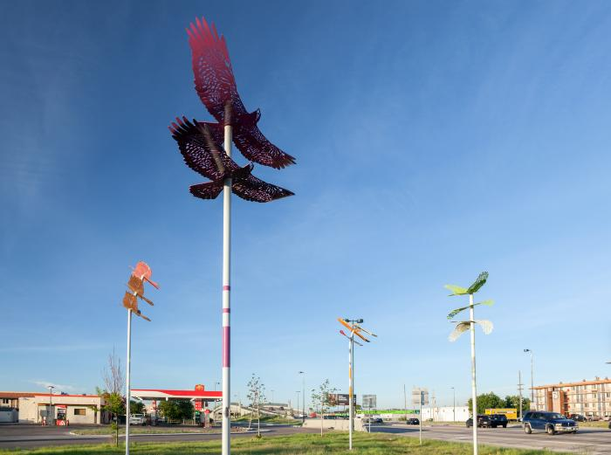
Pinion (2017.1.1)
Looking to native prairie species of birds found in and around Denver’s Montbello neighborhood, Zoccola designed and installed a series of winged sculptures in the teardrop-shaped lot on E 39th Avenue located north of the Peoria Crossing bridge. Inspired by the area’s proximity to the Rocky Mountain Arsenal Wildlife Refuge, the five sculptures depict a bald eagle, a northern harrier, an American kestrel, a red-tailed hawk, and a Swainson's hawk.

