Slide 1
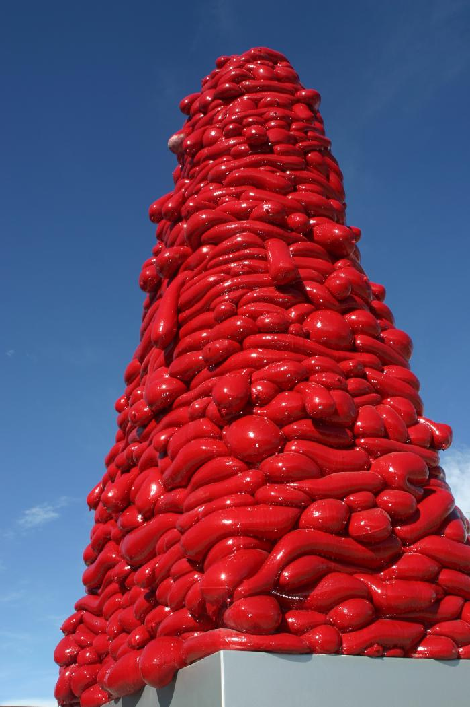
National Velvet (2008.7.1)
Created by artist John McEnroe, "National Velvet" is an Obelisk standing 20 feet tall near Highline Pedestrian Bridge. It is comprised of two parts: an aluminum base and a red fiberglass sculpture. The work was constructed using sand filled nylon, which was coated in resin, then drained of its sand to make a translucent "candy" shell. The hollow interior is lit internally by a "tree" of compact florescent lights. "National Velvet" won the People&#39;s Choice Award for best new public art in 2008. [vimeo src=https://player.vimeo.com/video/371495463]

