Slide 1
[BLANK] (IN PROGRESS_THEODORA HOTEL Ext)

Slide 2
[BLANK] [Duplicate] (IN PROGRESS_THEODORA HOTEL Int)

Slide 3
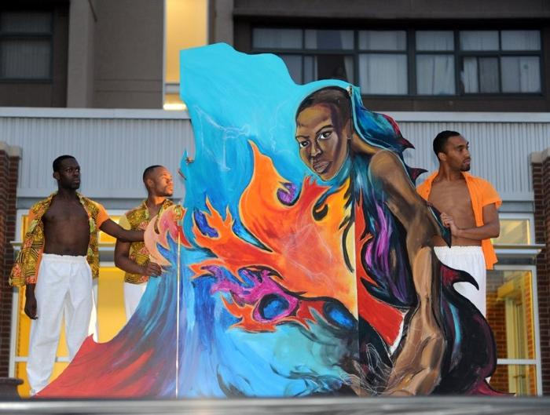
Cleo Parker Robinson: Green Technology Summer Institute of Service Youth Program - 2010 (UAF.2010.8)
This mural was created through a summer program with Cleo Parker Robinson Dance. Their summer institute targeted the North East Park Hill Neighborhood, engaging youth in a range of activities and projects designed to build and enhance value for the neighborhoods and communities where the students reside, work and play. Youth completed construction of a three-piece traveling mural that highlighted the four elements. Green Technology staff members Charles White and Leticia Tanguma worked with the youth to build the mural and produce a performance around the eight foot mural that creatively addressed taking care of Mother Earth and her inhabitants. Elements of the production were presented for patrons and passersby of Wystones World Teas as well as hundreds of students at the Bruce Randolph School.

