Slide 1
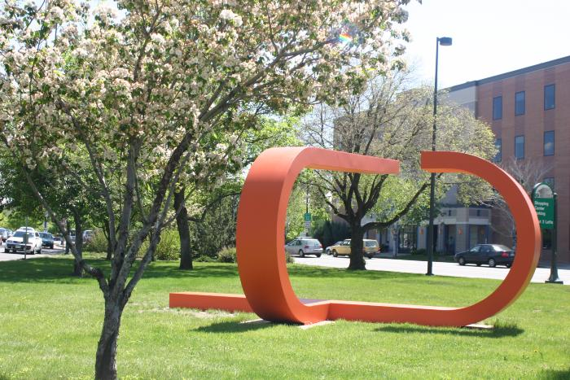
Untitled (U Shape) (1965.2.1)
This sculpture by Anthony Magar features two red abstract "u" shapes.

Slide 2
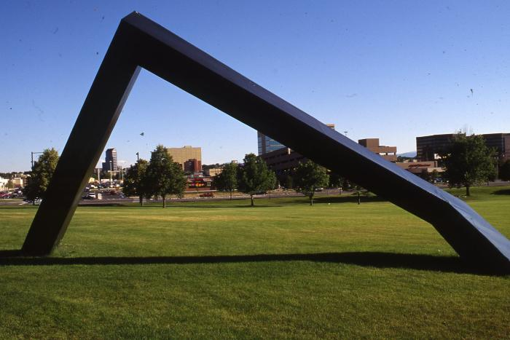
Untitled (black abstract line, dedicated to Martin Luther King, Jr.) (1968.11.1)
In 1968, Roger Kotoske brought artists Robert Morris, Angelo di Benedetto, Richard Van Buren, Peter Forakis, Tony Magar, Dean Fleming, Robert Mangold and Wilbert Verhelst to Denver to create and install outdoor sculptures in Burns Park as part of the Denver National Sculpture Symposium This piece was dedicated to Martin Luther King, Jr.

Slide 3
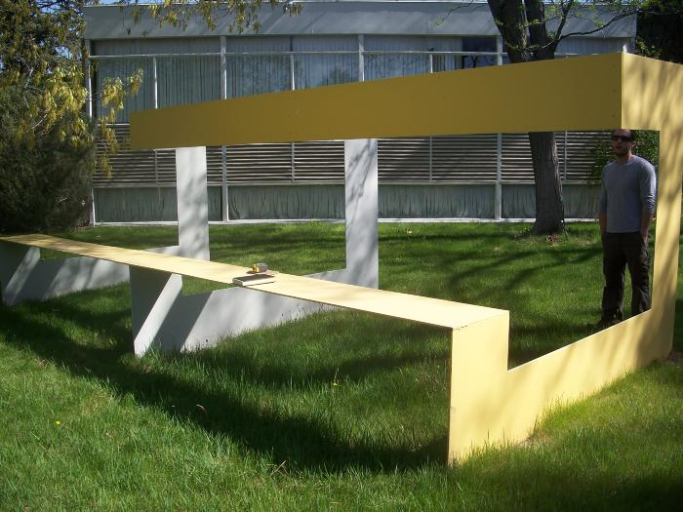
Untitled (yellow bench) (2009.8.1)

