Slide 1
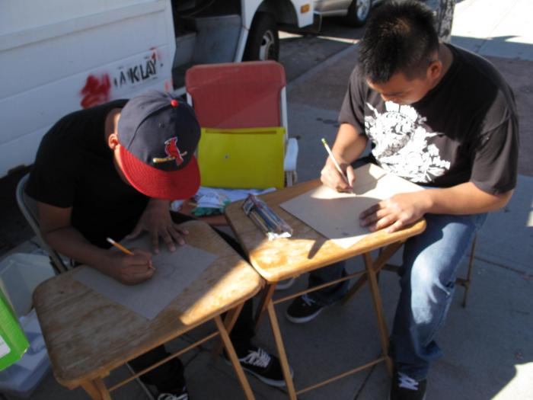
bARTer Collective Youth Educational Workshops (UAF.2010.12)
The bARTer collective worked with youth to design t-shirt stencils.

