Slide 1
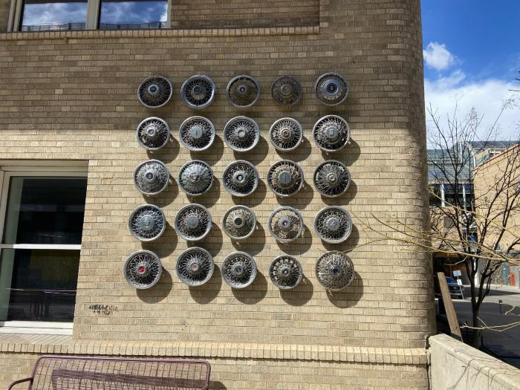
25 Fake Wire Spoke Knock – Off Hubcaps (AV.2019.1.1)

