Slide 1
We Belong (2015.1.1)
Andrea Moore was the “Artist-in-Residence” for the Bridge Project at La Alma Neighborhood House. Over a four-week period, she worked directly with students after school and on weekends, leading poetry workshops to generate content for a permanent WORD ART installation.

Slide 2
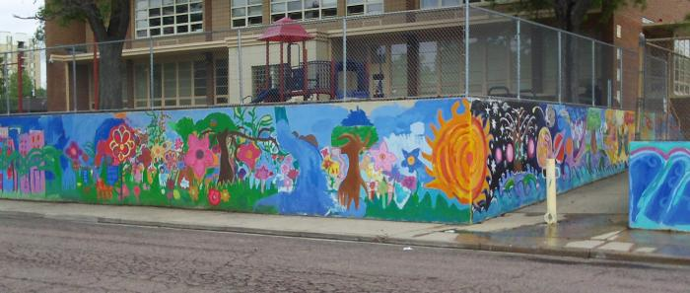
Brown Elementary School (abstract; sun, flowers, geometric designs) (UAF.2009.7)
Barth Quenzer, Denver Public School teacher, and local artist Jeremy Ulibarri (JOLT) created a mural program with students at Brown Elementary School.

Slide 3
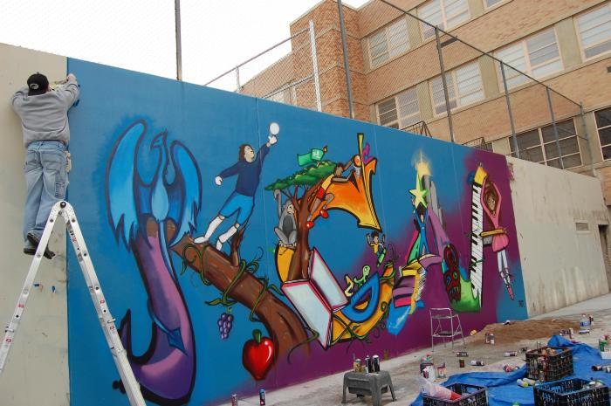
Kunnsmiller Art Academy (UAF.2009.11)
Barth Quenzer, Denver Public School teacher, and local artist Jeremy Ulibarri (JOLT) created a mural program with students at Kunnsmiller Art Academy.

Slide 4
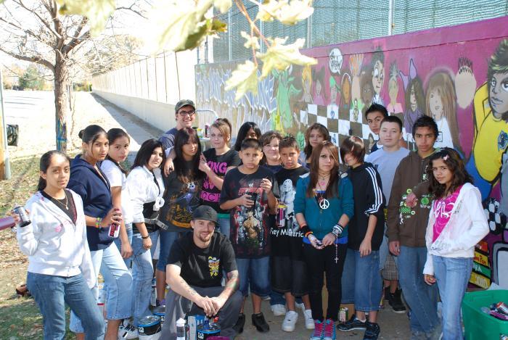
Lake Middle School (UAF.2009.12)
Barth Quenzer, Denver Public School teacher, and local artist Jeremy Ulibarri (JOLT) created a mural program with students at Lake Middle School.

Slide 5
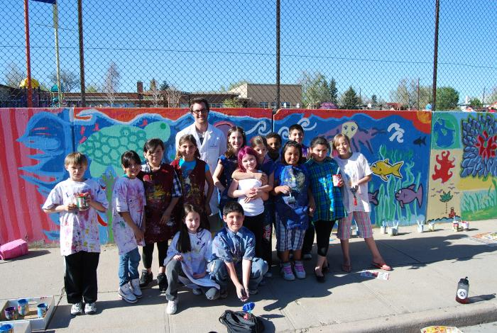
Brown Elementary School (flowers, blue design) (UAF.2010.1)
Barth Quenzer, Denver Public School teacher, and local artist Jeremy Ulibarri (JOLT) created a mural program with students at Brown Elementary School.

Slide 6
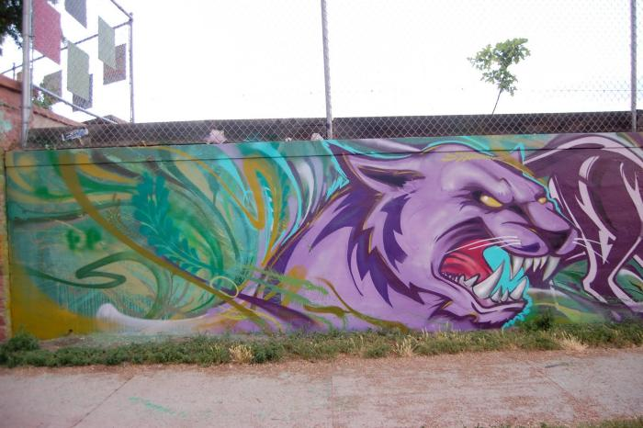
Valdez Elementary School (UAF.2010.2)
Local artist Jeremy Ulibarri (JOLT) worked with Valdez Elementary School students in the creation of this mural.

Slide 7
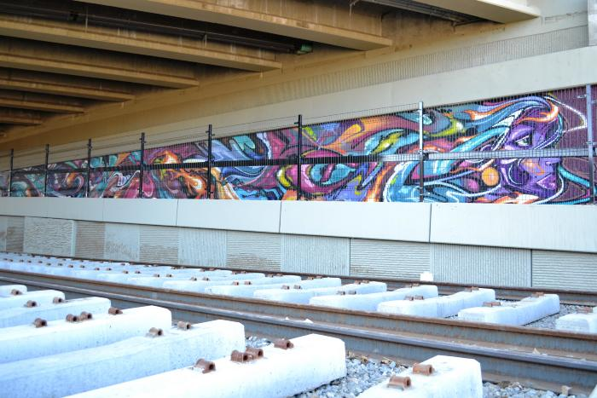
RTD Station (UAF.2011.7)
This Federal Blvd. bridge mural created by JOLT and Guerrilla Garden is visible to RTD Light Rail commuters.

Slide 8
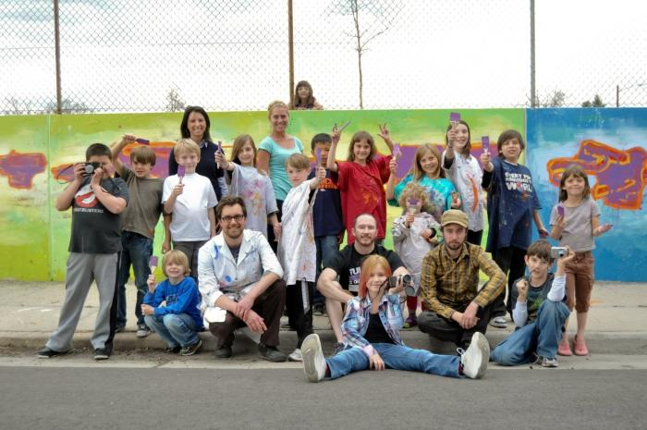
Brown Elementary School (abstract; purple, green, blue) (UAF.2011.10)
Barth Quenzer, Denver Public School teacher, and local artist Jeremy Ulibarri (JOLT) partnered with Think 360 Arts and local students for this Brown Elementary School mural.

Slide 9
We Are But Seeds of Social Change (UAF.2012.6)
Barth Quenzer and local artist Jeremy Ulibarri (JOLT) worked with Denver Public School teachers on this mural.

