Slide 1
[BLANK] (IN PROGRESS_FEDERAL&25TH)

Slide 2
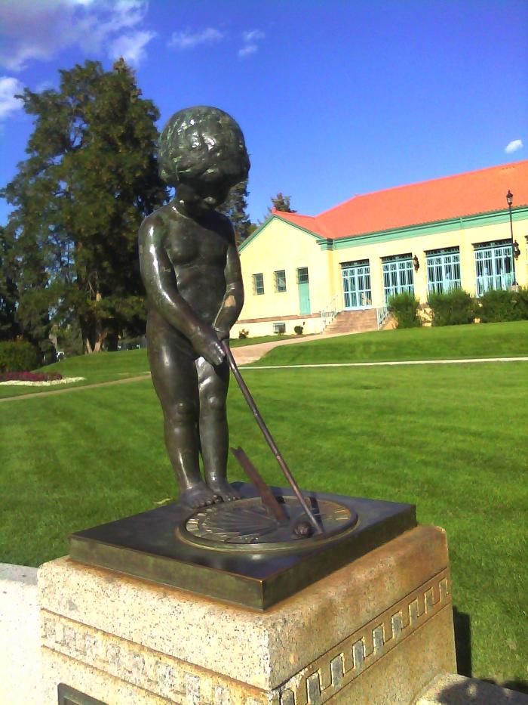
Elizabeth Allen Sopris Memorial; Sundial and Flagpole (1925.1.1)
The Sopris Memorial (a stone seat, a pool, and a small statue of a boy at whose feet is a bronze sundial) was another gift to Denver by S. T. Sopris in memory of his mother Elizabeth Ellen Sopris, in 1925. The memorial is just west of the pavilion, although the pool began to leak and is now a flower bed.

Slide 3
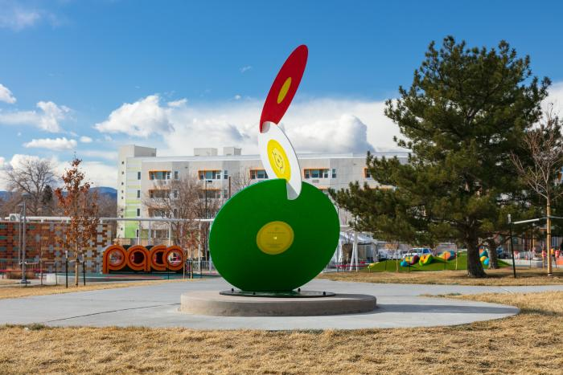
Que Viva Paco (2021.2.1)
Que Viva Paco honors Francisco “Paco” Sanchez, who in 1954 launched Denver’s first Spanish language radio station. The artwork consists of three stainless-steel music records, approximately five feet in diameter, painted in the colors of the United States and Mexican flags. The disks represent the Mexican and Latin music Paco would “spin” over the local airwaves.

Slide 4
Sun Spot (2011.4.1)
Sun Spot is a multi-piece artwork for Denver’s new Municipal Animal Shelter at the South Platte Campus. The primary piece is a 25’-tall iconic dog sculpture located at the southeast corner of the site, adjacent to the South Platte Trail and visible from Interstate-25. The form of the dog is an amalgam of many different dogs, in effect becoming “every dog.” Its pet-like, “sitting dog” pose expresses a friendly, playful, and welcoming nature. The sculpture is made from a structural steel skeleton overlaid with stainless steel mesh that is then covered with more than 90,000 individual stainless steel pet tags. The accumulation of pet tags is a symbol of the thousands of pet adoptions that occur at the shelter every year. In addition to metaphoric meaning, the pet tags will have phenomenological effects. The tags hang from hooks and flutter in the breeze. The second piece of Sun Spot is a suspended sculpture located in the front lobby and adoption waiting room of the Animal Shelter. Its principal ele­ment is a 6’-diameter collar, sized to fit the exterior dog sculpture. Hanging from the collar is an oversized pet tag etched with the name “Sun Spot.” The collar is made from blackened steel and gold aluminum, with stainless steel buckle and spike details. Decorative patterns cut and etched into the collar are derived from the leaves and berries of the plants used around the dog sculpture. The stainless steel chain used to suspend the collar from the ceiling references dog leashes. Hanging from the lower side of the collar are approximately 100 individual strands of chain, ranging in length from 30” to 66”. Every time a pet is adopted from the shelter the new owner will be given an opportunity to have a pet tag engraved with the name of the pet and date of the adoption, and then attached to a link of the chain. While the tags used on the dog sculpture are all stainless steel circles, the tags for the collar will be a variety of shapes and colors. Over the years the sculpture will accumulate more and more tags, becoming a communal gesture of animal stewardship. The sculpture is designed to accommodate up to 7,000 tags. The final element of the artwork is another set of approximately 50 pet tags, subtly marking native plants along the South Platte Trail west of the South Platte Campus. These tags are engraved with botanical and common plant names. Using pet tags to “name” the plants links their value with the societal value placed on pets. The artists hope that the tree tags may eventually inspire an “adopt-a-tree” program, whereby non-native plants are replaced with native plants in an effort to regenerate the riparian plant zone similar to how the adjacent brownfield has been reclaimed by the municipal facility, and linking back to the pet adoptions that occur at the Animal Shelter. The three pieces of Sun Spot each work on an individual basis but are tied together by their common use of pet tags as an inspirational material that has a direct link to the function of the Animal Shelter.

