Slide 1
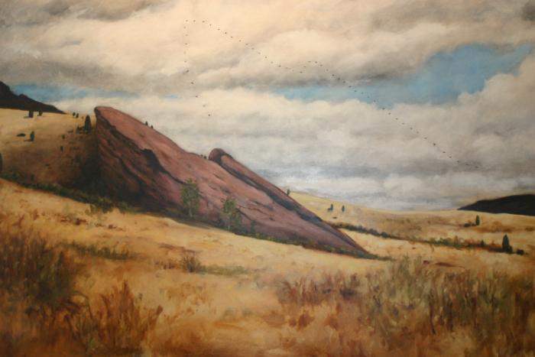
Untitled (Red Rocks) (2003.37.1)

Slide 2
Untitled (William Stockman 1)

Slide 3
Untitled (William Stockman 2)

Slide 4
Untitled (William Stockman 3)

Slide 5
Untitled (William Stockman 4)

