Slide 1
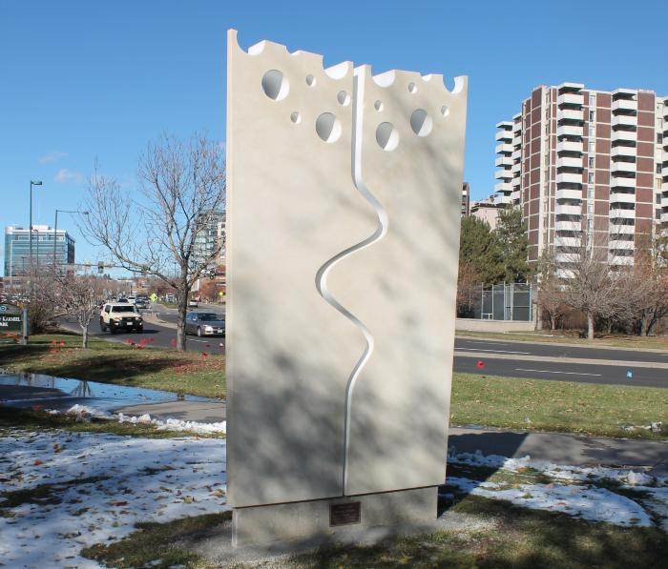
Allies in Life (2015.7.1)
Carved from a solid block of limestone, the work utilizes negative space to convey its message. The limestone block is divided into two pieces signifying the fact that Karmiel Park is part of Denver's Sister City program. The twin blocks represents "sisters" that, together, form a graphic of life.

