Slide 1
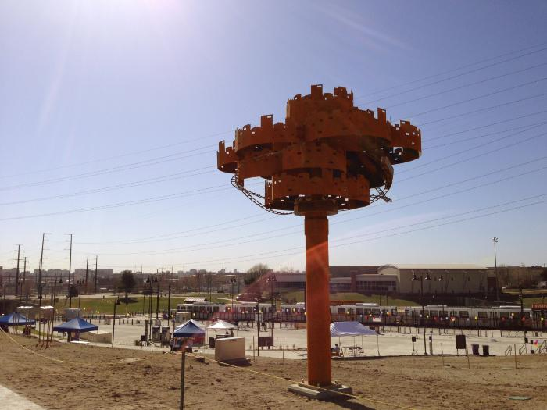
City of Dreams (2013.3.15)
"The Decatur/Federal Light Rail Station project represents our evolution. The sculpture expresses our advancement. Our transition to an ecologically balanced society will be inspiring: there will be innovation, planning, and discovery that will make it so our cities have virtually no negative impact on the planet. This sculpture illustrates a city with no environmental impact. It is designed to look like it is growing from within. The piece articulates what the light rail means to our future. At one point our cities were entirely defined by the waterways, and then they took shape in relationship to our highways. The light rail is guiding our future." - Joshua Wiener

Slide 2
[BLANK] (IN PROGRESS_56TH AVENUE)

