Slide 1
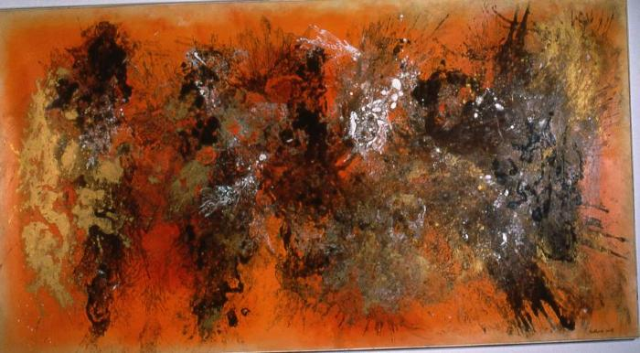
The Burmese Nebula (1961.3.1)
Abstract painting by Vance Kirkland.

Slide 2
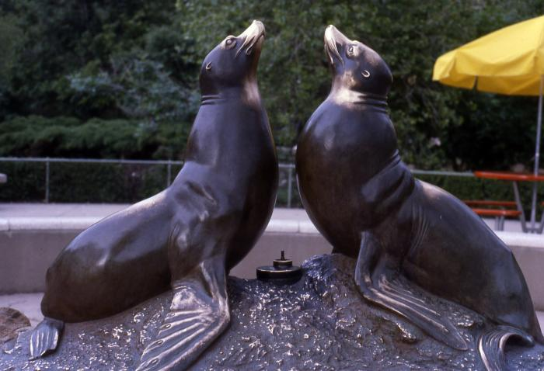
Norgren Fountain (seal fountain)
(1962.1.1)
This bronze sculpture by Louis Paul Jonas is a fountain featuring two seals.

