Slide 1
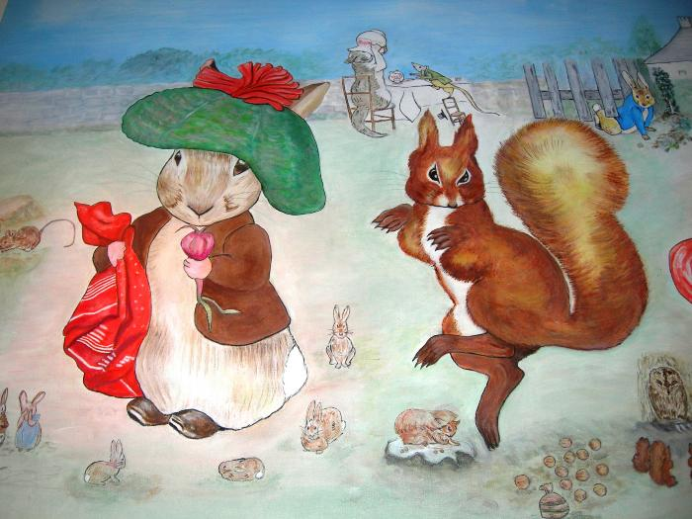
Beatrix Potter Characters (1989.1.1)
Characters created by English children&#39;s author Beatrix Potter. Peter Rabbit. Mrs Tiggy-Winkle. Squirrel Nutkin.

