Slide 1
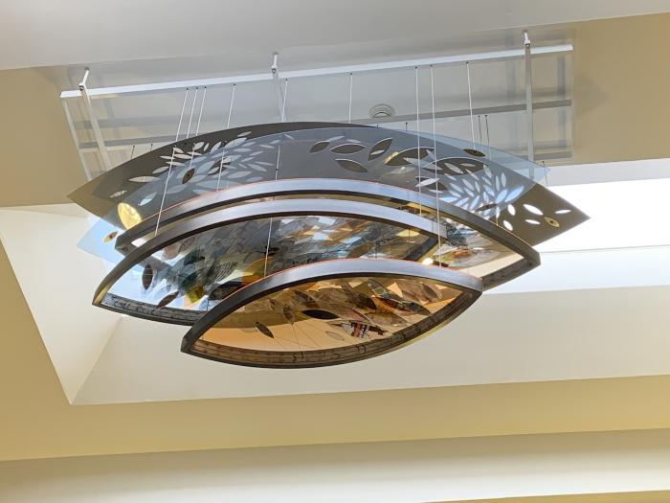
Beyond the Sky of Memories (2015.5.1)
Beyond the Sky of Memories is an 8 by 4 feet sculpture installed in the two-story atrium of the Elbra M. Wedgeworth Municipal building (Denver Motor Vehicle building). The artwork consists of five layers of steel and plexiglass cascading into the space. With this piece, Aell wanted to create a mood describing the vividly changing energy pattern of the district. She used historical photographs, and rephotographed and exposed them twice. She did the same with photographs from the present. With the photographs strung between the frames, Aell creates an atmosphere making the visitors feel special and also connecting the district's history to the neighbors today. From the artist: “For many years one of my favorite shapes has been a leaf-like shape. This leaf-like shape refers to the intersection of two circles. Two entities are coming together and sharing a common space. They connect with each other and mingle. What they leave behind is the best of their interaction, which by itself will develop its own identity. When the shapes are grouped together, they remind me of a flock of birds or a swarm of fish. They basically depict energy flow.”

Slide 2
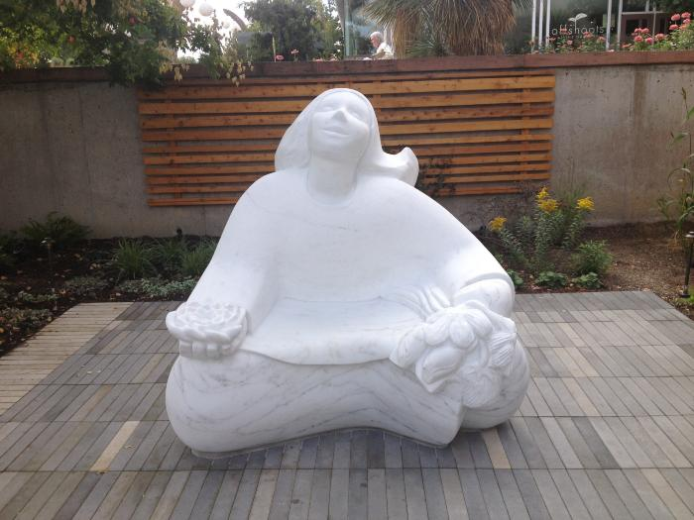
Flower Girl (2016.1.1)
Madeline Wiener created a carved marble sculpture of a girl holding a bouquet of flowers in her left hand and a lotus in her right hand. Her uplifted face is welcoming and her gesture is of joy in the experience of engaging with flowers. A joyful, interactive sculpture celebrating the natural world. Located at the Denver Botanic Gardens, visitors can find her inside the "Sensory Garden" and even sit on her lap. Carved from a solid block of Colorado Yule Marble she represents a garden visitor experiencing happiness through all her senses.

