Slide 1
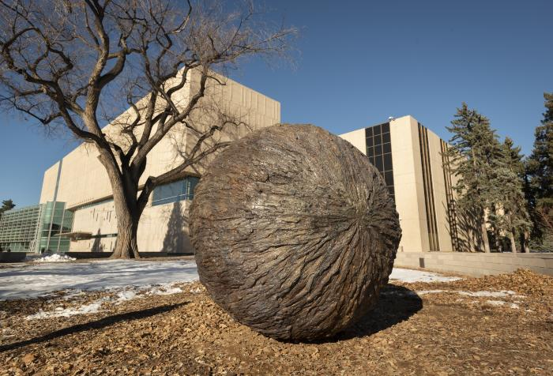
Rondure (2020.10.1)
"Rondure" by Nikki Pike (Denver, CO) consists of a 7&#39;5" spherical sculpture cast in bronze with a texture taken from tree bark. The sculpture contains a motion-activated sound component of wildlife found in Colorado. Pike collaborated with bARTer Collective, a collective of artists, educators and service workers, to offer outreach opportunities to create a community connection with the artwork and the Denver Museum of Nature & Science. [vimeo src=https://player.vimeo.com/video/834593935] [vimeo src=https://player.vimeo.com/video/827309599]

Slide 2
[BLANK] (IN PROGRESS_RUBY HILL PHASE 3)

Slide 3
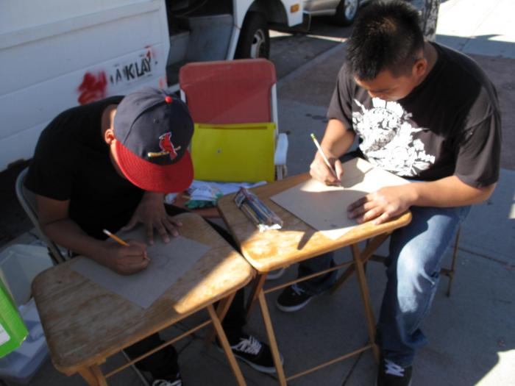
bARTer Collective Youth Educational Workshops (UAF.2010.12)
The bARTer collective worked with youth to design t-shirt stencils.

