Slide 1
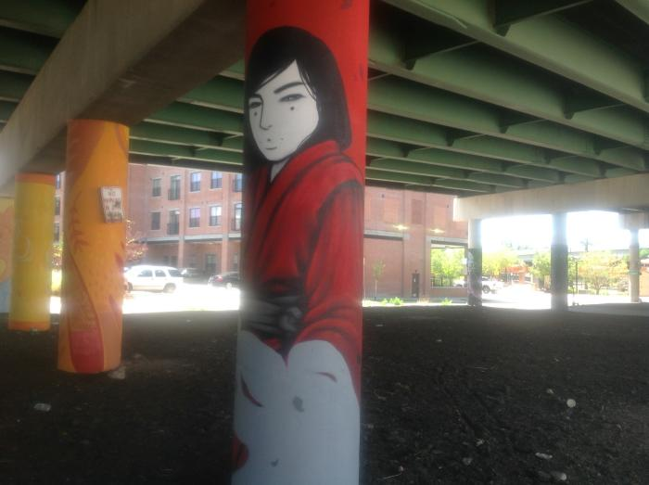
Evans Bridge Project (UAF.2018.15)

