Slide 1
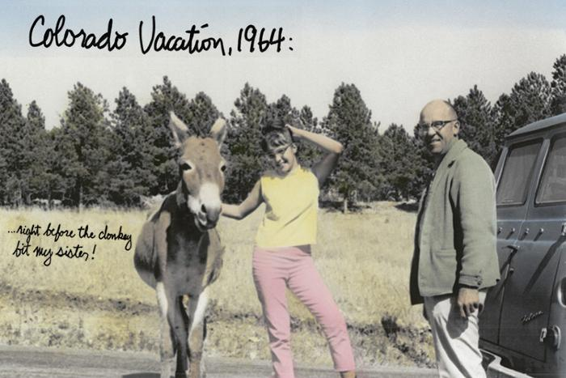
Colorado Vacationland (1991.10.1)

Slide 2
Albedo (2010.8.1)
Mr. Akan’s work often utilizes fiber optics and light in the natural environment allowing the elements (wind, natural light, etc) to enhance the piece. His pieces force the question of synthetic vs. natural environments. Albedo is an undulating sculptural wall that includes the fiber optic elements used in previous pieces for a night-time presence. The wall consists of multiple glass panels to resemble an abstract form of a greenhouse.

Slide 3
Thought Balloons (2011.1.1)
Thought Balloons is an interactive artwork that playfully inserts software generated text based dialog over seated people&#39;s heads. As people sit on the black bench, thought balloons, like those found in a comic book format, magically appear above their heads. At other times when two or more people sit on the bench a dialog starts up between them. The texts for each balloon or dialog bubble are kept fresh and lively with the help of the local community. Not only were Central Park residents of all ages invited to gather and playfully construct humorous conversations and informative repartee, community members are welcome to continually contribute to the dialog by submitting to www.thoughtballoons.org. In a new town like Central Park, Thought Balloons acts as a catalyst to bring people together. Not only by starting conversations in front of the piece but also by creating opportunities for members of the community to contribute language to the piece itself.

Slide 4
Sun Spot (2011.4.1)
Sun Spot is a multi-piece artwork for Denver’s new Municipal Animal Shelter at the South Platte Campus. The primary piece is a 25’-tall iconic dog sculpture located at the southeast corner of the site, adjacent to the South Platte Trail and visible from Interstate-25. The form of the dog is an amalgam of many different dogs, in effect becoming “every dog.” Its pet-like, “sitting dog” pose expresses a friendly, playful, and welcoming nature. The sculpture is made from a structural steel skeleton overlaid with stainless steel mesh that is then covered with more than 90,000 individual stainless steel pet tags. The accumulation of pet tags is a symbol of the thousands of pet adoptions that occur at the shelter every year. In addition to metaphoric meaning, the pet tags will have phenomenological effects. The tags hang from hooks and flutter in the breeze. The second piece of Sun Spot is a suspended sculpture located in the front lobby and adoption waiting room of the Animal Shelter. Its principal ele­ment is a 6’-diameter collar, sized to fit the exterior dog sculpture. Hanging from the collar is an oversized pet tag etched with the name “Sun Spot.” The collar is made from blackened steel and gold aluminum, with stainless steel buckle and spike details. Decorative patterns cut and etched into the collar are derived from the leaves and berries of the plants used around the dog sculpture. The stainless steel chain used to suspend the collar from the ceiling references dog leashes. Hanging from the lower side of the collar are approximately 100 individual strands of chain, ranging in length from 30” to 66”. Every time a pet is adopted from the shelter the new owner will be given an opportunity to have a pet tag engraved with the name of the pet and date of the adoption, and then attached to a link of the chain. While the tags used on the dog sculpture are all stainless steel circles, the tags for the collar will be a variety of shapes and colors. Over the years the sculpture will accumulate more and more tags, becoming a communal gesture of animal stewardship. The sculpture is designed to accommodate up to 7,000 tags. The final element of the artwork is another set of approximately 50 pet tags, subtly marking native plants along the South Platte Trail west of the South Platte Campus. These tags are engraved with botanical and common plant names. Using pet tags to “name” the plants links their value with the societal value placed on pets. The artists hope that the tree tags may eventually inspire an “adopt-a-tree” program, whereby non-native plants are replaced with native plants in an effort to regenerate the riparian plant zone similar to how the adjacent brownfield has been reclaimed by the municipal facility, and linking back to the pet adoptions that occur at the Animal Shelter. The three pieces of Sun Spot each work on an individual basis but are tied together by their common use of pet tags as an inspirational material that has a direct link to the function of the Animal Shelter.

Slide 5
Water in All Its States (L'eau dans tous ses etats) (2015.8.1)
Paris-based light artist Yann Kersalé was selected for a $1 million commission to provide a lighting design for the train and Level 5 canopies, and a unique video-based art installation for the escalator connecting the Public Transit Center to the Level 5 plaza. His work is titled “L’eau dans tous ses états” or “Water in all its states.” Kersalé is an internationally-acclaimed artist who works with light as his primary medium, and he has worked on public and private projects all over the world with acclaimed architects such as Helmut Jahn and Jean Nouvel.

Slide 6
Field of Air (2015.9.1)
California-based sculptor Ned Kahn has created a large wind-activated sculptural installation titled “Field of Air.” For his artwork at DIA, Kahn was inspired by the way the grasses of the plains expose the invisible force of the wind. Each of the thousands of individual blades are made from brushed aluminum and hinged so that the fascinating play of air on the plaza becomes a contemplative or even meditative backdrop to activity.

Slide 7
Shadow Array (2015.10.1)
Denver artist Patrick Marold has created a large-scale installation to enhance the expansive landscape area around the train platform at the Westin Denver International Airport. The sculpture, titled “Shadow Array,” consists of 236 beetle-kill spruce logs from southern Colorado, which will create an active experience for travelers as they enter and exit the valley by train, while also providing a dynamic panorama from the hotel and public spaces to the south of the plaza. The shadows and patterns created by the sculpture will change and shift according to the seasons, daily passage of the sun and with evening lighting.

Slide 8
Colorado River (2015.11.1)
Wopo Holup was commissioned to create a series of sculptural pieces to grace the west wall of the Westin Conference Center pre-function area. The work represents ten continuous sections of the Colorado River running from Grand Lake in the Rocky Mountains to the Gulf of California. Along the way it runs through five states forming Lake Powell, Lake Mead and irrigated lands such as Imperial Valley. The work was cut from aluminum and hand-covered in 24-carat gold leaf.

Slide 9
En-Route (2015.12.1)
Patterson was commissioned to produce nine panels of artwork that compose a large artwork on the east wall of the Westin Conference Center pre-function area. Patterson layered varied imagery through drawing, painting, and collaging sheets of acrylic paint, creating a sense of fragmented time. Her imagery hearkens urban street grids, flight maps and landscapes with bursts of color and energy.

Slide 10
Strange Continents (2015.13.1)
Mindy Bray painted her largest mural commission to date along the 150-foot-long hallway at the entrance to the Westin hotel. The imagery for the work is derived from hundreds of photographs of the Platte River at Confluence Park in Denver, which the artist digitally manipulated to arrive at a vocabulary of shapes that were composed to resemble a global map. The colors recall traditional colors used in maps.

