Slide 1
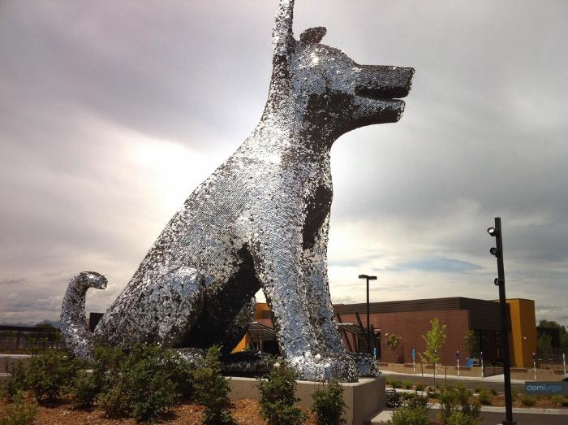
Sun Spot (2011.4.1)
Sun Spot is a multi-piece artwork for Denver’s new Municipal Animal Shelter at the South Platte Campus. The primary piece is a 25’-tall iconic dog sculpture located at the southeast corner of the site, adjacent to the South Platte Trail and visible from Interstate-25. The form of the dog is an amalgam of many different dogs, in effect becoming “every dog.” Its pet-like, “sitting dog” pose expresses a friendly, playful, and welcoming nature. The sculpture is made from a structural steel skeleton overlaid with stainless steel mesh that is then covered with more than 90,000 individual stainless steel pet tags. The accumulation of pet tags is a symbol of the thousands of pet adoptions that occur at the shelter every year. In addition to metaphoric meaning, the pet tags will have phenomenological effects. The tags hang from hooks and flutter in the breeze. The second piece of Sun Spot is a suspended sculpture located in the front lobby and adoption waiting room of the Animal Shelter. Its principal ele­ment is a 6’-diameter collar, sized to fit the exterior dog sculpture. Hanging from the collar is an oversized pet tag etched with the name “Sun Spot.” The collar is made from blackened steel and gold aluminum, with stainless steel buckle and spike details. Decorative patterns cut and etched into the collar are derived from the leaves and berries of the plants used around the dog sculpture. The stainless steel chain used to suspend the collar from the ceiling references dog leashes. Hanging from the lower side of the collar are approximately 100 individual strands of chain, ranging in length from 30” to 66”. Every time a pet is adopted from the shelter the new owner will be given an opportunity to have a pet tag engraved with the name of the pet and date of the adoption, and then attached to a link of the chain. While the tags used on the dog sculpture are all stainless steel circles, the tags for the collar will be a variety of shapes and colors. Over the years the sculpture will accumulate more and more tags, becoming a communal gesture of animal stewardship. The sculpture is designed to accommodate up to 7,000 tags. The final element of the artwork is another set of approximately 50 pet tags, subtly marking native plants along the South Platte Trail west of the South Platte Campus. These tags are engraved with botanical and common plant names. Using pet tags to “name” the plants links their value with the societal value placed on pets. The artists hope that the tree tags may eventually inspire an “adopt-a-tree” program, whereby non-native plants are replaced with native plants in an effort to regenerate the riparian plant zone similar to how the adjacent brownfield has been reclaimed by the municipal facility, and linking back to the pet adoptions that occur at the Animal Shelter. The three pieces of Sun Spot each work on an individual basis but are tied together by their common use of pet tags as an inspirational material that has a direct link to the function of the Animal Shelter.

Slide 2
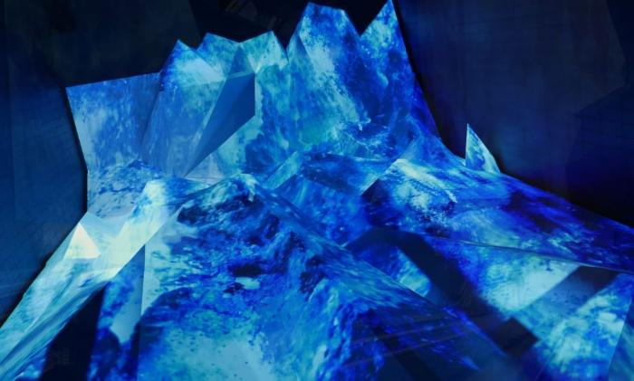
Water in All Its States (L'eau dans tous ses etats) (2015.8.1)
Paris-based light artist Yann Kersalé was selected for a $1 million commission to provide a lighting design for the train and Level 5 canopies, and a unique video-based art installation for the escalator connecting the Public Transit Center to the Level 5 plaza. His work is titled “L’eau dans tous ses états” or “Water in all its states.” Kersalé is an internationally-acclaimed artist who works with light as his primary medium, and he has worked on public and private projects all over the world with acclaimed architects such as Helmut Jahn and Jean Nouvel.

Slide 3
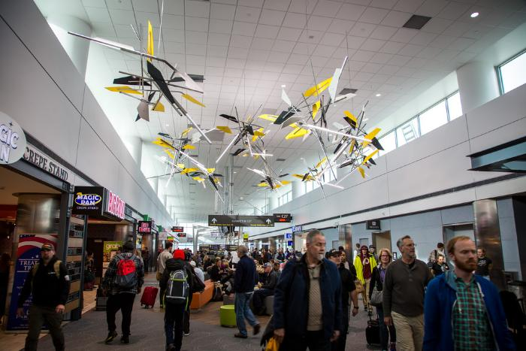
Vorticity (2016.4.1)
The installation is comprised of eleven suspended sculptures arranged in a spiral, the shapes of which were determined by tracing the Rocky Mountains’ dramatic profile. The spiral — or vortex, from which the work’s name is derived — is one of nature’s most common forms, found in elements as small as snail shells or as large as galaxies.

Slide 4
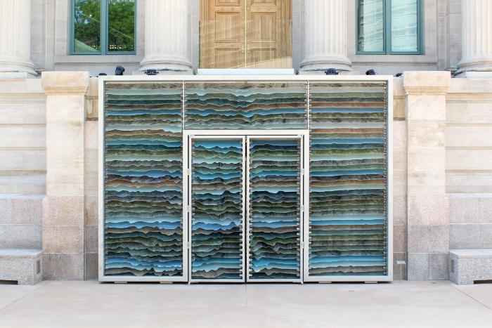
Mine Craft (2017.2.1)
Mine Craft is the result of studying of the iconic imagery associated with Colorado. Inspiration was drawn from the geography, industry and global presence of the state, and explored a variety of methods to represent these abstracted elements through the application of the current advancements in fabrication technology. The geography and landscape of Colorado is unique and exceptionally beautiful. Mine Craft uses the topography of the state, cut from a variety of materials embedded with significance to the region and stacked in order to create an abstracted scale map of Colorado. Decades ago, like many of the states that were on the frontier, Colorado was wild and beautiful and free for the taking. This artwork delves into the increasingly relevant subject of our responsibility to the environment. Conscientious extraction and use of the earth’s resources has implications not only for the residents of the region, but also on a much larger, global scale. The striations seen in the piece are intended to represent materials that are locally sourced. The overall design is tactile and nuanced - distinctly modern, both in its formal representation and materiality - and sits in subtle contrast to the neo-classical architecture of the McNichols Building. Mine Craft acts as an invitation to entice visitors into the building to explore its contemporary art exhibitions.

Slide 5
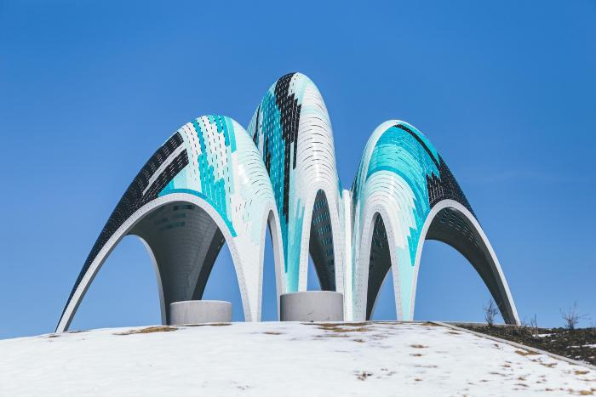
Phantom (2022.8.1)
The Phantom is a pavilion which offers both shading and seating elements to visitors while creating a colorful addition to Prairie Basin Park. The canopy of the pavilion features an array of multiple colors while introducing a formal color gradient from left to right and top to bottom. The skin of the pavilion also features a complex pattern of openings which produces playful shadows on the ground and ambiguous visual effects during the day and change of seasons. The symmetrical pavilion consists of three iconic vaults and stands 16 feet tall at its highest point. This artwork was commissioned by Park Creek Metropolitan District in the Central Park Neighborhood in 2015. It was installed in 2018 and donated to the City and County of Denver in 2022.

