Slide 1
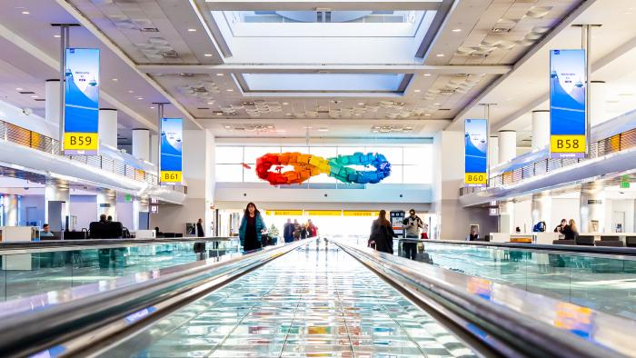
It's Not What You Take, It's What You Bring Back (2025.1.1)
It’s Not What You Take, It’s What You Bring Back is inspired by the idea that life is always in motion, with our luggage symbolizing the cherished items we carry through our journeys. The sculpture consists of 183 upcycled luggage pieces donated by Colorado residents. During the donation process, contributors were encouraged to share stories about their luggage, offering travelers a chance to connect with the history and significance of each piece. The sculpture’s shape evokes the take-off and landing of airplanes, representing the movement of passengers, while its colors mirror Colorado’s vibrant sunrises and sunsets. As travelers’ eyes follow the flow of the luggage, they see the bags metaphorically taking off during the day and landing at night, then taking off at night and landing in the day. Elements surrounding the sculpture highlight key aspects of Colorado’s culture and history, adding layers of meaning to the piece. Designed to be welcoming and engaging, the artwork invites passengers to learn more about Colorado while offering a heartfelt farewell to those departing on their journeys.

