Slide 1
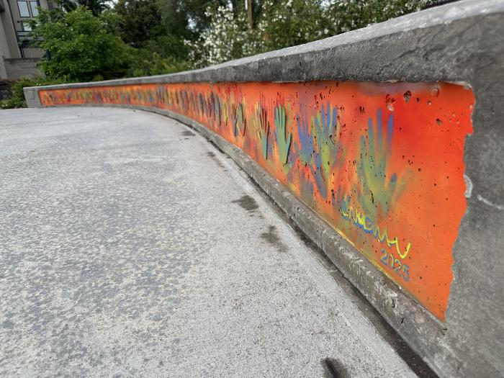
Past, Present, Future (2025.8.1)
I have three requirements for my work: that it is intellectually engaging, emotionally resonant,
and serves the community in which it lives.
The neighborhood means a lot of things to a lot of people, yet what we share is the generational
arc of families and friends that call it home. And, like generations of monarch butterflies, it takes
years to make change and build healthy people and their context.
I think artwork in parks is especially impactful. To quote Mr Rodgers: play is serious business.
Parks are where that happens, and where we learn to be good humans. By considering our ‘Past,
Present, and Future’, I hope to help us all honor those that came before us, be mindful of those
with us, and generous to those that will follow.

