Slide 1
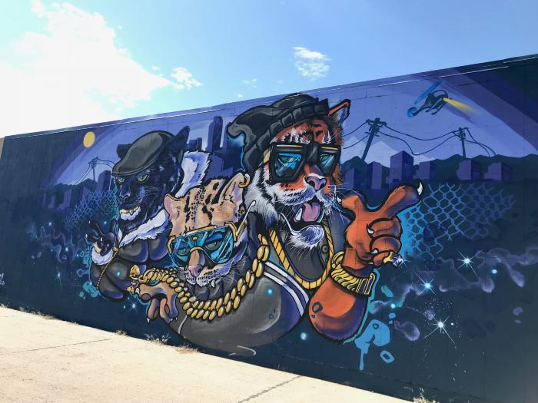
Untitled (stylized anthropomorphic city cats) (UAF.2019.15)

