Slide 1
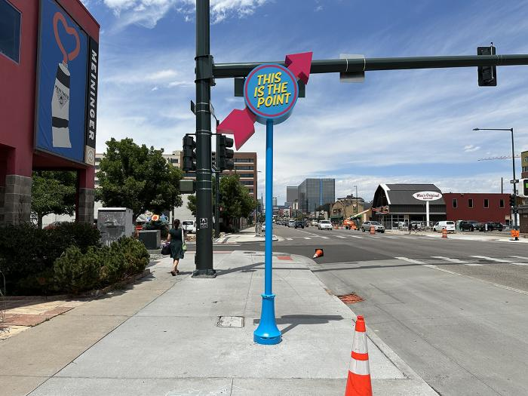
The Good Point (2024.1.1)
Eight whimsical, site-specific artworks along Broadway between 5th and Bayaud avenues were created by Jamie Pawlus. Titled “Happiness,” “I See Neon Lights,” “Mood,” “Signs of Life,” “Somebody/Nobody,” “The Good Point,” “Understanding” and “Understood,” the installations lead viewers along the corridor and inspire moments of contemplation and humor, underscoring the connection between passersby and the spaces they are inhabiting in the moment.

Slide 2
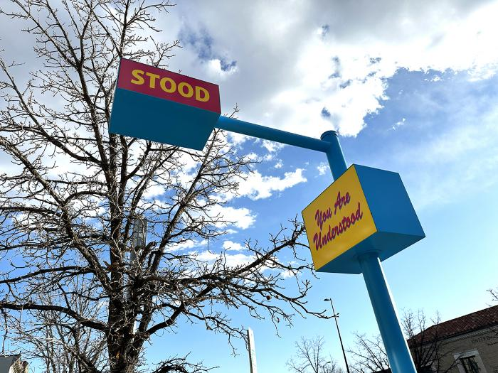
Understood (2024.1.2)
Eight whimsical, site-specific artworks along Broadway between 5th and Bayaud avenues were created by Jamie Pawlus. Titled “Happiness,” “I See Neon Lights,” “Mood,” “Signs of Life,” “Somebody/Nobody,” “The Good Point,” “Understanding” and “Understood,” the installations lead viewers along the corridor and inspire moments of contemplation and humor, underscoring the connection between passersby and the spaces they are inhabiting in the moment.

Slide 3
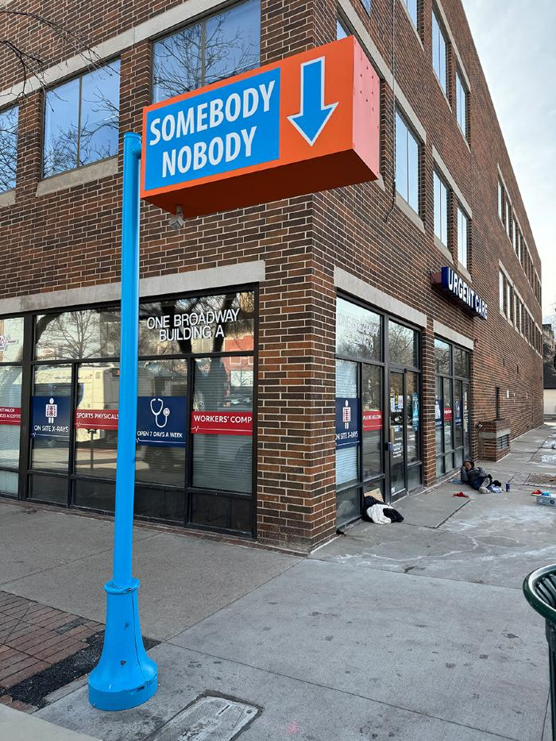
Somebody/Nobody (2024.1.3)
Eight whimsical, site-specific artworks along Broadway between 5th and Bayaud avenues were created by Jamie Pawlus. Titled “Happiness,” “I See Neon Lights,” “Mood,” “Signs of Life,” “Somebody/Nobody,” “The Good Point,” “Understanding” and “Understood,” the installations lead viewers along the corridor and inspire moments of contemplation and humor, underscoring the connection between passersby and the spaces they are inhabiting in the moment.

Slide 4
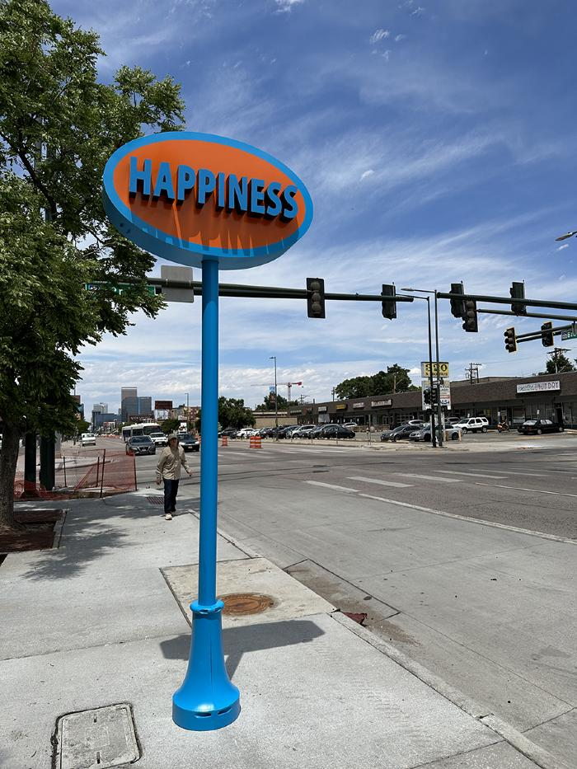
Happiness (2024.1.4)
Eight whimsical, site-specific artworks along Broadway between 5th and Bayaud avenues were created by Jamie Pawlus. Titled “Happiness,” “I See Neon Lights,” “Mood,” “Signs of Life,” “Somebody/Nobody,” “The Good Point,” “Understanding” and “Understood,” the installations lead viewers along the corridor and inspire moments of contemplation and humor, underscoring the connection between passersby and the spaces they are inhabiting in the moment.

Slide 5
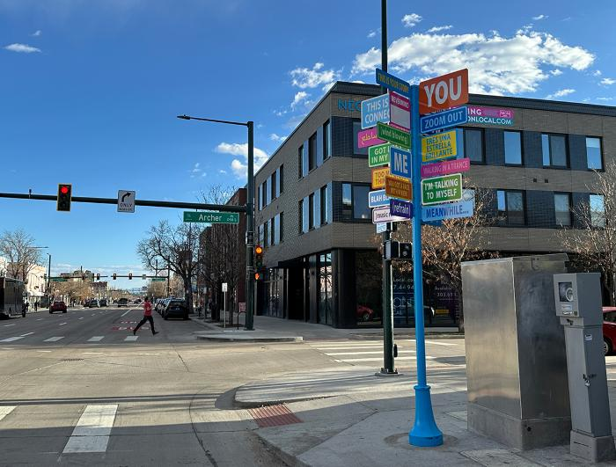
Signs of Life (2024.1.6)
Eight whimsical, site-specific artworks along Broadway between 5th and Bayaud avenues were created by Jamie Pawlus. Titled “Happiness,” “I See Neon Lights,” “Mood,” “Signs of Life,” “Somebody/Nobody,” “The Good Point,” “Understanding” and “Understood,” the installations lead viewers along the corridor and inspire moments of contemplation and humor, underscoring the connection between passersby and the spaces they are inhabiting in the moment.

Slide 6
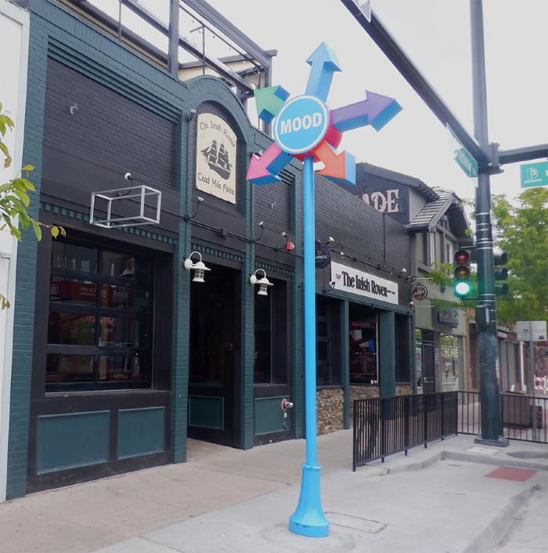
Mood (2024.1.7)
Eight whimsical, site-specific artworks along Broadway between 5th and Bayaud avenues were created by Jamie Pawlus. Titled “Happiness,” “I See Neon Lights,” “Mood,” “Signs of Life,” “Somebody/Nobody,” “The Good Point,” “Understanding” and “Understood,” the installations lead viewers along the corridor and inspire moments of contemplation and humor, underscoring the connection between passersby and the spaces they are inhabiting in the moment.

Slide 7
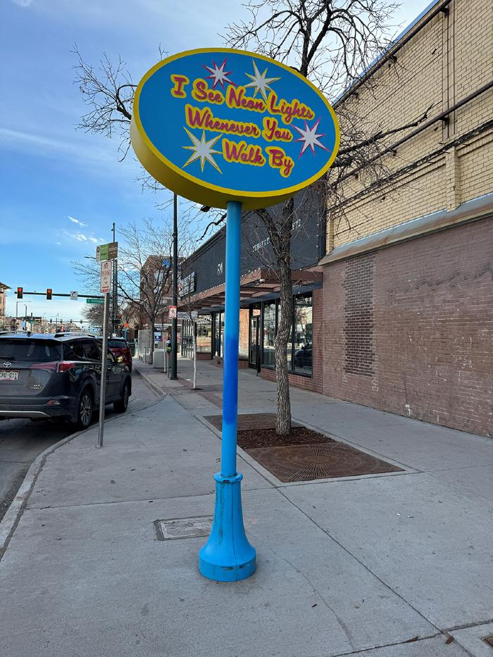
I See Neon Lights (2024.1.8)
Eight whimsical, site-specific artworks along Broadway between 5th and Bayaud avenues were created by Jamie Pawlus. Titled “Happiness,” “I See Neon Lights,” “Mood,” “Signs of Life,” “Somebody/Nobody,” “The Good Point,” “Understanding” and “Understood,” the installations lead viewers along the corridor and inspire moments of contemplation and humor, underscoring the connection between passersby and the spaces they are inhabiting in the moment.

