Slide 1
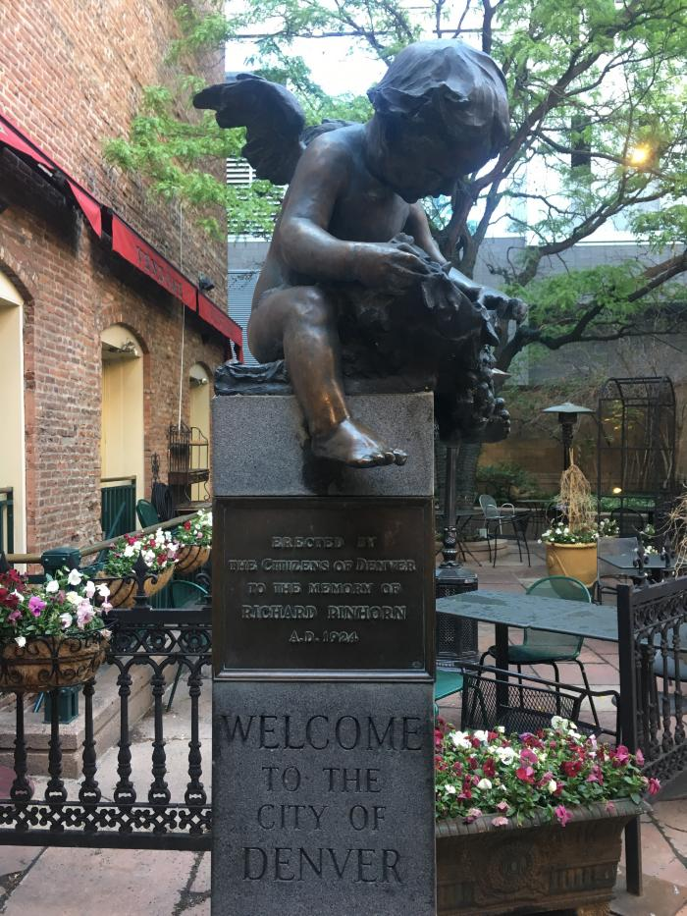
Pinhorn Statue and Fountain (1924.1.1)

Slide 2
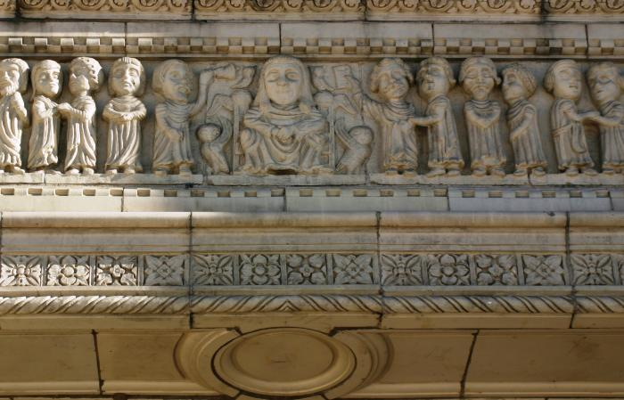
Faculty Row and Animal Spirits (1924.2.1)

Slide 3
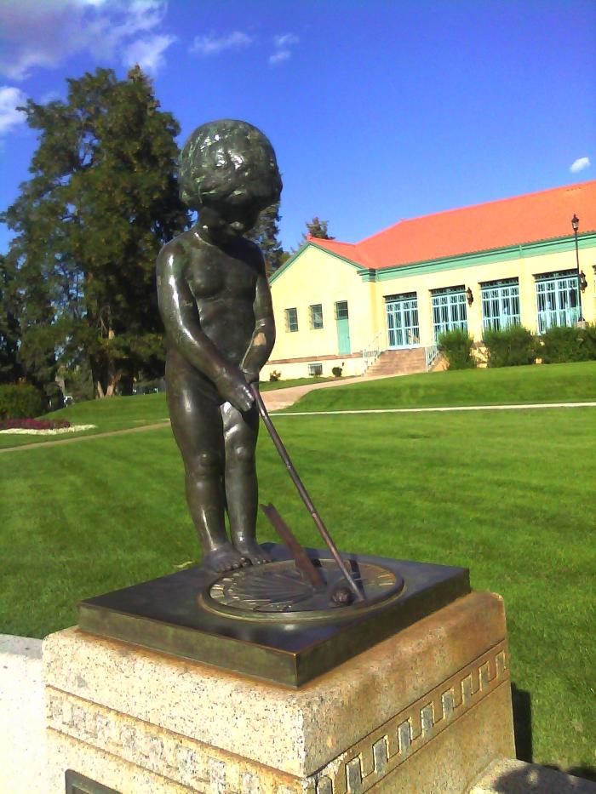
Elizabeth Allen Sopris Memorial; Sundial and Flagpole (1925.1.1)
The Sopris Memorial (a stone seat, a pool, and a small statue of a boy at whose feet is a bronze sundial) was another gift to Denver by S. T. Sopris in memory of his mother Elizabeth Ellen Sopris, in 1925. The memorial is just west of the pavilion, although the pool began to leak and is now a flower bed.

Slide 4
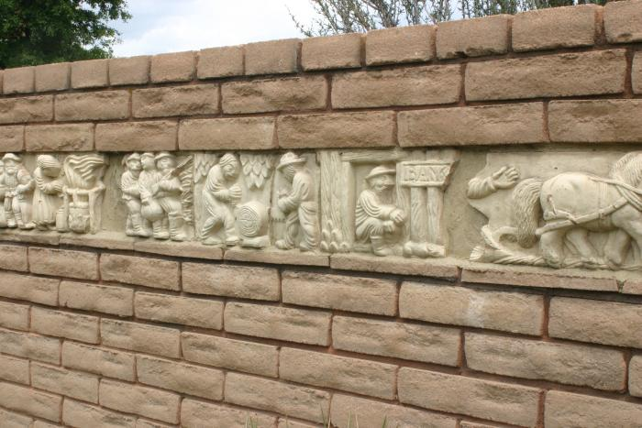
The Story of a Pikes Peaker (1925.2.1)
This relief by Robert Garrison shows the journey of a Pikes Peak traveler. The frieze stretches across the Laura Smith Porter Plains Garden at the Denver Botanic Gardens.

Slide 5
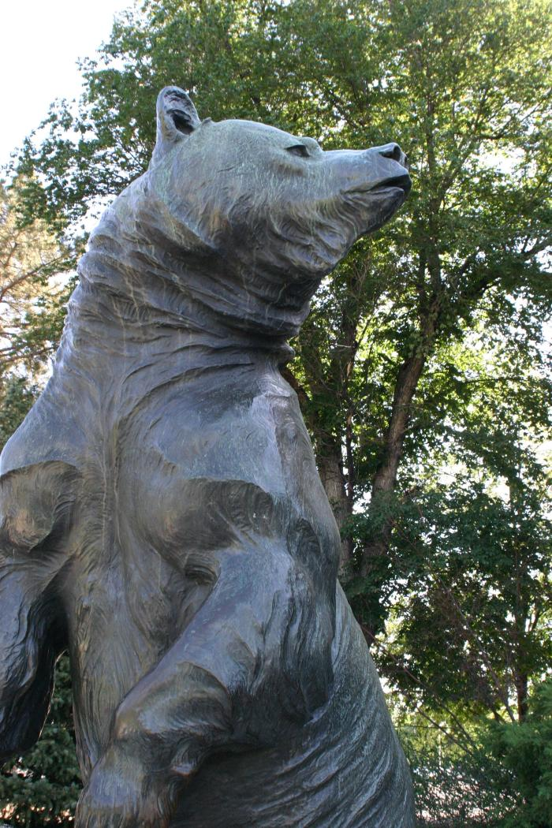
Grizzly's Last Stand (1930.1.1)
Gift, donated by John A. McGuire (Natural History Museum trustee and former editor of Outdoor Life Magazine) Inscribed at the base of the figure: "Louis Paul Jones Sc. 1930, followed by his insignia a "P" inside a square. Secondary Inscription: Plaque on the back of the stone base: "When the grizzly is gone, We shall have lost the most sublime specimen of wild life that exalts the western wilderness" (John A. McGuire, Founder, Outdoor Life Magazine)

Slide 6
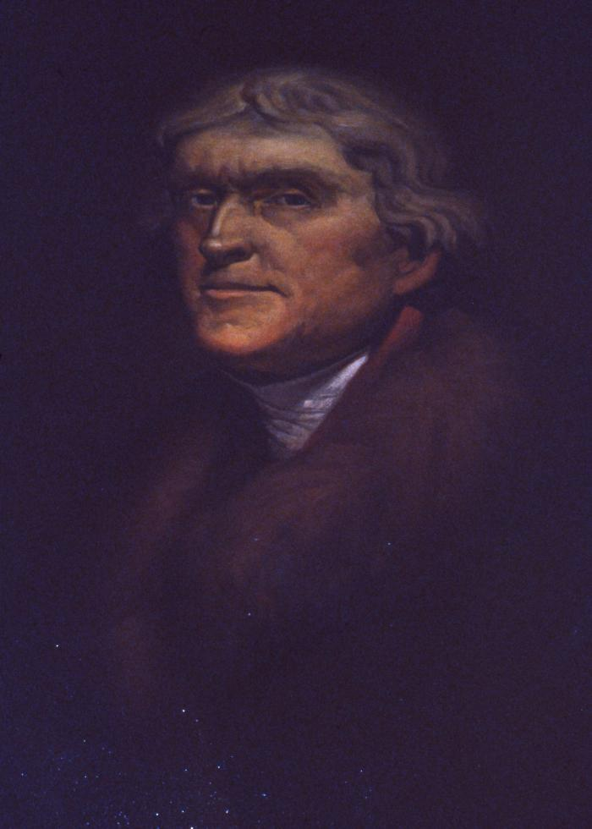
Portrait of Thomas Jefferson (1938.1.1)
Portrait of Thomas Jefferson.

Slide 7
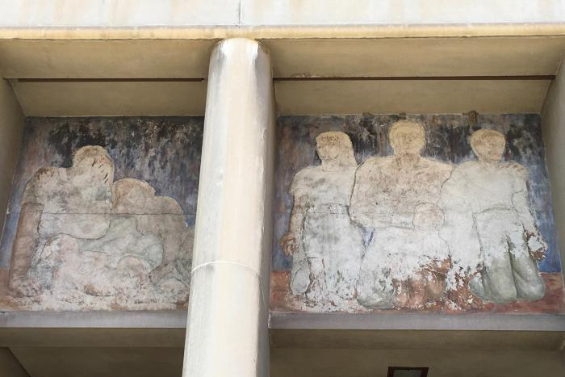
Untitled (figures in pediment) (1939.1.1)
This fresco by Louise Ronnebeck shows men, women and children.

